Slide 1
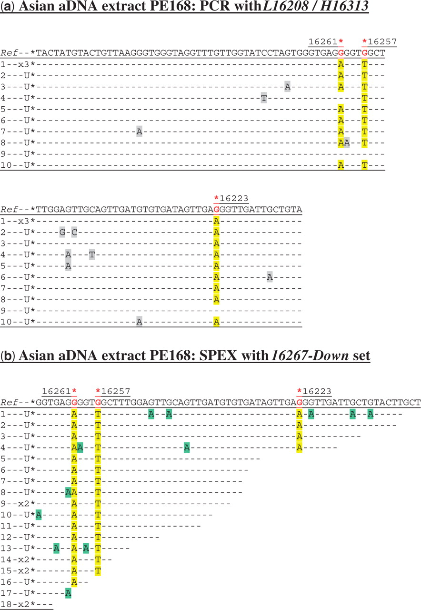
Figure 1. Cloned sequence data following ( a ) PCR and ( b ) SPEX amplification from the Asian aDNA extract PE168. U = ...
Notes:
Figure 1. Cloned sequence data following ( a ) PCR and ( b ) SPEX amplification from the Asian aDNA extract PE168. U = a unique sequence found in only one clone from that particular amplification reaction; X1, X2, etc. = identical sequences independently cloned (once, twice, etc). The L16208/H16313 PCR primer pair was used ( Supplementary Figure S1a and Table S1 ). The 16267-Down SPEX primer set ( Supplementary Table S1 ) was used in the amplification strategy described in Supplementary Figure S1a . In relation to the rCRS, hg N9a SNPs are C16223T, C16257A and C16261T. As the 16267-Down SPEX primer set targets the light mtDNA strand, hg N9a-specific SNPs are highlighted by a red asterisk above the reverse complement of the reference sequence ( Ref ). N9a-specific SNPs in PCR- and SPEX-generated sequence data are highlighted in yellow. In this and subsequent PCR-derived sequence data, base changes at non-diagnostic nucleotide positions—arising from sequence-modifying DNA damage and PCR-generated sequence artefacts—are highlighted in grey. In this and subsequent SPEX-derived sequence data, G > A transition base changes (arising from C > U-type miscoding lesion sequence-modifying DNA damage on template strands) are highlighted in green, with any other non-authentic base changes highlighted in grey. The final 3′-most positions of SPEX amplicons (i.e. the position immediately 5′ to the polyC-tail) do not necessarily reflect underlying template strand sequences, due to potential polymerase-mediated ‘non-templated’ nucleotide addition (NTNA) following SPEX ( 17 ). The 3′-most position is therefore not presented, or analysed, in SPEX-generated sequence data.
Unless provided in the caption above, the following copyright applies to the content of this slide: © The Author(s) 2009. Published by Oxford University Press.This is an Open Access article distributed under the terms of the Creative Commons Attribution Non-Commercial License (http://creativecommons.org/licenses/by-nc/2.5/uk/) which permits unrestricted non-commercial use, distribution, and reproduction in any medium, provided the original work is properly cited.

Slide 2
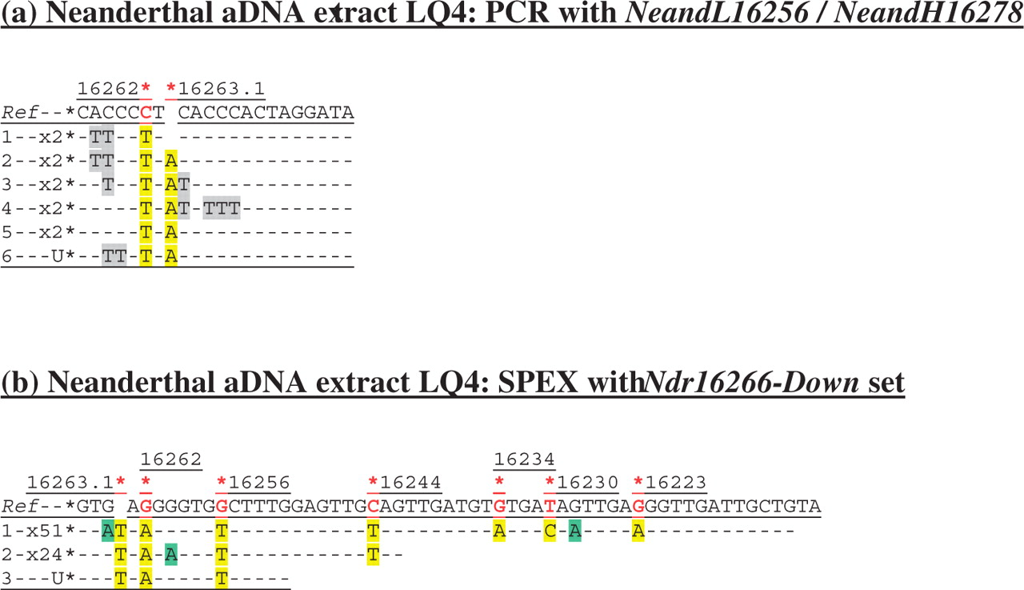
Figure 2. Cloned sequence data following ( a ) PCR, and ( b ) SPEX amplification from the Neanderthal LQ4 aDNA ...
Notes:
Figure 2. Cloned sequence data following ( a ) PCR, and ( b ) SPEX amplification from the Neanderthal LQ4 aDNA extract. The NeandL16256/NeandH16278 PCR primer pair was used ( Supplementary Figure S1b and Table S1 ). The Ndr16266-Down SPEX primer set ( Supplementary Table S1 ) was used in the amplification strategy described in Supplementary Figure S1b . Nucleotide positions of expected Neanderthal-specific SNPs are each highlighted by a red asterisk above: (a) the reference sequence ( Ref ); or (b) the reverse complement of the reference sequence ( Ref ). Presumed Neanderthal-specific SNPs in PCR- and SPEX-generated sequence data are highlighted in yellow. Given above-background levels of C > U-derived G > A transitions in SPEX data, an absence of np 16228 SNPs in published Neanderthal data, and a depth-of-coverage of just one generated for this site by SPEX, the G > A transition base change here is assumed to be due to miscoding lesion DNA damage.
Unless provided in the caption above, the following copyright applies to the content of this slide: © The Author(s) 2009. Published by Oxford University Press.This is an Open Access article distributed under the terms of the Creative Commons Attribution Non-Commercial License (http://creativecommons.org/licenses/by-nc/2.5/uk/) which permits unrestricted non-commercial use, distribution, and reproduction in any medium, provided the original work is properly cited.

Slide 3
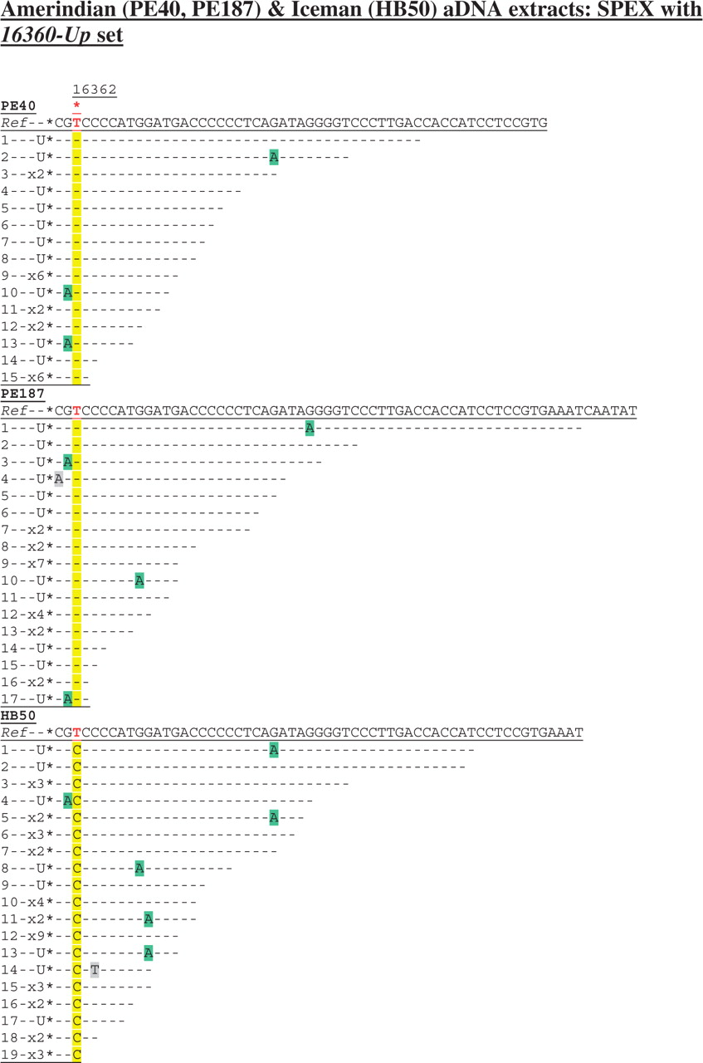
Figure 3. Cloned sequence data following SPEX amplification from the Amerindian (PE40, PE187) and Iceman (HB50) aDNA ...
Notes:
Figure 3. Cloned sequence data following SPEX amplification from the Amerindian (PE40, PE187) and Iceman (HB50) aDNA extracts using the 16360-Up SPEX primer set ( Supplementary Table S1 ) as for the amplification strategy described in Supplementary Figure S1c . A red asterisk above the reference sequence ( Ref ) highlights np 16362. The diagnostic site in SPEX-generated sequence data is highlighted in yellow; C > U-derived G > A transitions are highlighted in green; any other base changes are highlighted in grey.
Unless provided in the caption above, the following copyright applies to the content of this slide: © The Author(s) 2009. Published by Oxford University Press.This is an Open Access article distributed under the terms of the Creative Commons Attribution Non-Commercial License (http://creativecommons.org/licenses/by-nc/2.5/uk/) which permits unrestricted non-commercial use, distribution, and reproduction in any medium, provided the original work is properly cited.

Slide 4
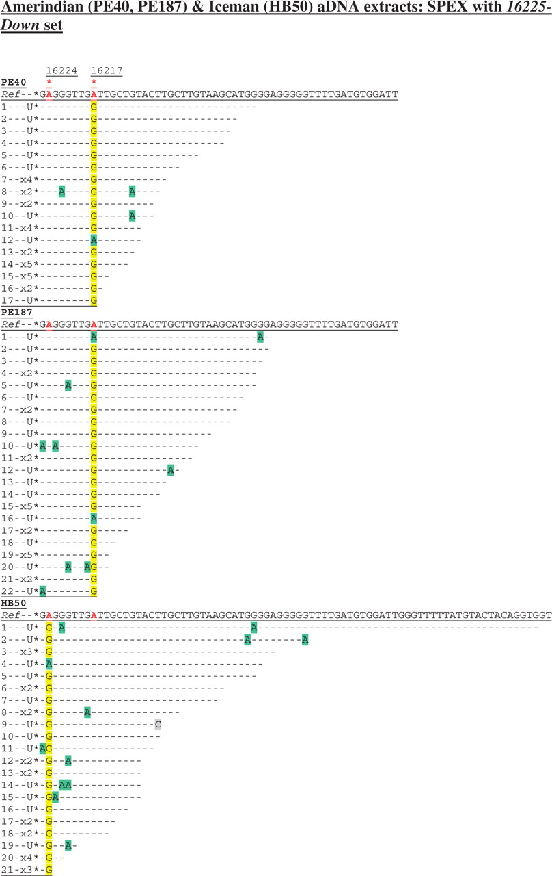
Figure 4. Cloned sequence data following SPEX amplification from the Amerindian (PE40, PE187) and Iceman (HB50) aDNA ...
Notes:
Figure 4. Cloned sequence data following SPEX amplification from the Amerindian (PE40, PE187) and Iceman (HB50) aDNA extracts using the 16225-Down SPEX primer set ( Supplementary Table S1 ), as for the amplification strategy described in Supplementary Figure S1c . Nucleotide positions of the hg K (np 16224) and hg B4b (np 16217) SNPs are each highlighted by a red asterisk above the reverse complement of the reference sequence ( Ref ). Diagnostic hg K (np 16224) and hg B4b (np 16217) sites in SPEX-generated sequence data are highlighted in yellow; C > U-derived G > A transitions are highlighted in green; any other base changes are highlighted in grey.
Unless provided in the caption above, the following copyright applies to the content of this slide: © The Author(s) 2009. Published by Oxford University Press.This is an Open Access article distributed under the terms of the Creative Commons Attribution Non-Commercial License (http://creativecommons.org/licenses/by-nc/2.5/uk/) which permits unrestricted non-commercial use, distribution, and reproduction in any medium, provided the original work is properly cited.

