Slide 1
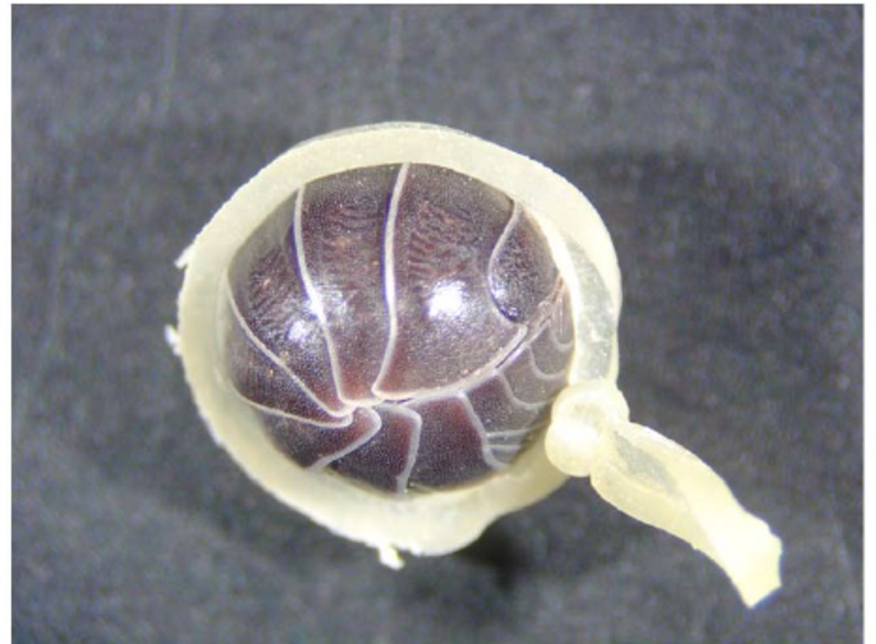
Figure 1 An isopod subjected to forced conglobation by a dental rubber band.
Notes:
Figure 1 An isopod subjected to forced conglobation by a dental rubber band.
Unless provided in the caption above, the following copyright applies to the content of this slide: This is an open access paper. We use the Creative Commons Attribution 3.0 license that permits unrestricted use, provided that the paper is properly attributed.This is an Open Access article distributed under the terms of the Creative Commons Attribution License (http://creativecommons.org/licenses/by/3.0/), which permits unrestricted reuse, distribution, and reproduction in any medium, providedthe original work is properly cited.

Slide 2
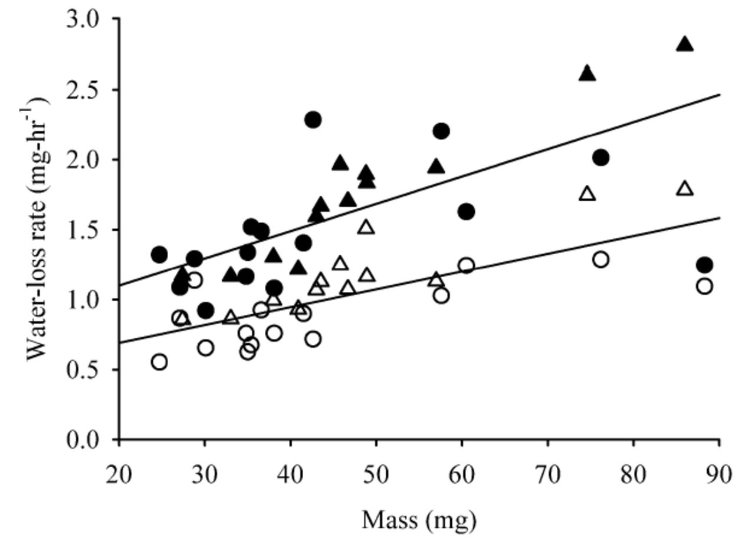
Figure 2 Rates of water loss from male and female A. vulgare in free and conglobated states. Symbols: Closed, free; ...
Notes:
Figure 2 Rates of water loss from male and female A. vulgare in free and conglobated states. Symbols: Closed, free; open, conglobated; circles, females; triangles, males.
Unless provided in the caption above, the following copyright applies to the content of this slide: This is an open access paper. We use the Creative Commons Attribution 3.0 license that permits unrestricted use, provided that the paper is properly attributed.This is an Open Access article distributed under the terms of the Creative Commons Attribution License (http://creativecommons.org/licenses/by/3.0/), which permits unrestricted reuse, distribution, and reproduction in any medium, providedthe original work is properly cited.

Slide 3
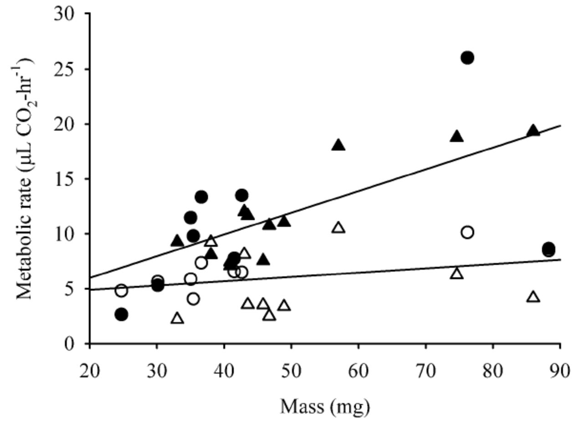
Figure 3 Rates of CO₂ release in male and female A. vulgare in free and conglobated states. Symbols: ...
Notes:
Figure 3 Rates of CO2 release in male and female A. vulgare in free and conglobated states. Symbols: Closed, free; open, conglobated; circles, females; triangles, males.
Unless provided in the caption above, the following copyright applies to the content of this slide: This is an open access paper. We use the Creative Commons Attribution 3.0 license that permits unrestricted use, provided that the paper is properly attributed.This is an Open Access article distributed under the terms of the Creative Commons Attribution License (http://creativecommons.org/licenses/by/3.0/), which permits unrestricted reuse, distribution, and reproduction in any medium, providedthe original work is properly cited.

Slide 4
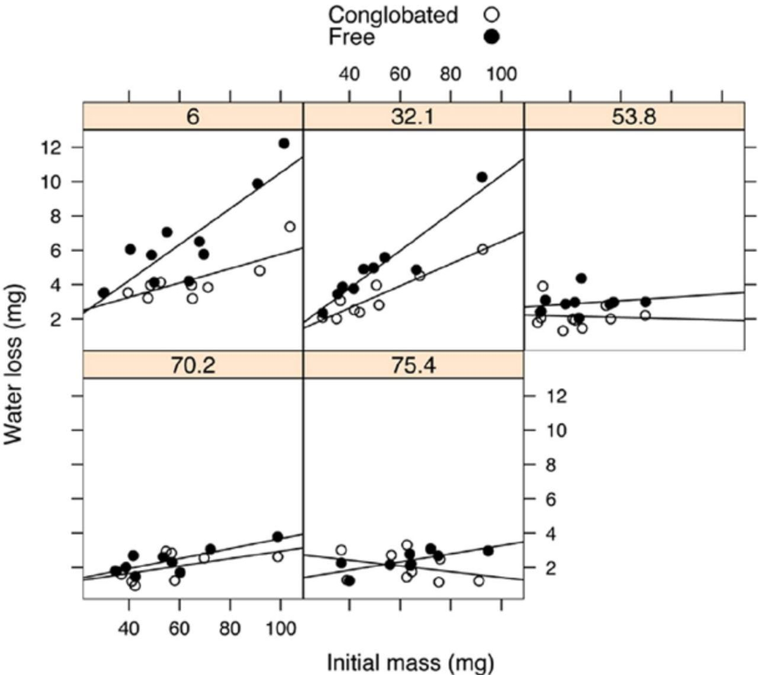
Figure 4 Water loss of A. vulgare in free and conglobated states, after 3 h in humidities ranging from 6.0 to 75.4 ...
Notes:
Figure 4 Water loss of A. vulgare in free and conglobated states, after 3 h in humidities ranging from 6.0 to 75.4 %RH.
Unless provided in the caption above, the following copyright applies to the content of this slide: This is an open access paper. We use the Creative Commons Attribution 3.0 license that permits unrestricted use, provided that the paper is properly attributed.This is an Open Access article distributed under the terms of the Creative Commons Attribution License (http://creativecommons.org/licenses/by/3.0/), which permits unrestricted reuse, distribution, and reproduction in any medium, providedthe original work is properly cited.

