Slide 1
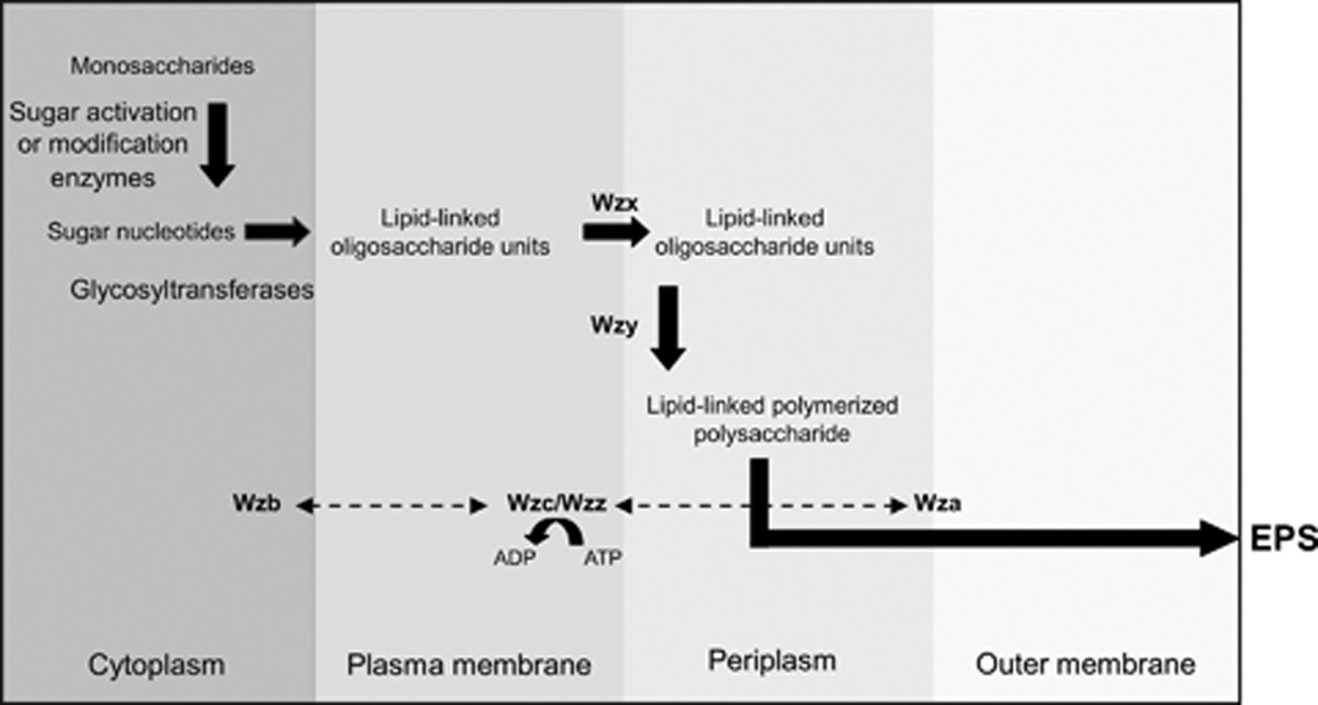
Figure 1 Sequence and compartmentalization of the putative biosynthetic pathway, polymerization and export of EPS in ...
Notes:
Figure 1 Sequence and compartmentalization of the putative biosynthetic pathway, polymerization and export of EPS in cyanobacteria, based on the information gathered for other bacteria as well as the genes present in the available cyanobacterial genomes. Some of the proteins involved in the polymerization, chain length control and export are highlighted along with the interactions among them (dashed line arrows).
Unless provided in the caption above, the following copyright applies to the content of this slide: © 2009 Federation of European Microbiological Societies.

Slide 2
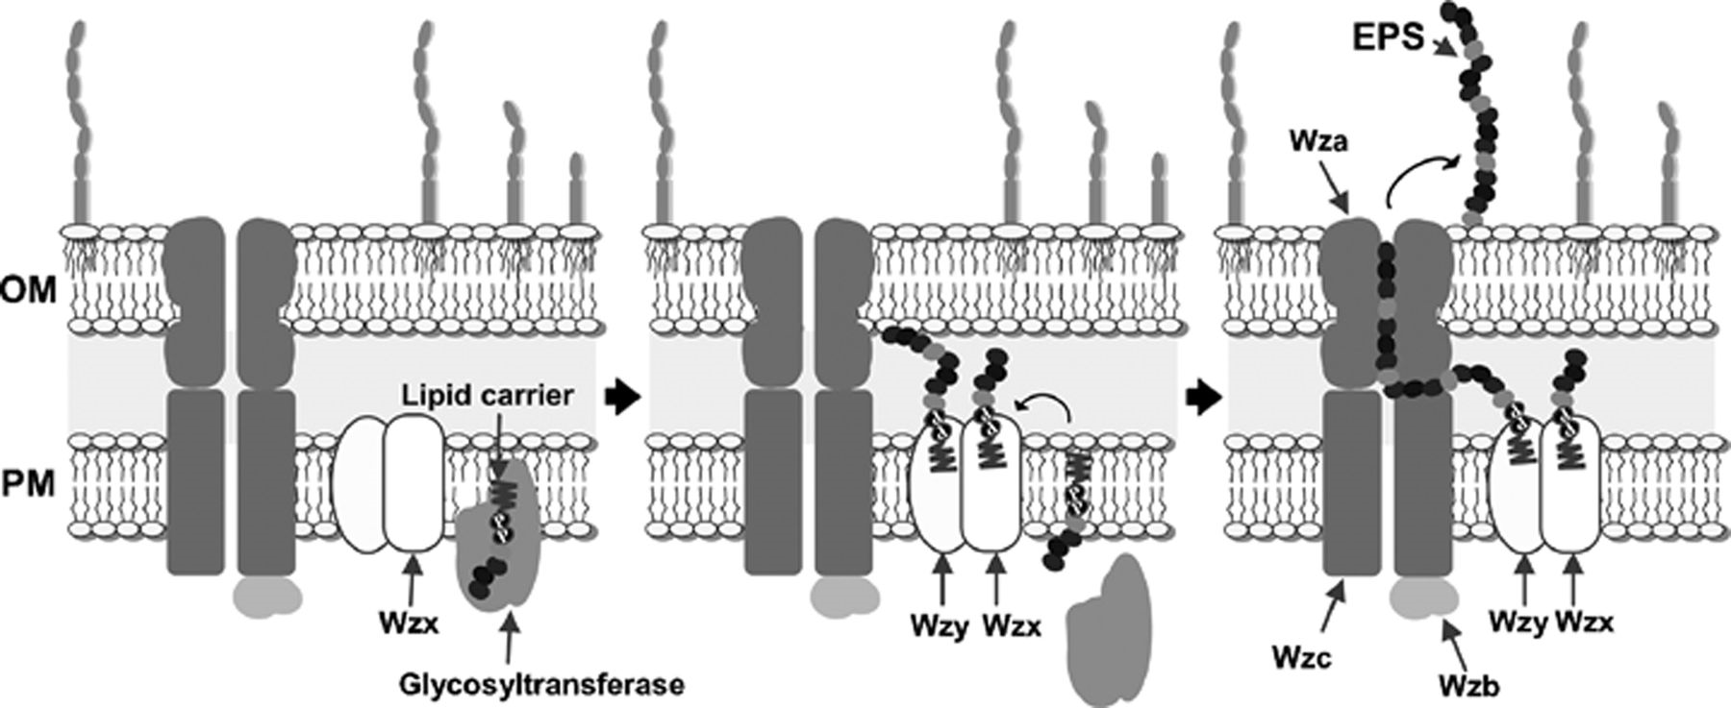
Figure 2 Proposed model for the assembly and export of cyanobacterial EPS based on the information gathered both for ...
Notes:
Figure 2 Proposed model for the assembly and export of cyanobacterial EPS based on the information gathered both for other bacteria and genes found in cyanobacterial genomes. (1) Glycosyltransferases transfer the nucleotide sugars onto a putative lipid carrier, and the lipid-linked repeated units are assembled at the interface between the cytoplasm and the plasma membrane. (2) Newly synthesized units are ‘flipped’ across the membrane in a process requiring the integral membrane protein Wzx. Subsequently, Wzy assembles the polysaccharide by addition of new repeating units to the growing polysaccharide chain. (3) The polymer is translocated in a process requiring the Wzc and Wzb proteins. In the final stage, the carbohydrate polymer is translocated across the outer membrane through the outer-membrane lipoprotein Wza (adapted from Whitfield et al., 2006). OM, outer membrane; PM, plasma membrane.
Unless provided in the caption above, the following copyright applies to the content of this slide: © 2009 Federation of European Microbiological Societies.

Slide 3
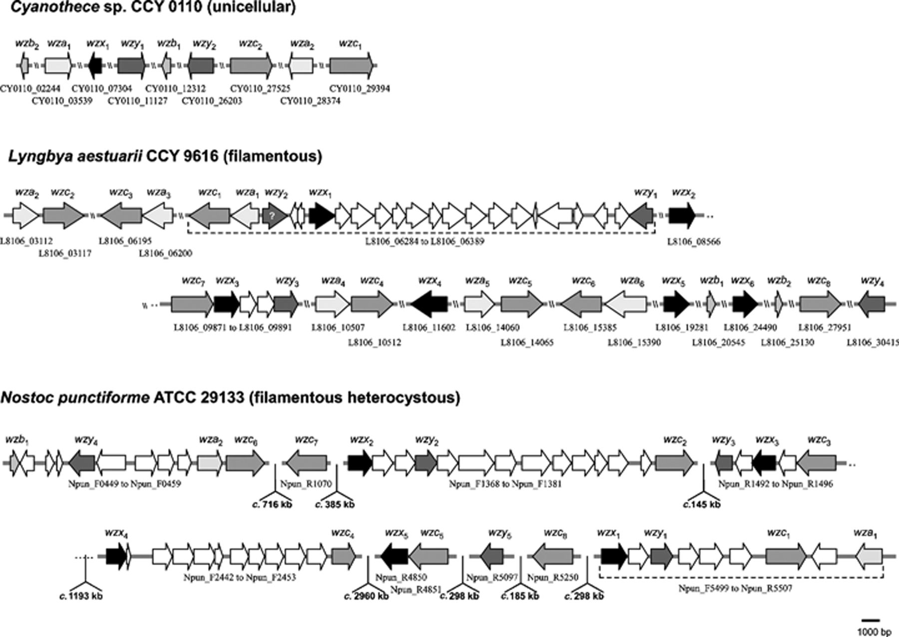
Figure 3 Physical map of the putative genes involved in the polymerization, chain length control and export of EPS in ...
Notes:
Figure 3 Physical map of the putative genes involved in the polymerization, chain length control and export of EPS in the three morphologically distinct types of cyanobacteria. The deduced protein sequences encoded by these genes were submitted to an in silico analysis to identify the conserved motifs of interest. This analysis was performed using the following bioinformatic tools: blastp, cdart (at NCBI –http://www.ncbi.nlm.nih.gov/), and smart (at EMBL –http://smart.embl-heidelberg.de/). In general, several copies of a specific gene could be identified in a single cyanobacterial strain. In a given organism, the copy that has the highest probability to be related to EPS production is designated by subscript 1 (taking into account both the percentage of identity with the corresponding sequences in other organisms and the position of the gene in relation to others involved in the same process); the other copies are numbered subsequently. In Lyngbya sp. and Nostoc punctiforme, the genome region containing all wz_, except wzb, is underlined with a dashed line.? indicates that the gene wzy2 from Lyngbya is the one with the lowest homology to the available wzy sequences. Genbank accession numbers: AAXW00000000 (Cyanothece sp. CCY 0110), AAVU00000000 (Lyngbya sp. PCC 8106) and CP001037 (N. punctiforme ATCC 29133).
Unless provided in the caption above, the following copyright applies to the content of this slide: © 2009 Federation of European Microbiological Societies.

