Slide 1
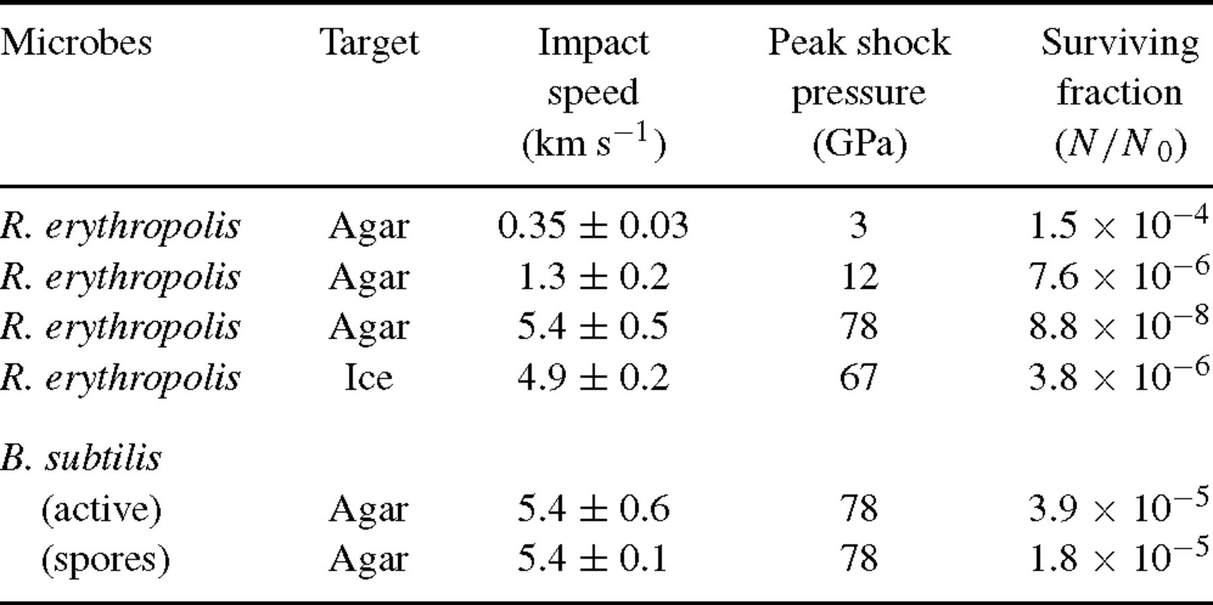
1 Results of impact experiments with Rhodococcus erythropolis and Bacillis subtilis.
Notes:
1 Results of impact experiments with Rhodococcus erythropolis and Bacillis subtilis.
Unless provided in the caption above, the following copyright applies to the content of this slide: © 2004 RAS

Slide 2
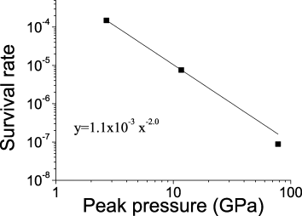
1 Survival rate for impacts of Rhodococcus erythropolis on agar targets.
Notes:
1 Survival rate for impacts of Rhodococcus erythropolis on agar targets.
Unless provided in the caption above, the following copyright applies to the content of this slide: © 2004 RAS

Slide 3
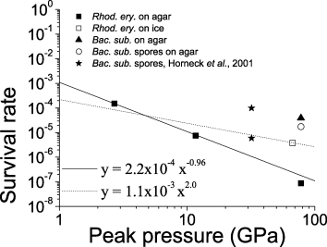
2 Survival rate for all experiments reported here and those from Horneck et al. (2001a). The fit to all data ...
Notes:
2 Survival rate for all experiments reported here and those from Horneck et al. (2001a). The fit to all data (except that of Horneck et al. 2001a) is shown as the dashed line. The fit to data from Fig. 1 is shown as the solid line.
Unless provided in the caption above, the following copyright applies to the content of this slide: © 2004 RAS

