Slide 1
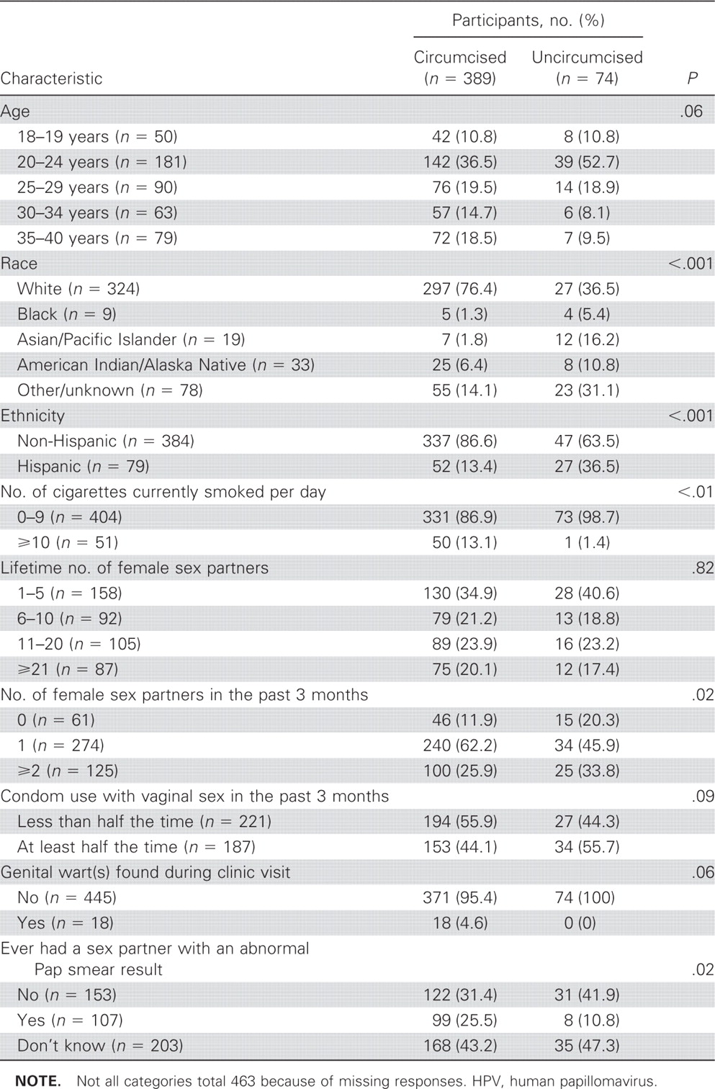
Table 1 Characteristics of participants in the HPV Detection in Men study, by circumcision status (n=463).
Notes:
Table 1 Characteristics of participants in the HPV Detection in Men study, by circumcision status (n=463).
Unless provided in the caption above, the following copyright applies to the content of this slide: © 2009 by the Infectious Diseases Society of America

Slide 2
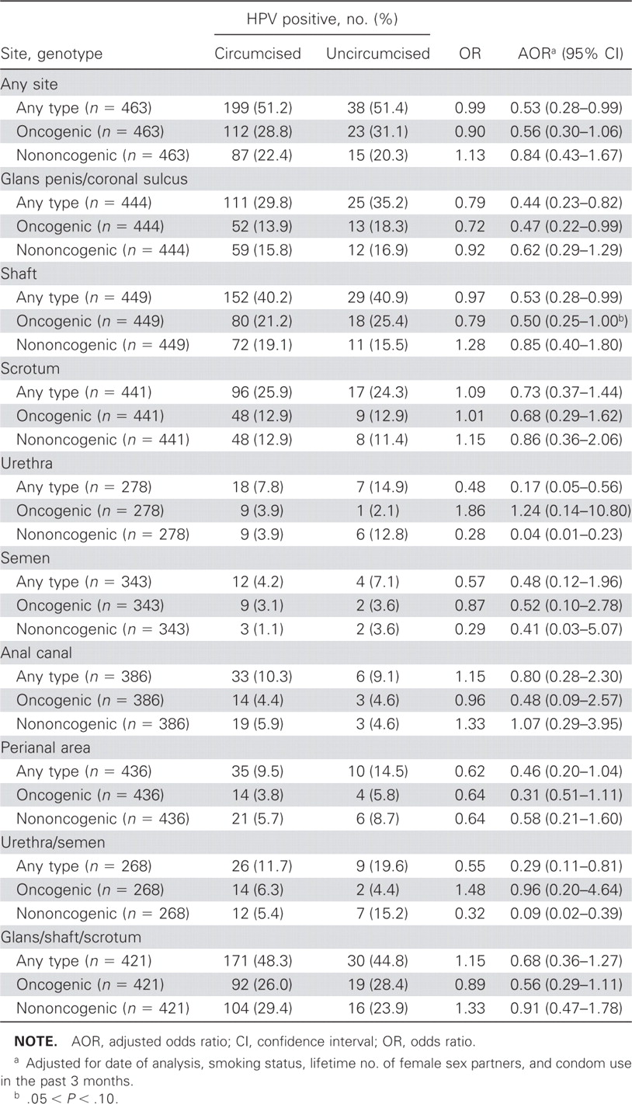
Table 2 Associations between circumcision and any, oncogenic, or nononcogenic human papillomavirus (HPV) detection in ...
Notes:
Table 2 Associations between circumcision and any, oncogenic, or nononcogenic human papillomavirus (HPV) detection in the HPV Detection in Men study, by genital anatomic site(s) or semen.
Unless provided in the caption above, the following copyright applies to the content of this slide: © 2009 by the Infectious Diseases Society of America

