Slide 1
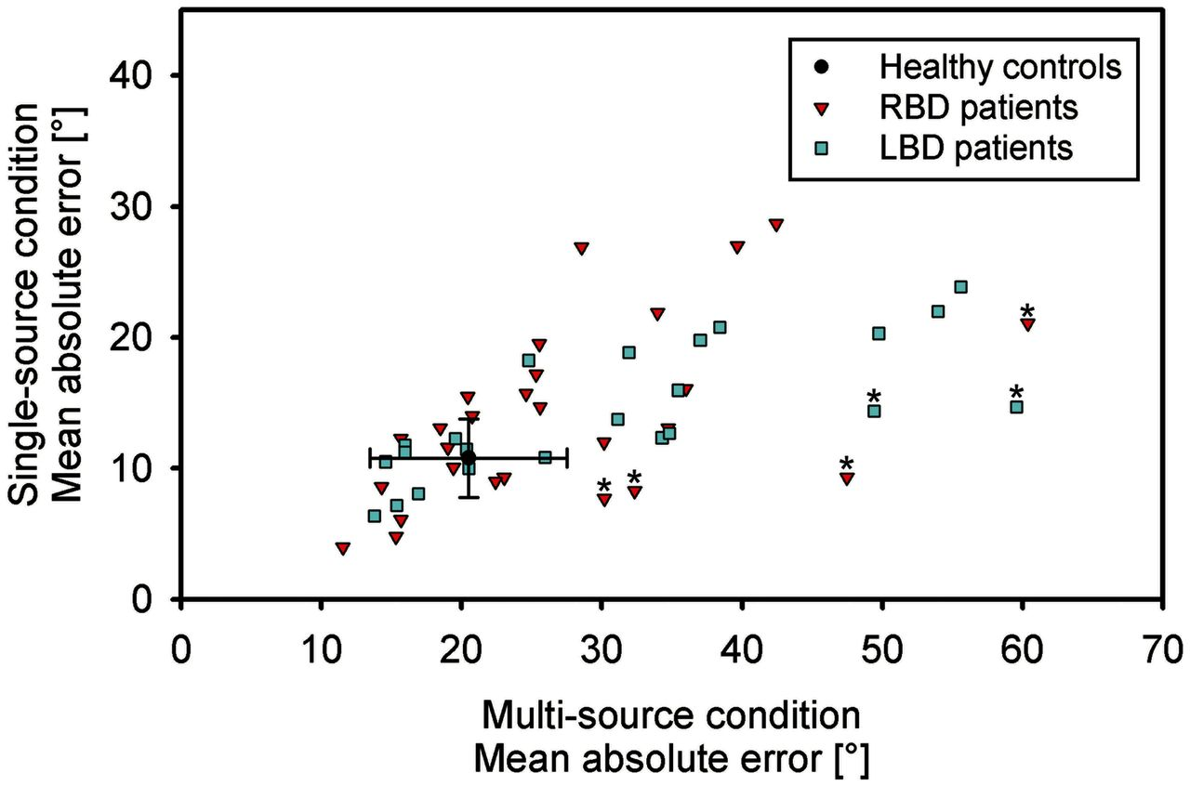
Figure 1 Sound localization performance of individual stroke patients and healthy controls in the single-source and ...
Notes:
Figure 1 Sound localization performance of individual stroke patients and healthy controls in the single-source and multi-source conditions. Red triangles indicate data of patients with right brain damage (RBD), light blue squares represent data of patients with left brain damage (LBD). Patients with significant revised Standardized Difference Test are represented with an asterisk above the data point. The black circle indicates the group average of healthy controls. Error bars, standard deviations (in healthy subjects).
Unless provided in the caption above, the following copyright applies to the content of this slide: © The Author (2014). Published by Oxford University Press on behalf of the Guarantors of Brain. All rights reserved. For Permissions, please email: journals.permissions@oup.com

Slide 2
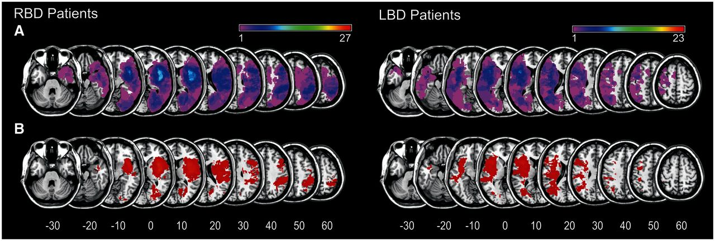
Figure 2 Overlap plots and voxels included in the statistical analyses. (A) Overlapping lesion plots for patients with ...
Notes:
Figure 2 Overlap plots and voxels included in the statistical analyses. (A) Overlapping lesion plots for patients with right (RBD) and left (LBD) brain damage. The number of overlapping lesions is illustrated by different colours coding increasing frequencies from violet (n = 1) to red (n = maximum). (B) Voxels included in the statistical analysis, at least affected in 15% of the subjects. MNI z-coordinates (mm) of each transverse section are given.
Unless provided in the caption above, the following copyright applies to the content of this slide: © The Author (2014). Published by Oxford University Press on behalf of the Guarantors of Brain. All rights reserved. For Permissions, please email: journals.permissions@oup.com

Slide 3
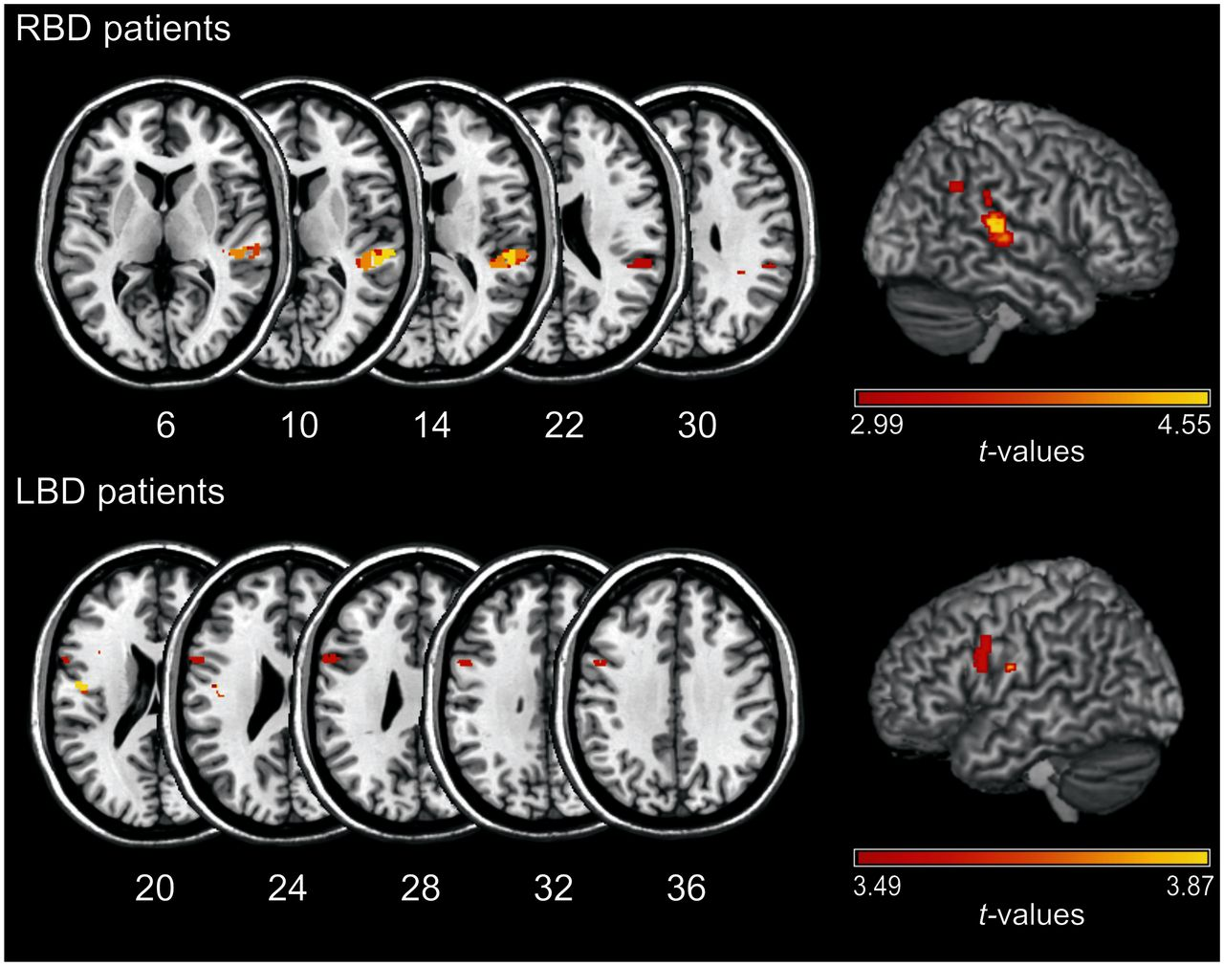
Figure 3 Statistical VLBM analysis (t-statistics) for the groups of patients with right (RBD) and left (LBD) brain ...
Notes:
Figure 3 Statistical VLBM analysis (t-statistics) for the groups of patients with right (RBD) and left (LBD) brain damage, focusing on the difference between each patient’s mean absolute errors in the multi-source minus the single-source conditions. Data were normalized with reference to the difference obtained from the control sample. Voxels displayed survived a correction for multiple comparisons using 5% discovery rate cut-off threshold. MNI z-coordinates (mm) of each transverse section are given.
Unless provided in the caption above, the following copyright applies to the content of this slide: © The Author (2014). Published by Oxford University Press on behalf of the Guarantors of Brain. All rights reserved. For Permissions, please email: journals.permissions@oup.com

Slide 4
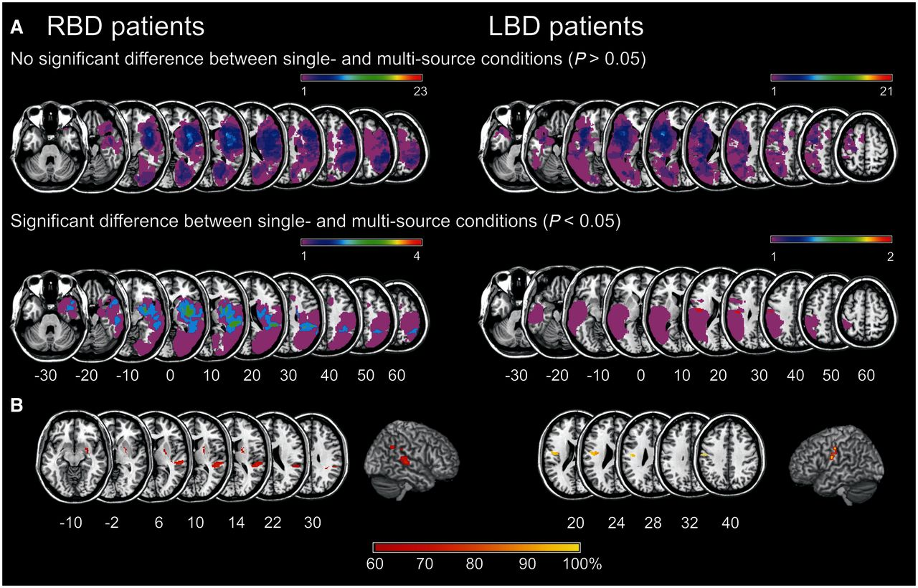
Figure 4 Subtraction analysis for patients with versus without statistically significant differences between ...
Notes:
Figure 4 Subtraction analysis for patients with versus without statistically significant differences between single-source and multi-source sound localization, as obtained by the revised Standardized Difference Test. (A) Lesion overlays for the patients with left (LBD) and right (RBD) brain damage without significant differences between single-source and multi-source sound localization (upper row of sections) and for the patients showing such significant differences (next lower row of sections). (B) Subtraction plots of the patients with significant revised Standardized Difference Test differences minus the patients without significant differences. The voxels shown were at least 60% more frequently damaged in patients with a significant difference between single- and multi-source localization than in patients without such a significant difference between these two conditions. MNI z-coordinates (mm) of each transverse section are given.
Unless provided in the caption above, the following copyright applies to the content of this slide: © The Author (2014). Published by Oxford University Press on behalf of the Guarantors of Brain. All rights reserved. For Permissions, please email: journals.permissions@oup.com

