Slide 1
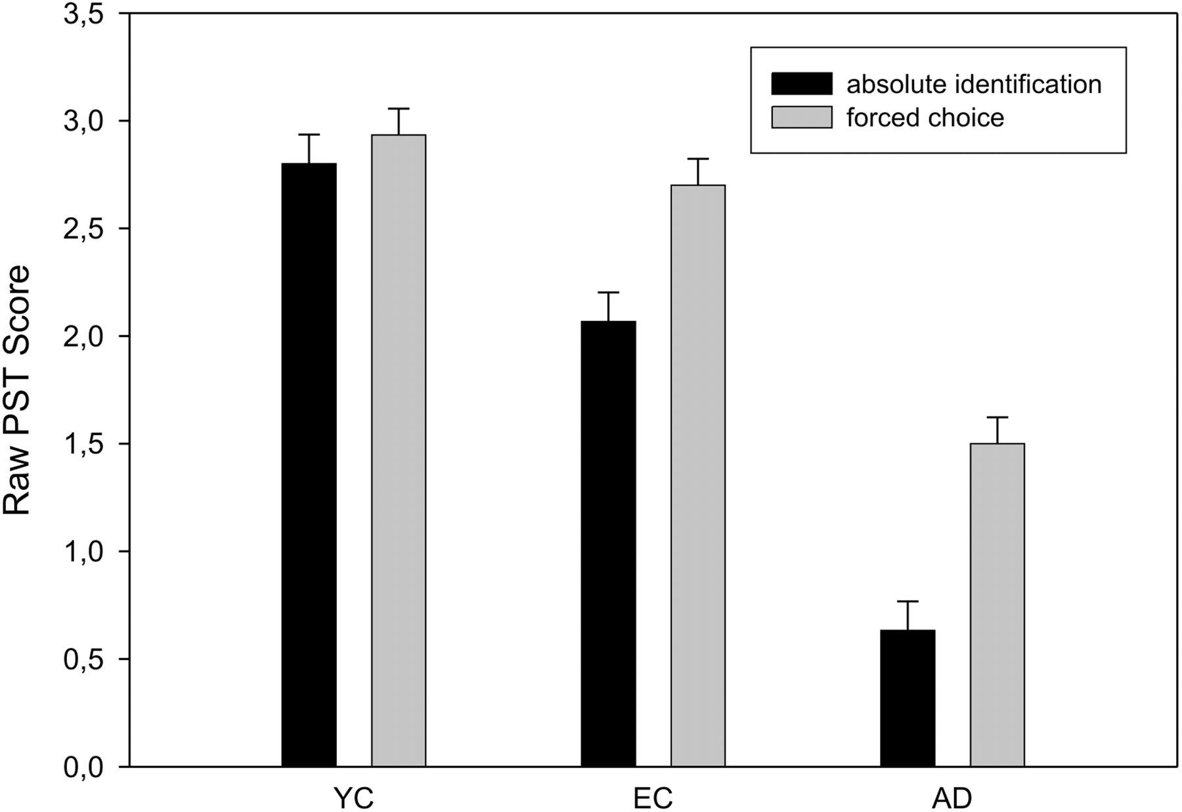
Fig. 1. Comparison of raw PST scores for YC, EC, and AD groups, in the first “absolute identification” and the second ...
Notes:
Fig. 1. Comparison of raw PST scores for YC, EC, and AD groups, in the first “absolute identification” and the second “forced choice” sessions (mean, SEM).
Unless provided in the caption above, the following copyright applies to the content of this slide: © The Author 2011. Published by Oxford University Press. All rights reserved. For permissions, please e-mail: journals.permissions@oup.com.

Slide 2
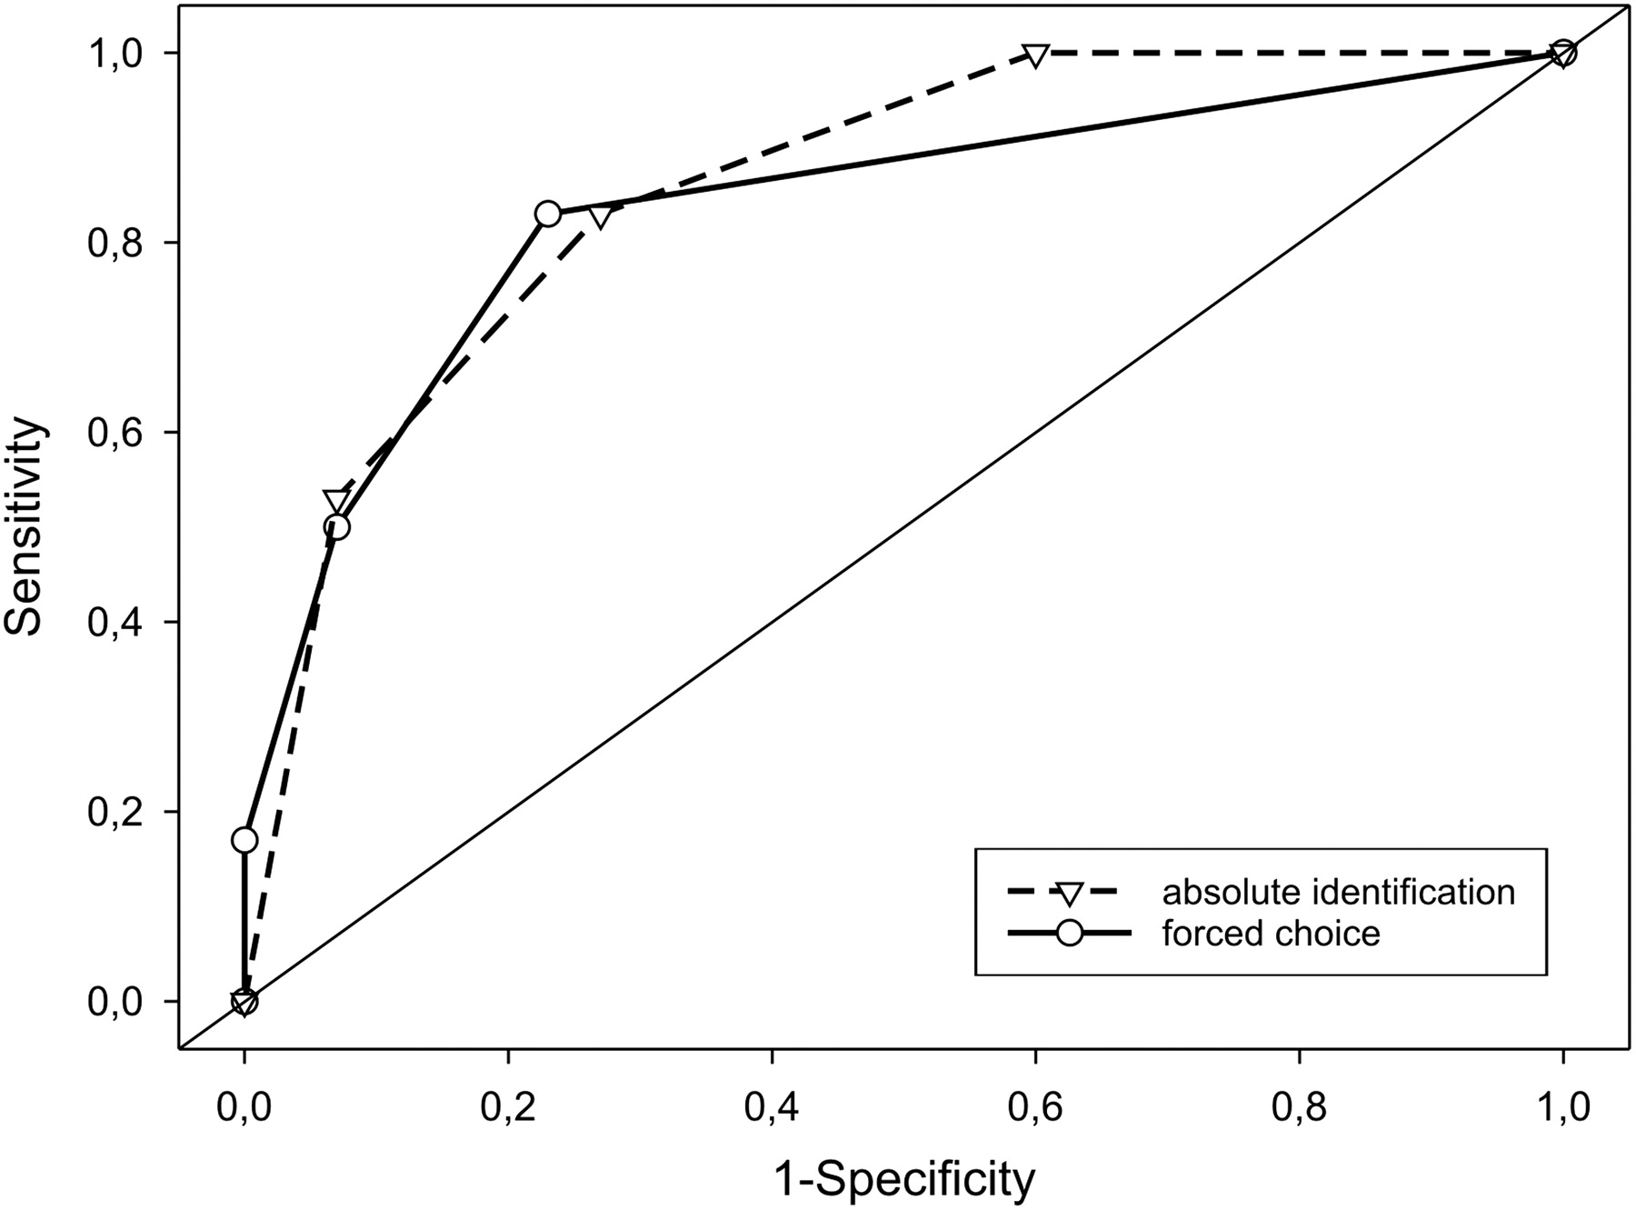
Fig. 2. Receiver operating characteristic curves for the ability of PST to discriminate AD patients from ECs in the ...
Notes:
Fig. 2. Receiver operating characteristic curves for the ability of PST to discriminate AD patients from ECs in the first “absolute identification” and the second “forced choice” sessions.
Unless provided in the caption above, the following copyright applies to the content of this slide: © The Author 2011. Published by Oxford University Press. All rights reserved. For permissions, please e-mail: journals.permissions@oup.com.

