Slide 1
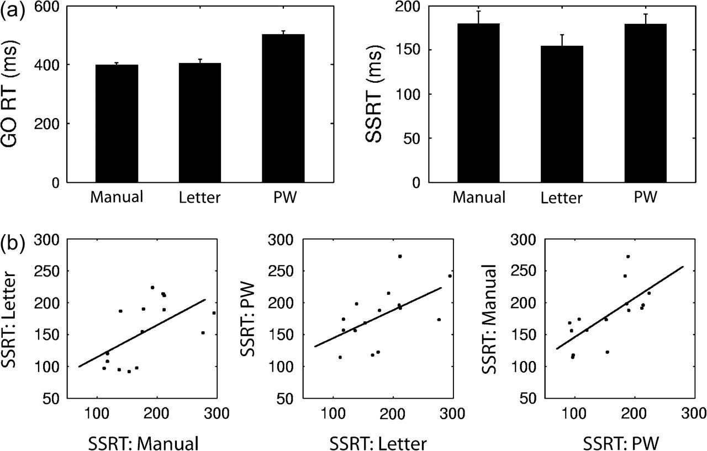
Figure 1. Go RT and SSRT in the behavioral test. (a) Go RT is the median of reaction time for all correct Go trials; ...
Notes:
Figure 1. Go RT and SSRT in the behavioral test. (a) Go RT is the median of reaction time for all correct Go trials; the SSRT is estimated using the race model (see Materials and Methods). This assumes that Go and Stop processes are in a race and are independent of each other. On Stop trials, a tone occurs at some delay, the SSD after the Stop signal. If this delay is short, then P(inhibit) is high and this is likely to be a StopInhibit trial; if the delay is long, then P(inhibit) is low and this is likely to be a StopFail trial. If SSD is varied so that P(inhibit)_0.5, then SSRT can be estimated by subtracting the SSD from the median value of the Go distribution. (b) SSRTs for Manual, Letter Naming, and PW Naming task were correlated with each other.
Unless provided in the caption above, the following copyright applies to the content of this slide: © The Author 2008. Published by Oxford University Press. All rights reserved. For permissions, please e-mail: journals.permissions@oxfordjournals.org

Slide 2
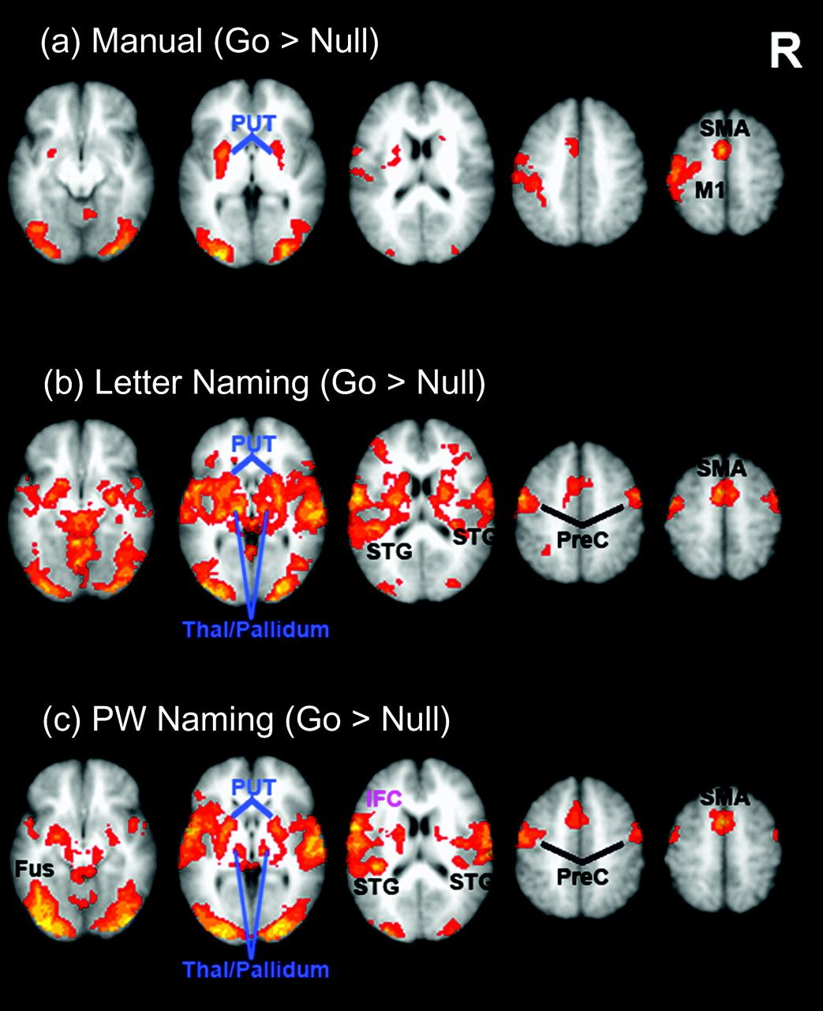
Figure 2. Brain activation associated with Go responses. Images are in neurological format (right = right). Activations ...
Notes:
Figure 2. Brain activation associated with Go responses. Images are in neurological format (right = right). Activations are overlaid on axial slices from the MNI structural template. All maps are thresholded at Z = 2.3 voxel level, P < 0.05 cluster corrected for whole brain. Go trials activate SMA, bilateral putamen (PUT) for all the 3 tasks. Manual responses activate the controlateral M1, and Letter Naming and PW Naming responses activate bilateral precentral cortex (PreC), and pallidum/thalamus (Thal) as well as bilateral STG, due to hearing subjects’ own speech. PW Naming responses activate additional left posterior inferior frontal lobe (IFC) and left middle fusiform gyrus (FUS). R: right hemisphere.
Unless provided in the caption above, the following copyright applies to the content of this slide: © The Author 2008. Published by Oxford University Press. All rights reserved. For permissions, please e-mail: journals.permissions@oxfordjournals.org

Slide 3
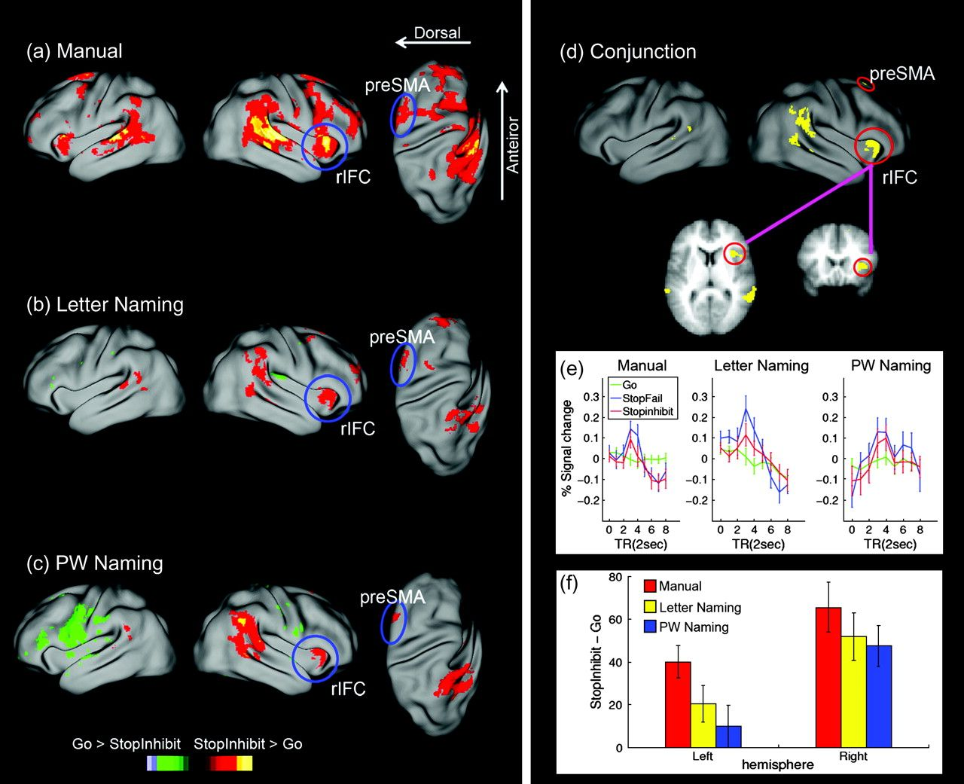
Figure 3. Brain activation associated with response inhibition. Left panel (a, b, c) shows the brain activations for ...
Notes:
Figure 3. Brain activation associated with response inhibition. Left panel (a, b, c) shows the brain activations for contrast StopInhibit versus Go. Surface rendering for the lateral view is created by mapping the group-averaged fMRI data into a population-averaged surface atlas using multifiducial mapping (Van Essen 2005). Red-yellow colors represent regions where StopInhibit > Go, and green-blue represents Go > Inhibit. For display purpose, all maps are thresholded at z = 2.3 (uncorrected) voxel level. The right orbital/insula cortex extending into the opercular IFC is activation for all the 3 tasks. The right IFC cluster in Manual and Letter Naming conditions survived cluster level correction for whole brain, whereas that in the PW Naming conditions survived small volume correction within the search volume of right opercularis and insula. (d) Regions show significant activation for contrast of StopInhibit > Go across the 3 tasks, revealed by conjunction analysis. (e) Peristimulus plots (with standard errors) for different trial types in the right IFC, which is defined as region survived the conjunction analysis within the anatomical boundary of right pars opercularis and adjacent insular cortex. (f) The right IFC shows stronger activation than the left homologue for StopInhibit > Go in all the 3 tasks.
Unless provided in the caption above, the following copyright applies to the content of this slide: © The Author 2008. Published by Oxford University Press. All rights reserved. For permissions, please e-mail: journals.permissions@oxfordjournals.org

Slide 4
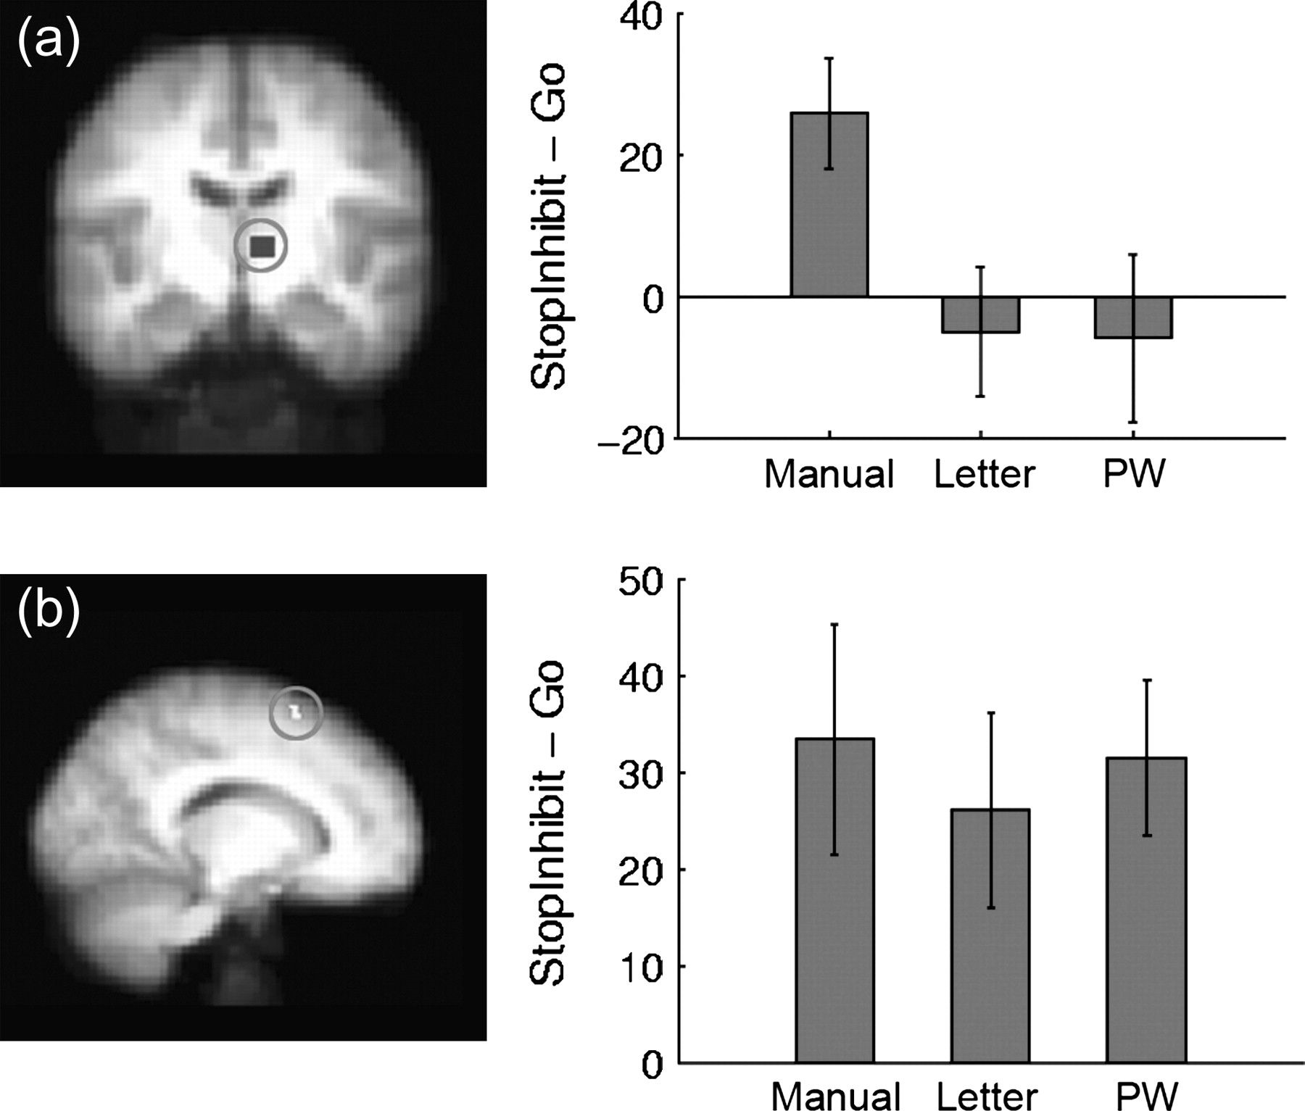
Figure 4. STN region (a) and pre-SMA (b) activation for StopInbit–Go. The STN ROI was defined as an 8 × 8 × 8 cubic ...
Notes:
Figure 4. STN region (a) and pre-SMA (b) activation for StopInbit–Go. The STN ROI was defined as an 8 × 8 × 8 cubic region based on the activation in Manual task, which is shown on a coronal slice. The pre-SMA ROI (Center of Gravity: 17,15,60) was defined as the cluster survived the conjunction analysis within the anatomical boundary of pre-SMA regions according to automated anatomical labeling. Right panels plot the activation (with standard error) for each task.
Unless provided in the caption above, the following copyright applies to the content of this slide: © The Author 2008. Published by Oxford University Press. All rights reserved. For permissions, please e-mail: journals.permissions@oxfordjournals.org

Slide 5
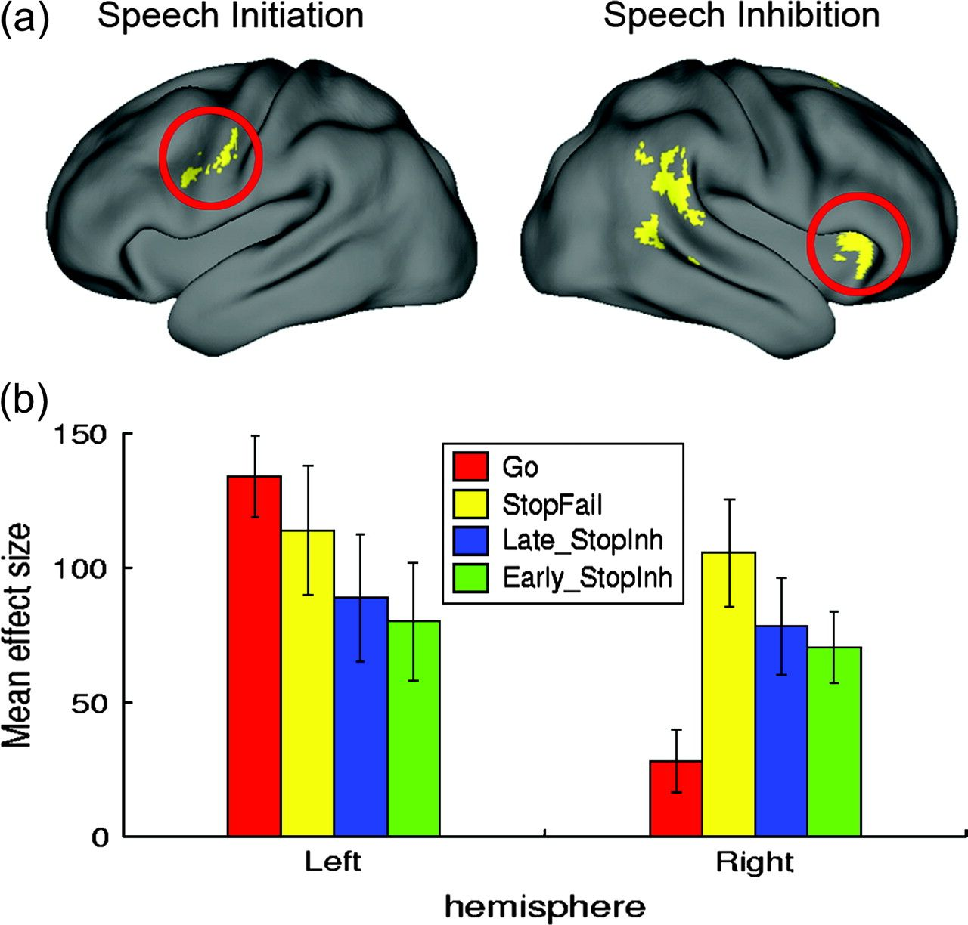
Figure 5. Functional asymmetry of left and right IFC in PW Naming. (a) Surface render of left and right frontal ROIs. ...
Notes:
Figure 5. Functional asymmetry of left and right IFC in PW Naming. (a) Surface render of left and right frontal ROIs. The left IFC, which is involved in the response initiation, is defined as the region surviving the contrast PW Naming (Go) > Letter Naming (Go) within the anatomical boundary of the left pars opercularis and adjacent ventral precentral gyrus. The right IFC, which is involved in response inhibition, is the region surviving the conjunction analysis (see caption of Fig. 3 for details of the definition of this ROI). (b) Brain activation in the left and right IFC for Go trials, StopFail trials, Late inhibit trials (Late_StopInh, i.e., SSD > SSDc), and Early inhibit trials (Early_StopInh, i.e., SSD < SSDc).
Unless provided in the caption above, the following copyright applies to the content of this slide: © The Author 2008. Published by Oxford University Press. All rights reserved. For permissions, please e-mail: journals.permissions@oxfordjournals.org

