Slide 1
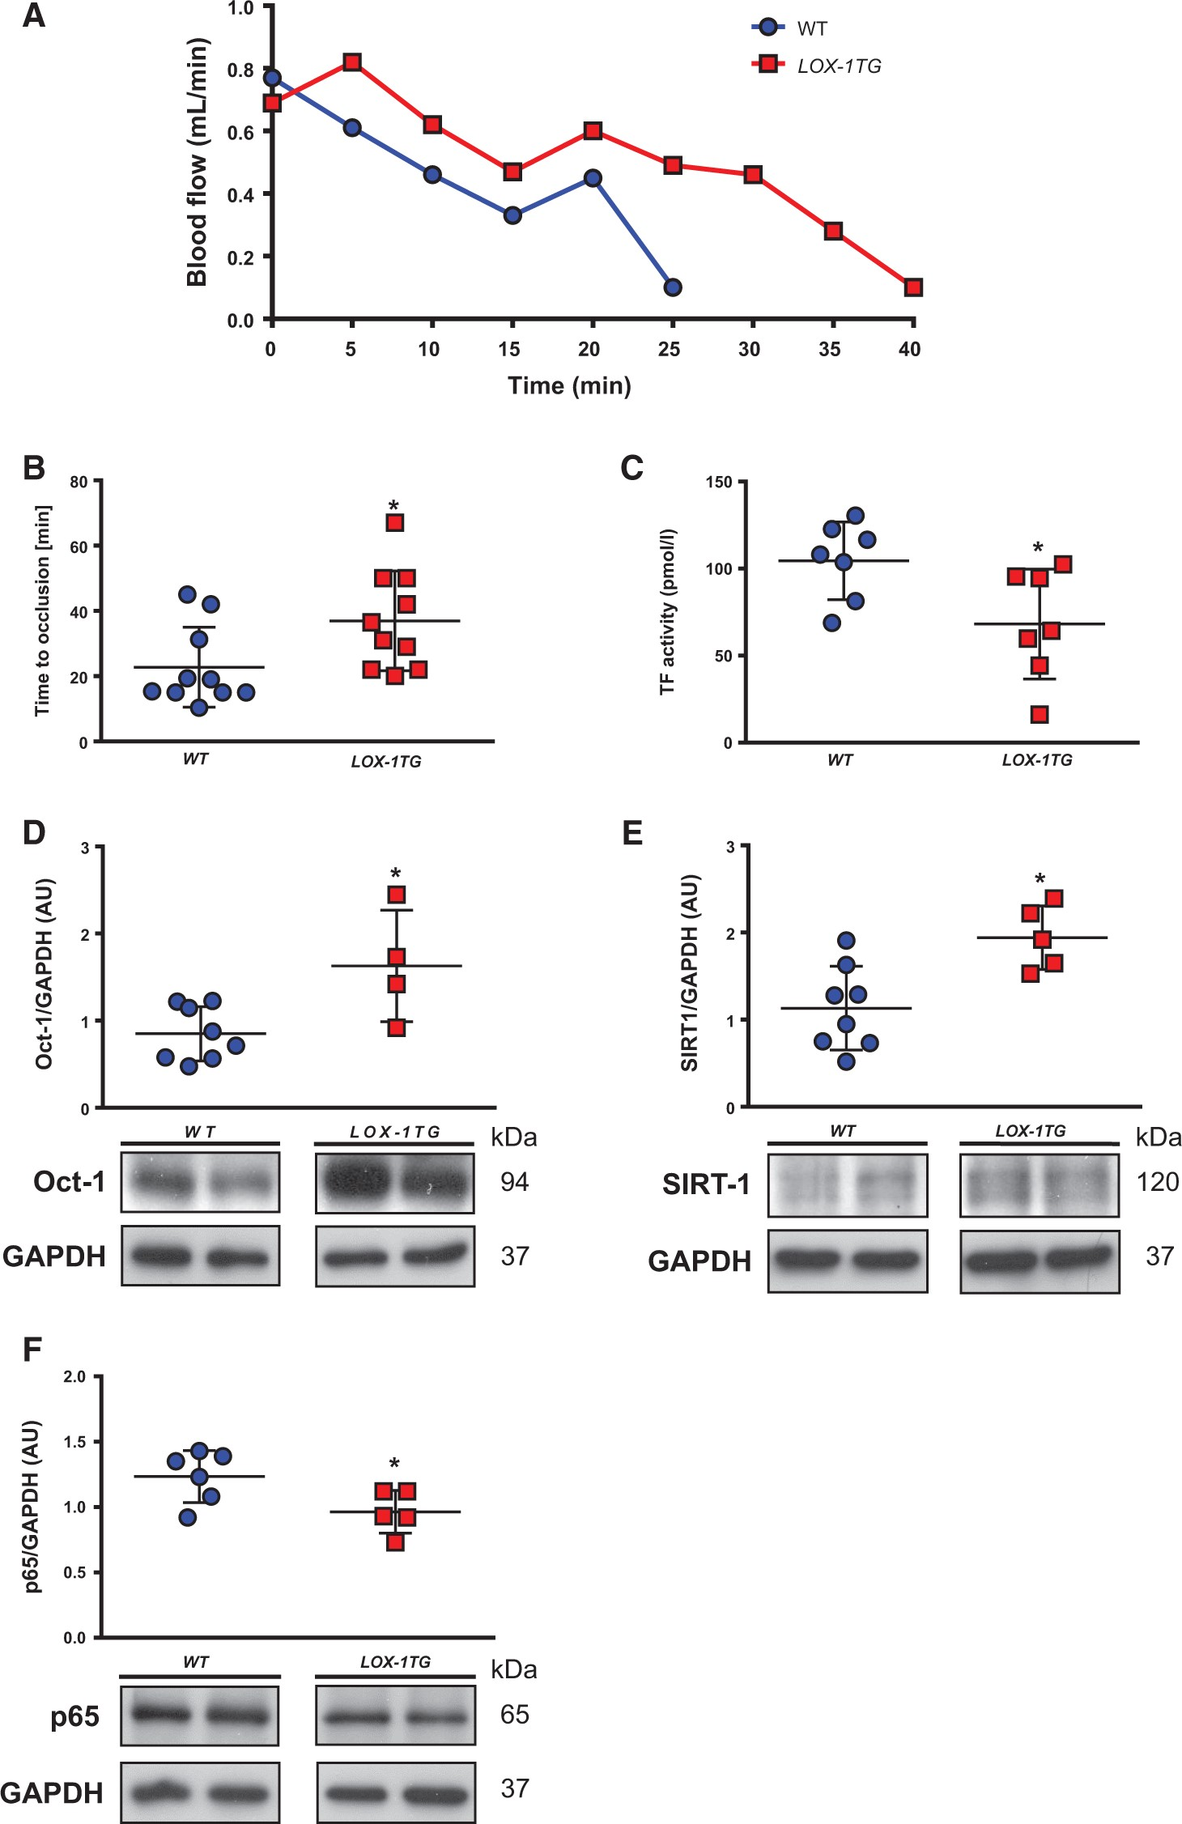
Figure 1 Endothelial-specific overexpression of LOX-1 prolongs arterial thrombosis, increases thrombosis-induced ...
Notes:
Figure 1 Endothelial-specific overexpression of LOX-1 prolongs arterial thrombosis, increases thrombosis-induced expression of Oct-1 and SIRT1, and decreases expression of RelA/p65 in carotid artery after injury. (A) Representative blood flow recordings of WT and LOX-1TG mice after in vivo photochemical injury which was initiated at 0 min. Occlusion was defined as blood flow below 0.1 mL/min for at least 1 min. (B) Time to thrombotic occlusion after photochemical injury in vivo (n = 10 in each group). Data are mean ± SEM. *P < 0.05 vs. wild type (WT) mice. (C) Total surface activity of tissue factor (TF) after thrombus formation (n=7 in each group). Data are mean ± SEM. *P < 0.05 vs. wild type (WT) mice. (D–F) Arterial in vivo thrombosis induces Oct-1 (D) and SIRT1 (E) protein expression, and reduces p65 expression (F). The Oct-1, SIRT1, and p65 protein expression was analysed by Western blot (n=4–8 in each group). Two representative samples for each genotype are shown. All samples were run on the same gel. Data are shown as mean ± SEM in all experiments. *P < 0.05 vs. wild type (WT) mice.
Unless provided in the caption above, the following copyright applies to the content of this slide: Published on behalf of the European Society of Cardiology. All rights reserved. © The Author 2017. For permissions, please email: journals.permissions@oup.com.

Slide 2
Figure 2 Oct-1 positively regulates SIRT1 expression through direct binding to its promoter. ChIP assay on carotid ...
Notes:
Figure 2 Oct-1 positively regulates SIRT1 expression through direct binding to its promoter. ChIP assay on carotid arteries isolated from WT and LOX-1TG mice after in vivo thrombosis. Chromatin was immunoprecipitated with either normal rabbit IgG or antibody against Oct-1. Precipitated genomic DNA was then analysed by polymerase chain reaction using primers specific for SIRT1 (−663 bp to − 478 and −590 bp to − 350), Oct-1 (−944 bp to − 672), LOX-1 (−298 bp to − 178), c-jun (−586 bp to − 338), and Hif1α (−83 bp to +78) promoter regions.
Unless provided in the caption above, the following copyright applies to the content of this slide: Published on behalf of the European Society of Cardiology. All rights reserved. © The Author 2017. For permissions, please email: journals.permissions@oup.com.

Slide 3
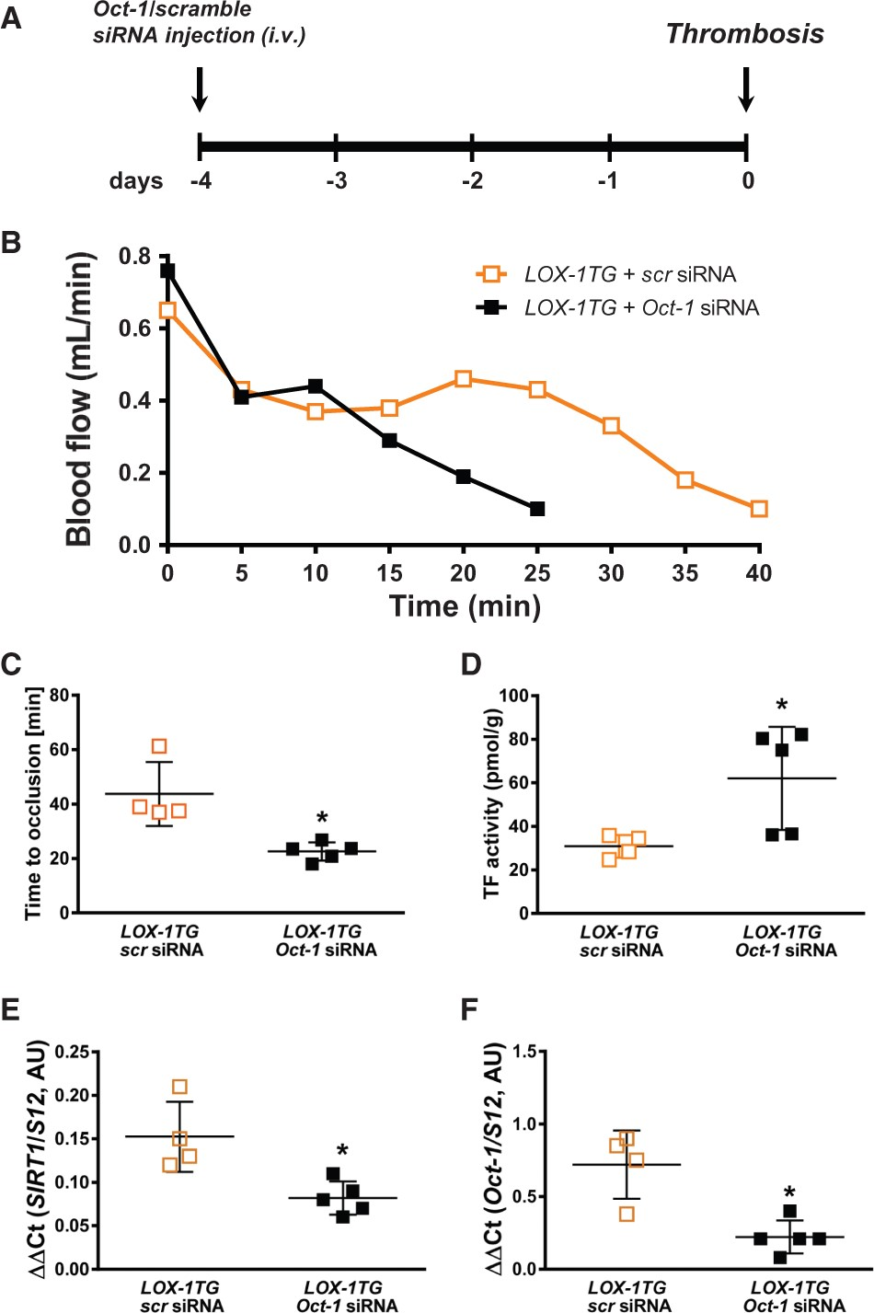
Figure 3 In vivo Oct-1 knockdown in LOX-1TG mice promotes arterial thrombosis and inhibits SIRT1 expression. (A) ...
Notes:
Figure 3 In vivo Oct-1 knockdown in LOX-1TG mice promotes arterial thrombosis and inhibits SIRT1 expression. (A) Scheme of experimental set-up. (B) Representative recordings during in vivo photochemical injury of LOX-1TG mice injected either with scrambled or Oct-1 siRNA. Laser injury was initiated at 0 min. Occlusion was defined as blood flow below 0.1 mL/min for at least 1 min. (C) Time to thrombotic occlusion after initiation of carotid artery photochemical injury in vivo (n = 4–5 in each group). *P < 0.05 vs. scrambled LOX-1TG mice. (D) Total surface activity of tissue factor (TF) after thrombus formation. *P < 0.05 vs. scrambled LOX-1TG mice. (E) In vivo knockdown of Oct-1 inhibits SIRT1 mRNA expression in carotid arteries. RNA was normalized to the internal control S12 (n = 4–5 in each group). *P < 0.05 vs. scrambled LOX-1TG mice. (F) Confirmation of Oct-1 downregulation on mRNA level after in vivo injection of siRNA by quantitative real time PCR. RNA was normalized to the internal control S12 (n = 4–5 in each group). *P < 0.05 vs. scrambled LOX-1TG mice. Data are shown as mean ± SEM in all experiments
Unless provided in the caption above, the following copyright applies to the content of this slide: Published on behalf of the European Society of Cardiology. All rights reserved. © The Author 2017. For permissions, please email: journals.permissions@oup.com.

Slide 4
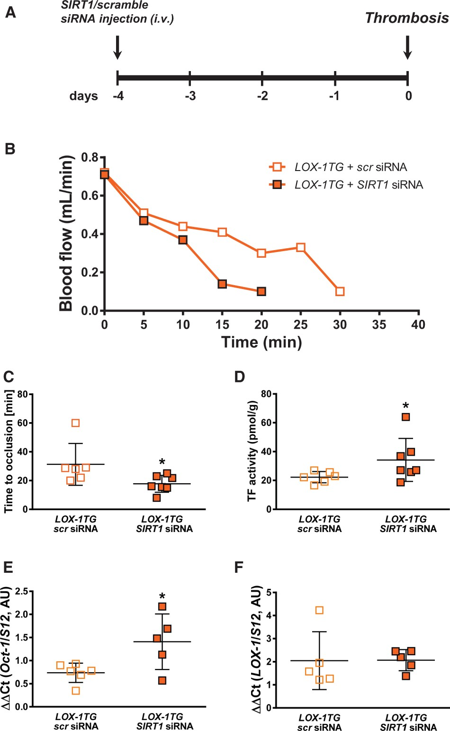
Figure 4 In vivo knockdown of SIRT1 in LOX-1TG mice promotes arterial thrombosis. (A) Scheme of experimental set-up. ...
Notes:
Figure 4 In vivo knockdown of SIRT1 in LOX-1TG mice promotes arterial thrombosis. (A) Scheme of experimental set-up. Scrambled or SIRT1 siRNA were injected i.v. 4 days before the start of in vivo thrombosis protocol. (B), Representative blood flow recordings during in vivo photochemical injury of LOX-1TG mice injected either with scrambled or SIRT1 siRNA. Laser injury was initiated at 0 min. Occlusion was defined as blood flow below 0.1 mL/min for at least 1 min. (C) Time to thrombotic occlusion after initiation of carotid artery photochemical injury in vivo (n = 6–7 in each group). *P < 0.05 vs. scrambled treated LOX-1TG mice. (D) Total surface activity of tissue factor (TF) after thrombus formation. *P < 0.05 vs. scrambled treated LOX-1TG. (E) In vivo knockdown of SIRT1 still keeps Oct-1 mRNA expression in carotid arteries higher compared to scrambled. The pattern of expression of Oct-1 mRNA in mice injected with SIRT1 or scrambled siRNA reflects Oct-1 mRNA expression in untreated WT and LOX-1TG mice after thrombosis. Oct-1 mRNA was analysed by quantitative real time PCR. RNA was normalized to the internal control S12 (n = 5–6 in each group). *P < 0.05 vs. scrambled treated LOX-1TG mice. (F) In vivo knockdown of SIRT1 does not change LOX-1 mRNA expression in carotid arteries. The LOX-1 mRNA was analysed by quantitative real time PCR. RNA was normalized to the internal control S12 (n = 5 in each group). *P < 0.05 vs. scrambled treated LOX-1TG mice. Data are shown as mean ± SEM in all experiments.
Unless provided in the caption above, the following copyright applies to the content of this slide: Published on behalf of the European Society of Cardiology. All rights reserved. © The Author 2017. For permissions, please email: journals.permissions@oup.com.

Slide 5
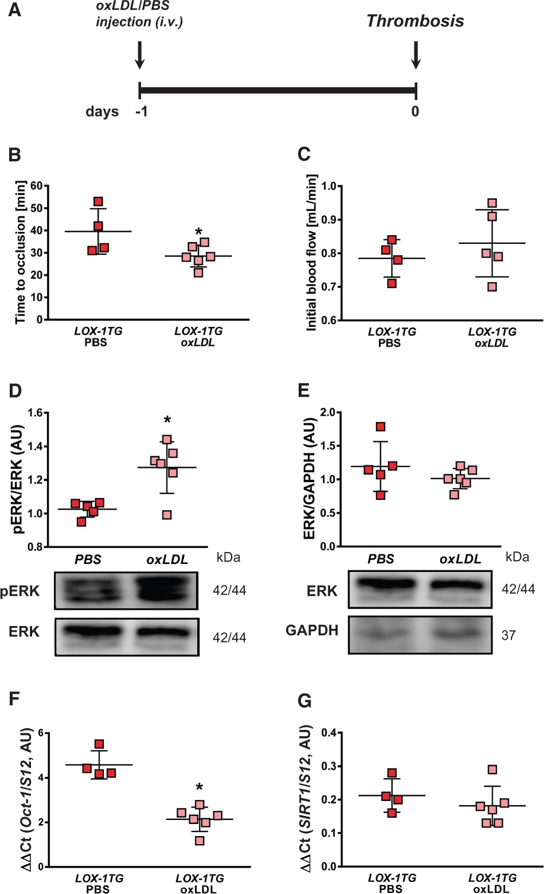
Figure 5 In vivo application of oxLDL into LOX-1TG mice promotes arterial thrombosis, activates MAPK-dependent ...
Notes:
Figure 5 In vivo application of oxLDL into LOX-1TG mice promotes arterial thrombosis, activates MAPK-dependent redox-sensitive pathway and inhibits Oct-1/SIRT1 pathway. (A) Scheme of experimental set-up. (B) Time to thrombotic occlusion after initiation of carotid artery photochemical injury in vivo (n = 4–6 in each group). *P < 0.05 vs. PBS-injected LOX-1TG mice. (C) Initial blood flow in carotid arteries stays unchanged in both groups of mice during arterial in vivo thrombosis (n = 4–5 in each group). (D) Arterial thrombosis induces ERK1/2 phosphorylation in carotid arteries. The ERK1/2 phosphorylation was analysed by Western blot (n = 5–6 in each group). *P < 0.05 vs. PBS-injected LOX-1TG mice. (E) Total expression of ERK1/2 remains unchanged in both groups. GAPDH was used as loading control. (F, G) Oct-1 (F) and SIRT1 (G) mRNA levels by quantitative real time PCR. RNA was normalized to the internal control S12 (n = 4–6 in each group). *P < 0.05 vs. PBS-injected LOX-1TG mice. Data are shown as mean ± SEM in all experiments.
Unless provided in the caption above, the following copyright applies to the content of this slide: Published on behalf of the European Society of Cardiology. All rights reserved. © The Author 2017. For permissions, please email: journals.permissions@oup.com.

Slide 6
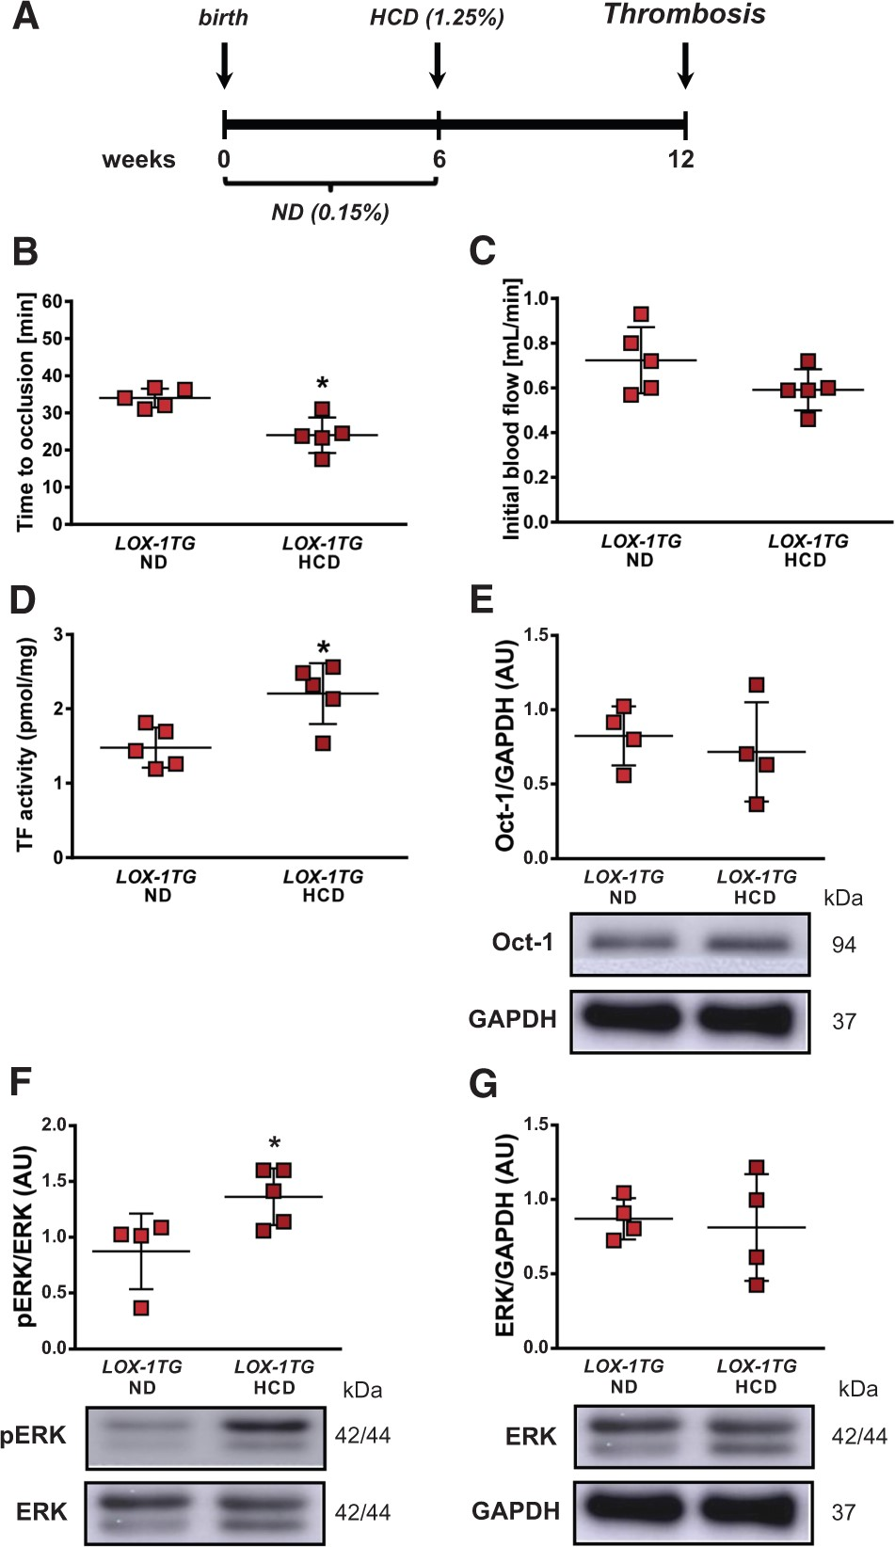
Figure 6 High cholesterol diet promotes arterial thrombosis in LOX-1TG mice, activates MAPK-dependent redox-sensitive ...
Notes:
Figure 6 High cholesterol diet promotes arterial thrombosis in LOX-1TG mice, activates MAPK-dependent redox-sensitive pathway and inhibits Oct-1/SIRT1 pathway. (A) Scheme of experimental set-up. (B) Time to thrombotic occlusion after initiation of photochemical injury in vivo (n = 5 in each group). (C) Initial blood flow in stays unchanged in both groups of mice during arterial in vivo thrombosis (n = 5 in each group). (D) Total surface activity of tissue factor (TF) after thrombus formation (n = 5 in each group). (E) Increased thrombus formation does not change Oct-1 protein expression in transgenic mice independently of the diet. (F) Arterial thrombosis induces ERK1/2 phosphorylation in carotid arteries after HCD. The ERK1/2 phosphorylation was analysed by Western blot (n = 4–5 in each group). (G) Total expression of ERK1/2 remains unchanged in both groups. GAPDH was used as loading control. Data are presented as mean ± SEM. *P < 0.05 vs. LOX-1TG mice on normal diet (ND).
Unless provided in the caption above, the following copyright applies to the content of this slide: Published on behalf of the European Society of Cardiology. All rights reserved. © The Author 2017. For permissions, please email: journals.permissions@oup.com.

Slide 7
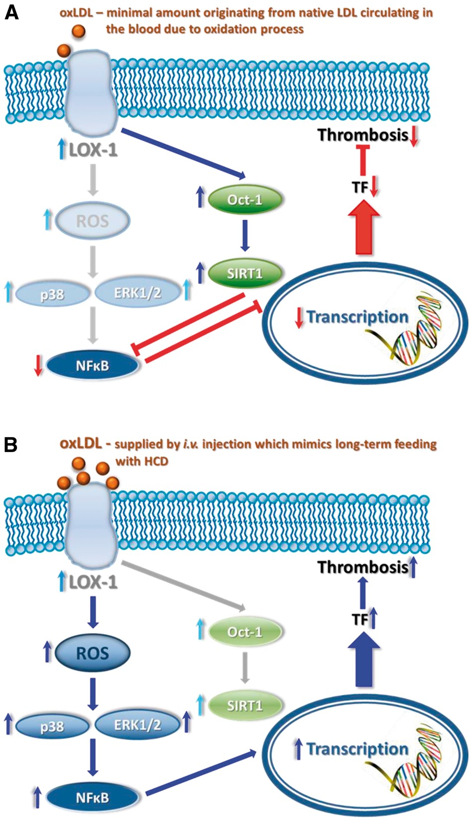
Figure 7 Schematic overview of LOX-1 signaling in arterial thrombus formation. (A) In the presence of normal ox LDL ...
Notes:
Figure 7 Schematic overview of LOX-1 signaling in arterial thrombus formation. (A) In the presence of normal ox LDL levels, the LOX-1 receptor modulates expression and activity of deacetylase SIRT1 through activation of transcription factor Oct-1. This subsequently inhibits expression of NFκB which leads to a repression of tissue factor expression and as a consequence to delayed thrombus formation. (B) In hyperlipidemia with elevated oxLDL levels, the Oct-1/SIRT1 protective pathway losses its activity and thus protective potential (right shadowed part of the scheme), while the redox-sensitive ‘classical’ LOX-1 pathway that involves MAPK and NFκB gets activated leading to enhanced tissue transcription and activity followed by increased thrombus formation.
Unless provided in the caption above, the following copyright applies to the content of this slide: Published on behalf of the European Society of Cardiology. All rights reserved. © The Author 2017. For permissions, please email: journals.permissions@oup.com.

