Slide 1
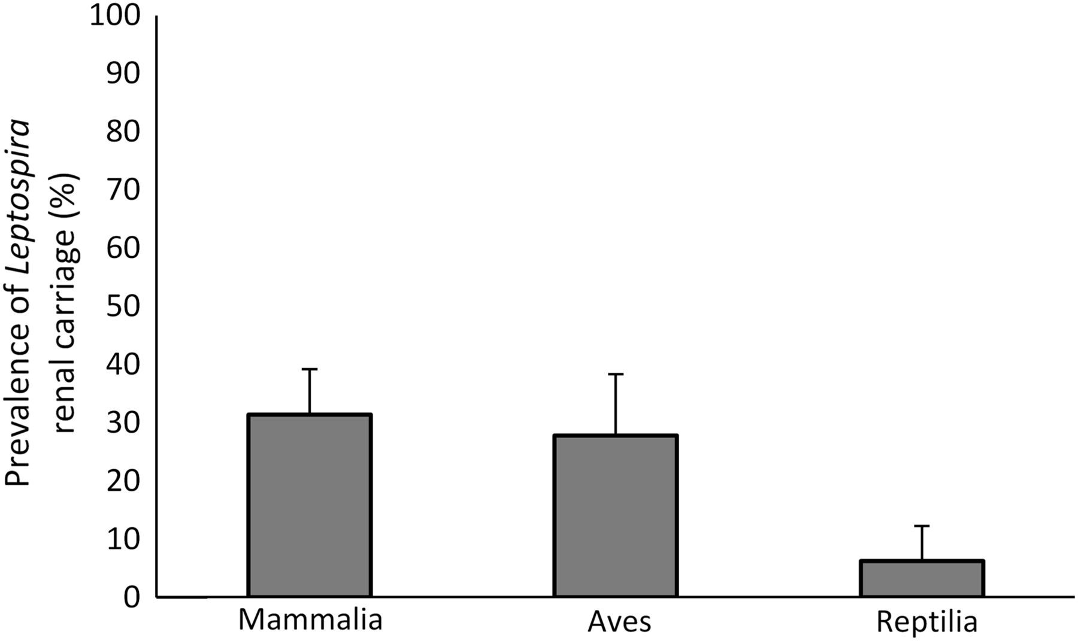
Figure 1. Prevalence (%) of renal carriage of pathogenic Leptospira in mammals (n=35 species), birds (n=18 species) and ...
Notes:
Figure 1. Prevalence (%) of renal carriage of pathogenic Leptospira in mammals (n=35 species), birds (n=18 species) and reptiles (n=16 species), in Chobe, Botswana. Error bars indicate standard errors of a proportion and are multiplied by 100 to produce scale bars which represent percentages.
Unless provided in the caption above, the following copyright applies to the content of this slide: © The Author 2015. Published by Oxford University Press on behalf of Royal Society of Tropical Medicine and Hygiene. All rights reserved. For permissions, please e-mail: journals.permissions@oup.com.

