Slide 1
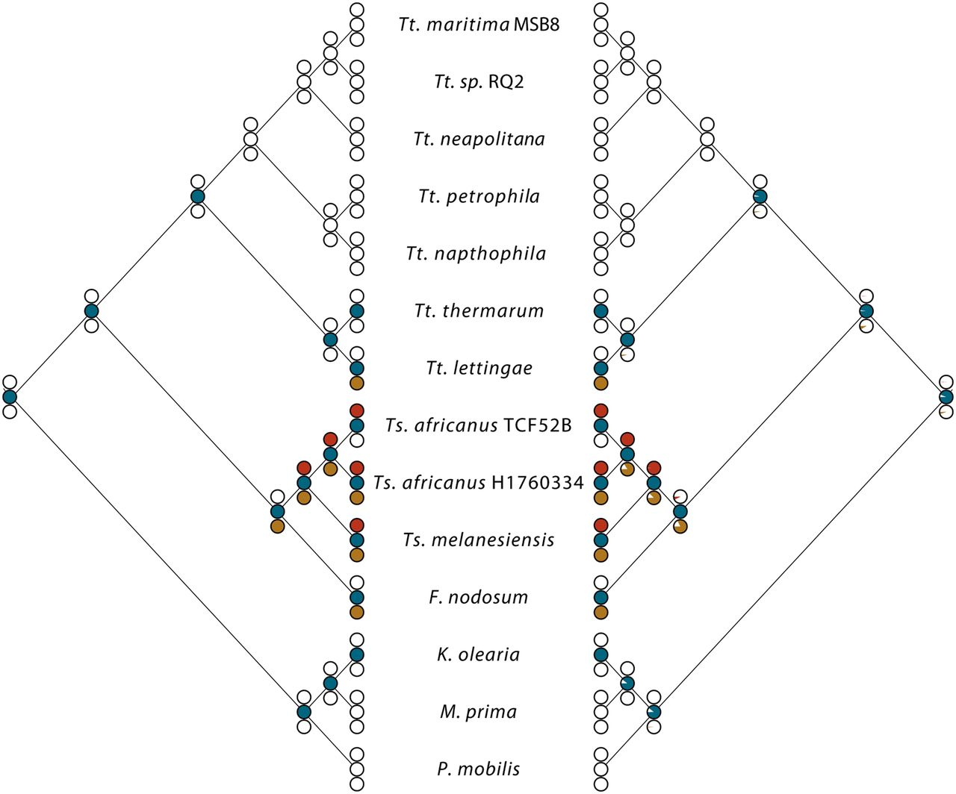
Fig. 2.— Ancestral state reconstructions of three gene clusters based on parsimony (left cladogram) and maximum ...
Notes:
Fig. 2.— Ancestral state reconstructions of three gene clusters based on parsimony (left cladogram) and maximum likelihood (ML) (right cladogram). Colored circles represent the three gene clusters. From top to bottom, red is the corrinoid synthesis gene cluster, blue is the cobinamide salvage gene cluster, and brown is the SucCoA synthetase gene cluster. Likelihood ratio of presence to absence is denoted by color to white on the ML cladogram. Because SucCoA is present as a pseudogene, it is considered absent in this analysis.
Unless provided in the caption above, the following copyright applies to the content of this slide: © The Author(s) 2012. Published by Oxford University Press on behalf of the Society for Molecular Biology and Evolution.This is an Open Access article distributed under the terms of the Creative Commons Attribution Non-Commercial License (http://creativecommons.org/licenses/by-nc/3.0), which permits unrestricted non-commercial use, distribution, and reproduction in any medium, provided the original work is properly cited.

Slide 2
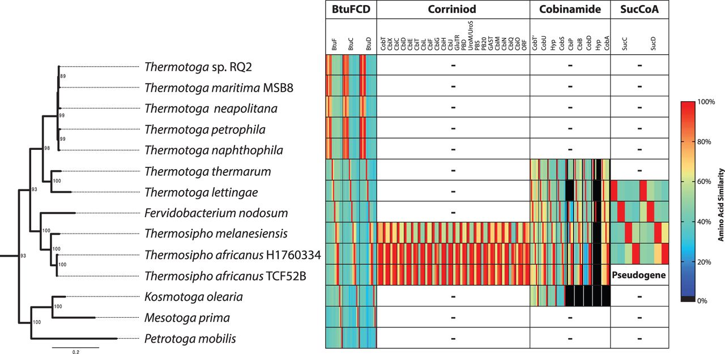
Fig. 1.— Presence/absence of the four gene clusters in the Thermotogales. A maximum likelihood 23S–16S rRNA ...
Notes:
Fig. 1.— Presence/absence of the four gene clusters in the Thermotogales. A maximum likelihood 23S–16S rRNA concatenated gene tree is on left. The presence of a gene cluster is denoted by color, whereas the absence of a gene cluster is denoted by “-” (right). BtuFCD is the B12/cobinamide ABC transporter genes, corrinoid is the corrinoid synthesis genes, cobinamide is the cobinamide salvage pathway genes, and SucCoA is the succinyl-CoA synthetase genes. For each gene cluster, the amino acid similarity of each gene is compared with its respective ortholog in that cluster and is colored according to the color bar on the right, adapted from Dagan and Martin 2007. The order in each box (left to right) is the same as in the table (top to bottom). Of the species that contain the cobinamide salvage pathway, the number of genes varies and missing genes within the cluster are colored black; K. olearia contains no archaea-derived genes in the cobinamide salvaging pathway. Bootstrap values ≥70 are shown in the tree.
Unless provided in the caption above, the following copyright applies to the content of this slide: © The Author(s) 2012. Published by Oxford University Press on behalf of the Society for Molecular Biology and Evolution.This is an Open Access article distributed under the terms of the Creative Commons Attribution Non-Commercial License (http://creativecommons.org/licenses/by-nc/3.0), which permits unrestricted non-commercial use, distribution, and reproduction in any medium, provided the original work is properly cited.

Slide 3
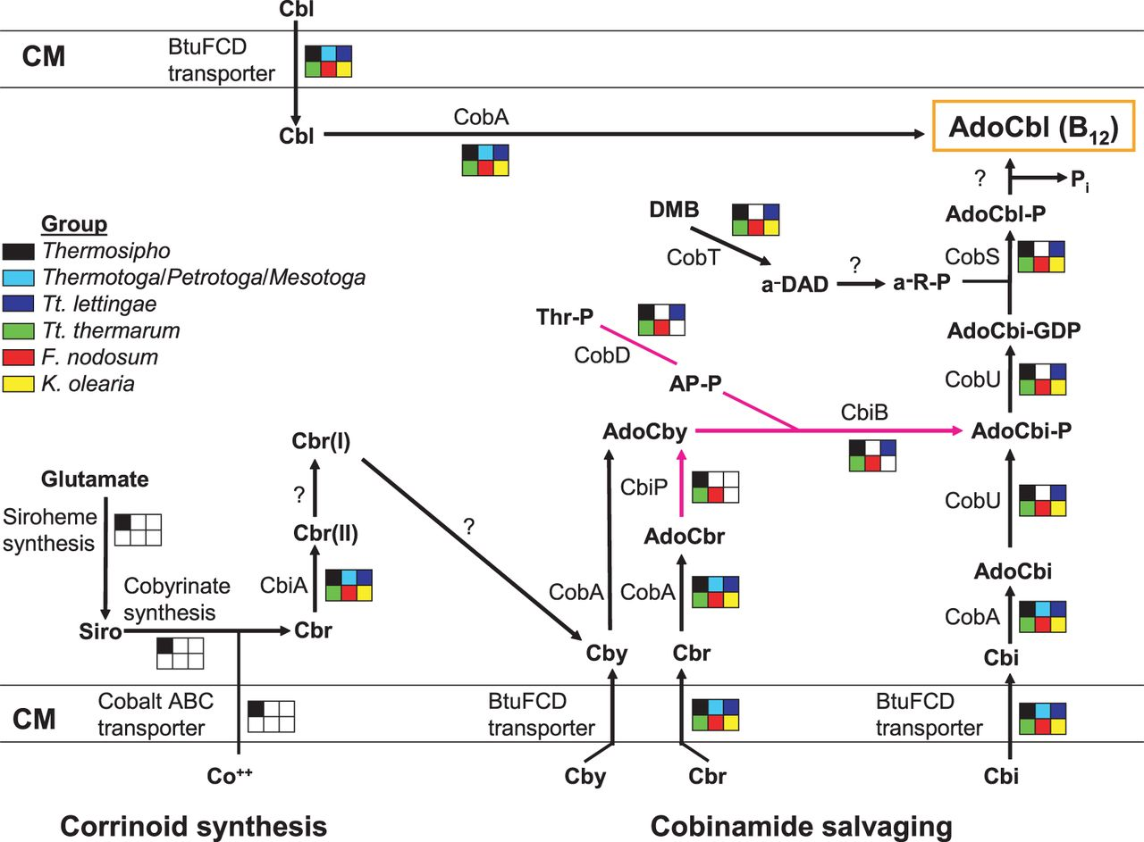
Fig. 3.— Proposed corrinoid synthesis and cobinamide salvage pathways in the Thermotogales. The color box indicates ...
Notes:
Fig. 3.— Proposed corrinoid synthesis and cobinamide salvage pathways in the Thermotogales. The color box indicates that the Thermotogales group contains a protein homolog, whereas an empty box indicates no protein homolog. Thermotogales groups: Thermosipho group (Ts. melanesiensis, Ts. africanus TCF52B and H1760334, black); Thermotoga/P. mobilis/M. prima (Tt. maritima, Tt. RQ2, Tt. cell2, Tt. naphthophila, Tt. neapolitana, Tt. petrophila, P. mobilis, M. prima, light blue), Tt. lettingae (dark blue), Tt. thermarum (light green), F. nodosum (red), and K. olearia (yellow). Reactions using archaea-derived proteins are indicated by pink arrows. In Thermosipho species, the B12 de novo pathway is broken into two gene clusters that encode corrinoid synthesis and cobinamide salvage. Corrinoid synthesis consists of three parts: cobyrinate synthesis (from sirohydrochlorin to cobyrinate), siroheme synthesis (from glutamate to siroheme/sirohydrochlorin), and a cobalt ABC transporter for importing cobalt. The final steps in B12 synthesis can also be used to salvage cobinamides. CM, cytoplasmic membrane; Cbi, cobinamide; AdoCbi, adenosylcobinamide; AdoCbi-P, adenosylcobinamide phosphate; AdoCbi-GDP, adenosylcobinamide guanosine diphosphate; Cbl, cobalamin; AdoCbl, adenosylcobalamin; Cby, cobyric acid; AdoCbr, adenosylcobyrinic acid; AdoCby, adenosylcobyric acid; Thr-P, threonine phosphate; AP-P, aminopropanol phosphate; a-R-P, α-ribazole; DMB, 5,6-dimethylbenzimidazole; a-DAD, α-5,6-dimethylbenzimidazole adenine dinucleotide; Cbr, cobyrinic acid; Cbr(II), cob(II)yrinate a,c-diamide; Cbr(I), cob(I)yrinate a,c-diamide; Siro, sirohydrochlorin. Proteins that have been identified in other microbes but have no homologs in the Thermotogales genomes are indicated by question marks. The reaction pathways were predicted based on evidence from other microbes (Escalante-Semerena 2007; Gray et al. 2008; Raux et al. 2000).
Unless provided in the caption above, the following copyright applies to the content of this slide: © The Author(s) 2012. Published by Oxford University Press on behalf of the Society for Molecular Biology and Evolution.This is an Open Access article distributed under the terms of the Creative Commons Attribution Non-Commercial License (http://creativecommons.org/licenses/by-nc/3.0), which permits unrestricted non-commercial use, distribution, and reproduction in any medium, provided the original work is properly cited.

Slide 4
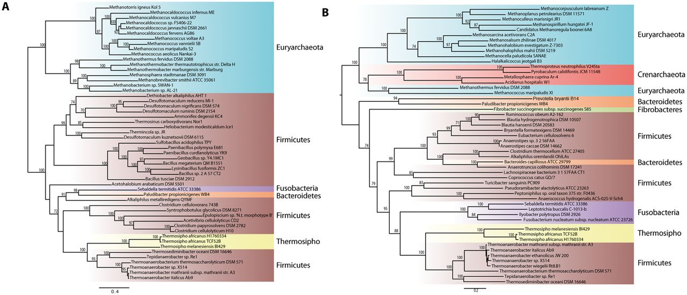
Fig. 4.— Concatenated maximum likelihood trees of proteins encoded by two different portions of the corrinoid gene ...
Notes:
Fig. 4.— Concatenated maximum likelihood trees of proteins encoded by two different portions of the corrinoid gene cluster. (A) The cobyrinate synthesis portion. (B) A subtree of the siroheme synthesis portion (for full tree, see supplementary fig. S4, Supplementary Material online). Bootstrap values ≥70 are shown.
Unless provided in the caption above, the following copyright applies to the content of this slide: © The Author(s) 2012. Published by Oxford University Press on behalf of the Society for Molecular Biology and Evolution.This is an Open Access article distributed under the terms of the Creative Commons Attribution Non-Commercial License (http://creativecommons.org/licenses/by-nc/3.0), which permits unrestricted non-commercial use, distribution, and reproduction in any medium, provided the original work is properly cited.

