Slide 1
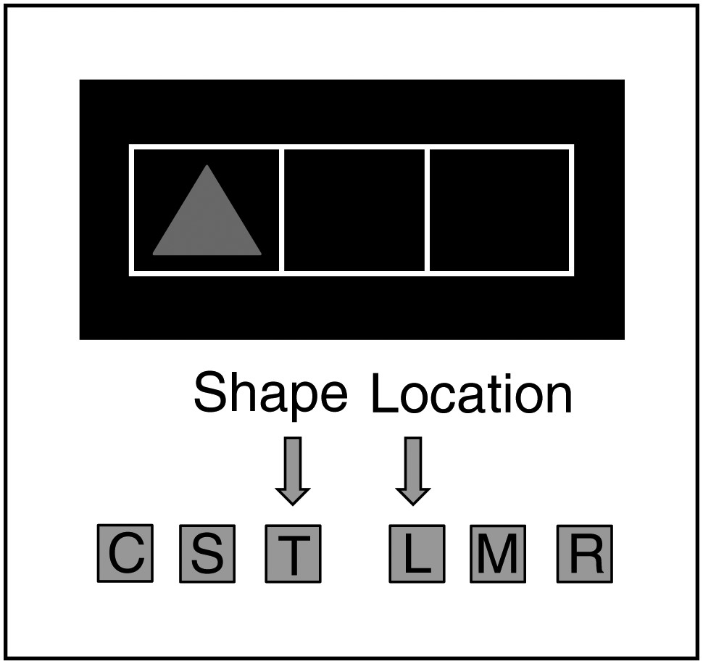
Figure 1. Schematic overview of stimulus presentation. The critical features of stimuli were related to the 2 tasks ...
Notes:
Figure 1. Schematic overview of stimulus presentation. The critical features of stimuli were related to the 2 tasks used: Shape (circle/square/triangle) and location (left/middle/right). The tasks were mapped separately to the 2 hands and the participants responded by pressing a key. In the example illustrated here, the left hand is used to respond to the shape (C = circle, S = square, T = triangle) and the right hand to the location of the stimulus (L = left, M = middle, R = right), with arrows indicating the correct response to the presented stimulus according to the 2 tasks.
Unless provided in the caption above, the following copyright applies to the content of this slide: © The Author 2012. Published by Oxford University Press.This is an Open Access article distributed under the terms of the Creative Commons Attribution License (http://creativecommons.org/licenses/by-nc/3.0/), which permits non-commercial reuse, distribution, and reproduction in any medium, provided the original work is properly cited. For commercial re-use, please contact journals.permissions@oup.com.

Slide 2
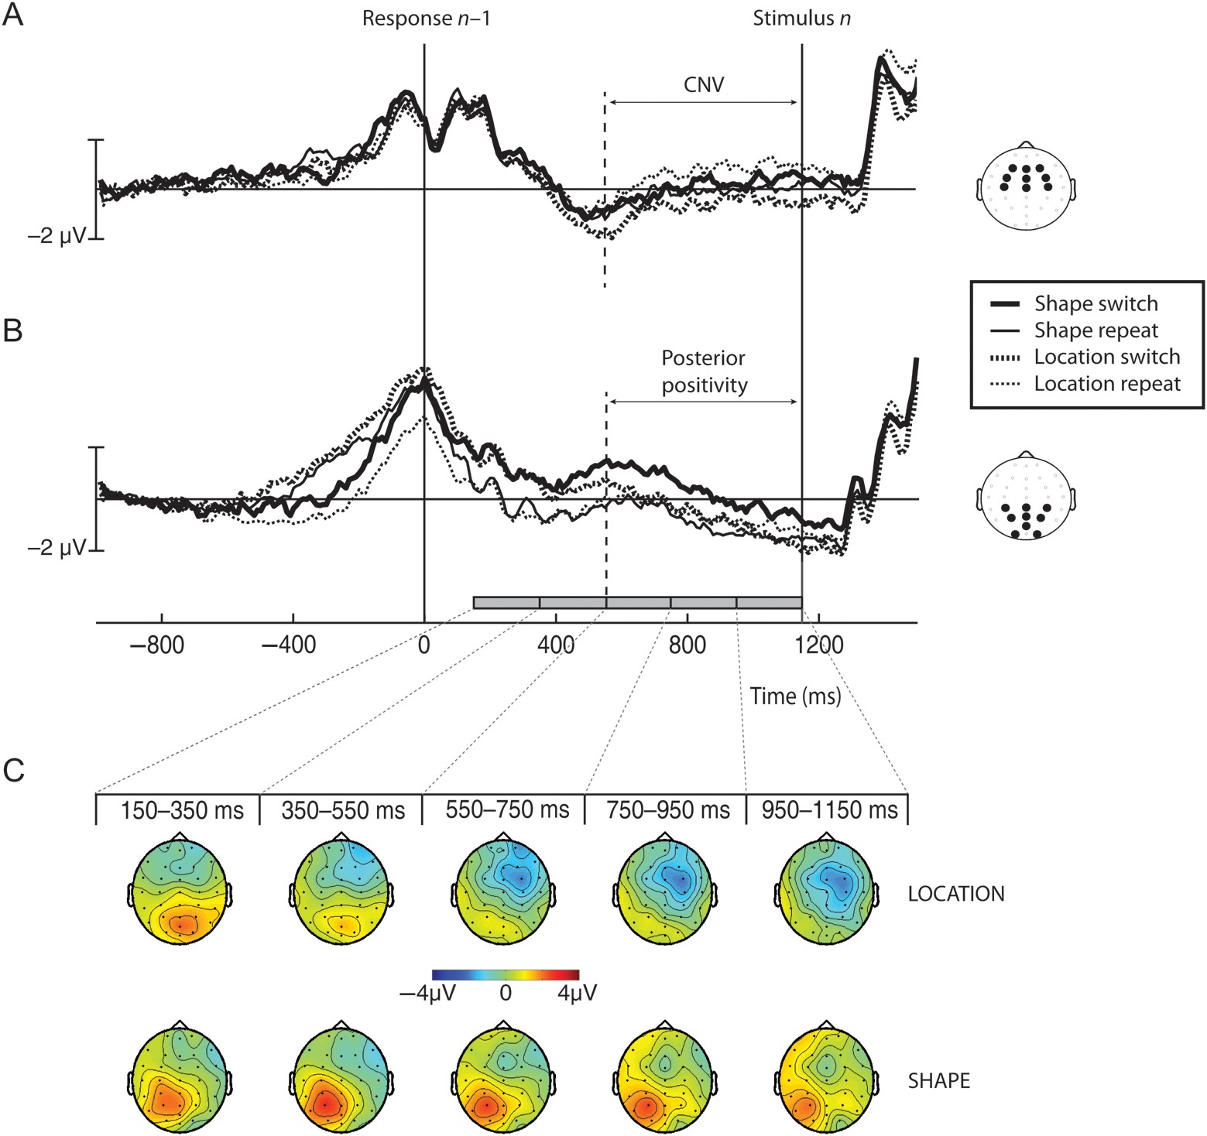
Figure 2. Grand average ERPs for switch and repeat trials of the location and the shape classification task during the ...
Notes:
Figure 2. Grand average ERPs for switch and repeat trials of the location and the shape classification task during the long RSI. (A) The CNV as measured at the electrodes F3, Fz, F4, FC3, FCz, FC4, C3, Cz, and C4 and (B) the posterior slow wave as measured at the electrodes CP3, CPz, CP4, P3, Pz, P4, POz, O1, and O2, both time-locked to the onset of the response on trial n− 1. (C) The scalp topography of the average signal differences between switch and repeat trials for the 2 tasks in steps of 200 ms starting from 150 ms after the response on n− 1 trial.
Unless provided in the caption above, the following copyright applies to the content of this slide: © The Author 2012. Published by Oxford University Press.This is an Open Access article distributed under the terms of the Creative Commons Attribution License (http://creativecommons.org/licenses/by-nc/3.0/), which permits non-commercial reuse, distribution, and reproduction in any medium, provided the original work is properly cited. For commercial re-use, please contact journals.permissions@oup.com.

Slide 3
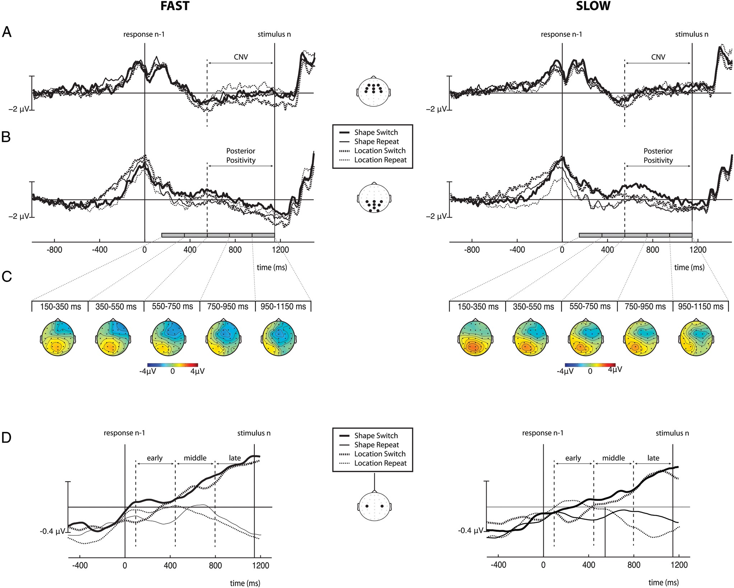
Figure 3. Modulation of the CNV, posterior positivity, and mu-MRAA by response speed. On the left, the CNV (A), the ...
Notes:
Figure 3. Modulation of the CNV, posterior positivity, and mu-MRAA by response speed. On the left, the CNV (A), the posterior positivity (B), and the mu-MRAA (D) are illustrated for trials with fast responses, and on the right the same components are illustrated for trials with slow responses. (C) The scalp topography of the average signal differences between switch and repeat trials. The distributions are presented in steps of 200 ms starting from 150 ms after the response on n− 1 trial, separately for the fast (left) and slow (right) trials.
Unless provided in the caption above, the following copyright applies to the content of this slide: © The Author 2012. Published by Oxford University Press.This is an Open Access article distributed under the terms of the Creative Commons Attribution License (http://creativecommons.org/licenses/by-nc/3.0/), which permits non-commercial reuse, distribution, and reproduction in any medium, provided the original work is properly cited. For commercial re-use, please contact journals.permissions@oup.com.

Slide 4
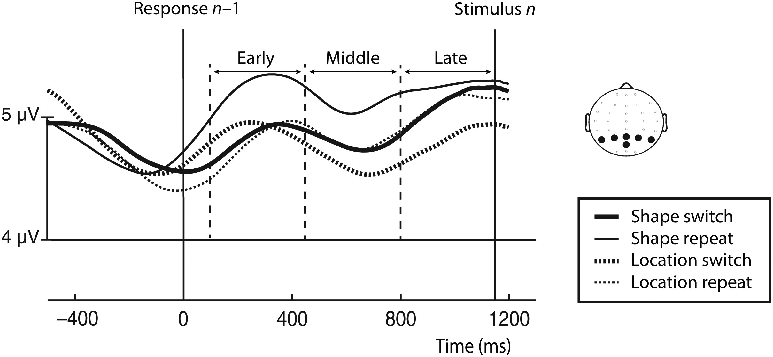
Figure 4. Grand average amplitude-modulated EEG signal after band-pass filtering at alpha frequencies, time-locked to ...
Notes:
Figure 4. Grand average amplitude-modulated EEG signal after band-pass filtering at alpha frequencies, time-locked to the onset of the response on trial n− 1. The signal is depicted for switch and repeat trials of the location and the shape classification task during the long RSI. Arrows indicate the 3 time intervals of interest (early, middle, and late). The scalp plot indicates the locations of the electrodes included in the analyses.
Unless provided in the caption above, the following copyright applies to the content of this slide: © The Author 2012. Published by Oxford University Press.This is an Open Access article distributed under the terms of the Creative Commons Attribution License (http://creativecommons.org/licenses/by-nc/3.0/), which permits non-commercial reuse, distribution, and reproduction in any medium, provided the original work is properly cited. For commercial re-use, please contact journals.permissions@oup.com.

Slide 5
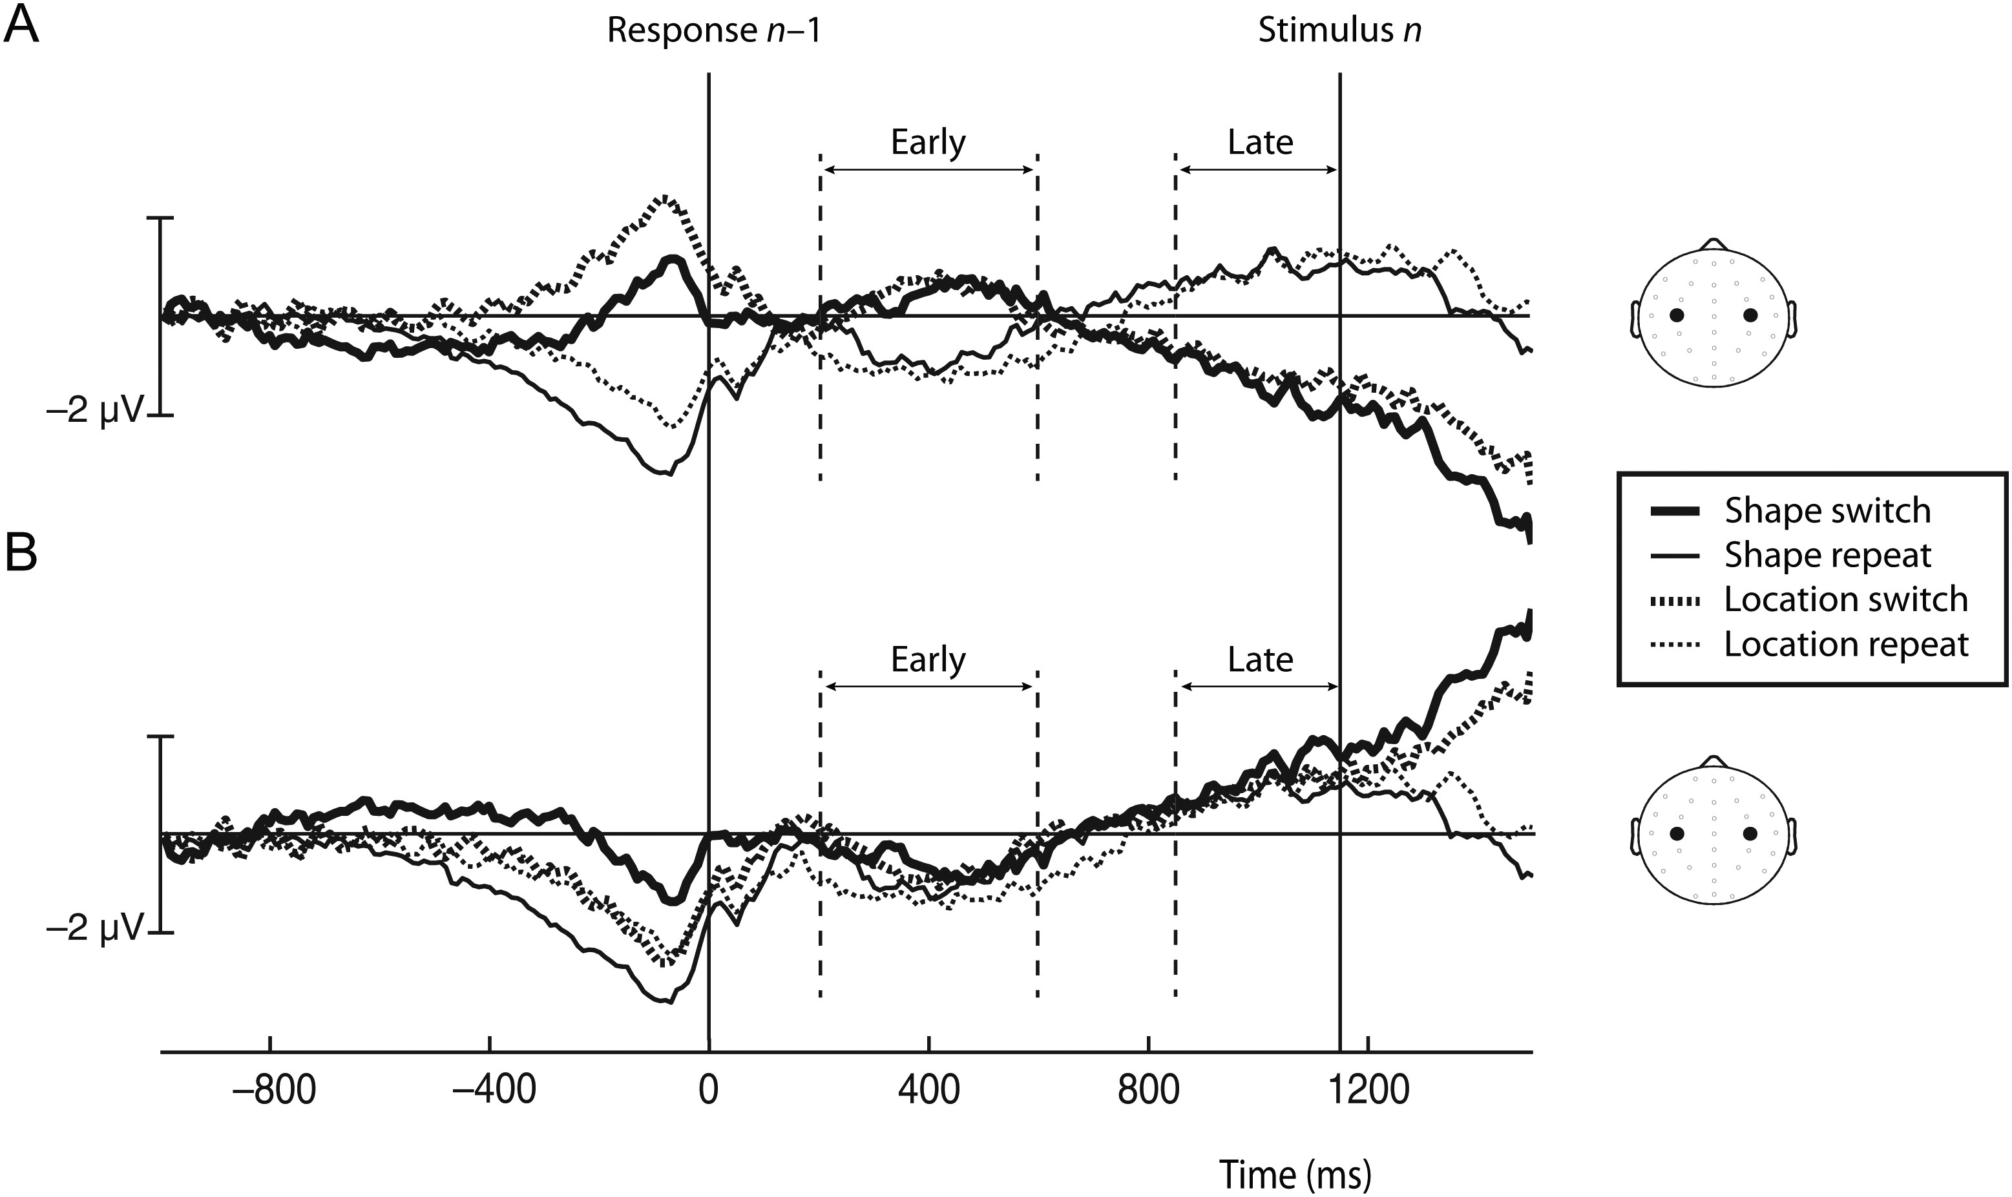
Figure 5. LRP for switch and repeat trials of the location and the shape classification task during the long RSI. The ...
Notes:
Figure 5. LRP for switch and repeat trials of the location and the shape classification task during the long RSI. The signal is time-locked to stimulus presentation, plotted either according to the hand used for the response on the current trial (A) or according to the hand used for the response on the previous trial (B). Arrows indicate the 2 time intervals of interest (early and late LRPs).
Unless provided in the caption above, the following copyright applies to the content of this slide: © The Author 2012. Published by Oxford University Press.This is an Open Access article distributed under the terms of the Creative Commons Attribution License (http://creativecommons.org/licenses/by-nc/3.0/), which permits non-commercial reuse, distribution, and reproduction in any medium, provided the original work is properly cited. For commercial re-use, please contact journals.permissions@oup.com.

Slide 6
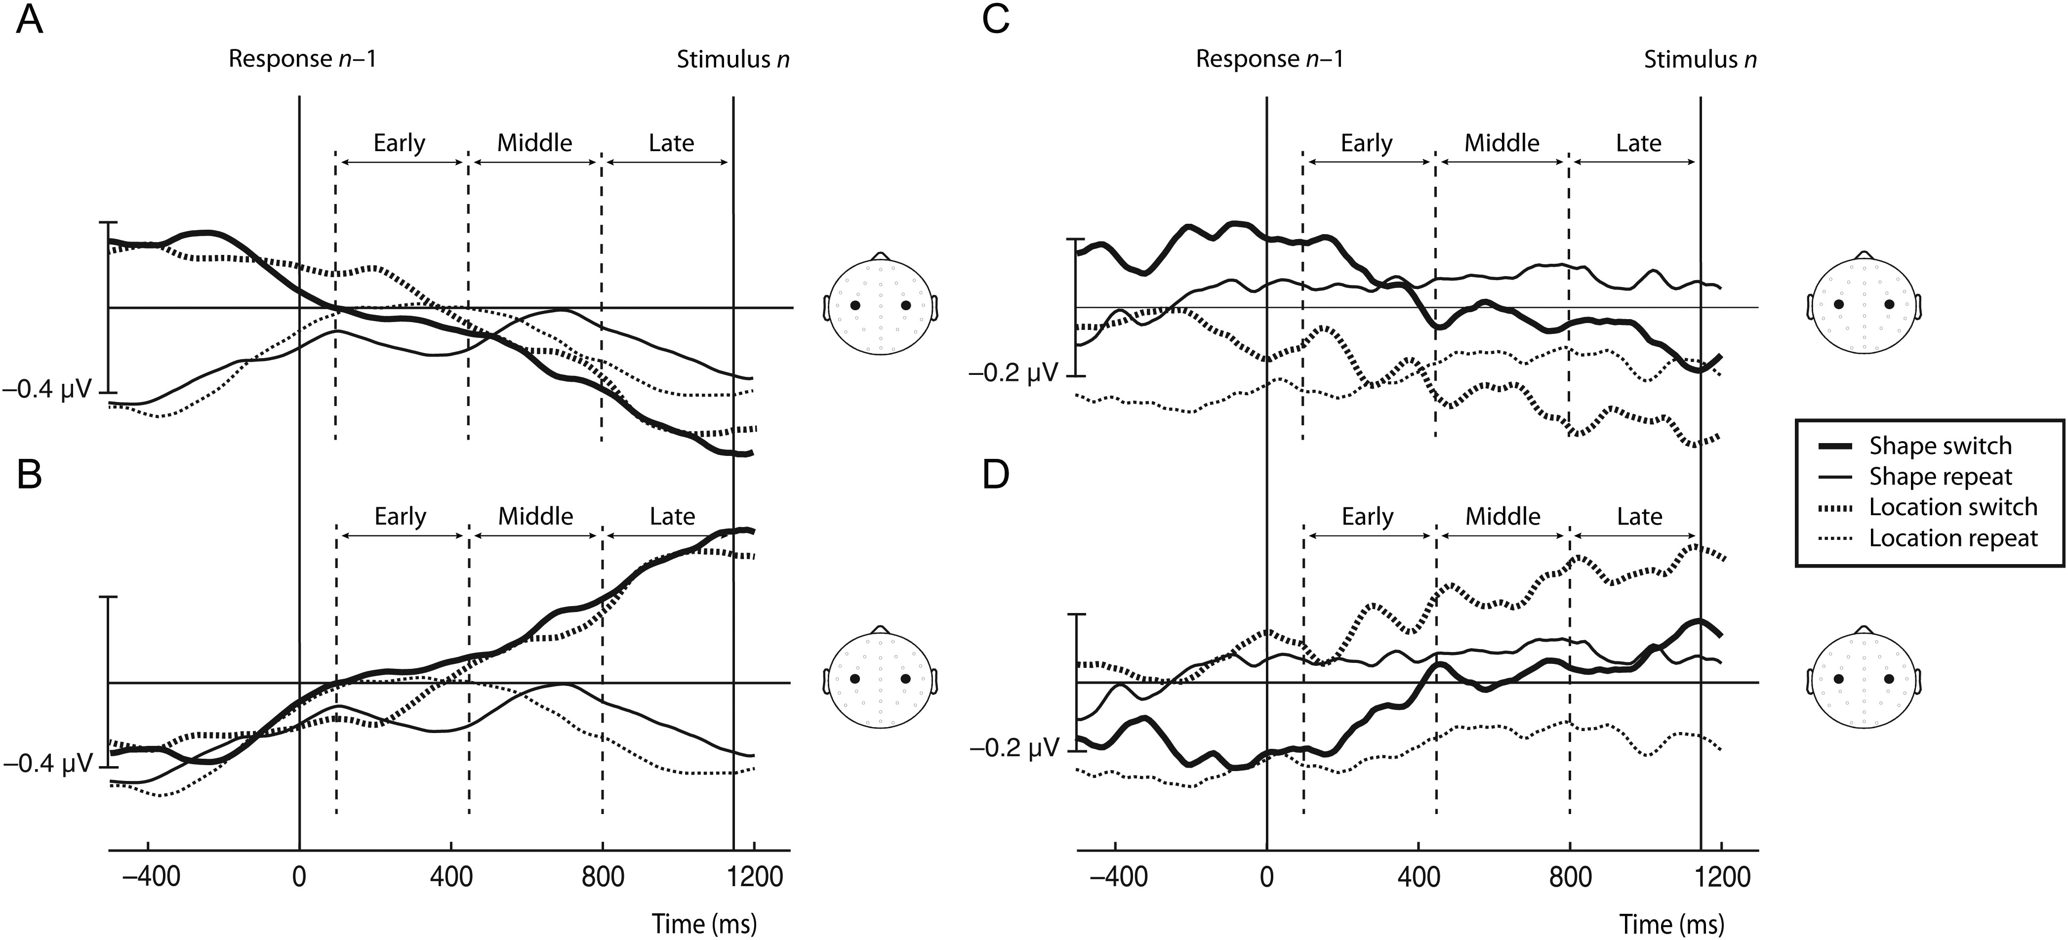
Figure 6. Motor-related amplitude asymmetries (MRAAs) for switch and repeat trials of the location and the shape ...
Notes:
Figure 6. Motor-related amplitude asymmetries (MRAAs) for switch and repeat trials of the location and the shape classification task during the long RSI. (A) and (B) show MRAA in the mu band (9–13 Hz, mu-MRAA) and (C) and (D) in the beta band (18–26 Hz, beta-MRAA). The signal is time-locked to stimulus presentation, plotted either according to the hand used for the response on the current trial (A, C) or according to the hand used for the response on the previous trial (B, D). Arrows indicate the time intervals of interest (early, middle, and late).
Unless provided in the caption above, the following copyright applies to the content of this slide: © The Author 2012. Published by Oxford University Press.This is an Open Access article distributed under the terms of the Creative Commons Attribution License (http://creativecommons.org/licenses/by-nc/3.0/), which permits non-commercial reuse, distribution, and reproduction in any medium, provided the original work is properly cited. For commercial re-use, please contact journals.permissions@oup.com.

Slide 7
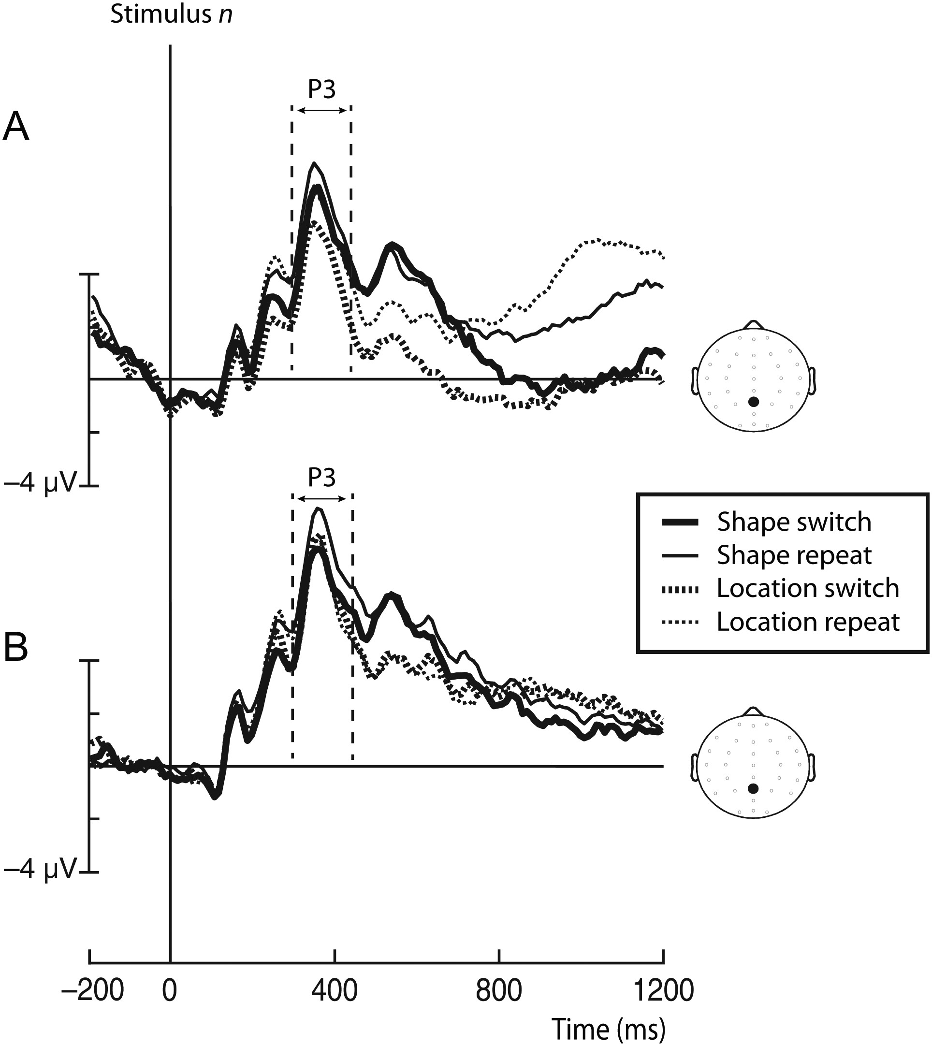
Figure 7. Grand average ERPs for switch and repeat trials of the location and the shape classification task during the ...
Notes:
Figure 7. Grand average ERPs for switch and repeat trials of the location and the shape classification task during the short (A) and the long (B) RSI. The signal is time-locked to stimulus presentation and measured at electrode Pz.
Unless provided in the caption above, the following copyright applies to the content of this slide: © The Author 2012. Published by Oxford University Press.This is an Open Access article distributed under the terms of the Creative Commons Attribution License (http://creativecommons.org/licenses/by-nc/3.0/), which permits non-commercial reuse, distribution, and reproduction in any medium, provided the original work is properly cited. For commercial re-use, please contact journals.permissions@oup.com.

