Slide 1
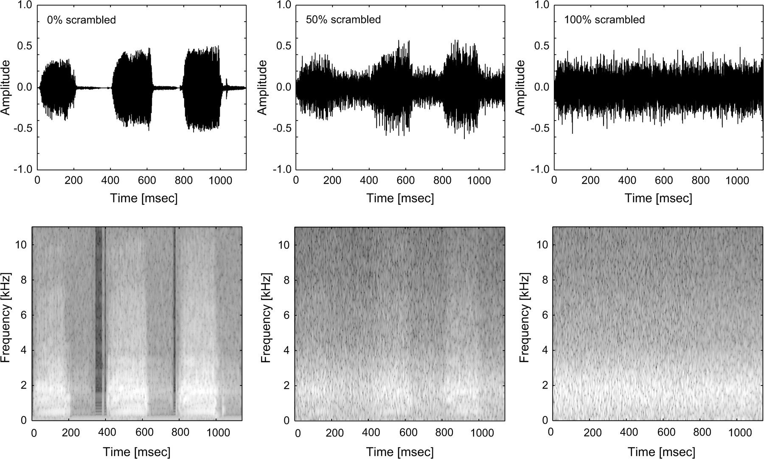
Figure 1. Sample stimulus (duck vocalization). Amplitude waveform (upper panel) of the original stimulus (left), 50% ...
Notes:
Figure 1. Sample stimulus (duck vocalization). Amplitude waveform (upper panel) of the original stimulus (left), 50% degraded (middle), and 100% degraded (right). Spectrograms (lower panel) of the original stimulus (left), 50% degraded (middle), and 100% degraded (right).
Unless provided in the caption above, the following copyright applies to the content of this slide: © The Author 2007. Published by Oxford University Press. All rights reserved. For permissions, please e-mail: journals.permissions@oxfordjournals.org

Slide 2
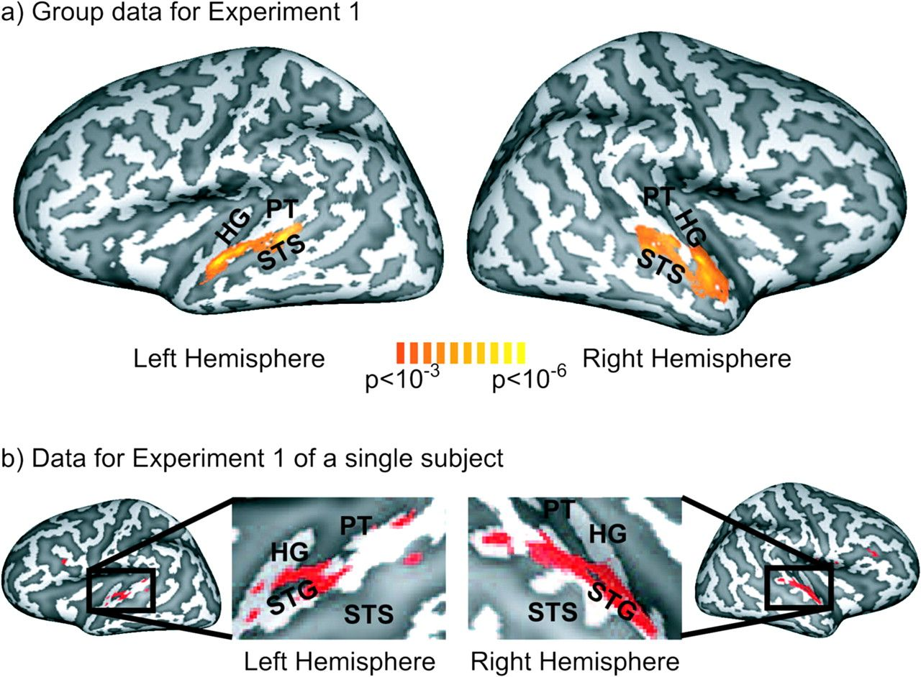
Figure 2. (a) Group data (n = 13) of the cortex-based general linear model analysis of experiment 1 shown on an ...
Notes:
Figure 2. (a) Group data (n = 13) of the cortex-based general linear model analysis of experiment 1 shown on an inflated 3D reconstruction of the cortical surface of a single subject which served as the target for cortex-based intersubject alignment. Gyri are shown in light gray and sulci in dark gray. The activation map shows voxels that exhibited significantly (P < 0.001, uncorrected) stronger fMRI responses for intact versus degraded stimuli as determined by linear contrast analysis (contrast weights—0% degraded: +2; 25% degraded: +1; 50% degraded: 0; 75% degraded: −1; 100% degraded: −2). (b) Data for a representative subject for experiment 1. This subject also served as target for the cortex-based alignment procedure employed in the group analysis. Voxels that exhibited significantly (P < 0.001, uncorrected) stronger fMRI responses for intact versus degraded stimuli are depicted in red.
Unless provided in the caption above, the following copyright applies to the content of this slide: © The Author 2007. Published by Oxford University Press. All rights reserved. For permissions, please e-mail: journals.permissions@oxfordjournals.org

Slide 3
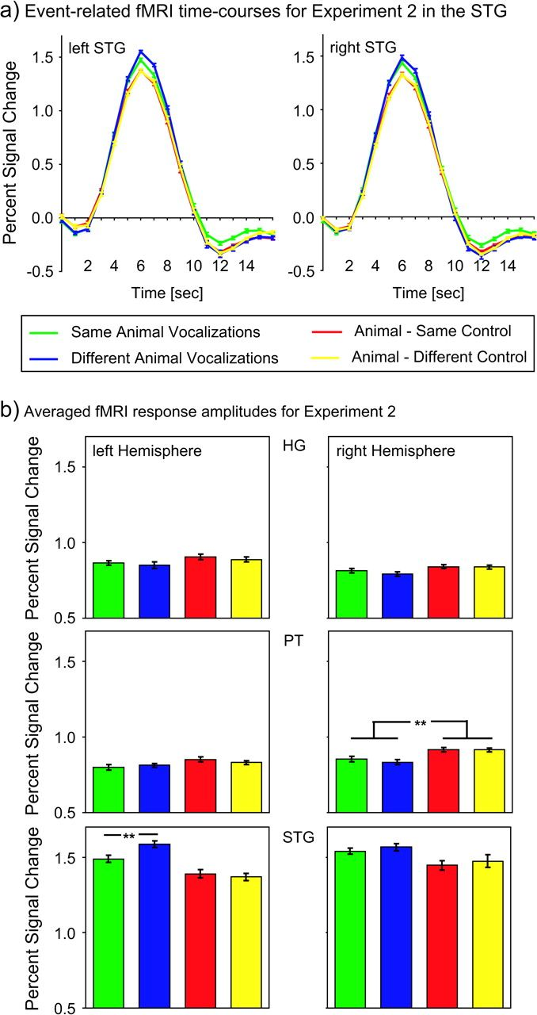
Figure 3. (a) Event-related time courses of fMRI responses in the left and right superior temporal gyrus (STG) for ...
Notes:
Figure 3. (a) Event-related time courses of fMRI responses in the left and right superior temporal gyrus (STG) for experiment 2 averaged across 13 subjects. (b) fMRI response amplitudes in HG, the PT, and the STG for experiment 2 averaged across 13 subjects. The error bars represent mean standard errors of the fMRI responses.
Unless provided in the caption above, the following copyright applies to the content of this slide: © The Author 2007. Published by Oxford University Press. All rights reserved. For permissions, please e-mail: journals.permissions@oxfordjournals.org

