Slide 1
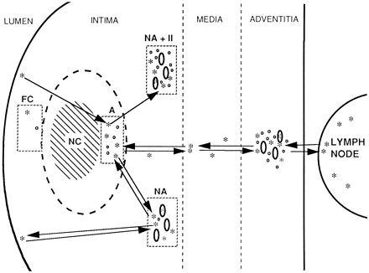
Fig. 1 Scheme of vascular dendritic cell (VDC) distribution in an atherosclerotic plaque and their possible ...
Notes:
Fig. 1 Scheme of vascular dendritic cell (VDC) distribution in an atherosclerotic plaque and their possible migration (explanation in text).* indicates VDC; ● indicates an inflammatory cell (T-cell or macrophage), ellipse indicates capillary from the neovascularisation plexus in the plaque and capillary of vasa vasorum in the adventitia. FC — fibrous cap; NA+II — neovascularisation area associated with massive inflammatory infiltrates; NA — neovascularisation area not associated with signs of inflammation; A — an area without neovascularisation underlying the necrotic core. NC — the necrotic core. Arrows indicate the possible VDC migration routes.
Unless provided in the caption above, the following copyright applies to the content of this slide: Copyright © 1998, European Society of Cardiology

Slide 2
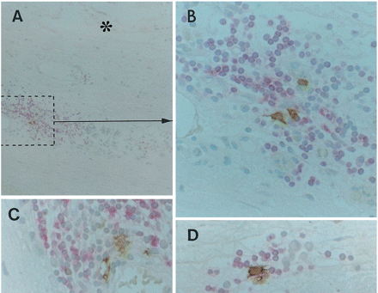
Fig. 3 S-100⁺ cells (brown) located between CD4⁺ cells (rose) in large (A–C) and small (D) ...
Notes:
Fig. 3 S-100+ cells (brown) located between CD4+ cells (rose) in large (A–C) and small (D) inflammatory infiltrates. B — detail of figure A. Aortic plaques. Frozen sections, double immunostaining (S-100+CD4: PAP+APAAP) technique, counterstaining with Mayer's haematoxylin. Original magnifications: ×100, ×400, ×400, ×400.
Unless provided in the caption above, the following copyright applies to the content of this slide: Copyright © 1998, European Society of Cardiology

Slide 3
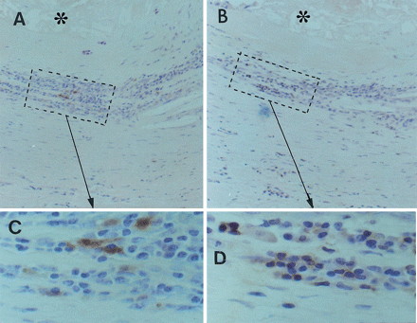
Fig. 2 S-100⁺ cells (A, C) and CD3⁺ cells (B, D) in massive inflammatory infiltrate in an ...
Notes:
Fig. 2 S-100+ cells (A, C) and CD3+ cells (B, D) in massive inflammatory infiltrate in an aortic plaque. A and B — consecutive paraffin sections. C — detail of figure A. D — detail of figure B. Asterisks indicate the necrotic core. ABC immunoperoxidase technique, counterstaining with Mayer's haematoxylin. Original magnifications: ×100, ×100, ×400, ×400.
Unless provided in the caption above, the following copyright applies to the content of this slide: Copyright © 1998, European Society of Cardiology

Slide 4
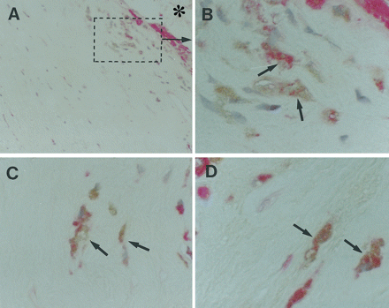
Fig. 4 S-100⁺ cells (brown) and CD68⁺ cells (rose) in the area underlying the necrotic core ...
Notes:
Fig. 4 S-100+ cells (brown) and CD68+ cells (rose) in the area underlying the necrotic core (A–D). Contacting cells are shown by arrows. Note that some VDCs and macrophages form close embracing contacts. Asterisk in figure A indicates the necrotic core. B — detail of figure A. Paraffin sections, double immunostaining (S-100+CD68: PAP+APAAP) technique, counterstaining with Mayer's haematoxylin. Original magnifications: ×100, ×400, ×400, ×400.
Unless provided in the caption above, the following copyright applies to the content of this slide: Copyright © 1998, European Society of Cardiology

Slide 5
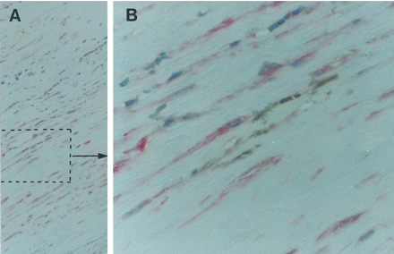
Fig. 5 A group of S-100⁺ cells (brown) located between SMA⁺ cells (rose) in the media. B — ...
Notes:
Fig. 5 A group of S-100+ cells (brown) located between SMA+ cells (rose) in the media. B — detail of figure A. Aortic specimen, paraffin section, double immunostaining (S-100+SMA: PAP+APAAP), counterstaining with Mayer's haematoxylin. Original magnifications: ×100, ×400.
Unless provided in the caption above, the following copyright applies to the content of this slide: Copyright © 1998, European Society of Cardiology

Slide 6
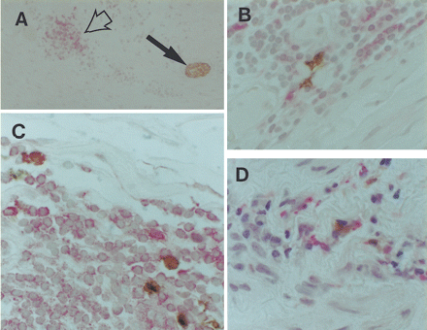
Fig. 6 Inflammatory infiltrates in the adventitia containing S-100⁺ cells (brown) contacting ...
Notes:
Fig. 6 Inflammatory infiltrates in the adventitia containing S-100+ cells (brown) contacting CD4+ cells (rose) (A–D). In figure A, inflammatory infiltrate is shown by the open arrow while the solid arrow indicates an S-100+ nerve twig (brown). Frozen sections, double immunostaining (S-100+CD4: PAP+APAAP) technique, counterstaining with Mayer's haematoxylin. Original magnifications: ×100, ×400, ×400, ×400.
Unless provided in the caption above, the following copyright applies to the content of this slide: Copyright © 1998, European Society of Cardiology

Slide 7
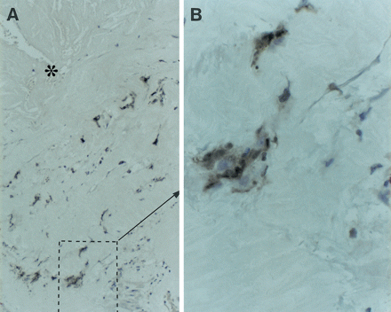
Fig. 7 ICAM-1 expression in cells and cell clusters surrounding the necrotic core (asterisk). B — detail of figure ...
Notes:
Fig. 7 ICAM-1 expression in cells and cell clusters surrounding the necrotic core (asterisk). B — detail of figure A. Frozen section, ABC immunoperoxidase technique, counterstaining with Mayer's haematoxylin. Original magnifications: ×100, ×400.
Unless provided in the caption above, the following copyright applies to the content of this slide: Copyright © 1998, European Society of Cardiology

Slide 8
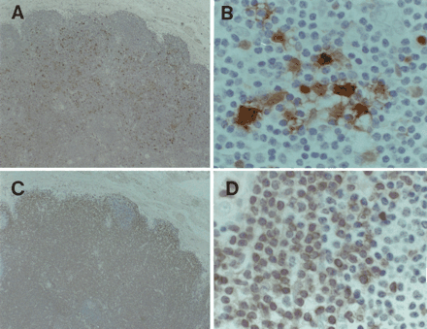
Fig. 8 S-100⁺ cells (A, B) and CD3⁺ cells (C, D) in a jugulodigastric lymph node adjacent to ...
Notes:
Fig. 8 S-100+ cells (A, B) and CD3+ cells (C, D) in a jugulodigastric lymph node adjacent to an atherosclerotic carotid artery. A and C — consecutive paraffin sections. ABC immunoperoxidase technique, counterstaining with Mayer's haematoxylin. Original magnifications: ×100, ×400, ×100, ×400.
Unless provided in the caption above, the following copyright applies to the content of this slide: Copyright © 1998, European Society of Cardiology

