Slide 1
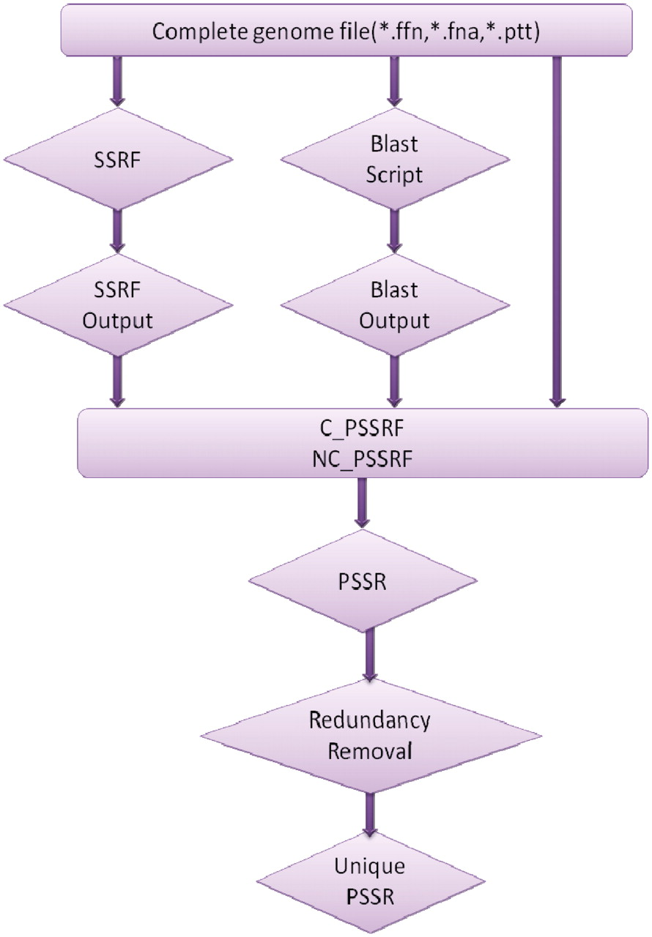
Figure 1. Schematic representation of PSSRFinder. C_PSSRF and NC_PSSRF are the two PERL programs which parse coding and ...
Notes:
Figure 1. Schematic representation of PSSRFinder. C_PSSRF and NC_PSSRF are the two PERL programs which parse coding and non-coding PSSRs respectively from the BLAST output.
Unless provided in the caption above, the following copyright applies to the content of this slide: © The Author(s) 2010. Published by Oxford University Press.This is an Open Access article distributed under the terms of the Creative Commons Attribution Non-Commercial License (http://creativecommons.org/licenses/by-nc/2.5), which permits unrestricted non-commercial use, distribution, and reproduction in any medium, provided the original work is properly cited.

Slide 2
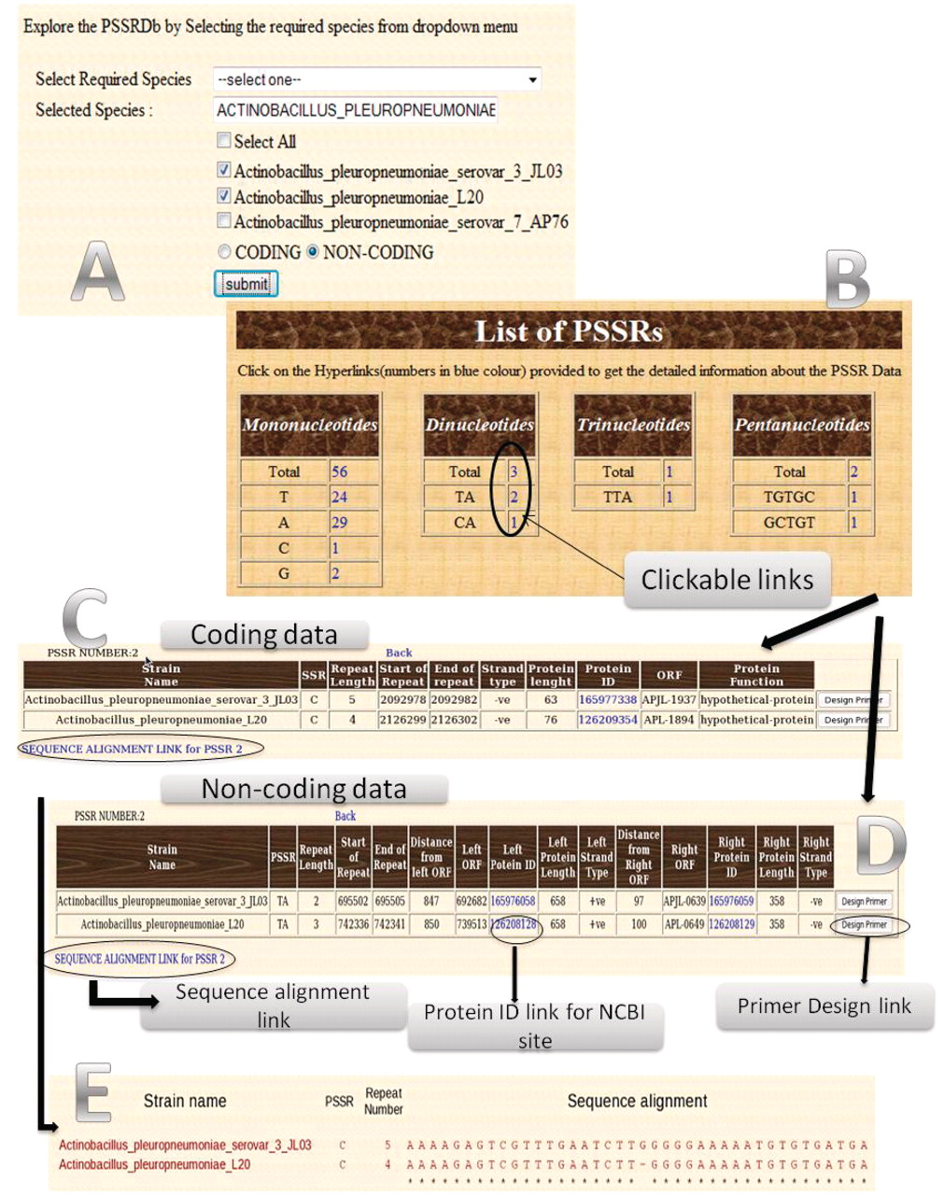
Figure 2. Overview of PSSRdb shown using screen-shots of various pages. ( A ) Main page containing species name which ...
Notes:
Figure 2. Overview of PSSRdb shown using screen-shots of various pages. ( A ) Main page containing species name which can be selected; ( B ) PSSRs found in the selected species; ( C ) Table containing the useful details of the selected coding PSSRs found in the selected species; ( D ) Table containing the useful details of the selected non-coding PSSRs found in the selected species; ( E ) Sequence alignment of a selected PSSR (in this case G tract).
Unless provided in the caption above, the following copyright applies to the content of this slide: © The Author(s) 2010. Published by Oxford University Press.This is an Open Access article distributed under the terms of the Creative Commons Attribution Non-Commercial License (http://creativecommons.org/licenses/by-nc/2.5), which permits unrestricted non-commercial use, distribution, and reproduction in any medium, provided the original work is properly cited.

