Slide 1
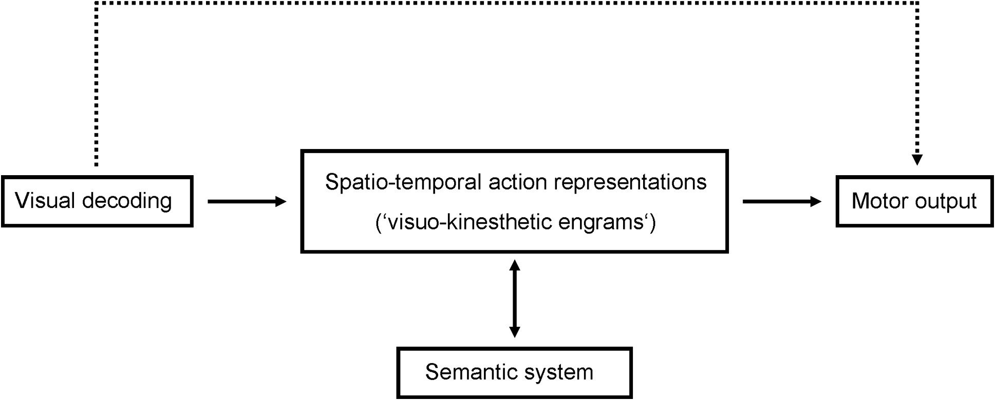
Figure 1. Modified Rothi-model. A modified version of the cognitive model of gesture imitation suggested by Rothi et ...
Notes:
Figure 1. Modified Rothi-model. A modified version of the cognitive model of gesture imitation suggested by Rothi et al. (1991). According to the model, imitation of meaningful gestures is exerted via the indirect route (solid lines), encompassing stored spatio-temporal action representations (“visuo-kinesthetic engrams”) (Heilman et al. 1982) or “action-blueprints” (Rijntjes et al. 1999), as well as additional semantic information. Contrary, imitation via the non-semantic, direct route (dotted line) directly leads from visual decoding to the innervatory pattern for motor output.
Unless provided in the caption above, the following copyright applies to the content of this slide: © The Author 2016. Published by Oxford University Press. All rights reserved. For Permissions, please e-mail: journals.permissions@oup.com

Slide 2
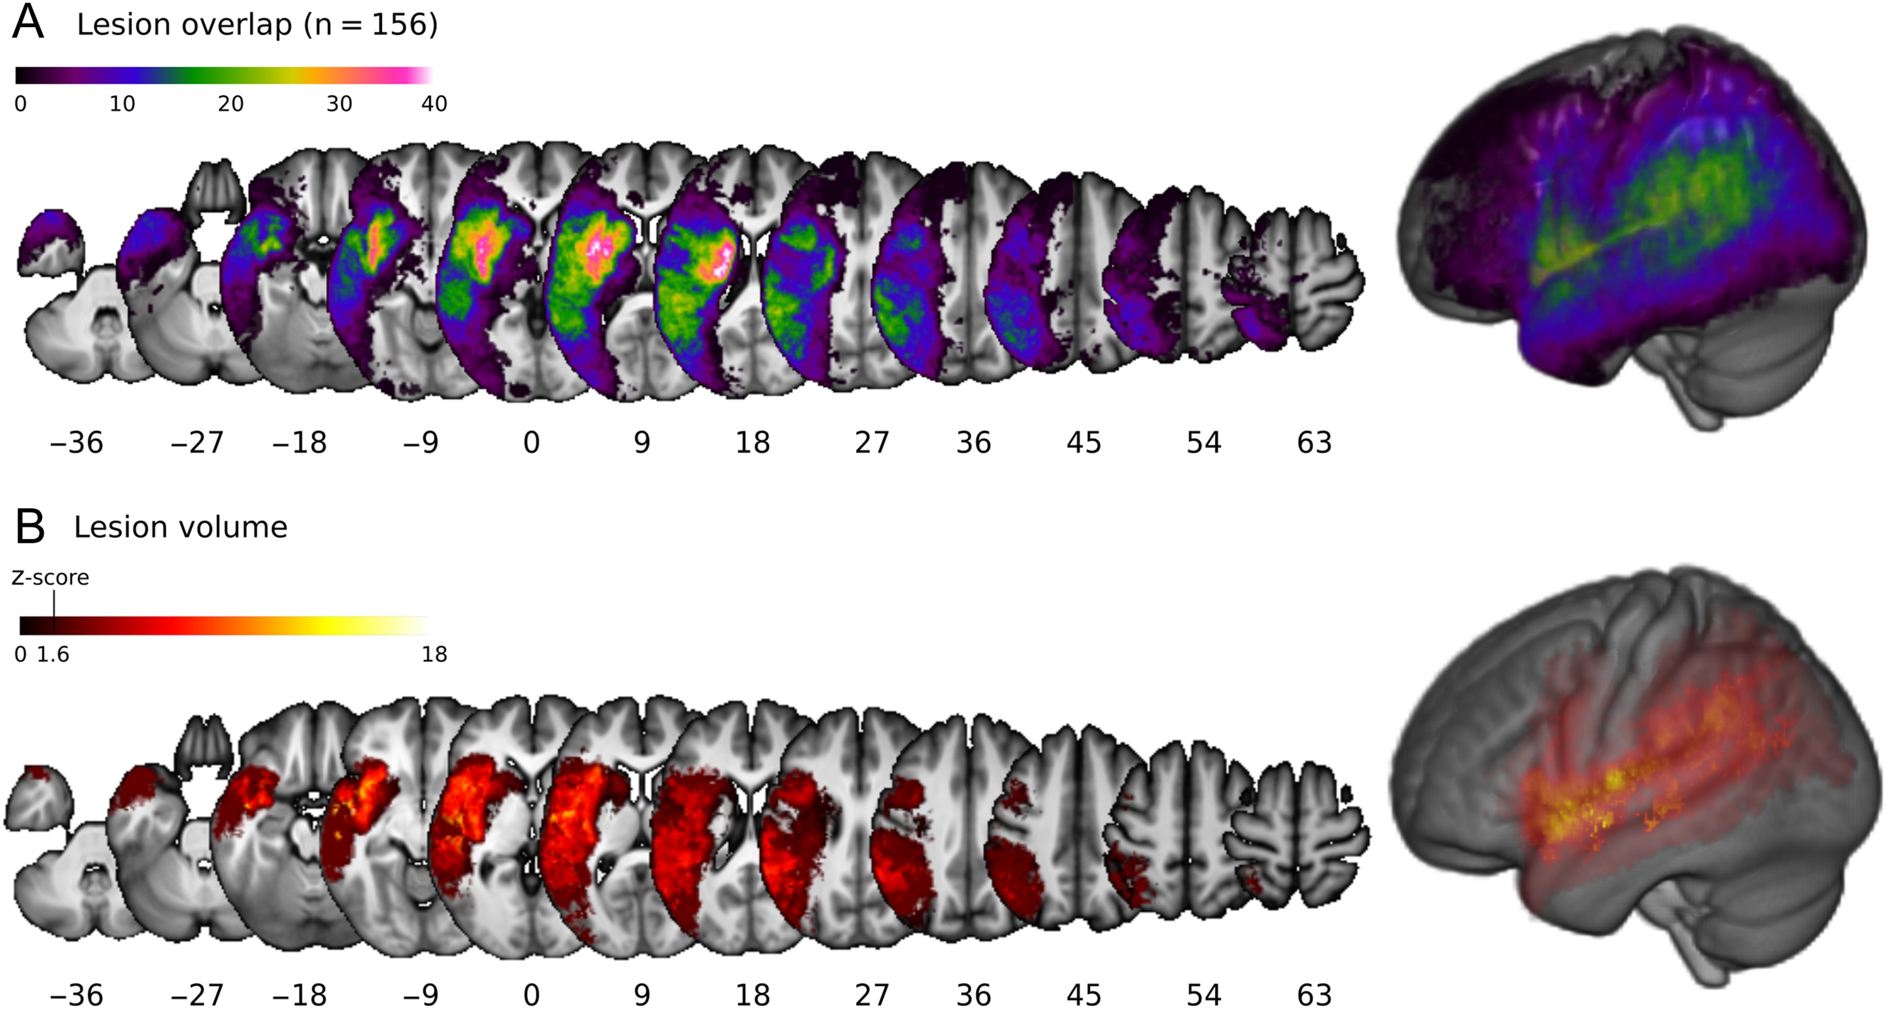
Figure 2. Lesion overlap and VLSM map for lesion volume. Overlap of the binarized lesions of the 156 patients included ...
Notes:
Figure 2. Lesion overlap and VLSM map for lesion volume. Overlap of the binarized lesions of the 156 patients included in the analysis (A). The color bar indicates the degree of overlap of lesions from 1 (black) to 40 (white) patients. The VLSM map for lesion volume (B) indicates voxels significantly associated with infarct size. Results are reported at a threshold of P < 0.05 FDR adjusted. The color bar shows Z-scores, the threshold for significant voxels is indicated.
Unless provided in the caption above, the following copyright applies to the content of this slide: © The Author 2016. Published by Oxford University Press. All rights reserved. For Permissions, please e-mail: journals.permissions@oup.com

Slide 3
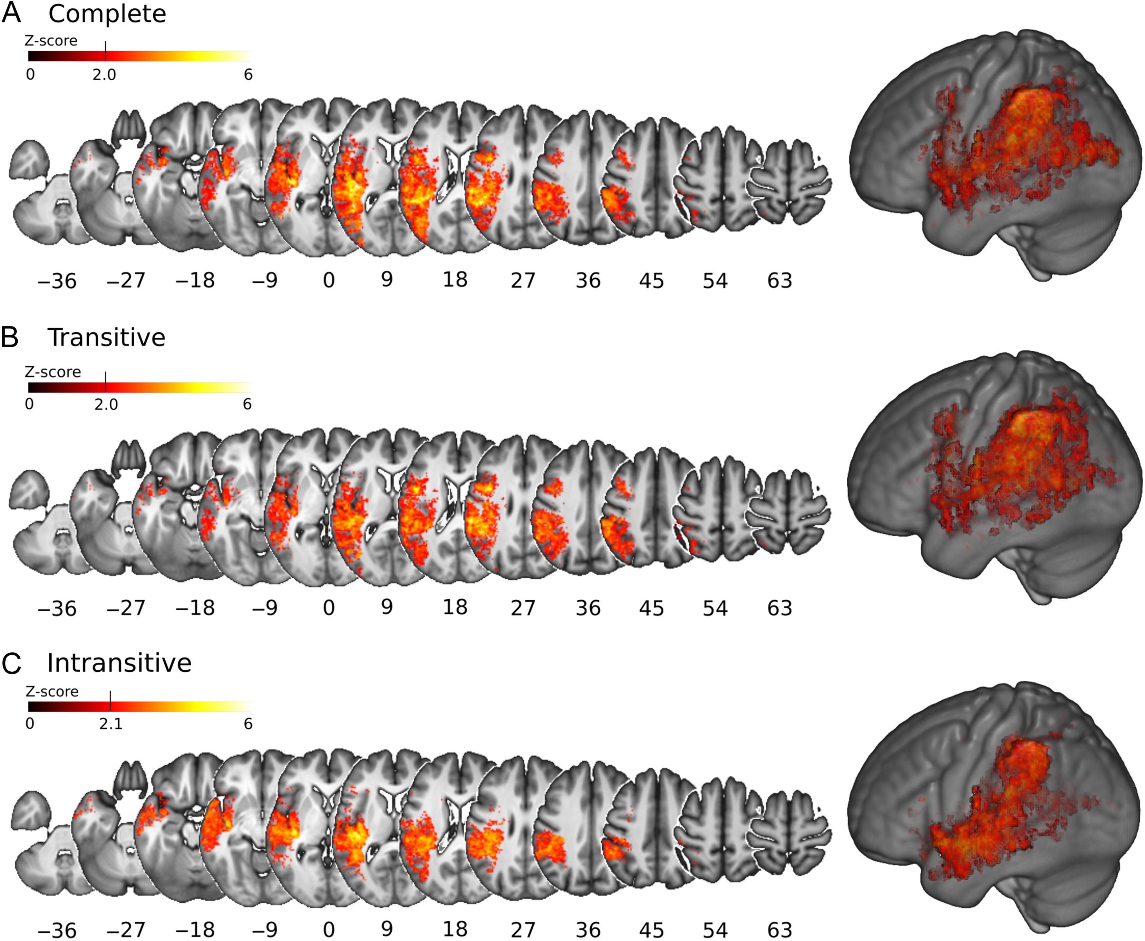
Figure 3. VLSM: Transitive and intransitive gesture imitation. VLSM maps for imitation of meaningful gestures ...
Notes:
Figure 3. VLSM: Transitive and intransitive gesture imitation. VLSM maps for imitation of meaningful gestures (Complete, A), imitation of transitive (B) and intransitive (C) gestures. Results are reported at a threshold of P < 0.05 FDR adjusted. Color bars show Z-scores, the threshold for significant voxels is indicated.
Unless provided in the caption above, the following copyright applies to the content of this slide: © The Author 2016. Published by Oxford University Press. All rights reserved. For Permissions, please e-mail: journals.permissions@oup.com

Slide 4
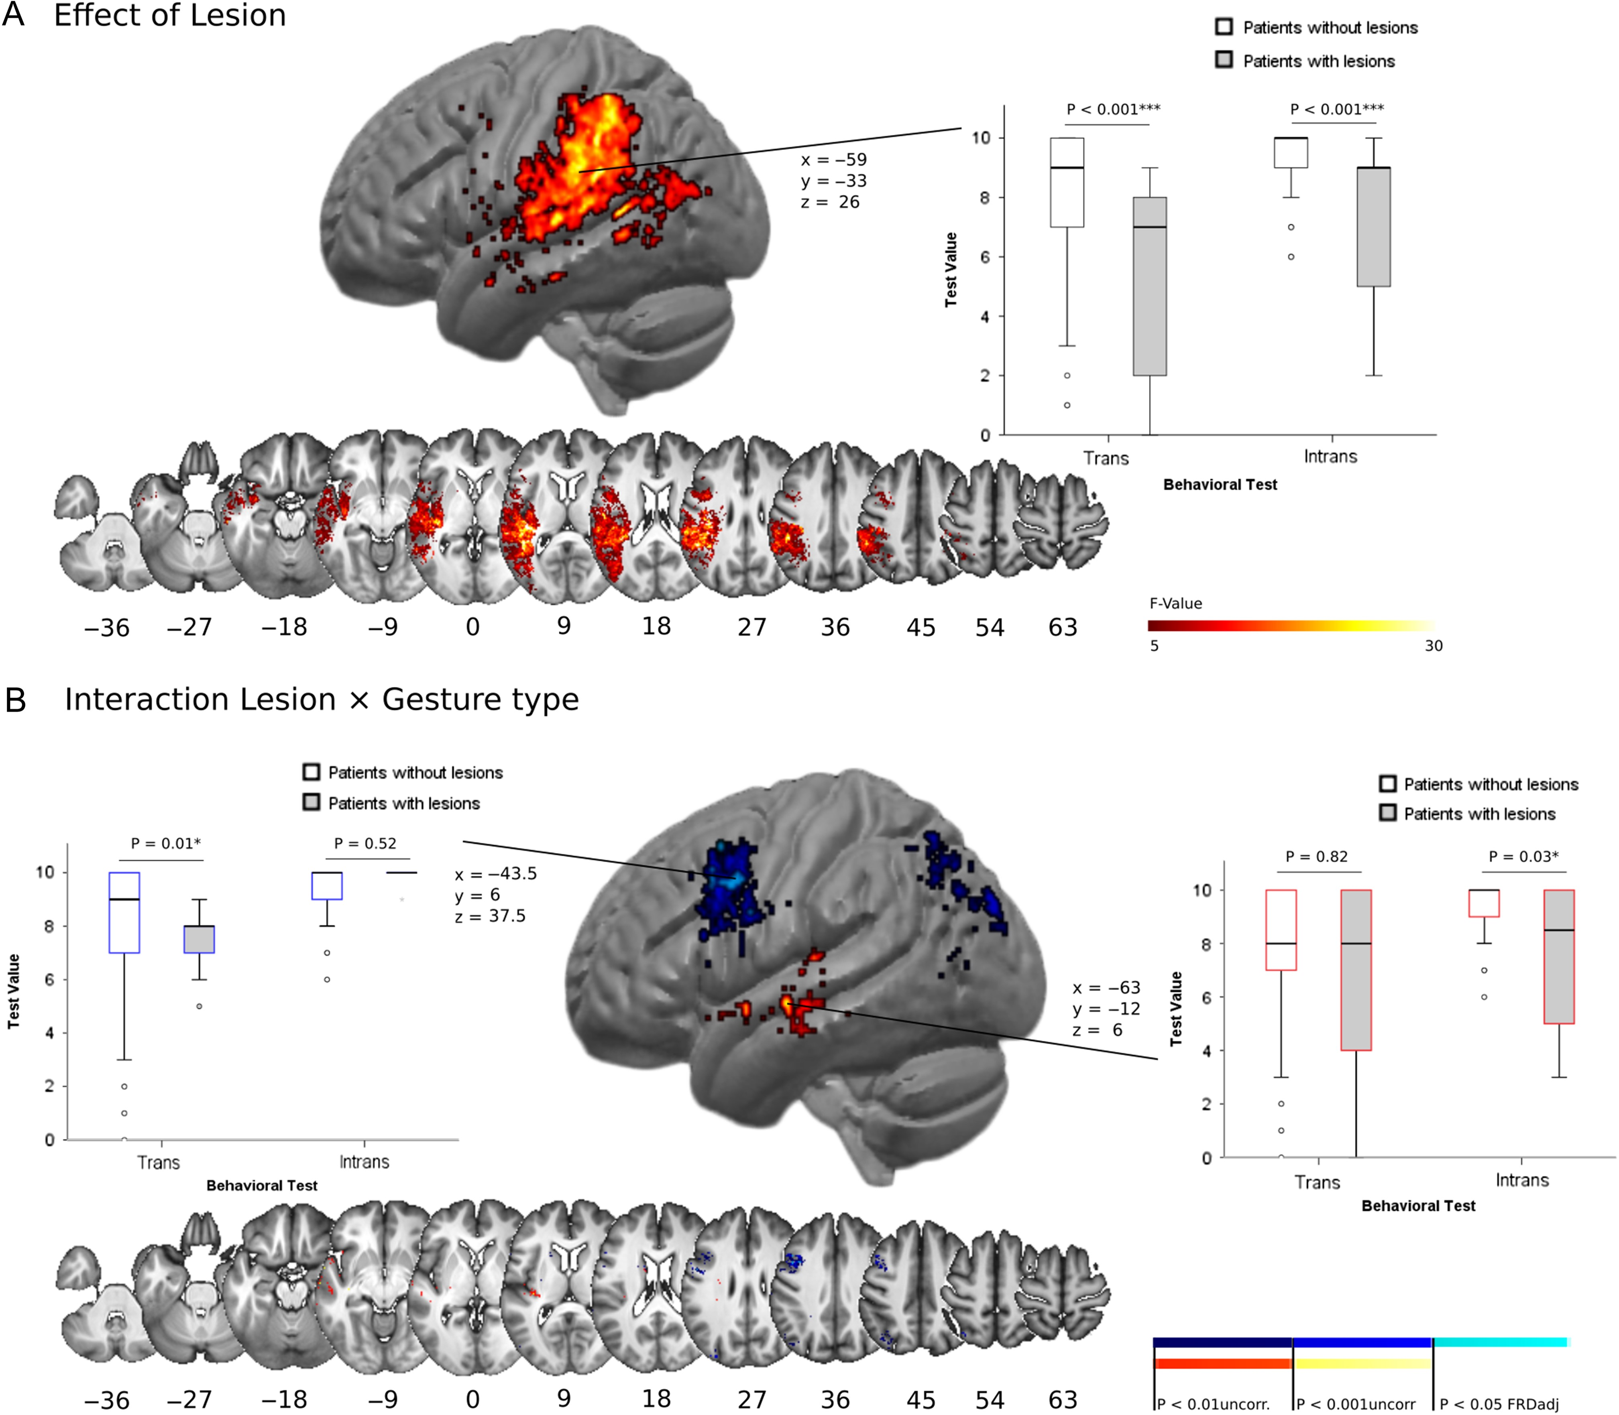
Figure 4. NIX in transitive and intransitive gesture imitation. Results calculated with the newly developed NIX toolbox ...
Notes:
Figure 4. NIX in transitive and intransitive gesture imitation. Results calculated with the newly developed NIX toolbox for the voxel-wise analysis of the factors lesion status (lesioned/non-lesioned) and gesture type (transitive and intransitive imitation). (A) The effect of lesion across both imitation subscores, that is, lesion locations that lead to deficits in both scores. Results are thresholded at P < 0.05, FDR adjusted for multiple comparisons. (B) Voxels where significant interaction effects between lesion status and gesture type were found; as indicated by post hoc tests, dorsal lesions (blue) differentially affected transitive imitation, whereas anterior temporal damage (red) had a greater effect on communicative emblems. Boxplots illustrate the behavioral data from patients with and without lesions at the premotor and anterior temporal peak voxels. To explore potential subthreshold effects, results in B are presented not only at the threshold of P < 0.05 FDR adjusted, but also at uncorrected P < 0.01 and P < 0.001. (C) An overlap of the binarized result maps obtained by the voxel-wise Brunner–Munzel tests (thresholded at P < 0.05, FDR adjusted); overlapping regions are depicted in green. In addition, to confirm the regions found to be differentially related to transitive versus intransitive gestures in the NIX analyses, the differences between the binarized maps were calculated (blue for transitive gestures only, red for intransitive gestures only).
Unless provided in the caption above, the following copyright applies to the content of this slide: © The Author 2016. Published by Oxford University Press. All rights reserved. For Permissions, please e-mail: journals.permissions@oup.com

Slide 5
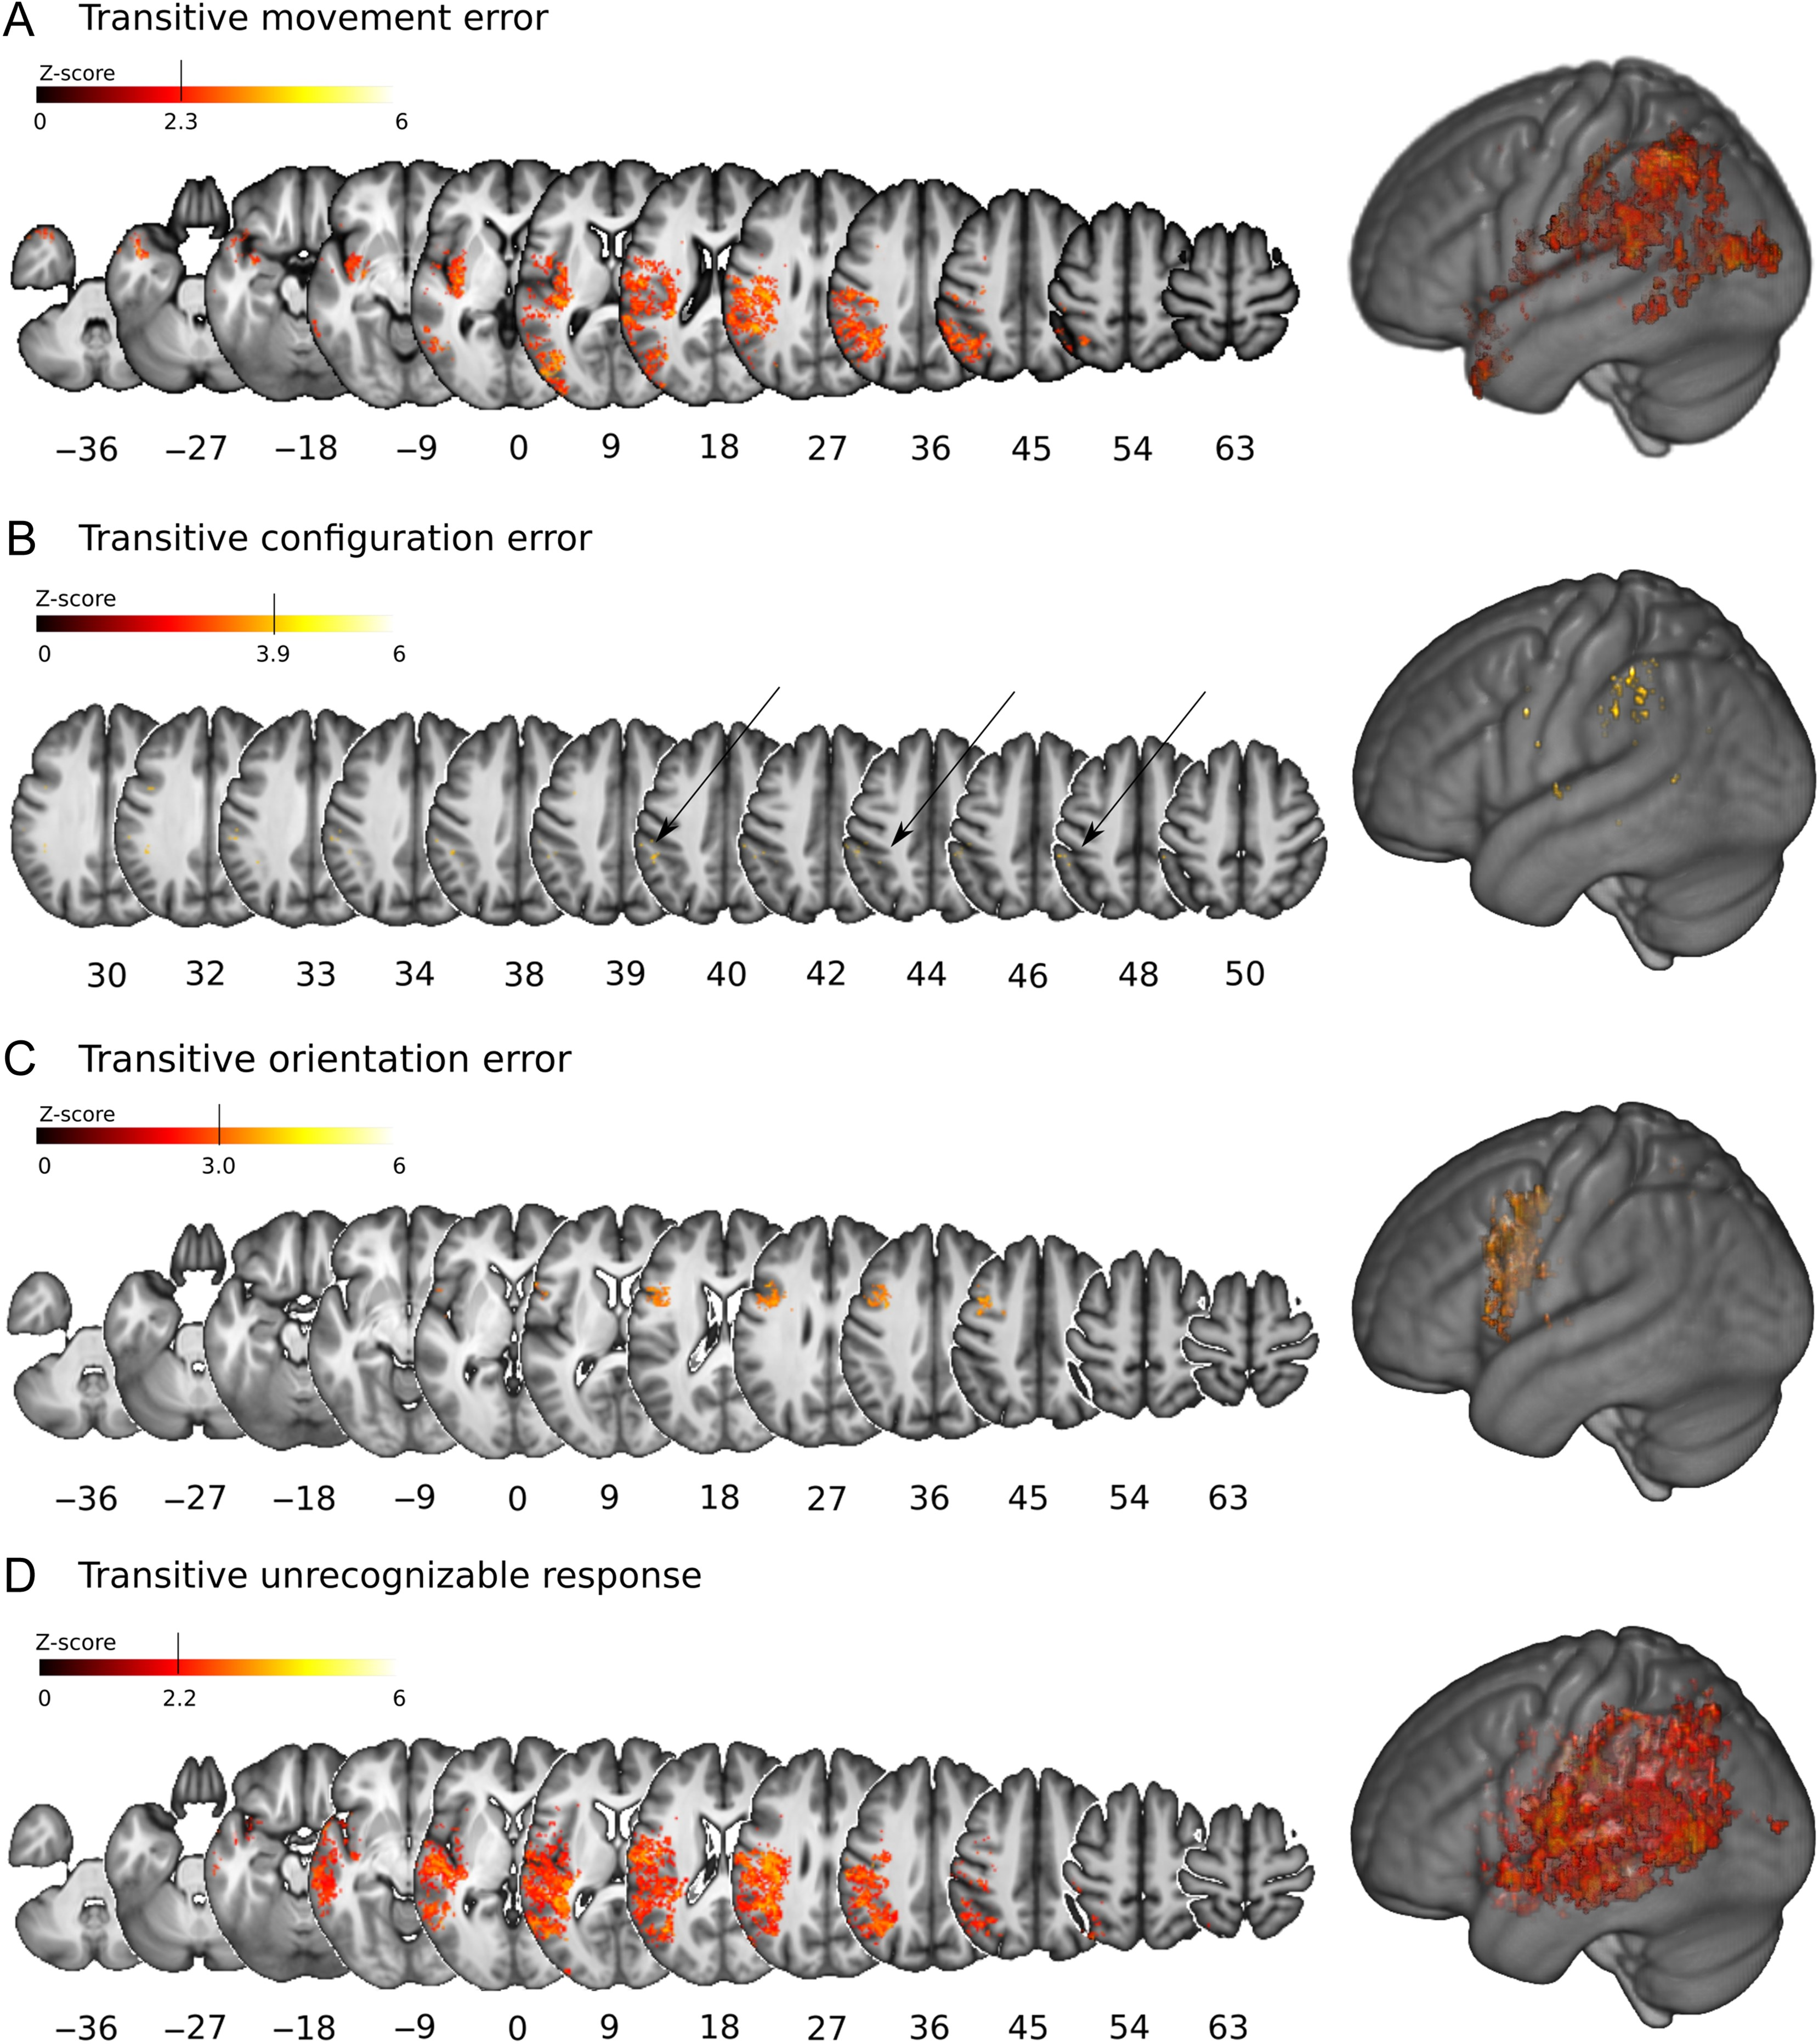
Figure 5. VLSM: error analysis in transitive gestures. Lesion locations significantly associated with single error ...
Notes:
Figure 5. VLSM: error analysis in transitive gestures. Lesion locations significantly associated with single error types in transitive gesture imitation. IPL and lateral temporo-occipital lesions were related to movement errors (A), whereas hand/wrist-orientation errors (C) were associated with premotor lesions. Anterior intraparietal lesions were linked to hand/wrist-configuration errors (B). A widespread parieto-temporal pattern of voxels was related to non-recognizable movements (D). Results are reported at a threshold of P < 0.05 FDR adjusted. Color bars indicate Z-scores.
Unless provided in the caption above, the following copyright applies to the content of this slide: © The Author 2016. Published by Oxford University Press. All rights reserved. For Permissions, please e-mail: journals.permissions@oup.com

Slide 6
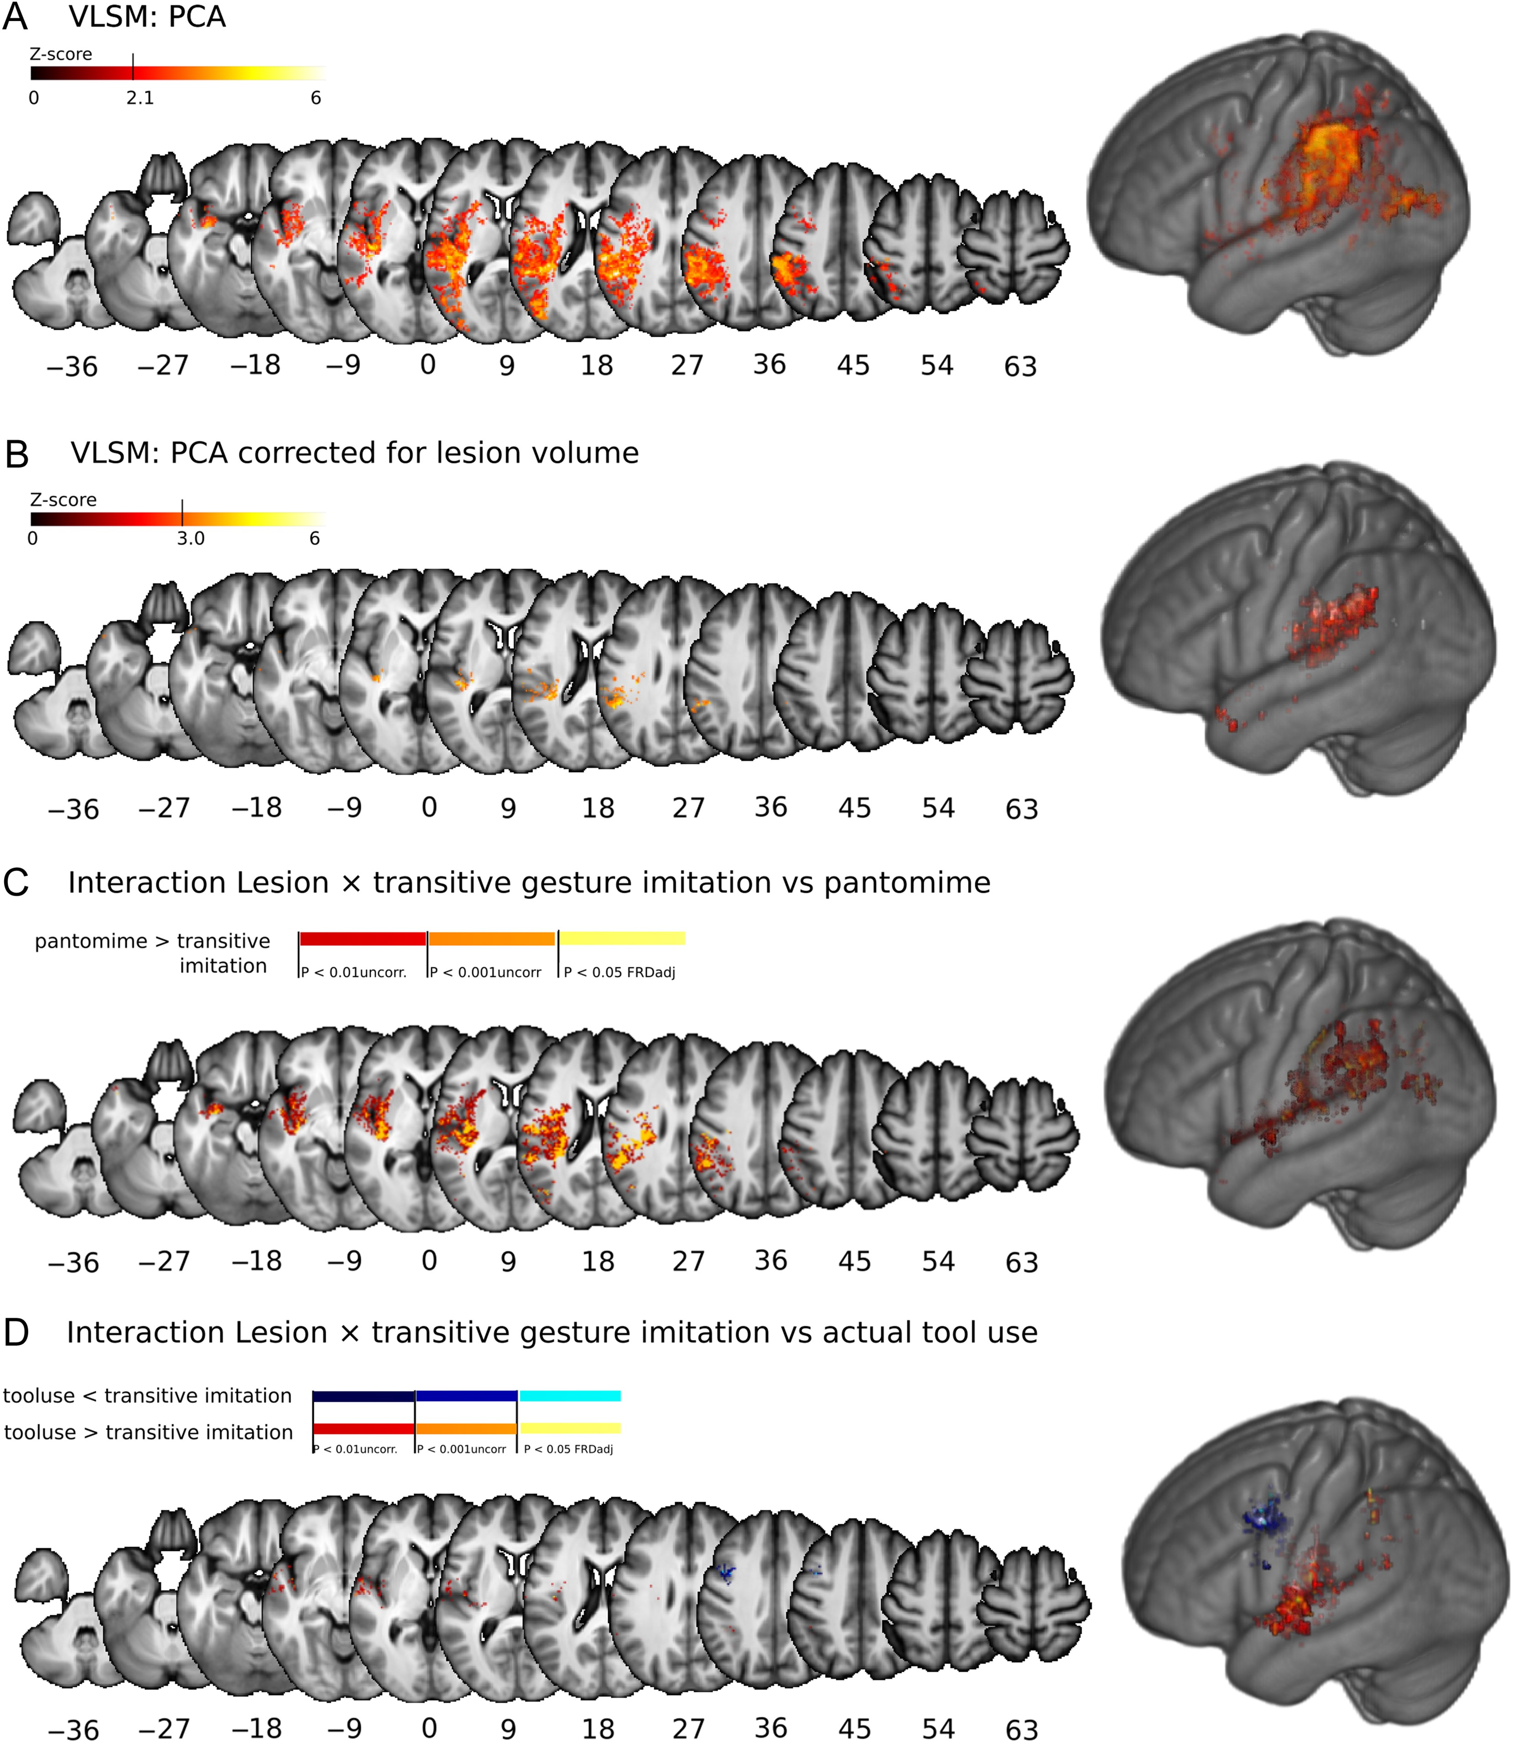
Figure 6. Imitation compared with pantomime and tool use. In a PCA with Varimax rotation the common variance of ...
Notes:
Figure 6. Imitation compared with pantomime and tool use. In a PCA with Varimax rotation the common variance of transitive and intransitive gesture imitation, pantomime, recipient selection, and performance of actual tool use was extracted. A Brunner–Munzel analysis for individual scores on the extracted factor (A) and with lesion volume as covariate (B) reveals an association of lesion in the IPL with the common variance of the different tests. Results are reported at a threshold of P < 0.05 FDR adjusted. Color bars indicate Z-scores. Modality-specific effects were detected by NIX analyses. Differential significant effects could be detected for lesioned voxels (i) in the insula cortex and subjacent extreme capsule for pantomime (C) and to a lesser extent for ToolUse (D) compared with transitive imitation, (ii) in the IPL for pantomime compared with transitive imitation (C) and (iii) in the PMC for transitive imitation compared with ToolUse; (D) to explore potential subthreshold effects, results in C and D are presented not only at the threshold of P < 0.05 FDR adjusted, but also at uncorrected P < 0.01 and P < 0.001.
Unless provided in the caption above, the following copyright applies to the content of this slide: © The Author 2016. Published by Oxford University Press. All rights reserved. For Permissions, please e-mail: journals.permissions@oup.com

