Slide 1
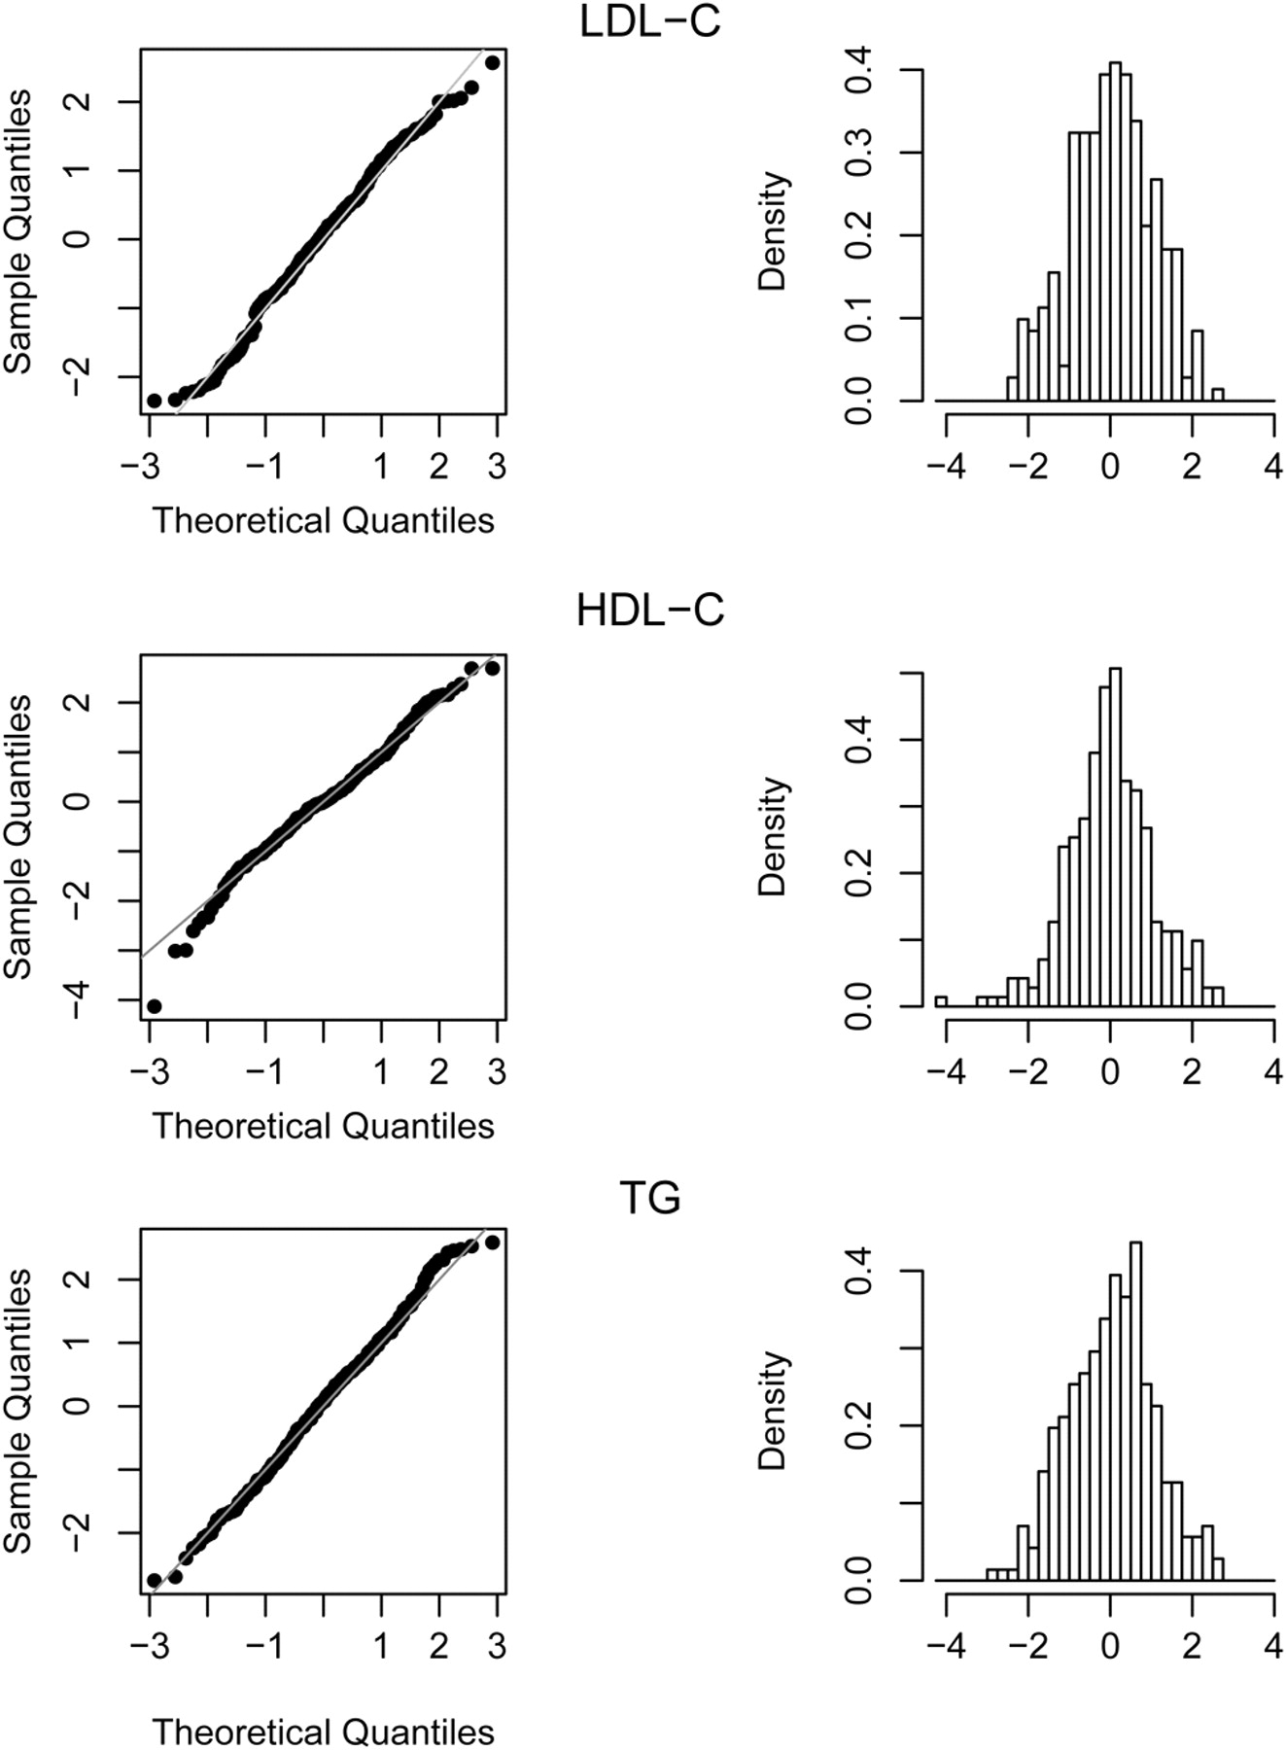
Figure 1. Q–Q plot comparing r_{l} with a standard normal distribution and the corresponding histograms for ...
Notes:
Figure 1. Q–Q plot comparing rl with a standard normal distribution and the corresponding histograms for the trait LDL-C, HDL-C and TG.
Unless provided in the caption above, the following copyright applies to the content of this slide: © The Author 2009. Published by Oxford University Press. All rights reserved. For Permissions, please email: journals.permissions@oxfordjournals.org

Slide 2
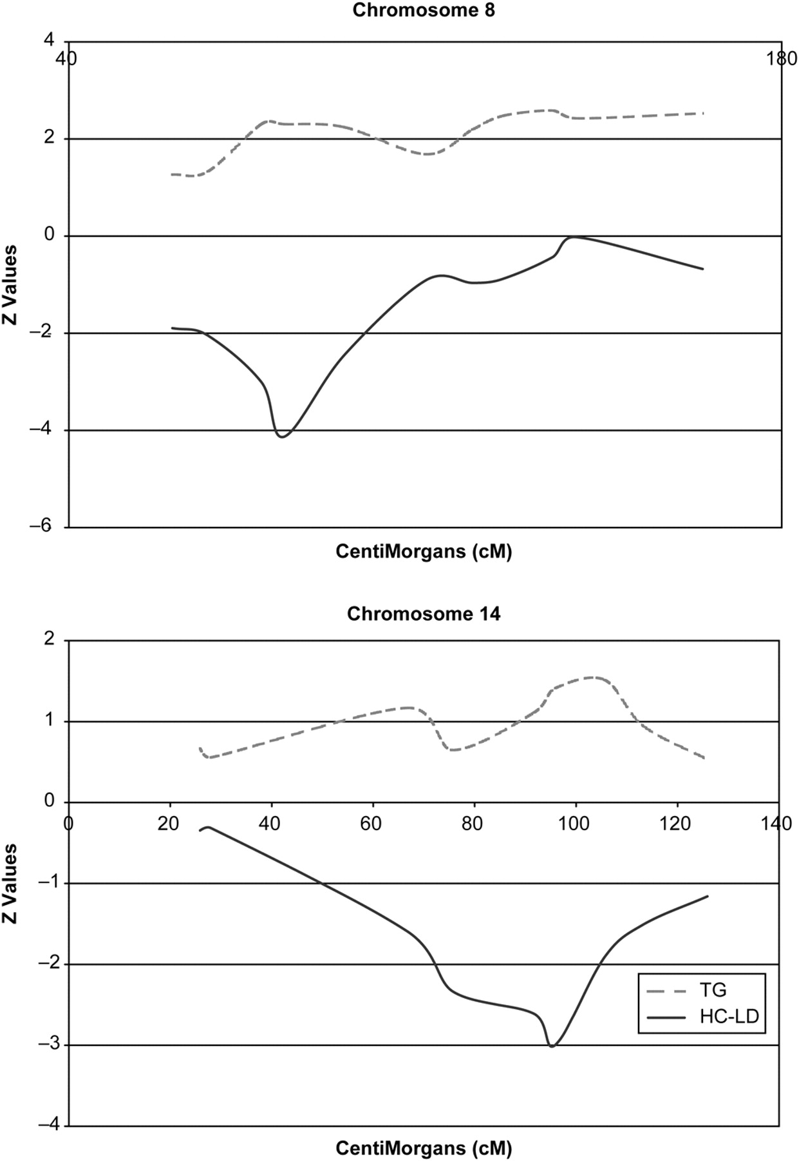
Figure 2. Overview of the Z-scores and its inverse relationship for HDL-C and TG across chromosomes 8 and 14.
Notes:
Figure 2. Overview of the Z-scores and its inverse relationship for HDL-C and TG across chromosomes 8 and 14.
Unless provided in the caption above, the following copyright applies to the content of this slide: © The Author 2009. Published by Oxford University Press. All rights reserved. For Permissions, please email: journals.permissions@oxfordjournals.org

