Slide 1
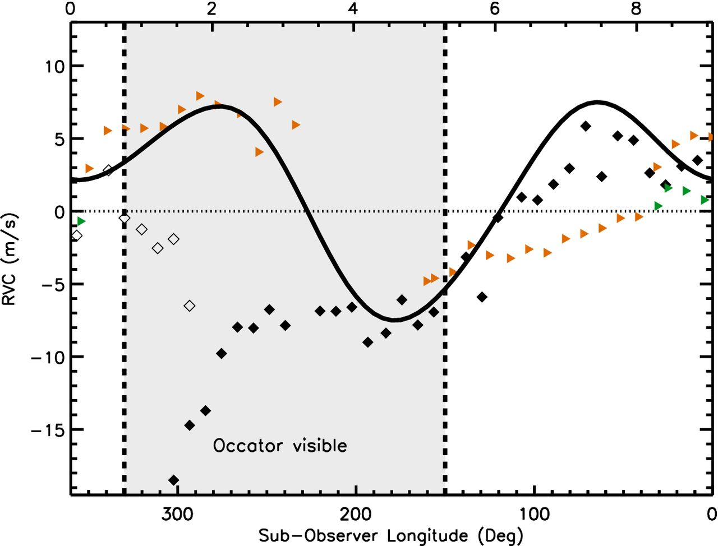
Figure 1. Radial velocities versus the east sub-observer longitude in the reference frame. The longitude decreases with ...
Notes:
Figure 1. Radial velocities versus the east sub-observer longitude in the reference frame. The longitude decreases with time (indicated in hours on the top axis) or the rotation phase. Black diamonds are the measurements taken in July, filled diamonds are for the beginning of the night and empty diamonds for the end. Orange triangles are the observations of August 26 and green triangles of August 27. A baseline of 115.4 m s−1 is subtracted in the observations. The symbol size is comparable to the expected radial velocity error, i.e. at sub-m s−1 level. The black continuous line shows the model of RV changes based on Chamberlain et al.'s photometric template light curve (see the text). The shadowed area is when Occator is visible.
Unless provided in the caption above, the following copyright applies to the content of this slide: © 2016 The Authors Published by Oxford University Press on behalf of the Royal Astronomical Society

