Slide 1
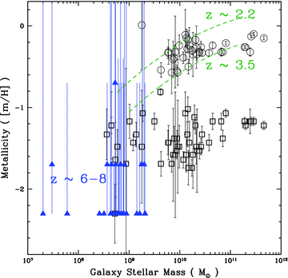
Figure 1 Mean metallicity of MRGCs (circles) and MPGCs (squares) in Virgo cluster galaxies as a function of their ...
Notes:
Figure 1 Mean metallicity of MRGCs (circles) and MPGCs (squares) in Virgo cluster galaxies as a function of their host galaxy stellar mass (for details see Spitler 2010 , GC data from Peng et al. 2006 ). Metallicity measurements for galaxies at redshifts z ∼ 6–8 are given with measurement uncertainty ranges (blue triangles; data from Finkelstein et al. 2010 , see also the simulations of Salvaterra, Ferrara & Dayal 2011 ). Using metallicity as a time-scale indicator, the overlap in stellar metallicity between MPGCs and the high-redshift galaxies supports the idea that MPGCs formed at redshifts z ∼ 7–10, when the Finkelstein et al. (2010) galaxies formed their stars. Dashed lines are observed mass–metallicity (from ionized gas observations) relations for redshifts z ∼ 2.2 and ∼3.5 ( Erb et al. 2006 ; Mannucci et al. 2009 ). As discussed in Spitler (2010) , the overlap between these relations and the MRGCs suggests they formed later than the MPGCs, at z ∼ 2–4.
Unless provided in the caption above, the following copyright applies to the content of this slide: © 2012 The Authors Monthly Notices of the Royal Astronomical Society © 2012 RAS

Slide 2
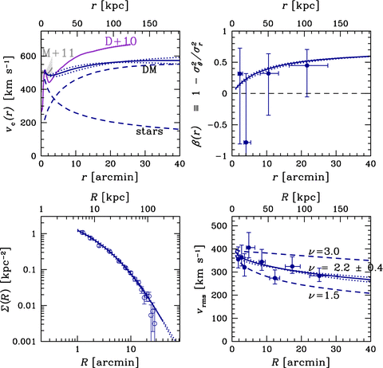
Figure 2 Modelling ingredients for the M87 MPGC system. Model predictions are shown as curves: the solid curves are ...
Notes:
Figure 2 Modelling ingredients for the M87 MPGC system. Model predictions are shown as curves: the solid curves are the best model, with ν= 2.19, rs = 126 kpc and ρ s = 1.4 × 10 6 M ⊙ kpc −3 (a normal concentration halo with Mvir ∼ 4.8 × 10 13 M ⊙ ). The dotted curves are ν= 2.61, rs = 191 kpc and ρ s = 0.7 × 10 6 M ⊙ kpc −3 (a low concentration halo with Mvir ∼ 7.2 × 10 13 M ⊙ ); and ν= 1.80, rs = 85 kpc and ρ s = 2.9 × 10 6 M ⊙ kpc −3 (a high concentration halo with Mvir ∼ 3.4 × 10 13 M ⊙ ). Note the mass modelling only incorporates tracers from within ∼100 kpc of M87 so the halo properties are a reflection of the M87 subhalo, not the entire Virgo cluster halo (e.g. see Doherty et al. 2009 ; Strader et al. 2011 ). R is for projected radii, r is for physical 3D radii. Upper left: circular velocity profile. The total profile for the best model is shown decomposed into its stellar and DM components (dashed curves, as labelled). Independent results are also shown from stellar dynamics ( Murphy, Gebhardt & Adams 2011 ) and X-ray gas ( Das et al. 2010 ). Upper right: MPGC velocity anisotropy in the model (lines) and estimated from the kurtosis of the observed line-of-sight velocity distribution (circles). Lower left: MPGC surface density. Lower right: MPGC line-of-sight velocity dispersion. Data are shown by points with error bars ( Strader et al. 2011 ). In fitting the dispersion data, there is a strong degeneracy between the halo parameters rs and ρ s , which is broken only by imposing cosmological priors. The remaining uncertainty on rs translates directly into an uncertainty on ν. The dashed curves show two models that are ruled out by the dispersion data, even after allowing for a 1σ scatter in the concentration.
Unless provided in the caption above, the following copyright applies to the content of this slide: © 2012 The Authors Monthly Notices of the Royal Astronomical Society © 2012 RAS

Slide 3
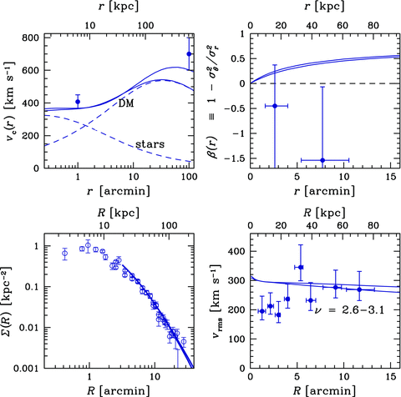
Figure 3 As Fig. 2 , for NGC 1407. Error bars in the upper left-hand panel are mass profile constraints from stellar ...
Notes:
Figure 3 As Fig. 2 , for NGC 1407. Error bars in the upper left-hand panel are mass profile constraints from stellar and satellite galaxy dynamics, as discussed in the text. Two possible solutions are shown by solid curves: one is a normal-concentration halo with ν= 2.61, rs = 122 kpc, ρ s = 1.4 × 10 6 M ⊙ kpc −3 and Mvir ∼ 4.4 × 10 13 M ⊙ ; the other is a low-concentration halo with ν= 3.11, rs = 205 kpc, ρ s = 0.7 × 10 6 M ⊙ kpc −3 and Mvir ∼ 8.6 × 10 13 M ⊙ .
Unless provided in the caption above, the following copyright applies to the content of this slide: © 2012 The Authors Monthly Notices of the Royal Astronomical Society © 2012 RAS

Slide 4
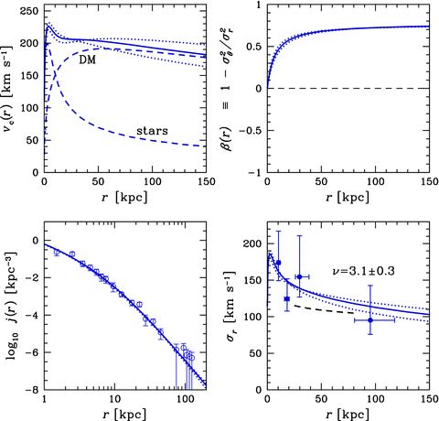
Figure 4 As Fig. 2 , for the Milky Way. Here the lower panels are three-dimensional rather than projected quantities. ...
Notes:
Figure 4 As Fig. 2 , for the Milky Way. Here the lower panels are three-dimensional rather than projected quantities. The dashed curve in the lower right-hand panel shows the velocity dispersion profile fit to halo tracers (mostly stars) from Gnedin et al. (2010) . The solid curve in this panel shows the best model, with ν= 3.12, rs = 33 kpc and ρ s = 2.5 × 10 6 M ⊙ kpc −3 (a normal concentration halo with Mvir ∼ 1.8 × 10 12 M ⊙ ). The dotted curves show a high-concentration halo with ν= 2.79, rs = 22 kpc, ρ s = 5.1 × 10 6 M ⊙ kpc −3 and Mvir ∼ 1.3 × 10 12 M ⊙ ; and a low-concentration halo with ν= 3.48, rs = 49 kpc, ρ s = 1.2 × 10 6 M ⊙ kpc −3 and Mvir ∼ 2.5 × 10 12 M ⊙ .
Unless provided in the caption above, the following copyright applies to the content of this slide: © 2012 The Authors Monthly Notices of the Royal Astronomical Society © 2012 RAS

Slide 5
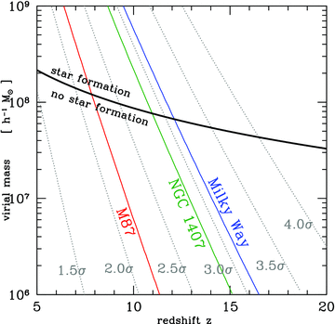
Figure 5 Evolution of subhalo rarity (νσ) over a range of virial masses and redshifts z . Various νσ peaks are ...
Notes:
Figure 5 Evolution of subhalo rarity (νσ) over a range of virial masses and redshifts z . Various νσ peaks are indicated by dotted, grey lines. Solid black line shows the mass–redshift pairs, where haloes have virial temperatures Tvir = 10 4 K and efficient star formation can take place (curve from Moore et al. 2006 ). The constraints for the galaxies studied here are given as the coloured, solid lines: ν= 2.2 ± 0.4, 2.9 ± 0.4 and 3.1 ± 0.3 from left to right (M87, NGC 1407 and the Milky Way, respectively).
Unless provided in the caption above, the following copyright applies to the content of this slide: © 2012 The Authors Monthly Notices of the Royal Astronomical Society © 2012 RAS

Slide 6
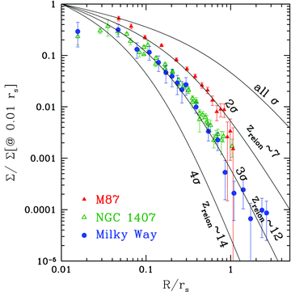
Figure 6 Normalized, projected surface density profiles of the MPGCs in each of the target galaxies, which are ...
Notes:
Figure 6 Normalized, projected surface density profiles of the MPGCs in each of the target galaxies, which are labelled in the figure. Curves show the subhalo spatial distribution for a range of rarity values (e.g. ν≥ 2, 3, 4 standard deviations from the cosmic mean mass-density), which directly constrain the epoch at which MPGC formation was halted by the local reionization epoch ( Diemand et al. 2005 ; Moore et al. 2006 ). From fitting the theoretical expectations for the spatial and kinematic distributions of MPGCs (see Section 4 ), the epoch of reionization is constrained to be , and for the Milky Way, NGC 1407 and M87, respectively.
Unless provided in the caption above, the following copyright applies to the content of this slide: © 2012 The Authors Monthly Notices of the Royal Astronomical Society © 2012 RAS

Slide 7
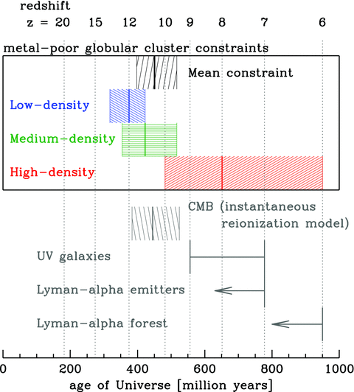
Figure 7 Reionization constraints from the current work and the literature. The reionization epoch measurements for ...
Notes:
Figure 7 Reionization constraints from the current work and the literature. The reionization epoch measurements for the local MPGC observations (coloured constraints) are labelled with their local environments (the Milky Way, NGC 1407 and M87 for low-, medium- and high-density environments, respectively) and dominated by uncertainties on galaxy’s mass model. High-redshift constraints include CMB result from Komatsu et al. (2011) , constraints from UV galaxy observations from Robertson et al. (2010) , Lyman α emitters from Kashikawa et al. (2011) , Pentericci et al. (2011) and Lyman α forest from Fan et al. (2006) . Arrows indicate an estimated limit on the reionization epoch, while each hatched region contains the 68 per cent uncertainty about a measurement.
Unless provided in the caption above, the following copyright applies to the content of this slide: © 2012 The Authors Monthly Notices of the Royal Astronomical Society © 2012 RAS

