Slide 1
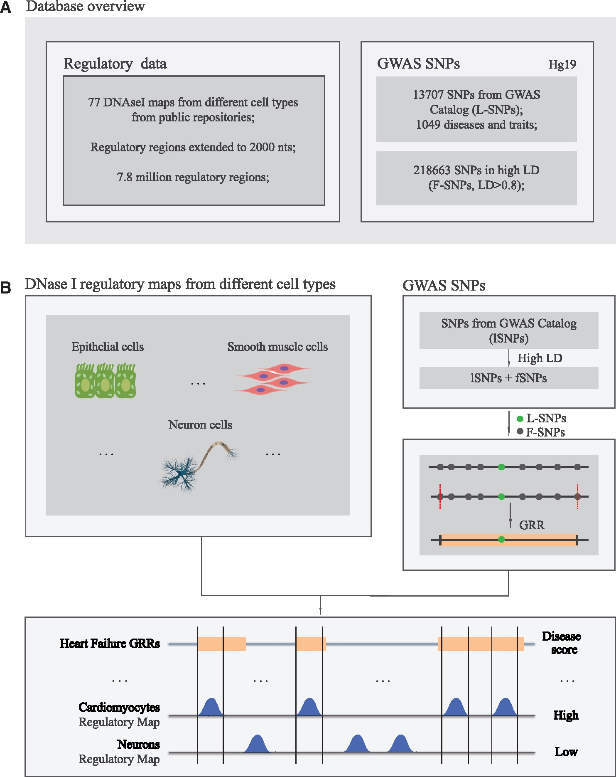
Figure 1. Overview of the GARLIC rationale and the included datasets. (A) SNPs causally involved in common complex ...
Notes:
Figure 1. Overview of the GARLIC rationale and the included datasets. (A) SNPs causally involved in common complex diseases are predicted to occur within CRE present in disease-relevant cell types. These SNPs can alter the regulatory properties of CRE, which can lead to quantitative changes in gene expression and increased disease susceptibility. (B) GARLIC major underlying hypothesis is that the regulatory maps from the cell types or tissues most relevant for a given disease should be preferentially enriched in disease-associated SNPs in comparison with non-relevant cell types.
Unless provided in the caption above, the following copyright applies to the content of this slide: © The Author 2016. Published by Oxford University Press.This is an Open Access article distributed under the terms of the Creative Commons Attribution License (http://creativecommons.org/licenses/by/4.0/), which permits unrestricted reuse, distribution, and reproduction in any medium, provided the original work is properly cited.

Slide 2
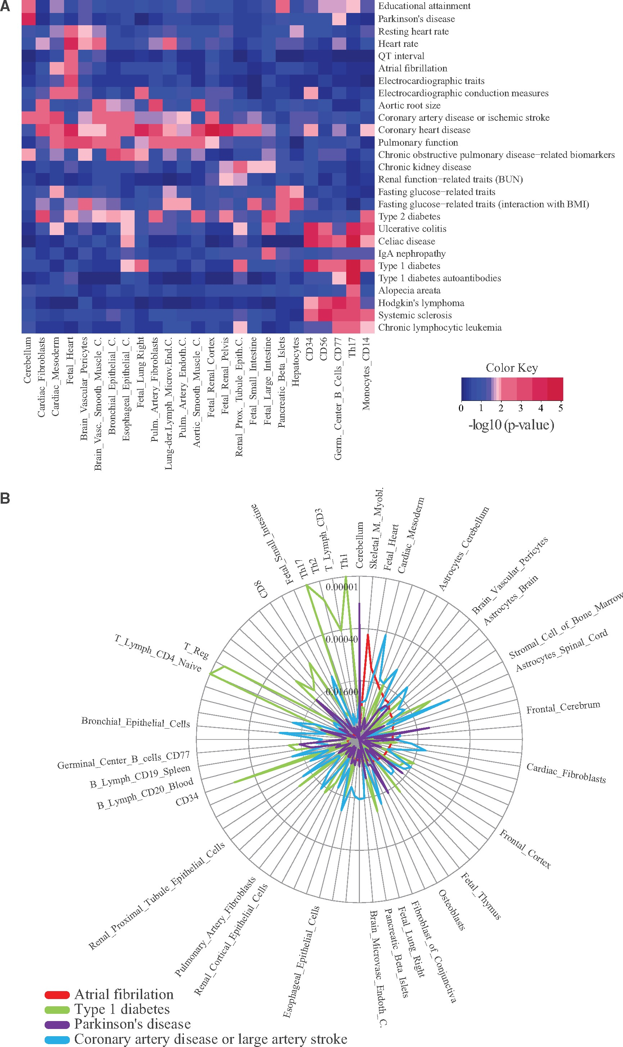
Figure 2. GARLIC can be used to aetiologically connect human complex diseases and cell type-specific CRE maps. (A) ...
Notes:
Figure 2. GARLIC can be used to aetiologically connect human complex diseases and cell type-specific CRE maps. (A) GARLIC results obtained for a selected subset of diseases (rows) and CRE maps (columns) are shown as a heat map. The statistical connection between each disease and cell type is color coded according to GARLIC P-values, with the most and least significant connections represented in red and blue, respectively. (B) Radial plot summarizing the statistical connection between four selected diseases (indicated in the bottom left corner) and all cell types included in the GARLIC DB. The name of only a subset of all the investigated cell types is shown. Peaks closer to the outer border of the radial plot represent more significant connections, while those closer to the center are the least significant ones.
Unless provided in the caption above, the following copyright applies to the content of this slide: © The Author 2016. Published by Oxford University Press.This is an Open Access article distributed under the terms of the Creative Commons Attribution License (http://creativecommons.org/licenses/by/4.0/), which permits unrestricted reuse, distribution, and reproduction in any medium, provided the original work is properly cited.

Slide 3
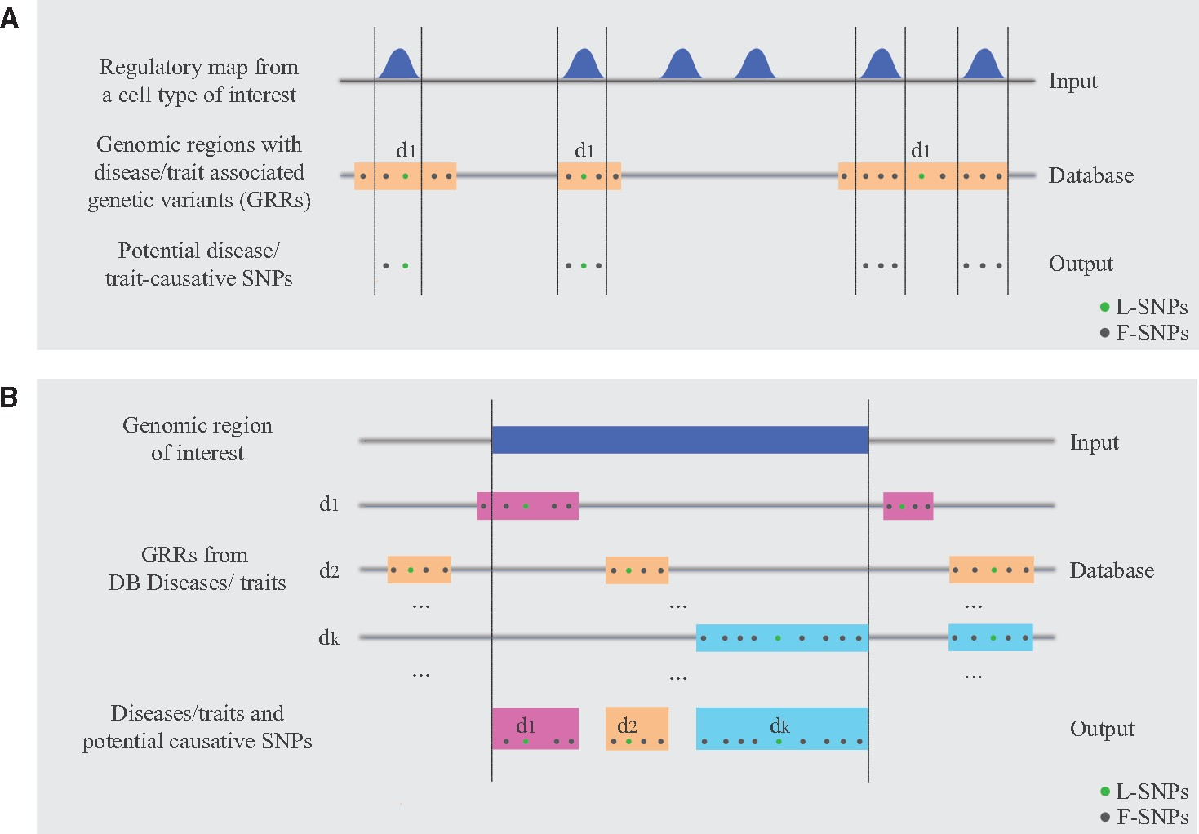
Figure 3. Identification of SNPs located within CREs of interest. (A) SNPs overlapping CREs and their ...
Notes:
Figure 3. Identification of SNPs located within CREs of interest. (A) SNPs overlapping CREs and their associated-diseases can be retrieved using as input either regulatory maps or (B) a single locus of interest. SNPs associated with congenital heart malformation overlapping CREs from Fetal heart NameChrPositionOverlapping Regionrs12725053chr1118939846118938659 – 118940963rs11100326chr4140797683140796912 – 140800330rs1455480chr4140800330140796912 – 140800330rs150260800chr4140798452140796912 – 140800330rs17368602chr4140800012140796912 – 140800330rs4863518chr4140799733140796912 – 140800330rs4863519chr4140799749140796912 – 140800330rs4863699chr4140799855140796912 – 140800330rs6834463chr4140797201140796912 – 140800330
Unless provided in the caption above, the following copyright applies to the content of this slide: © The Author 2016. Published by Oxford University Press.This is an Open Access article distributed under the terms of the Creative Commons Attribution License (http://creativecommons.org/licenses/by/4.0/), which permits unrestricted reuse, distribution, and reproduction in any medium, provided the original work is properly cited.

Slide 4
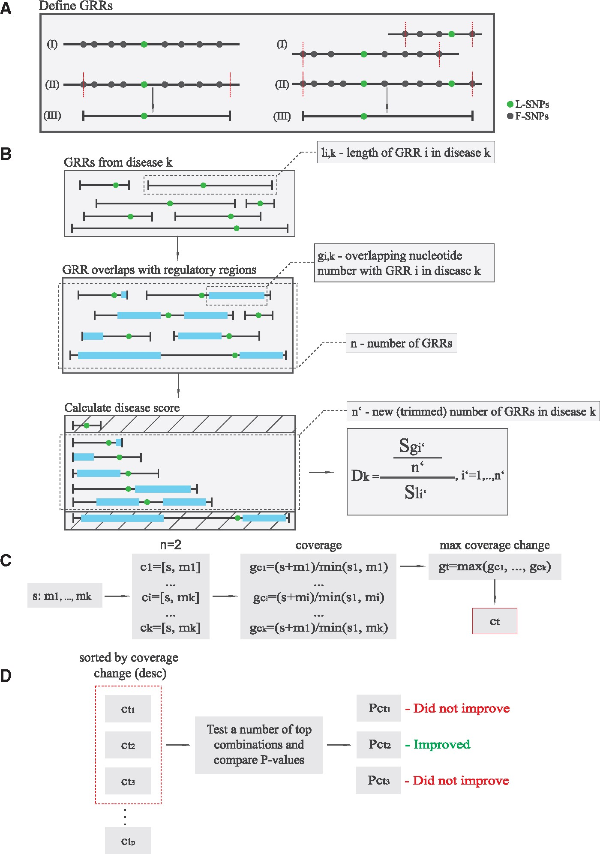
Figure 4. Graphical overview of GARLIC procedures. (A) As part of the data preprocessing, unique sets of GRRs for each ...
Notes:
Figure 4. Graphical overview of GARLIC procedures. (A) As part of the data preprocessing, unique sets of GRRs for each disease and trait are generated. This is illustrated when either a single (Left) or multiple L-SNPs in LD (Right) are considered. (B) Each GRR gets assigned a GRR length and number of overlapping bp with a given regulatory map. The 20% shortest and longest GRRs are excluded and the remaining 60% of GRRs are used to calculate disease scores from which empirical P-values can be derived using the random sampling procedure. (C) Each seed map gets assigned a set of “complementary” regulatory maps, which are then used to generate “combined” maps. The number of overlapping bp with a given disease or trait of interest is calculated for each combination and only the one with the highest increase in coverage is kept for the next step of the procedure. (D) Seed combinations with the highest increase in bp coverage can then be tested for statistical connection with human diseases/traits using the same method employed with individual CRE maps. The number of seed combinations to be tested can be determined with input parameters based on coverage increase.
Unless provided in the caption above, the following copyright applies to the content of this slide: © The Author 2016. Published by Oxford University Press.This is an Open Access article distributed under the terms of the Creative Commons Attribution License (http://creativecommons.org/licenses/by/4.0/), which permits unrestricted reuse, distribution, and reproduction in any medium, provided the original work is properly cited.

