Slide 1
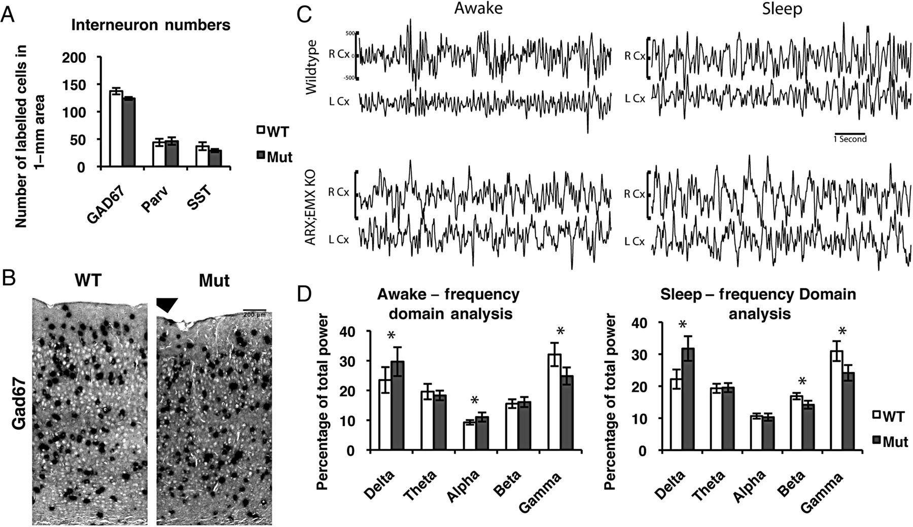
Figure 1. Arx^{−/Y} Emx1-Cre mice do not have seizures and have normal interneuron numbers. (A) Quantifications ...
Notes:
Figure 1. Arx−/Y Emx1-Cre mice do not have seizures and have normal interneuron numbers. (A) Quantifications of interneurons in a 1-mm bin of cortex from ventricular to pial surface from in situ hybridizations of GAD67 and immunofluorescence staining of Parv and SST on adult brain sections, showing no difference in the total number of interneurons (GAD67; WT = 137.3 ± 5.84 and Mut = 24 ± 2.65; n = 3 for each; P = 0.1359) and no change in the number of interneurons of 2 subtypes (Parv; WT = 50 ± 5 and Mut = 53 ± 2; n = 3 for each; P = 0.6575; and SST; WT = 37 ± 7.23 and Mut = 29 ± 2.89; n = 3 for each; P = 0.3897). Error bars correspond to SE. (B) GAD67 in situ hybridizations on cryosections of P21 brains of wild-type (ArxX/Y Emx1-Cre) and mutant (ArxF/Y Emx1-Cre) brains. Section of the cortex just above the hippocampus from pial surface (top) to white matter (bottom). (C) Samples of cortex recordings for Arx−/Y Emx1-Cre mice (Mut) and their control wild-type littermates (ArxX/Y Emx1-Cre), which showed no seizure activity. (D) Quantifications of EEGs of the cortex by FFT on both Awake and Sleep segments for wild-type and mutant mice (Awake—Delta: WT = 23.50 ± 4.34 and Mut = 29.69 ± 4.85, P = 0.0036; Theta: WT = 19.61 ± 2.60 and Mut = 18.32 ± 1.63, P = 0.1894; Alpha: WT = 9.28 ± 0.77 and Mut = 11.06 ± 1.53, P = 0.0017; Beta: WT = 15.54 ± 1.46 and Mut = 16.11 ± 1.68, P = 0.4199; Gamma: WT = 32.08 ± 3.92 and Mut = 24.83 ± 2.89, P = 9.1 × 10−6; Sleep—Delta: WT = 22.19 ± 3.84 and Mut = 31.77 ± 3.84, P = 2.3 × 10−8; Theta: WT = 19.32 ± 1.42 and Mut = 19.55 ± 1.41, P = 0.7178; Alpha: WT = 10.65 ± 0.83 and Mut = 10.32 ± 1.13, P = 0.4597; Beta: WT = 16.88 ± 1.00 and Mut = 14.20 ± 1.24, P = 9.2 × 10−7; Gamma: WT = 30.96 ± 3.11 and Mut = 24.16 ± 2.46, P = 4.7 × 10−7; WT n = 6 and Mut n = 4).
Unless provided in the caption above, the following copyright applies to the content of this slide: © The Author 2014. Published by Oxford University Press. All rights reserved. For Permissions, please e-mail: journals.permissions@oup.com

Slide 2
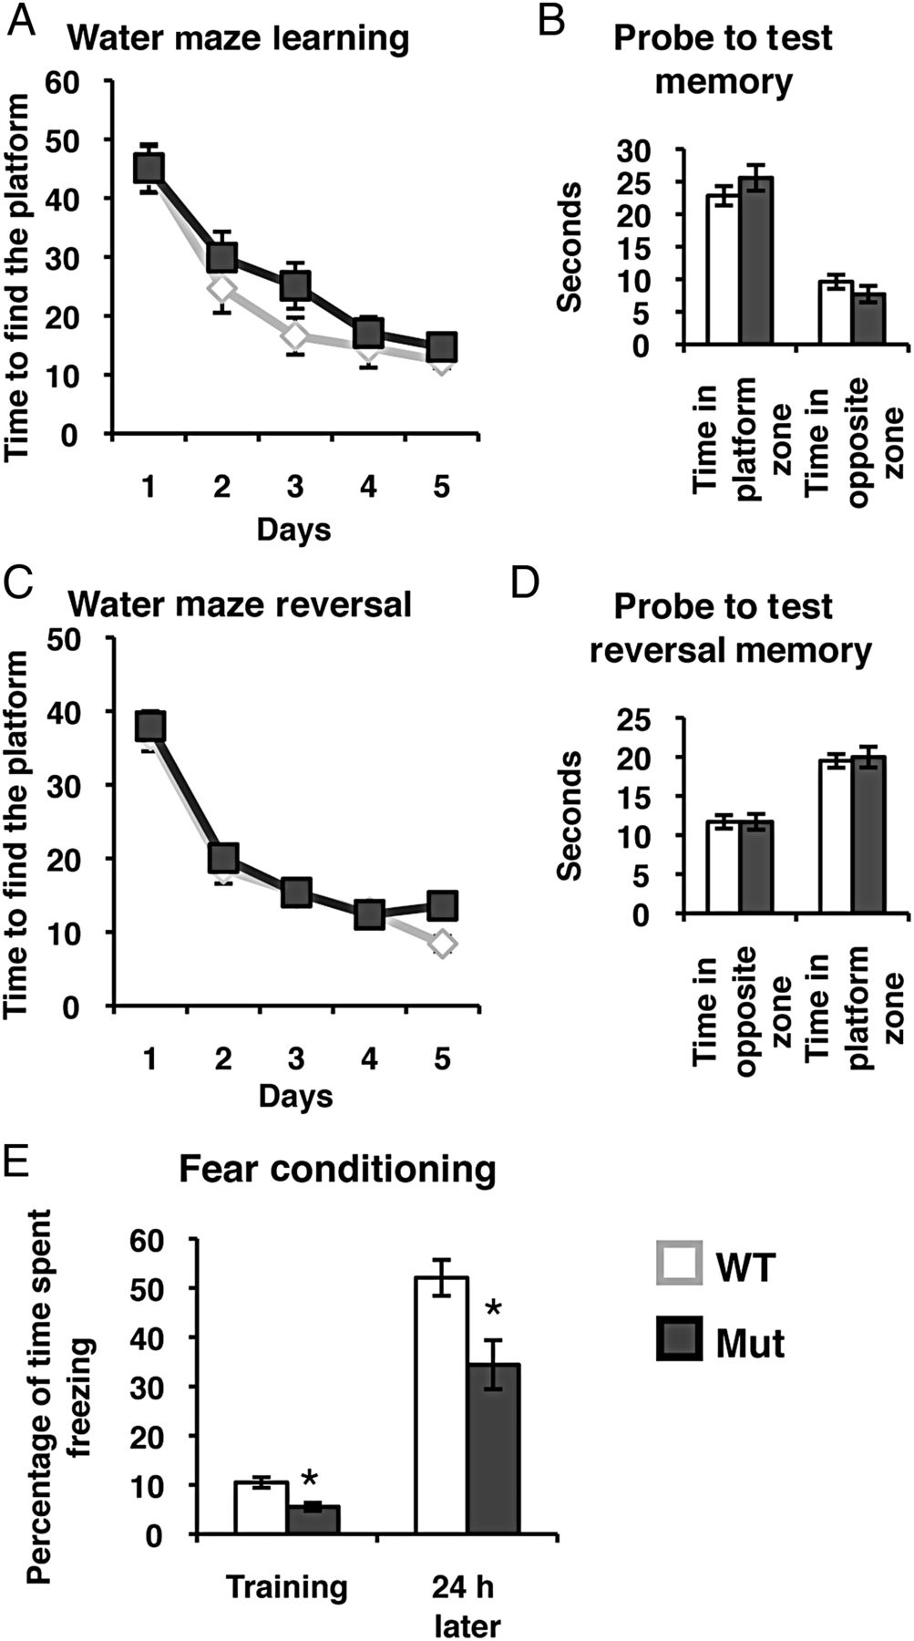
Figure 2. Arx^{−/Y} Emx1-Cre mice have normal spatial learning and memory, but impaired fear-based memory. (A) ...
Notes:
Figure 2. Arx−/Y Emx1-Cre mice have normal spatial learning and memory, but impaired fear-based memory. (A) Mutant mice and wild-type littermates were trained in the Morris water maze for 5 days and the mutants learned how to reach the platform just as quickly as their wild-type littermates (WT n = 20 and Mut n = 21; P = 0.0669). (B) On day 6 with the platform removed the mutant mice spent just as much time as their wild-type littermates in the correct quadrant showing that they remembered where the platform was located (time in platform quadrant: WT = 22.8 ± 1.47 s and Mut = 25.6 ± 1.97 s; P = 0.271; time in opposite quadrant: WT = 9.61 ± 1.07 s, n = 20 and Mut = 7.7 ± 1.28 s, n = 21; P = 0.256). (C) The reversal learning of the mice was then tested by retraining them for another 5 days with the platform on the opposite quadrant of the tank. The mutant mice relearned the task just as well as their wild-type littermates (WT n = 20 and Mut n = 21; P = 0.1545). (D) On day 12, the platform was again removed and the time the mice spent in each quadrant was recorded. The mutant mice spent just as much time in the new platform quadrant as their wild-type littermates (time in platform quadrant: WT = 19.5 ± 0.87 s and Mut = 19.9 ± 1.33 s; P = 0.762; time in opposite quadrant: WT = 11.7 ± 0.85 s, n = 20 and Mut = 11.7 ± 1.02 s, n = 21; P = 0.997). (E) Contextual fear conditioning was used to evaluate fear learning in wild-type and mutant mice. During a 3-min training period, the mice were given a foot shock and the amount of time spent freezing was recorded. Twenty-four hours later, the mice were re-exposed to the context where they were given the foot shock and the amount of time they spent freezing over a 5-min period was recorded. Mutant mice spent significantly less time freezing when compared with their wild-type littermates both in the training period and during testing, so therefore they did learn this task (percentage of time spent freezing training: WT = 10.5 ± 1.06, n = 17 and Mut = 5.57 ± 0.82, n = 14; P = 0.00099; percentage of time spent freezing testing: WT = 52.1 ± 3.65, n = 17 and Mut = 34.4 ± 4.99, n = 14; P = 0.0086). Error bars are SE.
Unless provided in the caption above, the following copyright applies to the content of this slide: © The Author 2014. Published by Oxford University Press. All rights reserved. For Permissions, please e-mail: journals.permissions@oup.com

Slide 3
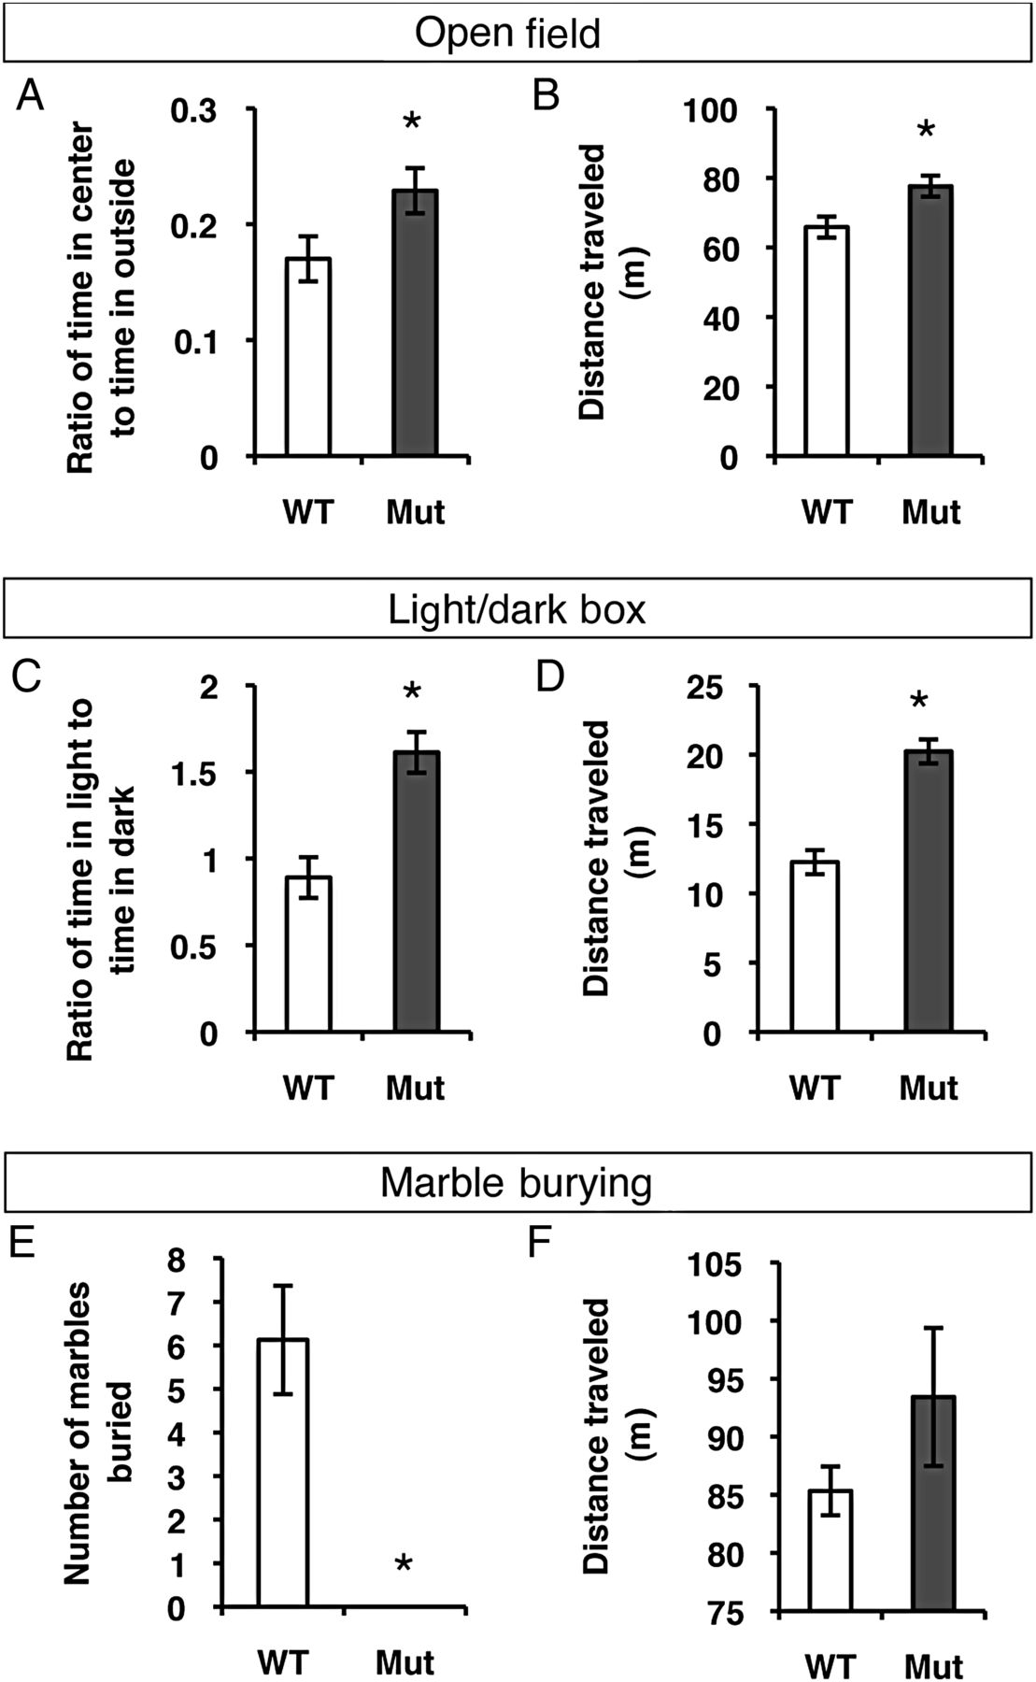
Figure 3. Arx^{−/Y} Emx1-Cre mice are less anxious and more active than wild-type mice. (A) In the open field ...
Notes:
Figure 3. Arx−/Y Emx1-Cre mice are less anxious and more active than wild-type mice. (A) In the open field test, the ratio of time spent in the center to time spent in the outside area of the box was used as a measure of anxiety. The mutant mice spent more time in the center of the box than their wild-type littermates, indicating they are less anxious (WT = 0.170 ± 0.019, n = 20 and Mut = 0.229 ± 0.020, n = 21; P = 0.0405). (B) The linear distance traveled by the mice during their 15-min testing period was calculated as a measure of their activity level. The mutant mice traveled further than their wild-type littermates during the open field test, indicating that they are hyperactive (WT = 65.9 ± 3.02 m, n = 20 and Mut = 77.6 ± 3.79 m, n = 21; P = 0.0201). (C) For the light/dark box assay, the ratio of time spent in the light side of the box to time spent in the dark side of the box was used as a measure of anxiety. The mutant mice spent more time in the light side of the box than their wild-type littermates, indicating that they are less anxious (WT = 0.891 ± 0.118, n = 20 and Mut = 1.61 ± 0.202, n = 21; P = 0.00204). (D) The linear distance traveled by the mice during their 10-min testing period was calculated as a measure of their activity level. The mutant mice traveled further than their wild-type littermates during the light/dark box test, again indicating that they are hyperactive (WT = 12.2 ± 0.867 m, n = 20 and Mut = 20.2 ± 1.13 m, n = 21; P = 0.000007). (E) The number of marbles buried in the Marble Burying assay was used as a measure of anxiety with increased burying meaning increased anxiety (WT = 6.13 ± 1.25, n = 8 and Mut = 0 ± 0, n = 8; P = 0.00759). (F) The amount of distance traveled by the mice during the 30-min testing period was used as a measure of activity level (WT = 85.34 ± 2.10 m, n = 8 and Mut = 93.42 ± 5.94 m, n = 8; P = 0.2322). Error bars are SE.
Unless provided in the caption above, the following copyright applies to the content of this slide: © The Author 2014. Published by Oxford University Press. All rights reserved. For Permissions, please e-mail: journals.permissions@oup.com

Slide 4
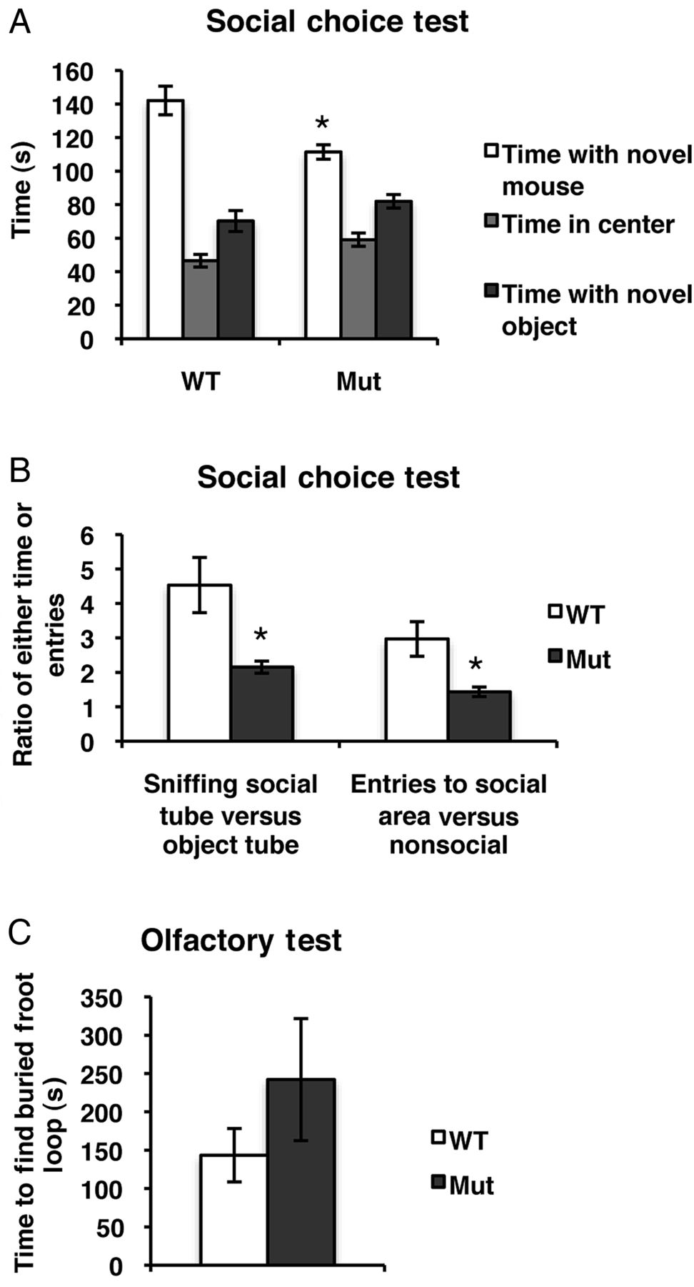
Figure 4. Arx^{−/Y} Emx1-Cre mice have social deficits. (A) The social abilities of mutant and wild-type mice ...
Notes:
Figure 4. Arx−/Y Emx1-Cre mice have social deficits. (A) The social abilities of mutant and wild-type mice were assessed using the social choice test. The time spent in the novel mouse section (social), the center of the box, and the novel object section (nonsocial) were compared using a two-way ANOVA. The mutant mice spent significantly less time in the social section of the box than their wild-type littermates did (time spent in social section: WT = 142.07 ± 8.54 s, n = 15 and Mut = 111.37 ± 4.28 s, n = 18; P < 0.001). (B) The mutant mice spent significantly less time sniffing the novel mouse tube than their wild-type littermates did, compared with the object tube (sniffing: WT = 4.53 ± 0.80, n = 15 and Mut = 2.15 ± 0.18, n = 18; P = 0.01379). The mutant mice also entered the social section of the box few times when compared with the nonsocial section than their wild-type littermates did (entries: WT = 2.97 ± 0.50, n = 15 and Mut = 1.44 ± 0.14, n = 18; P = 0.00952). (C) To assess the olfactory ability of the mice, the buried food test was used. If the mice have normal olfactory abilities, they should be able to find the Froot Loop buried in the bedding. Both the mutant mice and their wild-type littermates were equally capable of finding the Froot Loop (WT = 143.38 ± 34.86 s and Mut = 242.13 ± 79.60 s, n = 8 for each; P = 0.2834). Error bars are SE.
Unless provided in the caption above, the following copyright applies to the content of this slide: © The Author 2014. Published by Oxford University Press. All rights reserved. For Permissions, please e-mail: journals.permissions@oup.com

Slide 5
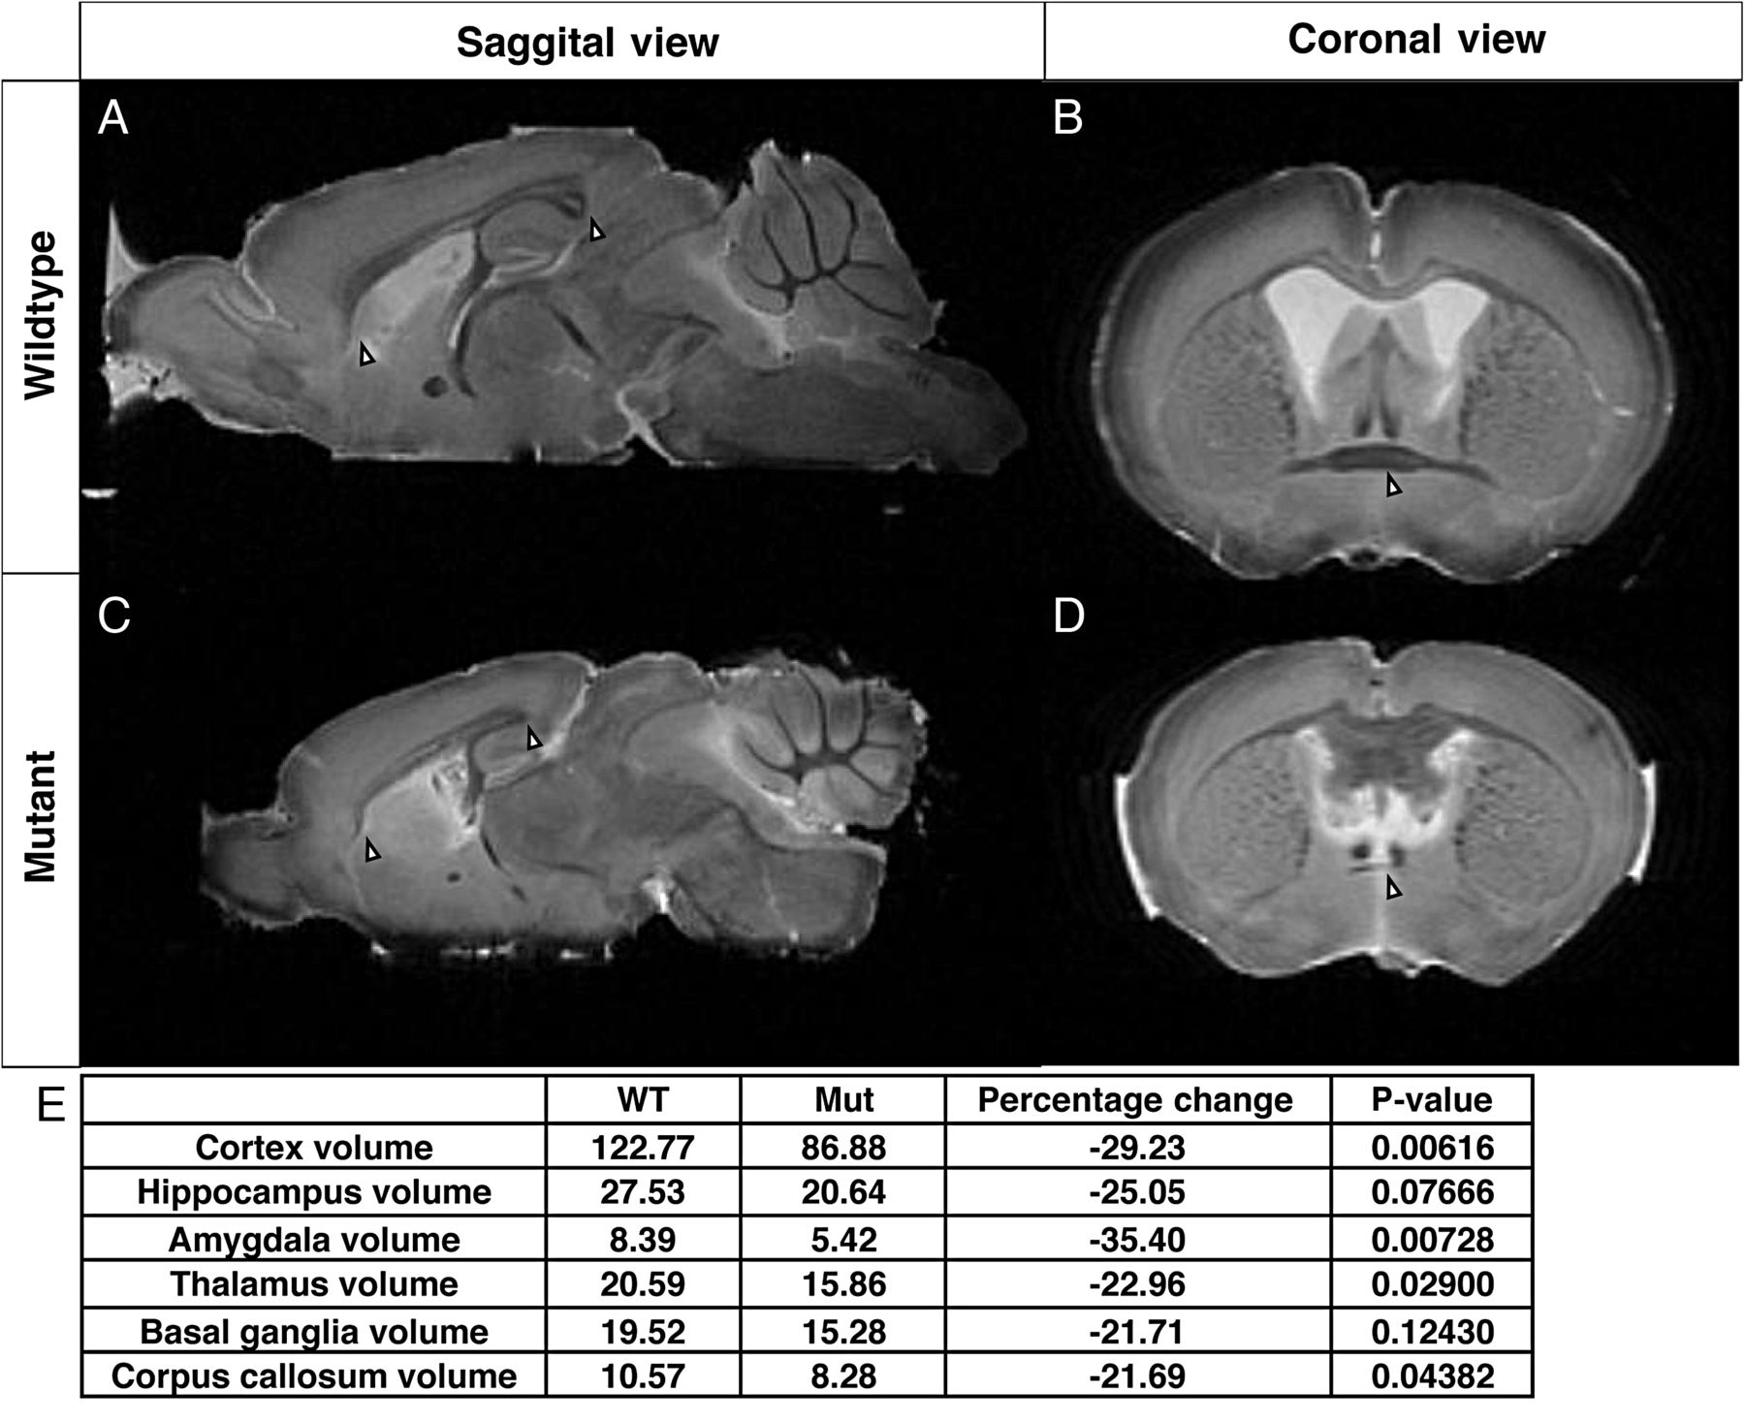
Figure 5. Arx^{−/Y} Emx1-Cre mice have hypoplastic corpus callosums and anterior commissures. MRIs were made of ...
Notes:
Figure 5. Arx−/Y Emx1-Cre mice have hypoplastic corpus callosums and anterior commissures. MRIs were made of 3 brains from mutant mice and 3 from their wild-type littermates. (A) A midsagittal section from an MRI of a wild-type brain (0.65 mm lateral to bregma). The white arrows mark the rostral and caudal ends of a normal corpus callosum. (C) A midsagittal section from an MRI of a mutant brain (0.65 mm lateral to bregma). The white arrows again mark the ends of the corpus callosum, showing that the corpus callosum is both shorter and thinner in the mutant mice. (B) A rostral coronal section from an MRI of a wild-type brain (0.14 mm posterior to bregma). The white arrow marks the middle of the anterior commissure. (D) A rostral coronal section from an MRI of a mutant brain (0.14 mm posterior to bregma). The white arrow marks the middle of the anterior commissure, showing that in the mutant it is much thinner. (E) Table of volumes (mm3) of brain regions of wild-type and mutant mice from T2-weighted MRI data and comparisons between the wild-type and mutant volumes for each region.
Unless provided in the caption above, the following copyright applies to the content of this slide: © The Author 2014. Published by Oxford University Press. All rights reserved. For Permissions, please e-mail: journals.permissions@oup.com

Slide 6
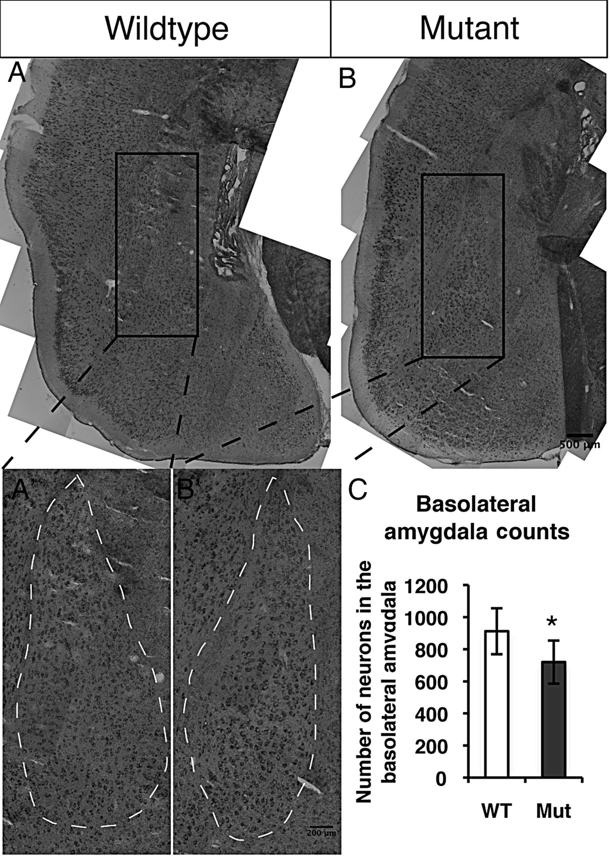
Figure 6. Arx^{−/Y} Emx1-Cre mice have a loss of neurons in the basolateral amygdala. (A and B) Coronal brain ...
Notes:
Figure 6. Arx−/Y Emx1-Cre mice have a loss of neurons in the basolateral amygdala. (A and B) Coronal brain sections of adult mutant mice and their wild-type littermates were stained with Nissl, which labels all neurons. (A′ and B′) Enlarged sections showing the basolateral amygdala region (dotted white outline) which was counted. (C) Quantification of the number of neurons counted in the basolateral amygdala of the Arx−/Y Emx1-Cre mice and their wild-type littermates, showing that the mutant mice have fewer neurons in the basolateral amygdala when compared with wild-type littermates (WT = 1118 ± 124 and Mut = 891 ± 152, n = 3 for each; P = 0.01952). Error bars are SE.
Unless provided in the caption above, the following copyright applies to the content of this slide: © The Author 2014. Published by Oxford University Press. All rights reserved. For Permissions, please e-mail: journals.permissions@oup.com

