Slide 1
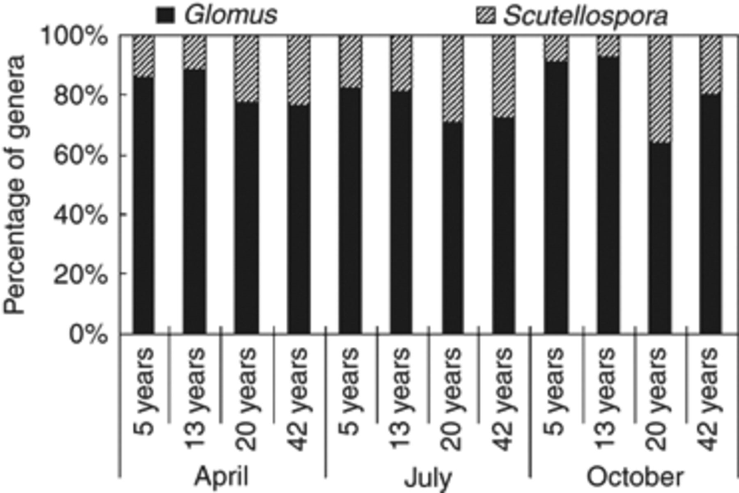
3 Proportional distribution of the genus of Glomus and Scutellospora spores in different sites of each month.
Notes:
3 Proportional distribution of the genus of Glomus and Scutellospora spores in different sites of each month.
Unless provided in the caption above, the following copyright applies to the content of this slide: © 2008 Federation of European Microbiological Societies. Published by Blackwell Publishing Ltd. All rights reserved

Slide 2
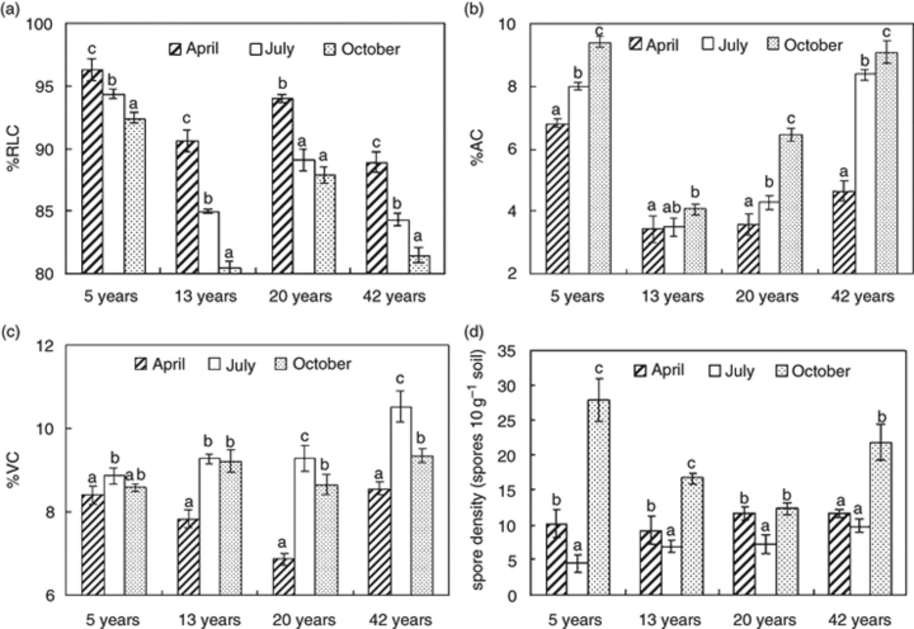
2 Percent of AM fungal colonization and spore density of different samples from four sites in each month (bars ...
Notes:
2 Percent of AM fungal colonization and spore density of different samples from four sites in each month (bars represent SDs). (a) %RLC, percent of root length colonization; (b) %AC, percent of arbuscular colonization; (c) %VC, percent of vesicular colonization; (d) spore density. Significant differences between columns of the same cluster (plantation age class) were determined using Fisher's Least Significant Difference at the 5% level after one-way anova and indicated by dissimilar letters above the bars.
Unless provided in the caption above, the following copyright applies to the content of this slide: © 2008 Federation of European Microbiological Societies. Published by Blackwell Publishing Ltd. All rights reserved

Slide 3
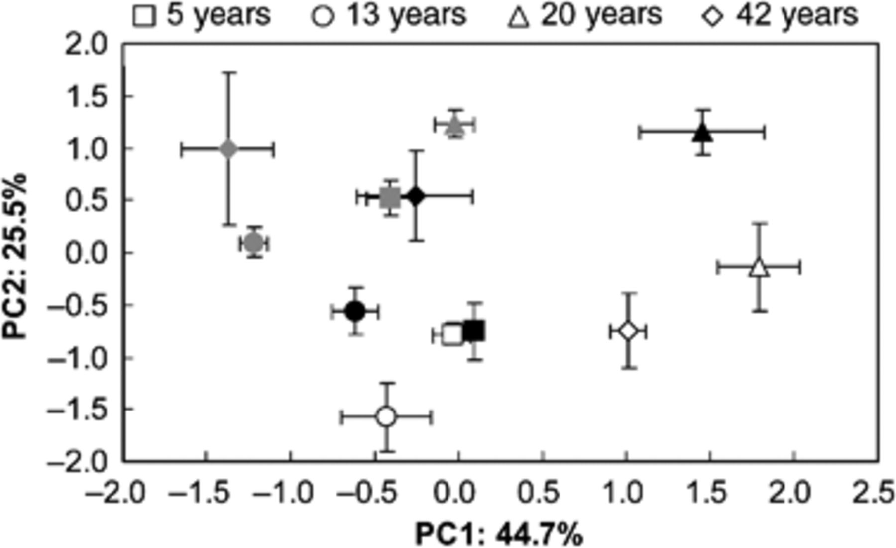
1 PCA of soil characteristics (including soil total nitrogen, organic carbon, carbon/nitrogen, total ...
Notes:
1 PCA of soil characteristics (including soil total nitrogen, organic carbon, carbon/nitrogen, total phosphorus, available phosphorus and soil moisture) marked by sampling site and time. The points represent the mean of PC1 and PC2 scores of each site in each month. Bars represent the SEs. Black closed symbols, gray closed symbols and open symbols represent the April, July and October samples, respectively.
Unless provided in the caption above, the following copyright applies to the content of this slide: © 2008 Federation of European Microbiological Societies. Published by Blackwell Publishing Ltd. All rights reserved

Slide 4
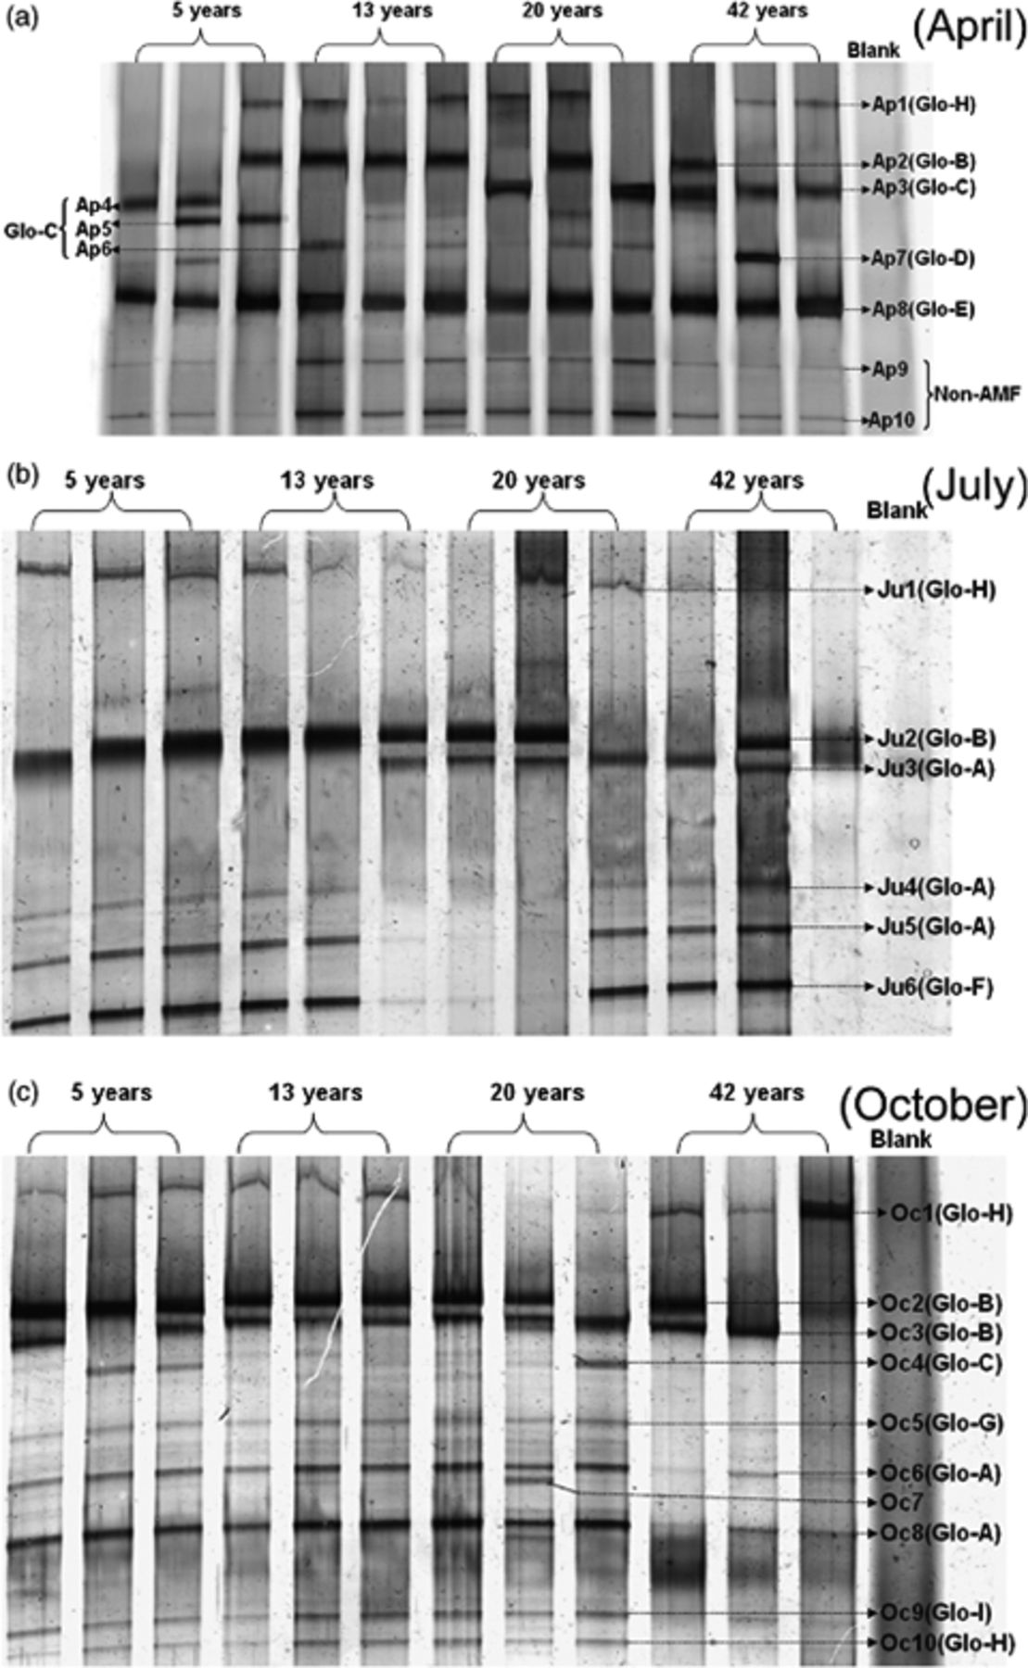
4 DGGE profiles of partial SSU rRNA gene sequences of AM fungi colonizing roots of Caragana korshinskii. ...
Notes:
4 DGGE profiles of partial SSU rRNA gene sequences of AM fungi colonizing roots of Caragana korshinskii. Ap1–Ap10, Ju1–Ju6 and Oc1–Oc10 represent bands from samples of April, July and October, respectively. Glo-A–Glo-I represent the sequence groups to which the bands belong.
Unless provided in the caption above, the following copyright applies to the content of this slide: © 2008 Federation of European Microbiological Societies. Published by Blackwell Publishing Ltd. All rights reserved

Slide 5
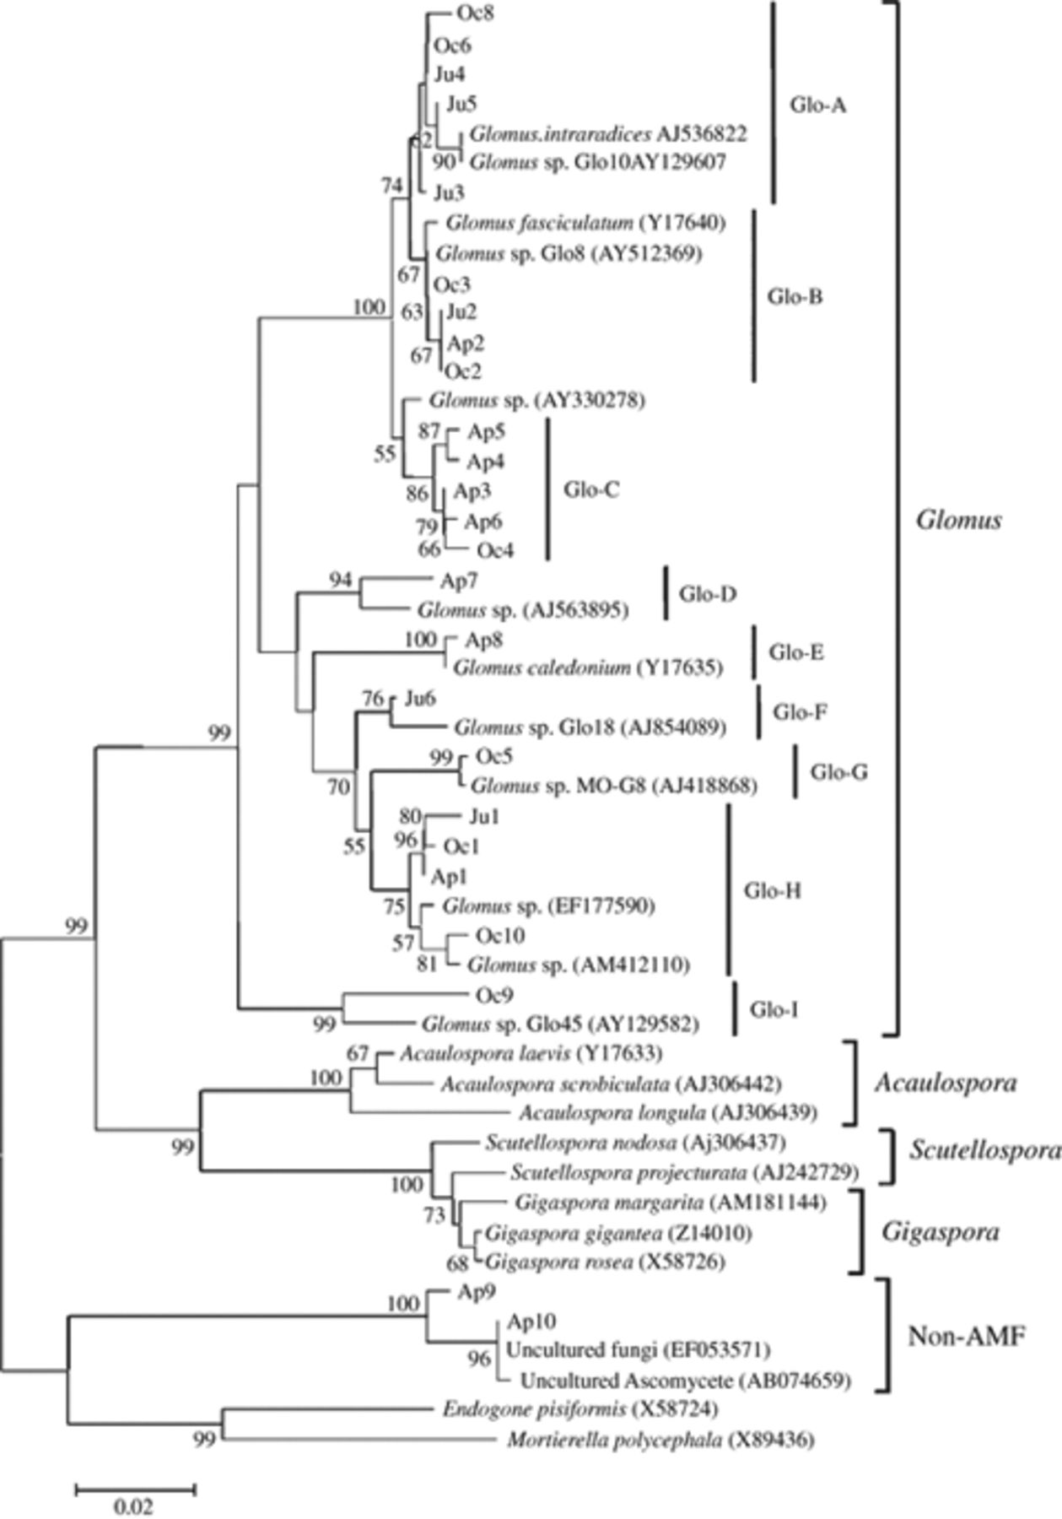
5 Neighbor-joining phylogenetic tree inferred from partial SSU rRNA gene sequences of all identified AM fungi ...
Notes:
5 Neighbor-joining phylogenetic tree inferred from partial SSU rRNA gene sequences of all identified AM fungi in Caragana korshinskii roots and referenced sequences. Bootstrap value (1000 replicates) >55% are shown. Sequence groups (Glo-A, etc.) identify distinct clusters of sequences with similarity >98% (except Glo-I, 96%). All sequences have been submitted in the GenBank database under the accession numbers EU350045–EU350069.
Unless provided in the caption above, the following copyright applies to the content of this slide: © 2008 Federation of European Microbiological Societies. Published by Blackwell Publishing Ltd. All rights reserved

Slide 6
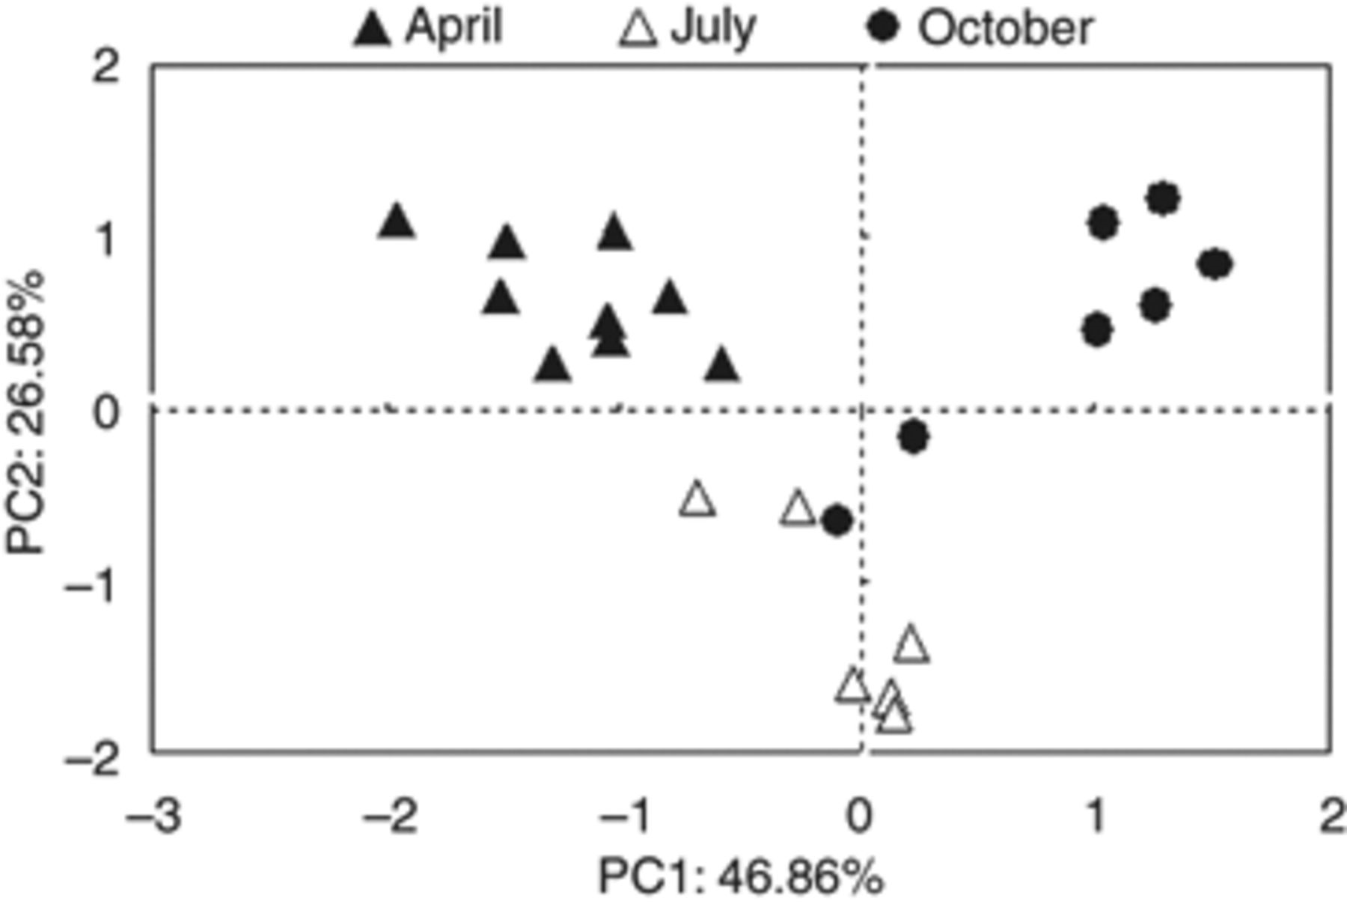
6 PCA pattern of AM fungal community composition marked by sampling time. Scatterplots (35 in total) represent ...
Notes:
6 PCA pattern of AM fungal community composition marked by sampling time. Scatterplots (35 in total) represent AM fungal communities described in terms of phylotypes.
Unless provided in the caption above, the following copyright applies to the content of this slide: © 2008 Federation of European Microbiological Societies. Published by Blackwell Publishing Ltd. All rights reserved

