Slide 1
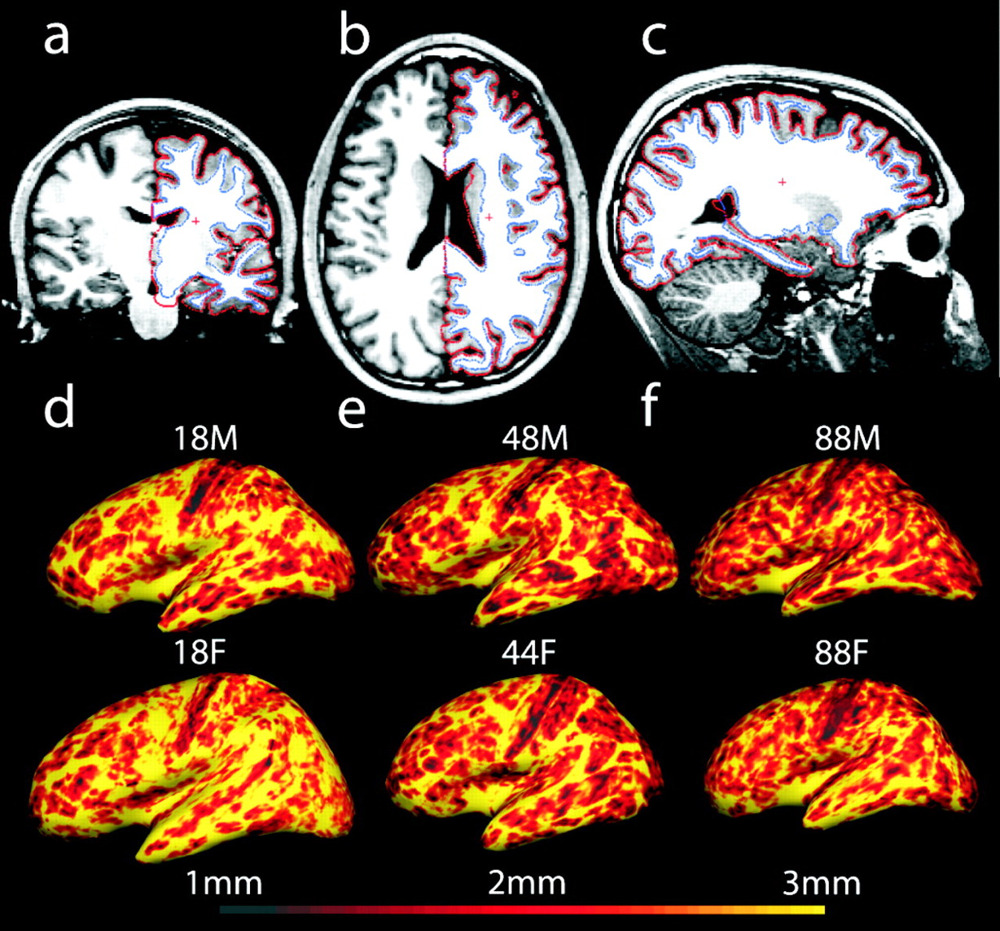
Figure 1. Cortical reconstruction technique. Top panel: example of MR image segmentation in the coronal, ...
Notes:
Figure 1. Cortical reconstruction technique. Top panel: example of MR image segmentation in the coronal, axial and sagittal planes (a–c). The segmentation procedure uses both intensity and continuity information from the three-dimensional high-resolution, high signal-to-noise MR image volume to produce accurate representations of the gray matter/white matter boundary (blue line) and the outer surface of the cortex (red line). The red cross-hair represents the same volumetric point in each slice of the three cardinal axes. Thickness measures were obtained by calculating the distance between the two surfaces across the entire volume in each hemisphere. Bottom panel: example of cortical thickness maps in the left hemisphere of six individual participants on the inflated surface of the cortex (age and gender is given for each). The color scale at the bottom represents the thickness (in millimeters). Age-associated thinning is apparent in these individual participants as the surface maps show a greater portion of cortex below the midpoint of the color scale (red) with increasing age.
Unless provided in the caption above, the following copyright applies to the content of this slide:

Slide 2
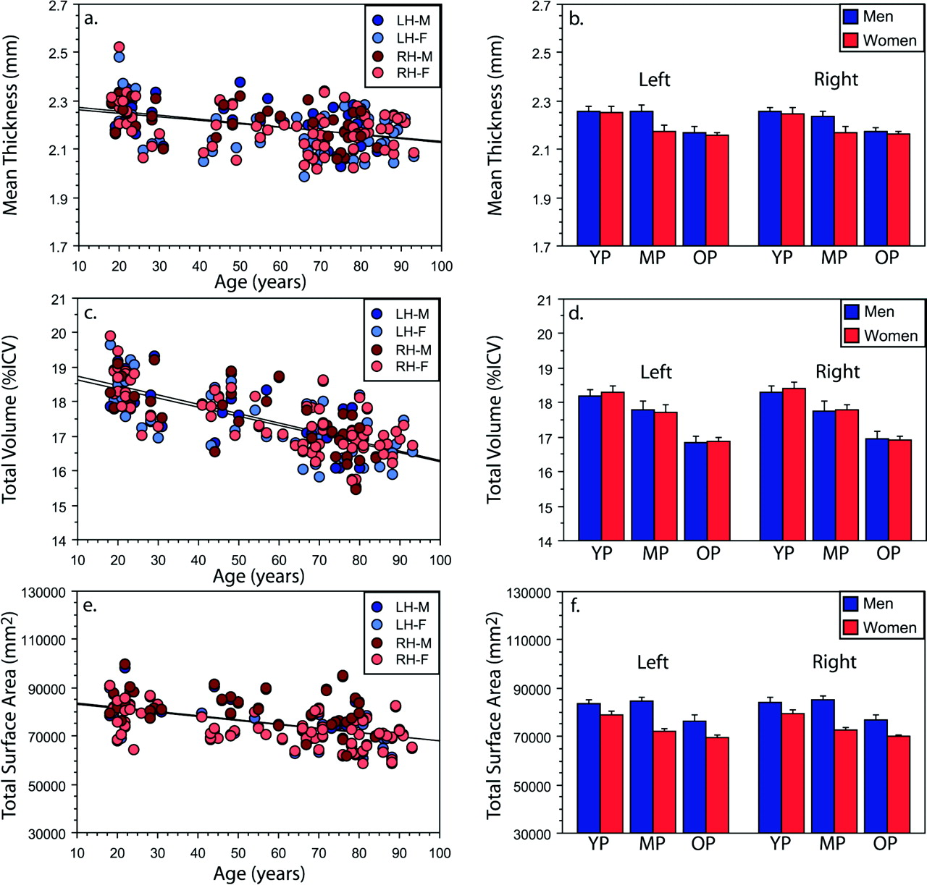
Figure 2. Effects of aging on total mean cortical thickness (a,b), total cortical volume (percentage of ...
Notes:
Figure 2. Effects of aging on total mean cortical thickness (a,b), total cortical volume (percentage of intracranial volume; c,d) and total cortical surface area (e–f). Scatter plots of mean cortical thickness (a), total cortical volume (percentage of intracranial volume; c) and total cortical surface area (e) in each hemisphere regressed by age, separated by sex and cortical hemisphere (lh, left hemisphere; rh, right hemisphere). Age significantly correlates with all three measures. Mean cortical thickness (b), total cortical volume (percentage of total intracranial volume; d) and total cortical surface area (f) in young participants (YP), middle-aged participants (MP) and older participants (OP) separated by gender. Minimal gender differences were apparent in measures of cortical thickness within each group. In contrast, gender differences in total cortical surface area were apparent within each group. Bars represent mean and standard error of the mean.
Unless provided in the caption above, the following copyright applies to the content of this slide:

Slide 3
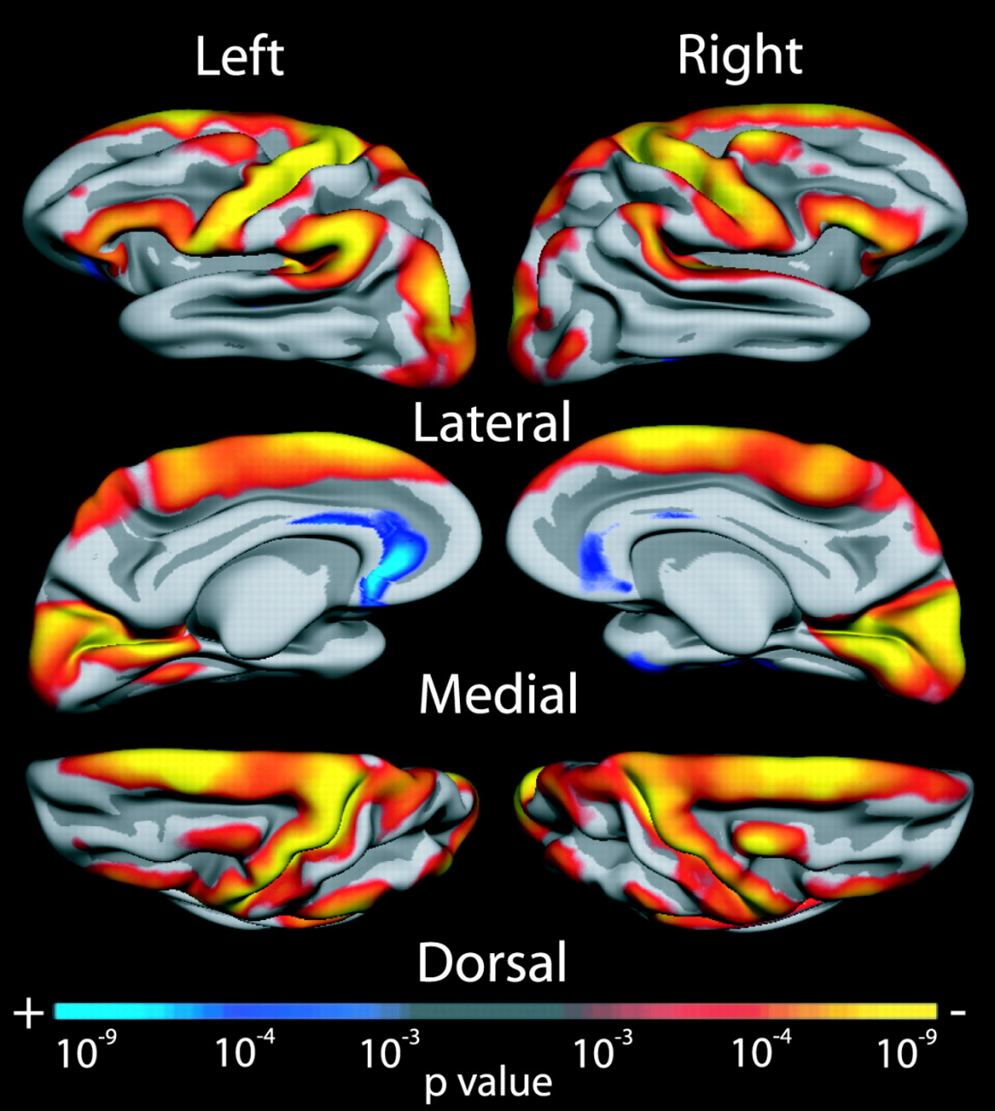
Figure 3. Age-associated map of cortical thinning. Surface maps of cortical thinning in aging were generated ...
Notes:
Figure 3. Age-associated map of cortical thinning. Surface maps of cortical thinning in aging were generated by assessing the influence of age on thickness (using the general linear model) at each vertex across the entire cortical mantle. Maps are presented on the semi-inflated cortical surface of an average brain with dark gray regions representing sulci and light gray regions representing gyri. Non-neocortical regions and regions that are not part of the cortical mantle (such as the corpus callosum and thalamus) have been excluded from the analysis. The colorscale at the bottom represents the significance of the thickness change with yellow indicating regions of most significant thinning.
Unless provided in the caption above, the following copyright applies to the content of this slide:

Slide 4
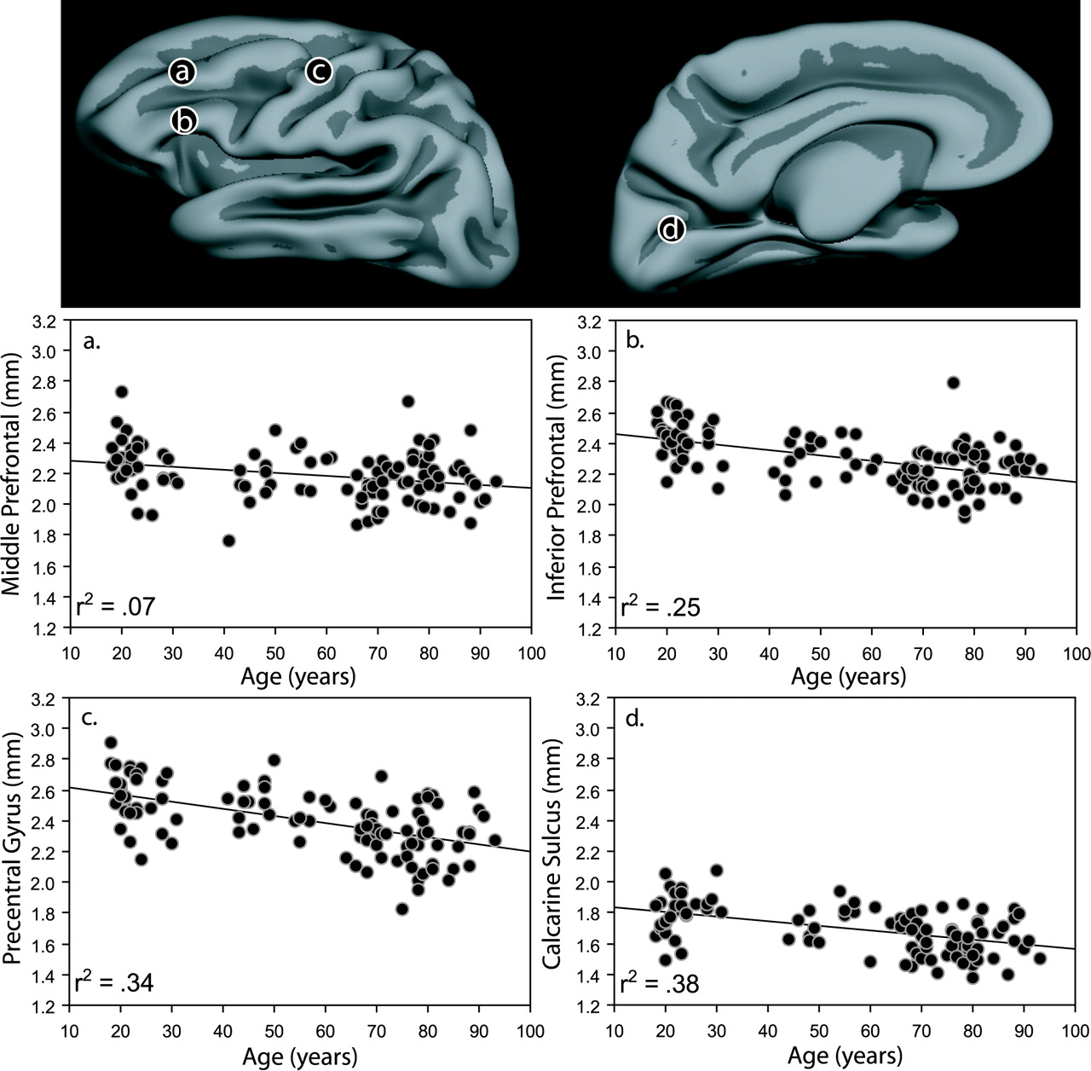
Figure 4. Age-associated regional cortical thinning. Top panel: lateral (left) and medial (right) views of ...
Notes:
Figure 4. Age-associated regional cortical thinning. Top panel: lateral (left) and medial (right) views of the semi-inflated cortical surface of an average brain with dark gray regions representing sulci and light gray regions representing gyri. Bottom panel: scatterplots of regional thickness regressed by age as denoted by the regional demarcations of the top panel. Thinning was variable across the cortex. Significant thinning was found in various regions including portions of inferior prefrontal (b) precentral (c) and calcarine cortex (d).
Unless provided in the caption above, the following copyright applies to the content of this slide:

Slide 5
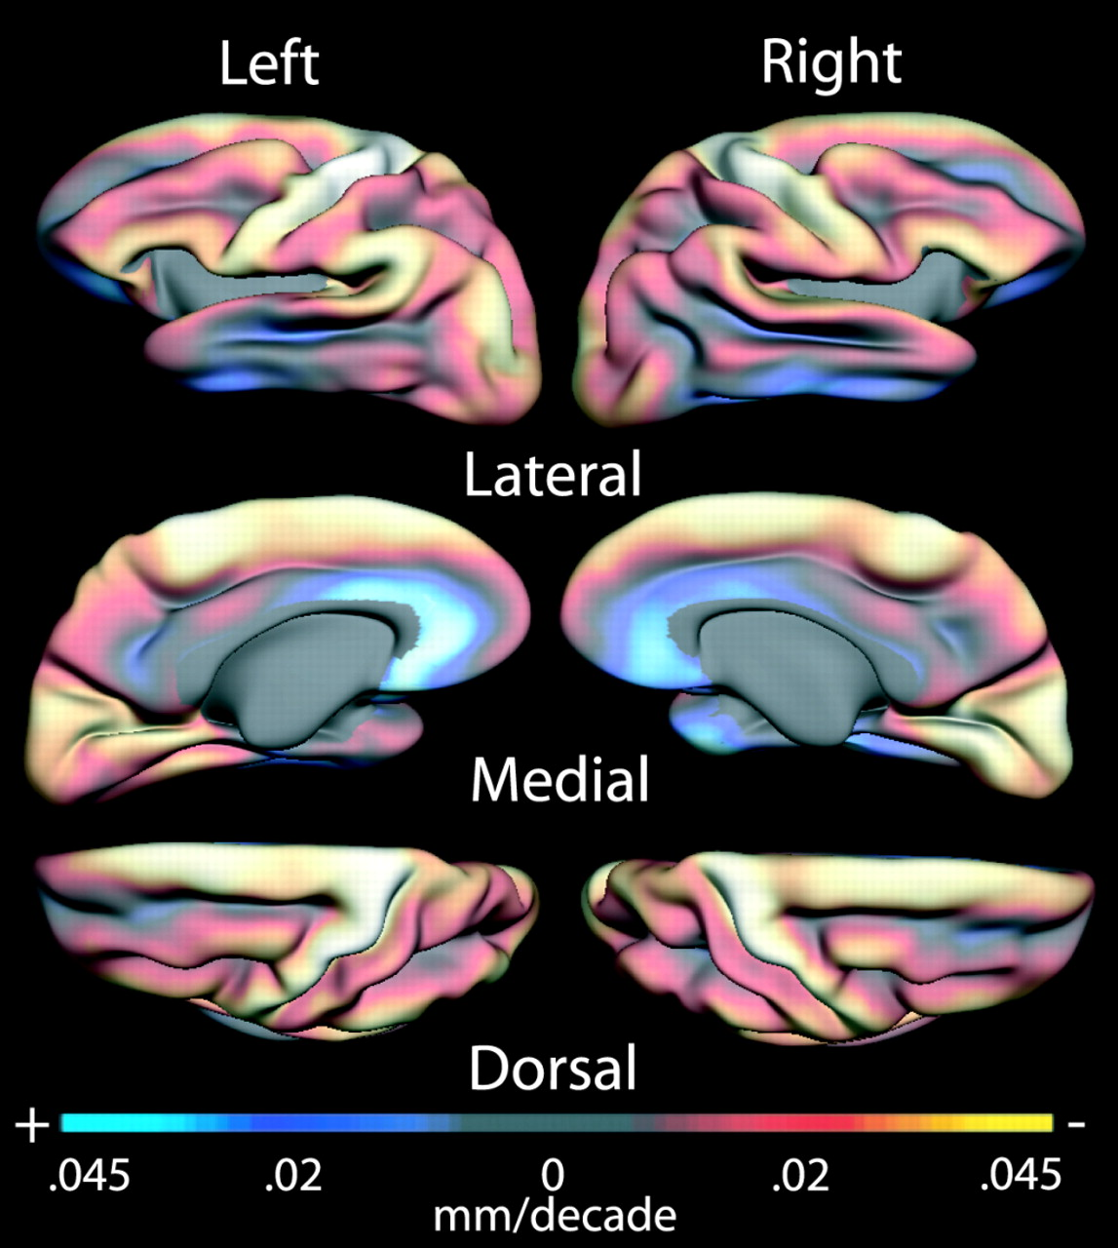
Figure 5. Age-associated map of cortical thinning in mm/per decade. Absolute thinning per decade is presented ...
Notes:
Figure 5. Age-associated map of cortical thinning in mm/per decade. Absolute thinning per decade is presented on the inflated cortical surface of an average brain. The colorscale at the bottom represents the absolute size of the thickness change (in mm/per decade) with red and yellow indicating regions of greatest thinning.
Unless provided in the caption above, the following copyright applies to the content of this slide:

Slide 6
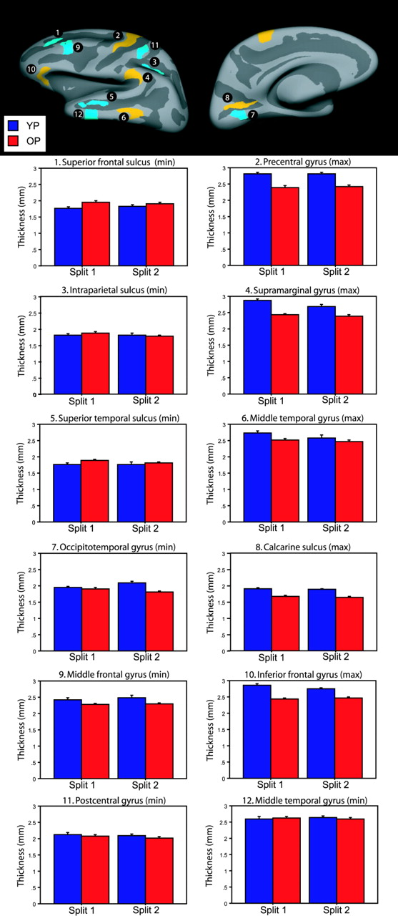
Figure 6. Reliability of regional measures of cortical thinning. Regional measures of cortical thickness are ...
Notes:
Figure 6. Reliability of regional measures of cortical thinning. Regional measures of cortical thickness are presented for two independent samples of participants comprising age-matched splits of the total sample (Split 1 versus Split 2). Regions were defined in areas of maximal and minimal thinning across each cortical lobe in the first sample and then mapped to the second sample of participants for an unbiased, independent measure of regional cortical thickness (top panel). Regional patterns of maximal and minimal thinning were similar across the two samples suggesting reliability in the measured pattern (bottom panel). Data are presented as the mean and standard error of the mean in the YP (blue bars) and OP groups (red bars) in each of the numbered regions chosen as showing minimal (min) or maximal (max) thinning.
Unless provided in the caption above, the following copyright applies to the content of this slide:

Slide 7
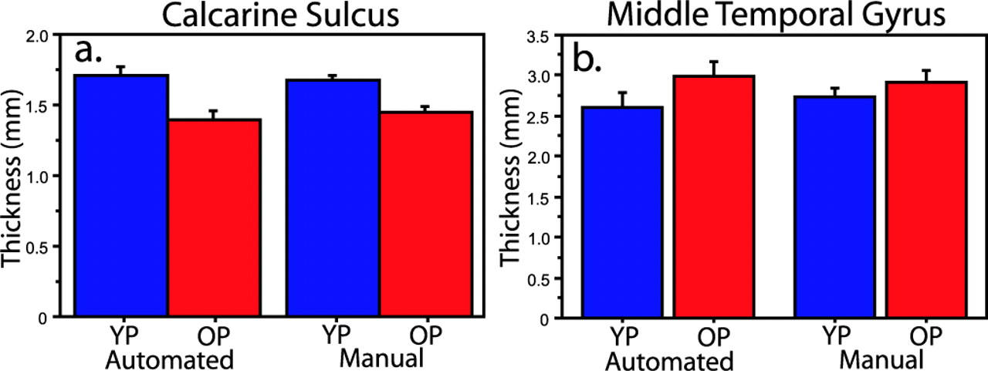
Figure 7. Manual measures of cortical thickness. A region of the middle temporal gyrus and a region of the ...
Notes:
Figure 7. Manual measures of cortical thickness. A region of the middle temporal gyrus and a region of the calcarine sulcus were defined from the effect maps and mapped to the volume of 12 of the youngest and 12 of the oldest participants (matched for gender). Ten manual measurements of cortical thickness were obtained in these regions for each participant (the distance from the gray/white border to the gray/CSF border). The mean of these 10 measurements was then taken as the regional thickness for each participant. This procedure confirmed our negative finding showing preservation of temporal cortex and our novel finding of thinning in calcarine cortex.
Unless provided in the caption above, the following copyright applies to the content of this slide:

Slide 8
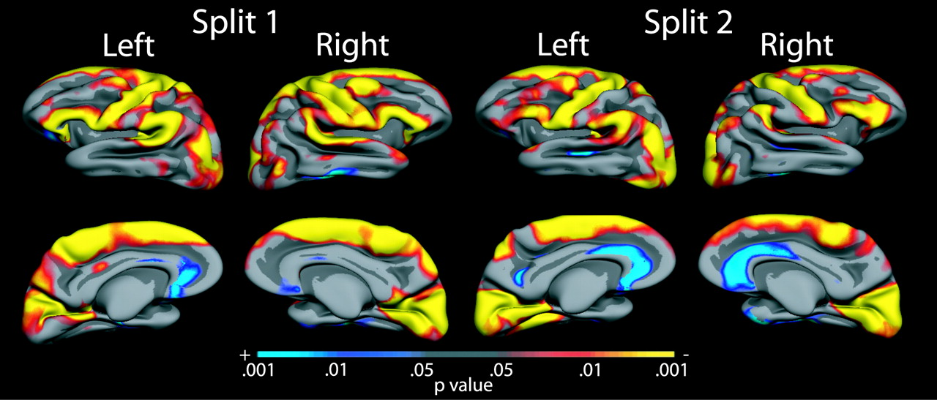
Figure 8. Reliability of cortical thinning maps. Using the same procedures as Figure 3, statistical maps of ...
Notes:
Figure 8. Reliability of cortical thinning maps. Using the same procedures as Figure 3, statistical maps of cortical thinning are presented for two independent samples of participants comprising age-matched splits of the total sample (Split 1 versus Split 2). While some differences between samples can be detected, the overall patterns of statistically significant cortical thinning are remarkably conserved between the independent samples and these maps are similar to the map produced by the total sample of participants (Figure 3) suggesting reliability in the measured pattern.
Unless provided in the caption above, the following copyright applies to the content of this slide:

