Slide 1
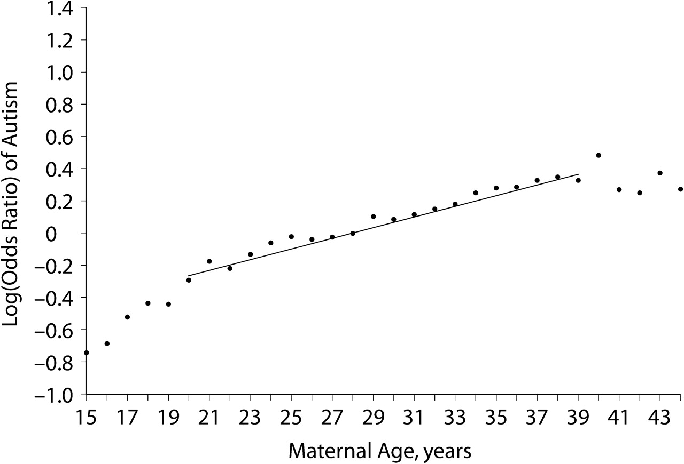
Figure 1. Maternal age and risk of autism, California resident births, 1989–2002. Children with autism are clients of ...
Notes:
Figure 1. Maternal age and risk of autism, California resident births, 1989–2002. Children with autism are clients of the California Department of Developmental Services; the denominator population is all remaining resident livebirths alive at 1 year of age. The line (—) represents the log(odds ratio) when parental age was modeled as a continuous variable; the dots (•) represent the log(odds ratio) at each year of age when parental age was represented as indicator variables.
Unless provided in the caption above, the following copyright applies to the content of this slide: American Journal of Epidemiology Published by the Johns Hopkins Bloomberg School of Public Health 2009.

Slide 2
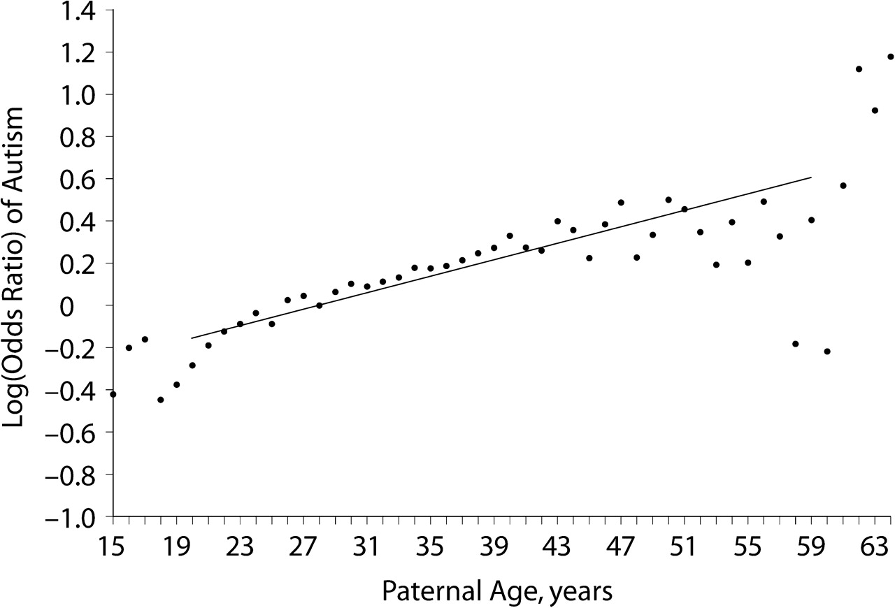
Figure 2. Paternal age and risk of autism, California resident births, 1989–2002. Children with autism are clients of ...
Notes:
Figure 2. Paternal age and risk of autism, California resident births, 1989–2002. Children with autism are clients of the California Department of Developmental Services; the denominator population is all remaining resident livebirths alive at 1 year of age. The line (—) represents the log(odds ratio) when parental age was modeled as a continuous variable; the dots (•) represent the log(odds ratio) at each year of age when parental age was represented as indicator variables.
Unless provided in the caption above, the following copyright applies to the content of this slide: American Journal of Epidemiology Published by the Johns Hopkins Bloomberg School of Public Health 2009.

