Slide 1
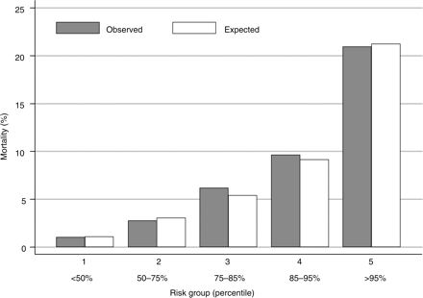
Figure 1 Observed and expected risk of mortality within 1 year by risk group. The comparison of the observed and ...
Notes:
Figure 1 Observed and expected risk of mortality within 1 year by risk group. The comparison of the observed and expected probabilities of dying demonstrates the model's goodness of fit.
Unless provided in the caption above, the following copyright applies to the content of this slide: Published on behalf of the European Society of Cardiology. All rights reserved. © The Author 2009. For permissions please email: journals.permissions@oxfordjournals.org

Slide 2
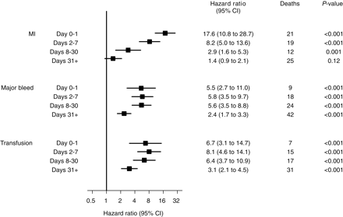
Figure 4 Influence of recurrent MI, major bleed, and non-CABG related transfusion on mortality to 1 year [three Cox ...
Notes:
Figure 4 Influence of recurrent MI, major bleed, and non-CABG related transfusion on mortality to 1 year [three Cox model with recurrent MI, major bleed, and transfusion as binary time-updated covariates (time since event) adjusted for baseline predictors]. The excess risk of death following a major bleed and transfusion within 30 days of randomization remained steady and highly significant over time, whereas the impact of an MI within 30 days on the risk of mortality decreased rapidly over time.
Unless provided in the caption above, the following copyright applies to the content of this slide: Published on behalf of the European Society of Cardiology. All rights reserved. © The Author 2009. For permissions please email: journals.permissions@oxfordjournals.org

Slide 3
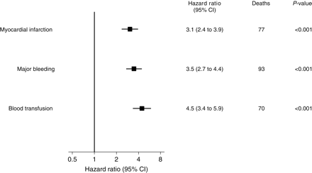
Figure 3 Influence of recurrent MI, major bleed, and non-CABG related blood transfusion on mortality to 1 year [three ...
Notes:
Figure 3 Influence of recurrent MI, major bleed, and non-CABG related blood transfusion on mortality to 1 year [three Cox model with MIs, bleeds, and transfusions as time-updated covariates (pre-/post-event) adjusted for baseline predictors]. When included as a time-updated covariate in the Cox model, major bleeding and blood transfusion within 30 days of randomization had similar or slightly greater risk of 1-year mortality compared with MI within 30 days.
Unless provided in the caption above, the following copyright applies to the content of this slide: Published on behalf of the European Society of Cardiology. All rights reserved. © The Author 2009. For permissions please email: journals.permissions@oxfordjournals.org

Slide 4
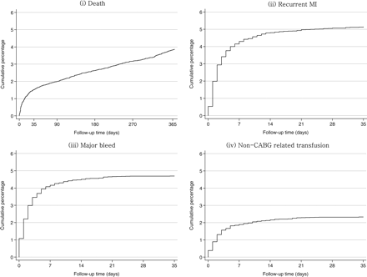
Figure 2 Cumulative risk of (i) death; (ii) recurrent MI, (iii) major bleed; (iv) non-CABG related transfusion. The ...
Notes:
Figure 2 Cumulative risk of (i) death; (ii) recurrent MI, (iii) major bleed; (iv) non-CABG related transfusion. The cumulative risk of mortality (to 1 year), recurrent MI, major bleed, and non-CABG related transfusion (to 35 days).
Unless provided in the caption above, the following copyright applies to the content of this slide: Published on behalf of the European Society of Cardiology. All rights reserved. © The Author 2009. For permissions please email: journals.permissions@oxfordjournals.org

