Slide 1
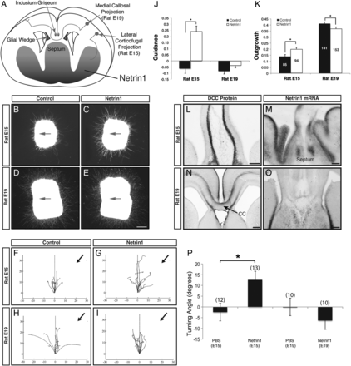
Figure 1. Netrin1 does not guide E19 rat neocortical axons in vitro. (A) Schematic of a coronally sectioned rodent ...
Notes:
Figure 1. Netrin1 does not guide E19 rat neocortical axons in vitro. (A) Schematic of a coronally sectioned rodent brain demonstrating the trajectories of the laterally projecting corticofugal axons and the medially projecting callosal axons, together with the expression pattern of Netrin1 (green) and DCC (red). As these axonal populations both originate from the neocortex, this tissue was collected at different temporal stages to optimize for either corticofugal axons or callosal axons. (B–E) Neocortical explants were taken from E15 rat (as a positive control; B and C) for corticofugal axons, and E19 rat (D and E) for callosal axons, and were cocultured with control (B and D) or recombinant Netrin1-soaked (C and E) agar cubes (positioned ≥250 μm from the explant in the direction of the arrow). (J and K) The laterally projecting axons (E15) were attracted toward the Netrin1 source (J; P < 0.001), and the explants also displayed more outgrowth than seen in the control condition (K; P = 0.004, n = 85 control explants and n = 94 Netrin1 explants). However, axons from E19 explants were neither attracted nor repelled by Netrin1 (J; P = 0.072), and outgrowth was slightly decreased (K; P = 0.021, n = 141 control explants, n = 153 Netrin1 explants). Explants were pooled from 4 separate experiments; total explant n values are in columns in panel K. Asterisk indicates a statistically significant difference (P < 0.05). (L–O) DCC and Netrin1 expression were analyzed at E15 and E19 in rat. DCC protein was expressed on axons approaching the midline at E15 and E19 (L and arrow in N, n = 3 per stage). Netrin1 mRNA was expressed in the septum and ventral forebrain at both stages of rat development as assessed by in situ hybridization (M and O). (F–I) Growth cones of dissociated rat neocortical axons were subjected to a gradient of Netrin1 (G and I) or PBS as a control (F and H) in the growth cone turning assay. Growth cones of neurons dissociated at E15 were attracted to Netrin1 (G) whereas growth cones of neurons dissociated at E19 were unresponsive (I). Traces shown indicate the growth cone trajectories. (P) Summary of the turning angles in response to PBS and Netrin1. Error bars = SEM, numbers in brackets are growth cones per condition, Asterisk indicates P < 0.05, Kolmogorov–Smirnov test. All scale bars = 200 μm.
Unless provided in the caption above, the following copyright applies to the content of this slide: © The Author 2013. Published by Oxford University Press. All rights reserved. For Permissions, please e-mail: journals.permissions@oup.com

Slide 2
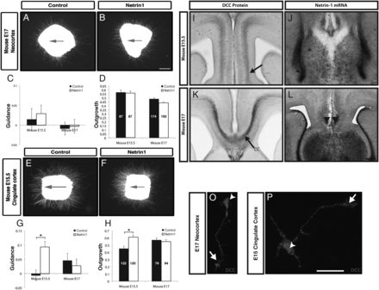
Figure 2. Netrin1 attracts callosal pioneering axons projecting from the cingulate cortex but not neocortical callosal ...
Notes:
Figure 2. Netrin1 attracts callosal pioneering axons projecting from the cingulate cortex but not neocortical callosal axons in vitro. (A–D) To examine the guidance of cingulate callosal axons by Netrin1, cingulate explants were dissected from E15.5 and E17 (explants shown only for E15.5) mouse and plated next to control or Netrin1-soaked agar cubes (the direction of the red arrow in A and B indicates the position of the agar cube). Callosal pioneering axons from E15.5 cingulate cortex were attracted toward the Netrin1 source (C; P = 0.00003) and also displayed more outgrowth compared with control conditions (D; P = 10−5). Axons from E17 cingulate cortex were neither attracted nor repelled by Netrin1 (C; P = 0.59) and outgrowth was unaffected (D; P = 0.56). (E–H) Neocortical explants from E15.5 and E17 (explants shown only for E17) mouse neocortex were dissected and plated next to control or Netrin1-soaked agar cubes. Neocortical explants at both ages were neither attracted nor repelled by Netrin1 (G) and axon outgrowth was also unaffected. Explants were pooled from 3 to 6 separate experiments; total explant n values are in columns in panel D and H. (I–L) Netrin1 and DCC expression was investigated in mouse coronal brain sections. The DCC antibody labeled callosal pioneering axons at E15.5 in mouse (arrow in I; n = 3) and later callosal axons as they crossed the midline (E17 in mouse, arrow in K; n = 3). Netrin1 mRNA (J and L) was expressed in the ventrolateral septum and the indusium griseum (IG); n = 3 per stage. (M and N) To examine DCC expression on growth cones, neurons were stained for DCC and DAPI by immunofluorescence. DCC is expressed in neurons of both the cingulate cortex and the neocortex at stages equivalent to when axons arising in these areas are navigating the corpus callosum. DCC expression was present throughout the cell body (arrowhead in M and N), axon and growth cone (arrow in M and N). Scale bar in F = 200 μm for A and B and E and F; bar in I–L = 200 μm and M and N = 20 μm.
Unless provided in the caption above, the following copyright applies to the content of this slide: © The Author 2013. Published by Oxford University Press. All rights reserved. For Permissions, please e-mail: journals.permissions@oup.com

Slide 3
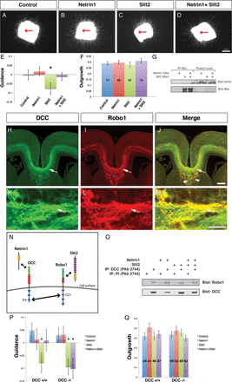
Figure 3. Netrin1 abolishes Slit2-mediated repulsion of E17 neocortical axons. (A–F) Explants of E17 wild-type mouse ...
Notes:
Figure 3. Netrin1 abolishes Slit2-mediated repulsion of E17 neocortical axons. (A–F) Explants of E17 wild-type mouse neocortex were cocultured in semidry collagen for 2 days alongside control agar cell blocks containing HEK cells alone (A), or a source of guidance factor consisting of HEK cell blocks soaked in recombinant Netrin1 (B), HEK-Slit2-expressing cell blocks (C), or HEK-Slit2 cell blocks soaked in recombinant Netrin1 (D). A red arrow shows the direction of the cell block in relation to the explant. In the presence of Slit2 (C) axons were repelled compared with controls (E; P = 0.04, Student's t-test, n = 67–80), but in the presence of Netrin1 (B), axons showed no guidance preference compared with controls. When Netrin1 and Slit2 were combined, Slit2-mediated repulsion was abolished and no significant guidance was observed (E; P = 0.41 vs. Control, P = 0.047 vs. Slit2, Student's t-test, n = 70). No significant differences in outgrowth were observed between conditions (F). Explants were pooled from at least 3 independent experiments. Total explants per condition are shown on the bars in panel F. Asterisk indicates a significant (1-tailed Students t-test) difference from all other conditions. (G) Recombinant Netrin1 and Slit2 from HEK-Slit2 cell supernatants do not coimmunoprecipitate from collagen cultures. Explants were cultured with an overlay of HEK-Slit2-conditioned medium, control HEK medium, Netrin1-containing medium, or Netrin1-containing Slit2-conditioned medium. Immunoprecipitates and total protein lysates were analyzed by western blot. Slit2 was detected with anti-Myc antibody, and Netrin1 with anti-6xHis antibody. (H–M) DCC and Robo1 are colocalized on callosal axons at E17. Immunohistochemistry on thin (4 μm) paraffin coronal sections of an E17 wild-type mouse brain stained with DCC (H and K), or Robo1 (I and L). Both receptors are located on callosal axons with a largely overlapping pattern at the cerebral midline (arrows in H–M), while some fibers in the fornix label with either DCC or Robo1 alone (J, arrowheads). (N) Model diagram adapted from Stein and Tessier-Lavigne (2001), demonstrating receptor and ligand interactions on callosal axons. (O) Endogenous DCC and Robo1 coimmunoprecipitate from explants grown in the presence or absence of Netrin1 and Slit2 ligands. E17 neocortical explants were cultured for 2 days in a semidry collagen matrix with an overlay of control-conditioned medium, control medium with added recombinant Netrin1, HEK-Slit2-conditioned medium, or HEK-Slit2 medium-containing Netrin1. Proteins were immunoprecipitated from lysates with anti-DCC (PAb 2744) or control preimmune antiserum (PI), and analyzed by western blot with antibodies against Robo1 or DCC. DCC was successfully immunoprecipitated in all conditions with anti-DCC antibody, but not the preimmune serum. Robo1 was detected in the presence or absence of Netrin1 and/or Slit2. (P and Q) DCC is required for Netrin1-mediated silencing of Slit2-mediated repulsion. E17 neocortical explants from wild-type, heterozygote, or DCC knockout mice were cultured for 2 days in semidry collagen alongside control cell blocks, or a source of Netrin1, Slit2, or Netrin1 and Slit2 combined. Slit2 significantly repelled neocortical axons from wild-type tissue as previously shown (P; P = 0.016, 2-tailed Student's t-test), from DCC heterozygous tissue (P; P = 0.019, 2-tailed Student's t-test), and from DCC knockout tissue (P; P = 0.004, 2-tailed Student's t-test). However, whereas neocortical axons were not responsive to a combination of Netrin1 and Slit2 in the wild type (P; P = 0.49, 2-tailed Student's t-test), and heterozygous conditions (P; P = 0.16, 2-tailed Student's t-test), DCC knockout axons were significantly repelled by a combination of these 2 ligands (P; P = 0.008, 2-tailed Student's t-test). Asterisks denote significant levels of repulsion compared with control and Netrin1 conditions per genotype (P 0.05, 2-tailed Student's t-test). Explants were pooled from 4 separate experiments. The total numbers of explants used per condition are shown on bars in panel Q. Scale bar in H–J = 200 μm; scale bar in K–M = 20 μm in D–F.
Unless provided in the caption above, the following copyright applies to the content of this slide: © The Author 2013. Published by Oxford University Press. All rights reserved. For Permissions, please e-mail: journals.permissions@oup.com

Slide 4
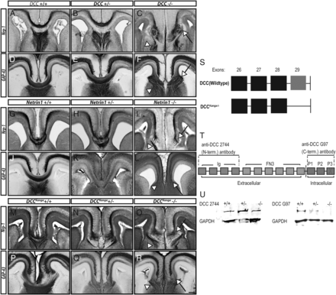
Figure 4. Comparison of the callosal malformation phenotypes in Netrin1 and DCC knockout mice and DCC^{Kanga} ...
Notes:
Figure 4. Comparison of the callosal malformation phenotypes in Netrin1 and DCC knockout mice and DCCKanga mutant mice. (A–R) Coronal brain sections of E17 Netrin1, DCC, and DCCKanga mutant mice (n > 3 per genotype) were stained for GAP-43, a marker of growing axons and Neuropilin-1 (Nrp-1), a marker of cingulate pioneering axons (Piper et al. 2009). The corpus callosum formed normally in both wild-type (+/+; A and D, G and J, and M and P) and heterozygous (+/−; B and E, H and K, and N and Q) Netrin1, DCC, and DCCKanga mice, with GAP-43- and Nrp-1-positive axons having crossed the telencephalic midline within the callosal tract as well as within the fornix and the hippocampal commissure (not shown). In contrast, GAP-43- and Nrp-1-positive axons were disrupted in the Netrin1, DCC, and DCCKanga knockout animals and failed to cross the midline (C and F, I and L, and O and R). Instead, these axons misprojected within ipsilateral Probst bundles (arrow in C and F, I and L, and O and R). Some GAP-43- and Neuropilin-1-positive axons projected ventrally into the septum; these were likely to be axons of the fornix (arrowhead in C and F, I and L, and O and R). (S–U) In DCCKanga−/− mice, the final exon of the DCC gene, exon 29, that encodes the P3 intracellular domain (T), is deleted, such that a truncated mRNA is expressed (S). To determine whether a truncated protein is expressed, western blots were performed on neocortical protein lysates of DCCKanga E17 mice using an antiserum raised against a DCC N-terminal peptide (2744) and an antibody raised against a DCC C-terminal peptide (G97) (T). (2744: n = 1 for all genotypes, G97: n = 3 for all genotypes). In DCCKanga+/+ animals, DCC protein was detected using the N-terminal antiserum and the C-terminal antibody, while lower levels of protein were present in heterozygous mice (U). In homozygous animals, DCC protein was detected using the N-terminal antiserum but was undetectable using the C-terminal antibody (U). Scale bar in R = 200 μm for A-R.
Unless provided in the caption above, the following copyright applies to the content of this slide: © The Author 2013. Published by Oxford University Press. All rights reserved. For Permissions, please e-mail: journals.permissions@oup.com

Slide 5
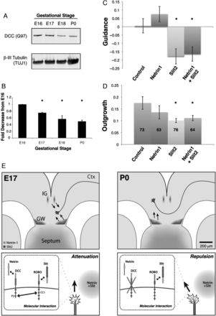
Figure 5. Downregulation of DCC allows postcrossing axons to be repelled from the midline by Slit2. (A and B) DCC ...
Notes:
Figure 5. Downregulation of DCC allows postcrossing axons to be repelled from the midline by Slit2. (A and B) DCC protein is progressively downregulated in the neocortex from E16 through to P0. Neocortical tissue was taken from E16, E17, E18, and P0 mice and DCC protein levels were analyzed by western blot (A). An approximate 2-fold progressive reduction in expression was observed between E16 and P0, which was significant at all ages tested (B, asterisks, P < 0.05, Student's t-test). Data are representative of tissue collected from 3 separate litters per age. (C and D) Explants of P0 wild-type mouse neocortex were cocultured for 2 days in semidry collagen alongside control HEK cell blocks, or a source of Netrin1, Slit2, or Netrin1 and Slit2 combined. Explants projected neurites that were neither attracted nor repelled by control and Netrin1 cell blocks, but were repelled by Slit2-expressing cell blocks (C; P = 0.009, 2-tailed Student's t-test). When Netrin1 and Slit2 were combined, similar levels of repulsion were observed to those seen with Slit2 alone (C; P < 0.001 vs. Control, P = 0.322 vs. Slit2, 2-tailed Student's t-test). (D) A significant reduction in outgrowth was observed in the Slit2 alone condition (P = 0.012, 2-tailed Student's t-test) and with Netrin1/Slit2 combined (P = 0.041, 2-tailed Student's t-test). Explants were pooled from 4 independent experiments. Total explants per condition are shown on the bars in panel D. Asterisk indicates a significant difference (P < 0.05, 2-tailed Student's t-test) from control and Netrin1 conditions. (E) Schematic diagram depicting callosal axons as they traverse the midline at E17 and P0 in mouse. At E17, callosal axons express both Robo1 and DCC. As they approach, the midline the increasing level of surrounding Netrin1 attenuates the Slit2-mediated repulsion encountered from the glial wedge and indusium griseum, allowing axons to approach the midline while helping to “channel” them into a narrow tract (arrows). At P0, DCC is downregulated, thus allowing Slit2-mediated repulsion as axons leave the midline and enter the contralateral hemisphere.
Unless provided in the caption above, the following copyright applies to the content of this slide: © The Author 2013. Published by Oxford University Press. All rights reserved. For Permissions, please e-mail: journals.permissions@oup.com

