Slide 1
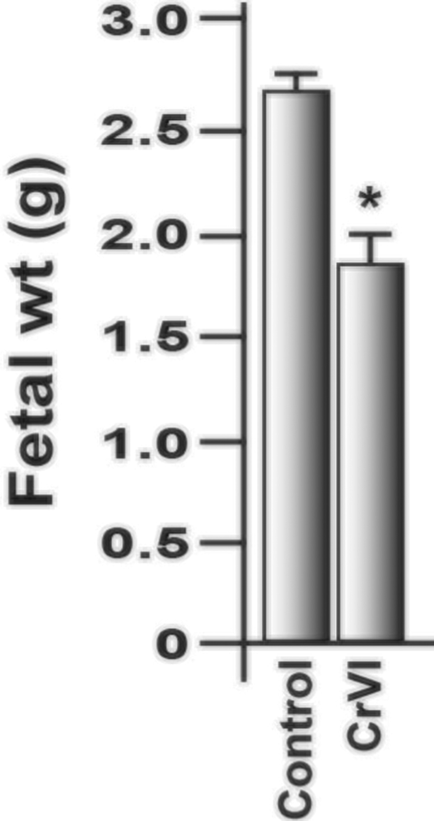
FIG. 1 Effect of CrVI on the fetal weight on 18.5 dpc. Pregnant mothers (n = 5) received drinking water with or ...
Notes:
FIG. 1 Effect of CrVI on the fetal weight on 18.5 dpc. Pregnant mothers (n = 5) received drinking water with or without CrVI (50 ppm) from GD 9.5 to 14.5. The rats were euthanized on 18.5 dpc, and fetuses were separated and weighed. CrVI significantly decreased fetal weight (Figure 1). dpc, days postcoitum. Each value represents mean ± SEM of 25 placentas. *Control versus CrVI, P < .05.
Unless provided in the caption above, the following copyright applies to the content of this slide: © The Author 2016. Published by Oxford University Press on behalf of the Society of Toxicology. All rights reserved. For Permissions, please e-mail: journals.permissions@oup.com

Slide 2
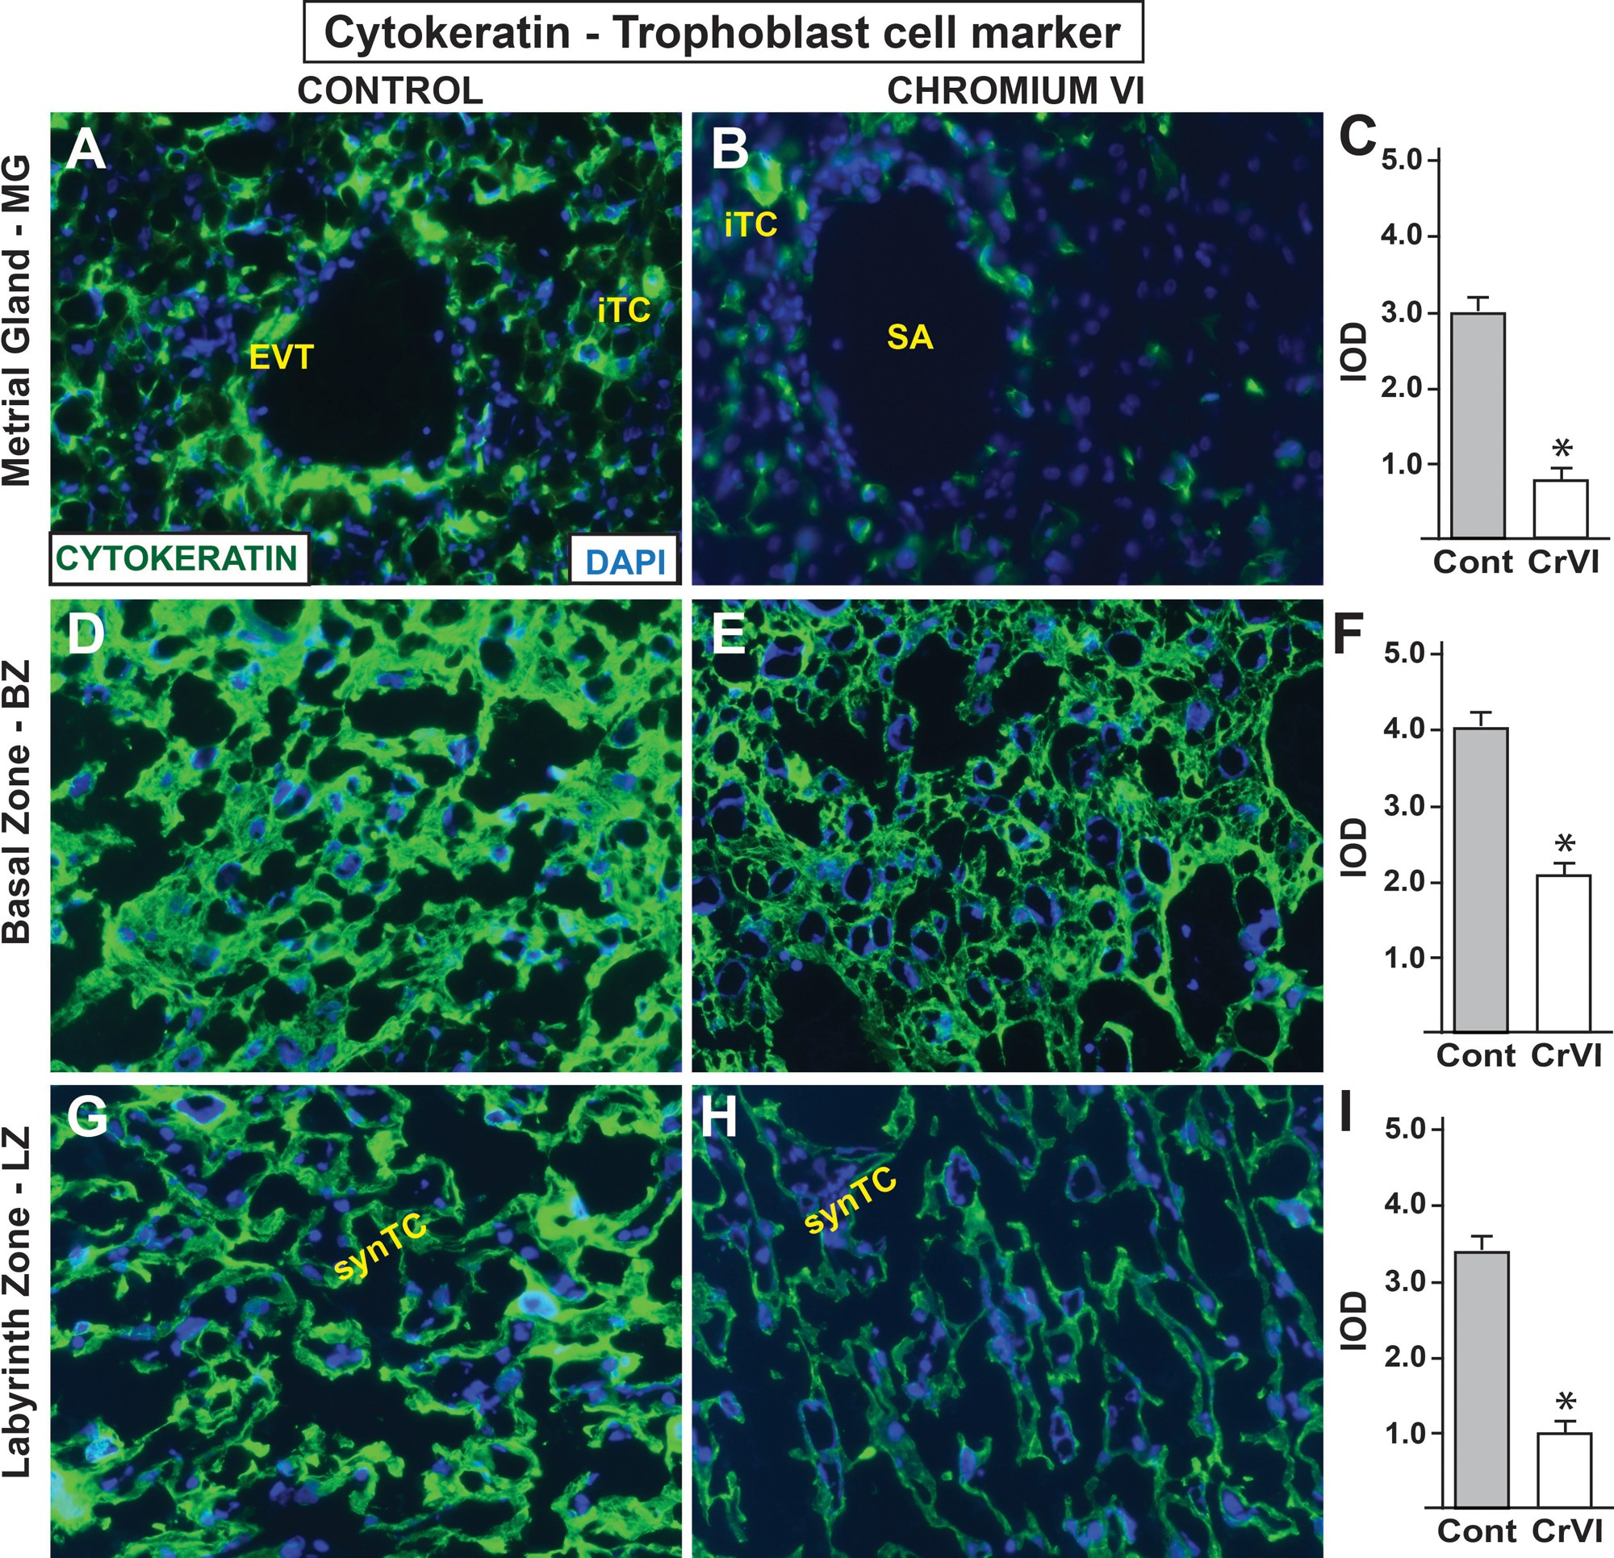
FIG. 2 Effect of CrVI on the expression of TC marker cytokeratin on 18.5 dpc. Pregnant mothers (n = 5) received ...
Notes:
FIG. 2 Effect of CrVI on the expression of TC marker cytokeratin on 18.5 dpc. Pregnant mothers (n = 5) received drinking water with or without CrVI (50 ppm) from 9.5 to 14.5 dpc. Placentas were separated on 18.5 dpc, embedded in OCT and processed for immunofluorescence. Images were captured from MG (A, control; B, CrVI), BZ (D, control; E, CrVI), labyrinth zone (G, control; H, CrVI), and shown in histograms (MG, C; BZ, F; and LZ, I). EVT - endovascular trophoblast, iTC, interstitial trophoblast; SA, spiral artery; synTC, syncytial trophoblast. MG, metrial gland; BZ, basal zone; LZ, labyrinth zone; YS, yolk sac; dpc, days postcoitum. CrVI decreased TCs invasion into the MG. Each value represents mean ± SEM of 5 placentas. *Control versus CrVI, P < .05. Width of field for each image is 220 μm.
Unless provided in the caption above, the following copyright applies to the content of this slide: © The Author 2016. Published by Oxford University Press on behalf of the Society of Toxicology. All rights reserved. For Permissions, please e-mail: journals.permissions@oup.com

Slide 3
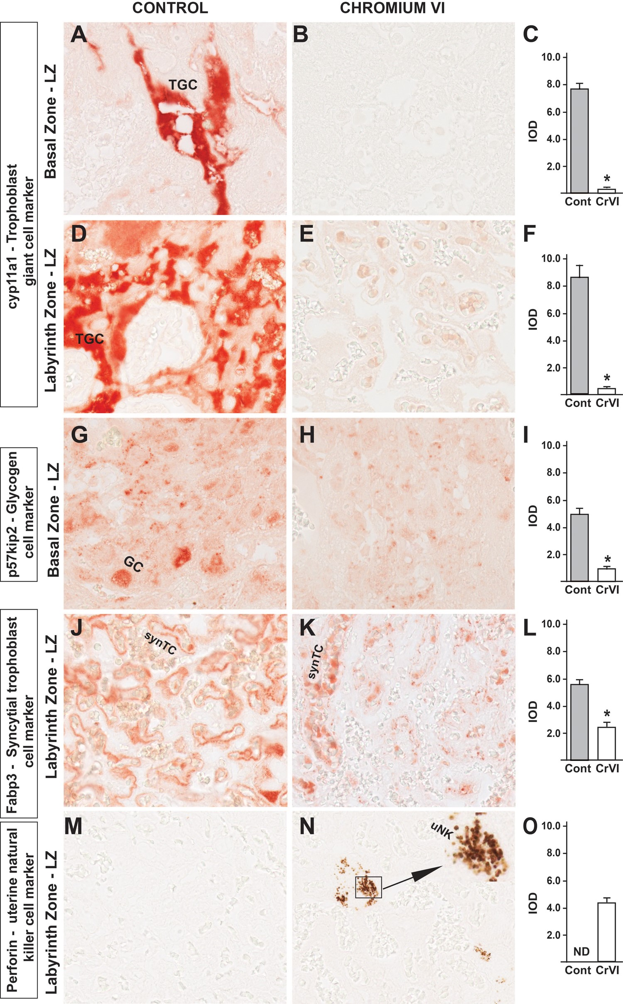
FIG. 3 Effect of CrVI on the expression of TC differentiation markers of various placental compartments on 18.5 dpc. ...
Notes:
FIG. 3 Effect of CrVI on the expression of TC differentiation markers of various placental compartments on 18.5 dpc. Pregnant mothers (n = 5) received drinking water with or without CrVI (50 ppm) from 9.5 to 14.5 dpc. Placentas were separated on 18.5 dpc and processed for IHC. Representative images are shown for the expression of the following markers: cyp11a1, TGC marker in the BZ (A, Control; B, CrVI; and C, histogram) and LZ (D, Control; E, CrVI; and F, histogram); p57kip2, GC marker in the LZ (G, Control; H, CrVI; and I, histogram); Fabp3, syncytial trophoblast marker in the LZ (J, Control; K, CrVI; and L, histogram); Perforin, uNK cell marker in the LZ (M, Control; N, CrVI; and O, histogram). The inset (N) shows an enlarged view of the infiltration of uNK cells in the synTCs of the LZ. TGC, trophoblastic giant cells; GC, glycogen cells; synTC, syncytial trophoblast; uNK, uterine natural killer cells; BZ, basal zone; LZ, labyrinth zone; dpc, days postcoitum. Each value represents mean ± SEM of 5 placentas. *Control versus CrVI, P < .05. Width of field for each image is 220 μm.
Unless provided in the caption above, the following copyright applies to the content of this slide: © The Author 2016. Published by Oxford University Press on behalf of the Society of Toxicology. All rights reserved. For Permissions, please e-mail: journals.permissions@oup.com

Slide 4
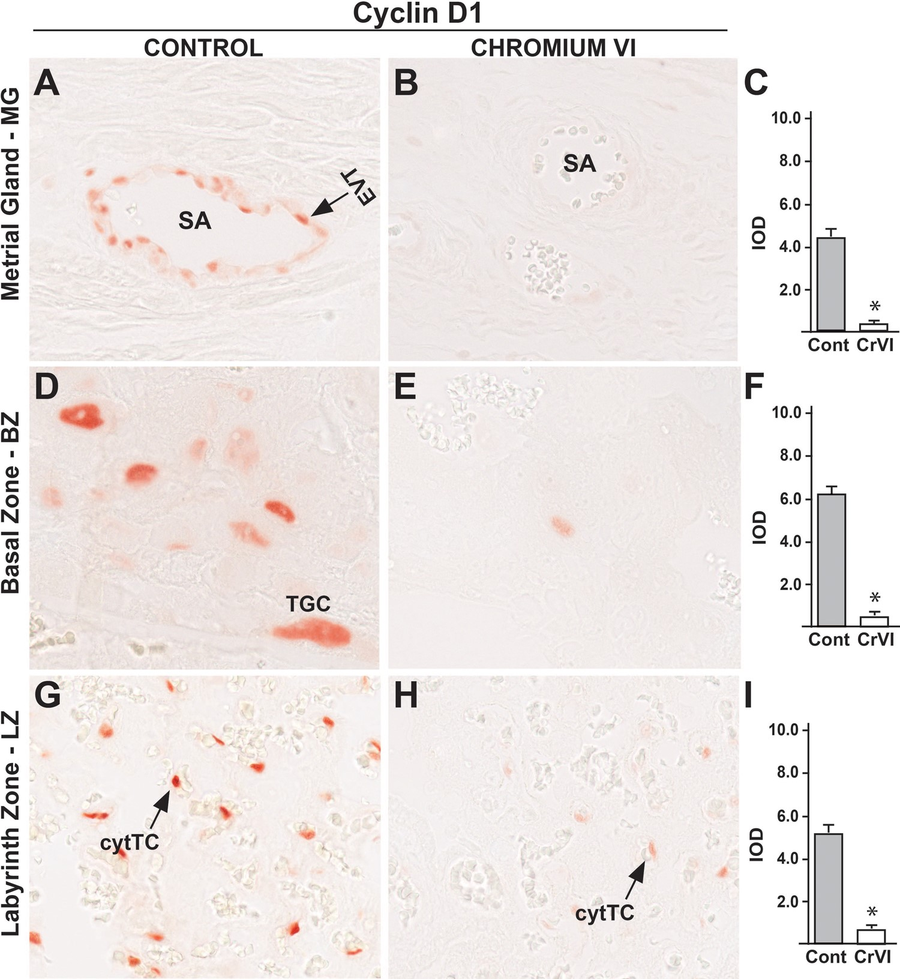
FIG. 4 Effect of CrVI on the expression of cyclin D1 on 18.5 dpc in the placenta. Pregnant mothers (n = 5) received ...
Notes:
FIG. 4 Effect of CrVI on the expression of cyclin D1 on 18.5 dpc in the placenta. Pregnant mothers (n = 5) received drinking water with or without CrVI (50 ppm) from 9.5 to 14.5 dpc. Placentas were separated on 18.5 dpc and processed for IHC. Representative images are shown for the expression of cyclin D1 in MG (A, Control; B, CrVI and C, histogram) and BZ (D, Control; E, CrVI; and F, histogram); and LZ (G, Control; H, CrVI, and I, histogram). EVT, endovascular trophoblast; SA, spiral artery; TGC, trophoblastic giant cells; cytTC, cytotrophoblast cells; dpc, days postcoitum. Each value represents mean ± SEM of 5 placentas. *Control versus CrVI, P < .05. Width of field for each image is 220 μm.
Unless provided in the caption above, the following copyright applies to the content of this slide: © The Author 2016. Published by Oxford University Press on behalf of the Society of Toxicology. All rights reserved. For Permissions, please e-mail: journals.permissions@oup.com

Slide 5
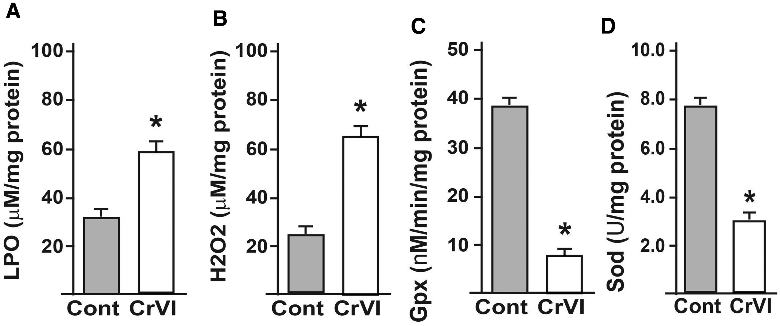
FIG. 5 Effect of CrVI on the activities of oxidative stress markers (LPO and H₂O₂) and AOXs ...
Notes:
FIG. 5 Effect of CrVI on the activities of oxidative stress markers (LPO and H2O2) and AOXs (Gpx and Sod) in the placental extracts. Pregnant mothers (n = 5) received drinking water with or without CrVI (50 ppm) from 9.5 to 14.5 dpc. Placentas were separated on 18.5 dpc and extracts prepared as given in materials and methods. Histograms of LPO (A), H2O2 (B), Gpx (C), and Sod (D) are shown. dpc, days postcoitum. Each value represents mean ± SEM of 5 placentas. *Control versus CrVI, P < .05.
Unless provided in the caption above, the following copyright applies to the content of this slide: © The Author 2016. Published by Oxford University Press on behalf of the Society of Toxicology. All rights reserved. For Permissions, please e-mail: journals.permissions@oup.com

Slide 6
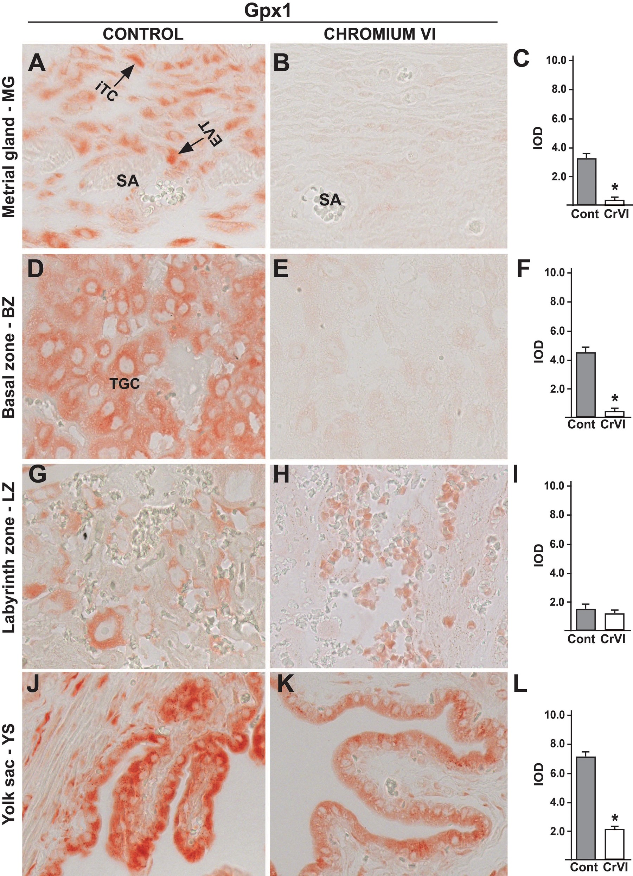
FIG. 6 Effect of CrVI on the expression of Gpx1 on 18.5 dpc in the placenta. Pregnant mothers (n = 5) received ...
Notes:
FIG. 6 Effect of CrVI on the expression of Gpx1 on 18.5 dpc in the placenta. Pregnant mothers (n = 5) received drinking water with or without CrVI (50 ppm) from 9.5 to 14.5 dpc. Placentas were separated on 18.5 dpc and processed for IHC. Representative images are shown for the expression of Gpx1 in MG (A, Control; B, CrVI; and C, histogram) and BZ (D, Control; E, CrVI; and F, histogram); LZ (G, Control; H, CrVI; and I, histogram) and YS (J, Control; K, CrVI; and L, histogram). EVT, endovascular trophoblast; iTC, interstitial trophoblast; TGC, trophoblastic giant cells; dpc, days postcoitum. Each value represents mean ± SEM of 5 placentas. *Control versus CrVI, P < .05. Width of field for each image is 220 µm.
Unless provided in the caption above, the following copyright applies to the content of this slide: © The Author 2016. Published by Oxford University Press on behalf of the Society of Toxicology. All rights reserved. For Permissions, please e-mail: journals.permissions@oup.com

Slide 7
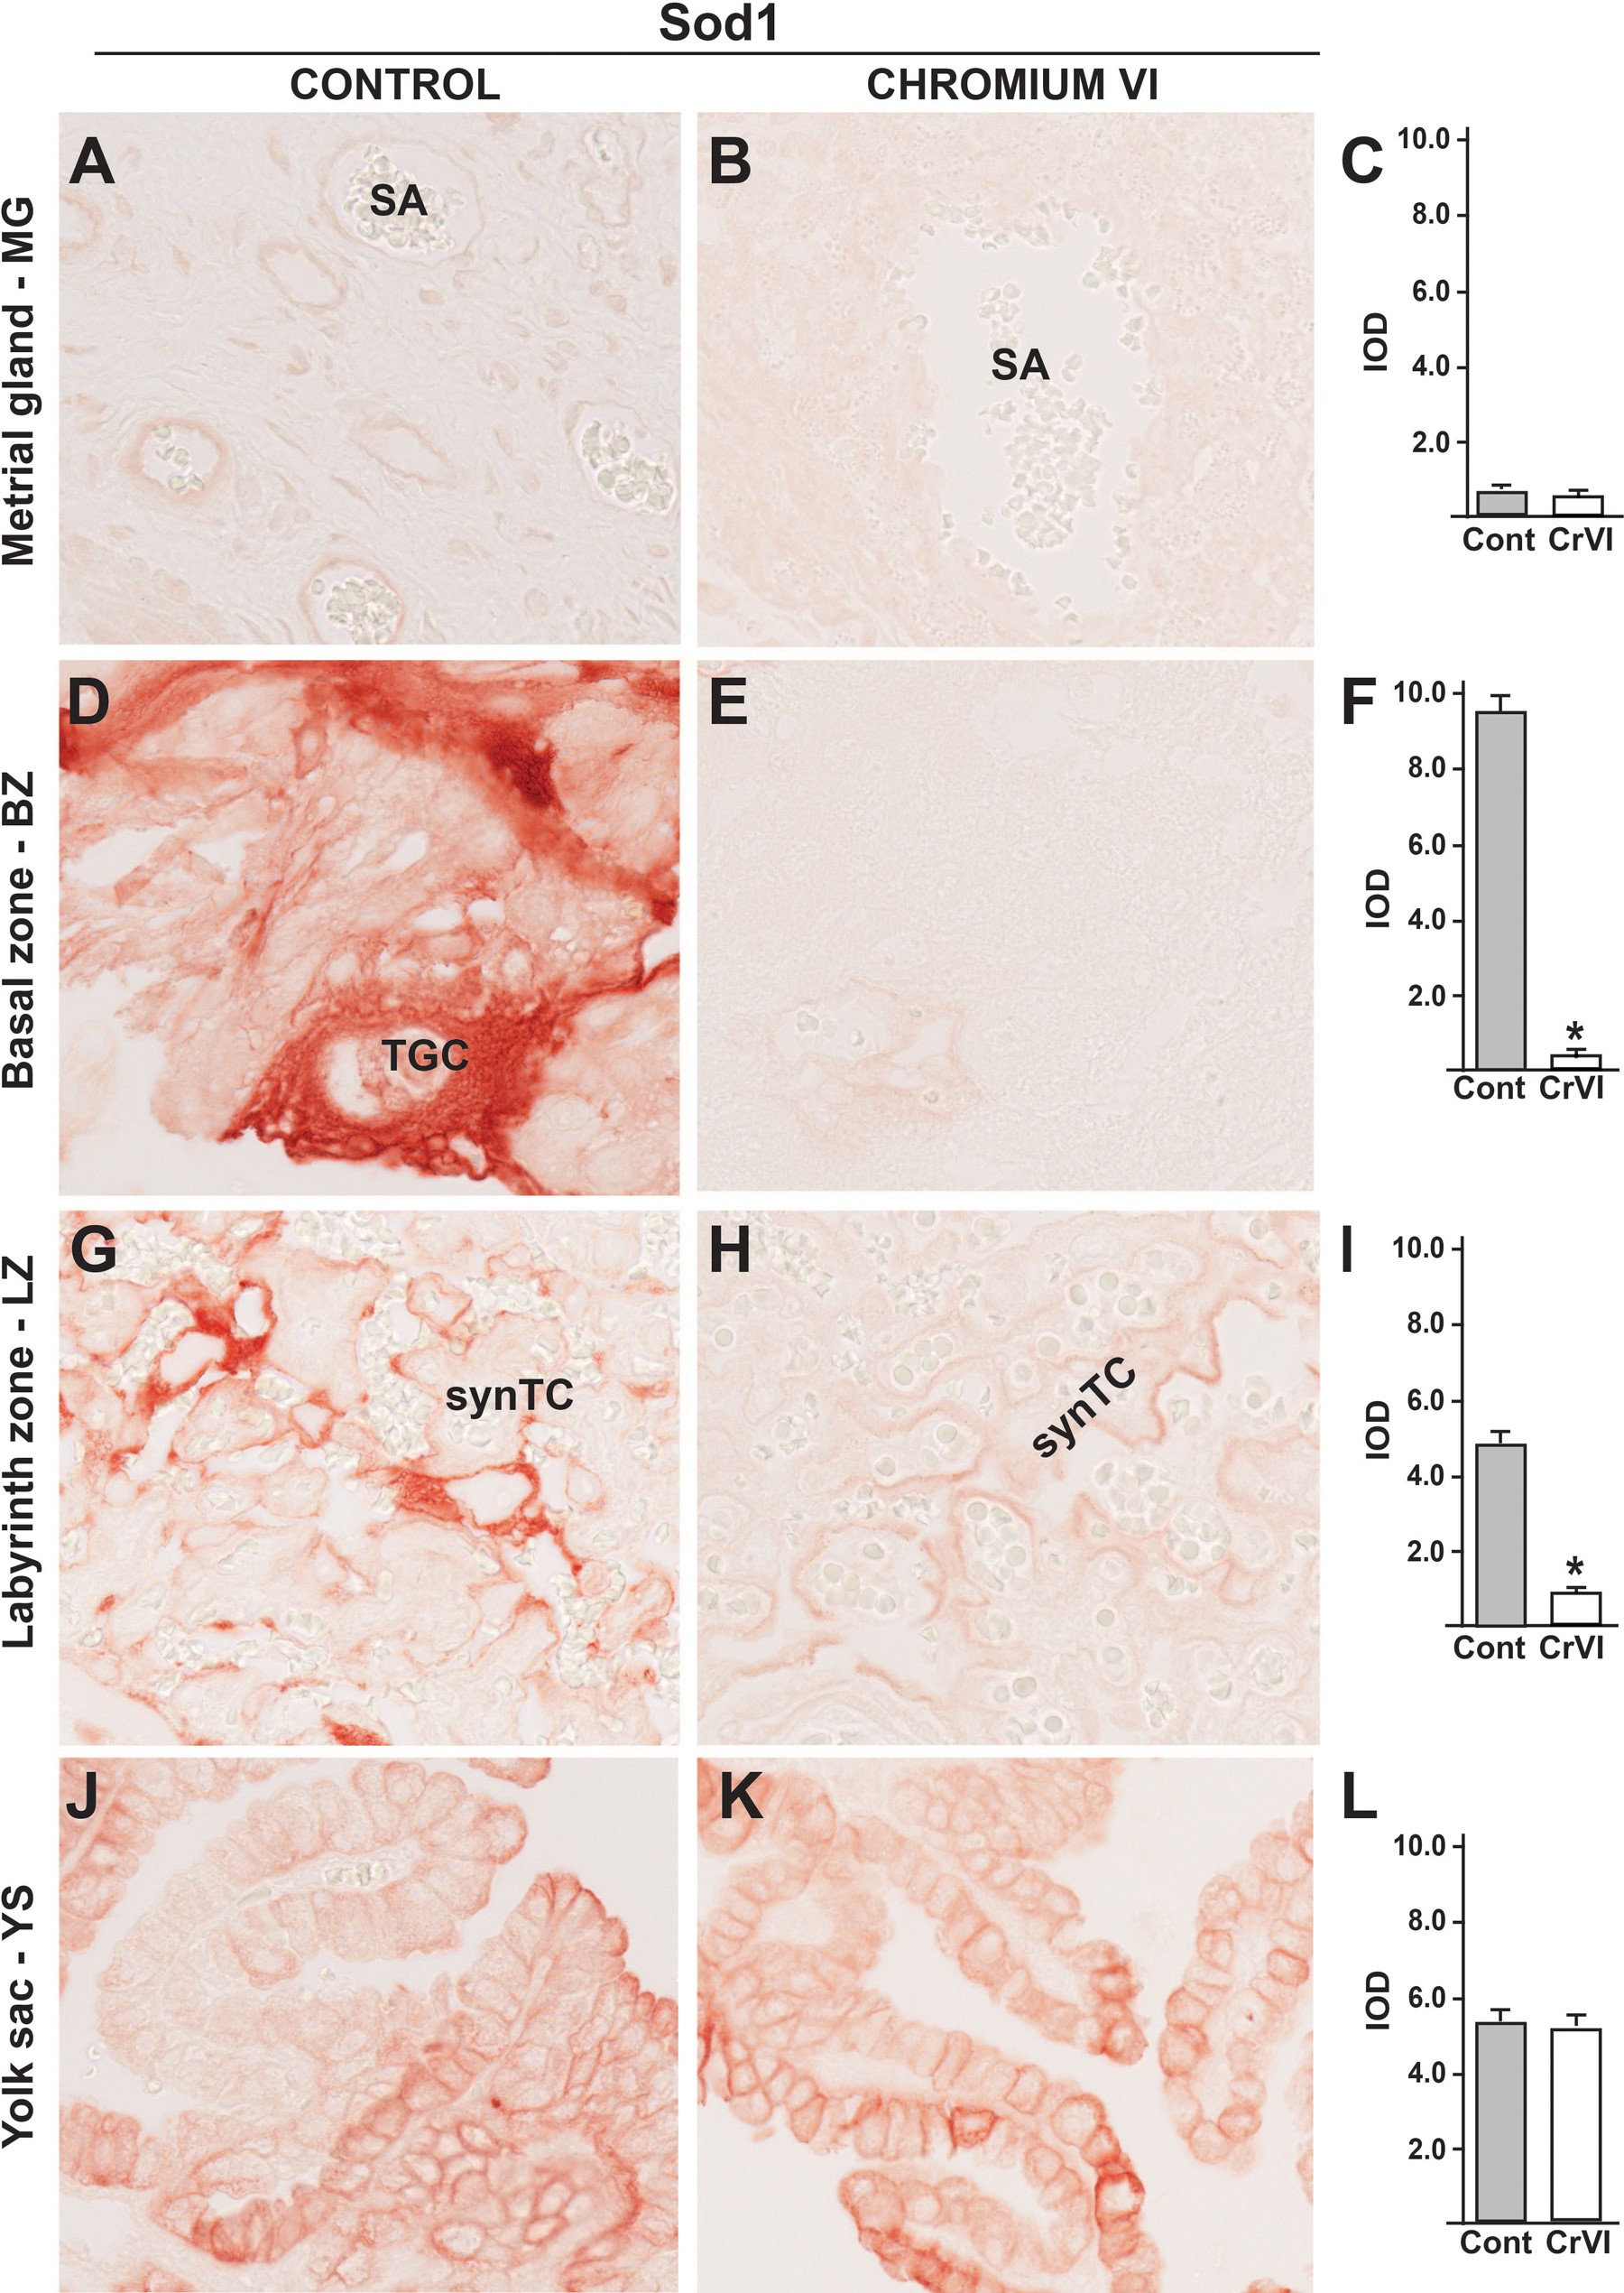
FIG. 7 Effect of CrVI on the expression of Sod1 on 18.5 dpc in the placenta. Pregnant mothers (n = 5) received ...
Notes:
FIG. 7 Effect of CrVI on the expression of Sod1 on 18.5 dpc in the placenta. Pregnant mothers (n = 5) received drinking water with or without CrVI (50 ppm) from 9.5 to 14.5 dpc. Placentas were separated on 18.5 dpc and processed for IHC. Representative images are shown for the expression of Sod1 in MG (A, Control; B, CrVI; and C, histogram) and BZ (D, Control; E, CrVI; and F, histogram); LZ (G, Control; H, CrVI; and I, histogram) and YS (J, Control; K, CrVI; and L, histogram). TGC, trophoblastic giant cells; synTC, syncytial trophoblast; dpc, days postcoitum. Each value represents mean ± SEM of 5 placentas. *Control versus CrVI, P < .05. Width of field for each image is 220 µm.
Unless provided in the caption above, the following copyright applies to the content of this slide: © The Author 2016. Published by Oxford University Press on behalf of the Society of Toxicology. All rights reserved. For Permissions, please e-mail: journals.permissions@oup.com

Slide 8
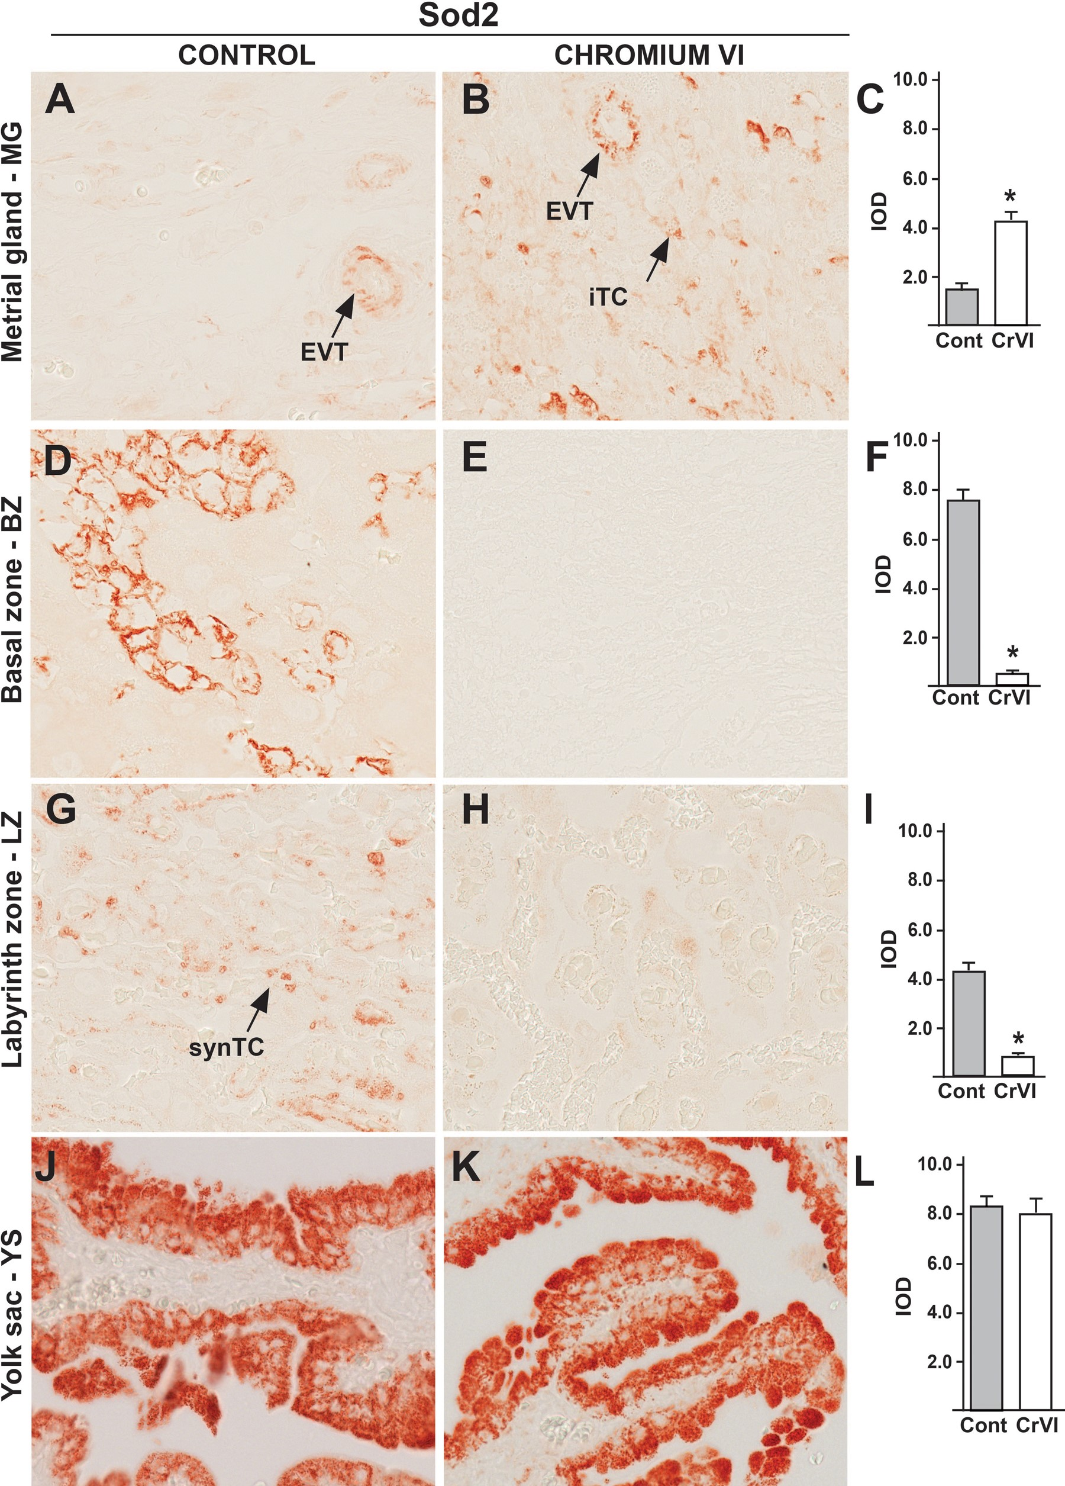
FIG. 8 Effect of CrVI on the expression of Sod2 on 18.5 dpc in the placenta. Pregnant mothers (n = 5) received ...
Notes:
FIG. 8 Effect of CrVI on the expression of Sod2 on 18.5 dpc in the placenta. Pregnant mothers (n = 5) received drinking water with or without CrVI (50 ppm) from 9.5 to 14.5 dpc. Placentas were separated on 18.5 dpc and processed for IHC. Representative images are shown for the expression of Sod2 in MG (A, Control; B, CrVI; and C, histogram) and BZ (D, Control; E, CrVI; and F, histogram); LZ (G, Control; H, CrVI; and I, histogram) and YS (J, Control; K, CrVI; and L, histogram). EVT, endovascular trophoblast; iTC, interstitial trophoblast; synTC, syncytial trophoblast; dpc, days postcoitum. Each value represents mean ± SEM of 5 placentas. *Control versus CrVI, P ≤ .05. Width of field for each image is 220 µm.
Unless provided in the caption above, the following copyright applies to the content of this slide: © The Author 2016. Published by Oxford University Press on behalf of the Society of Toxicology. All rights reserved. For Permissions, please e-mail: journals.permissions@oup.com

Slide 9
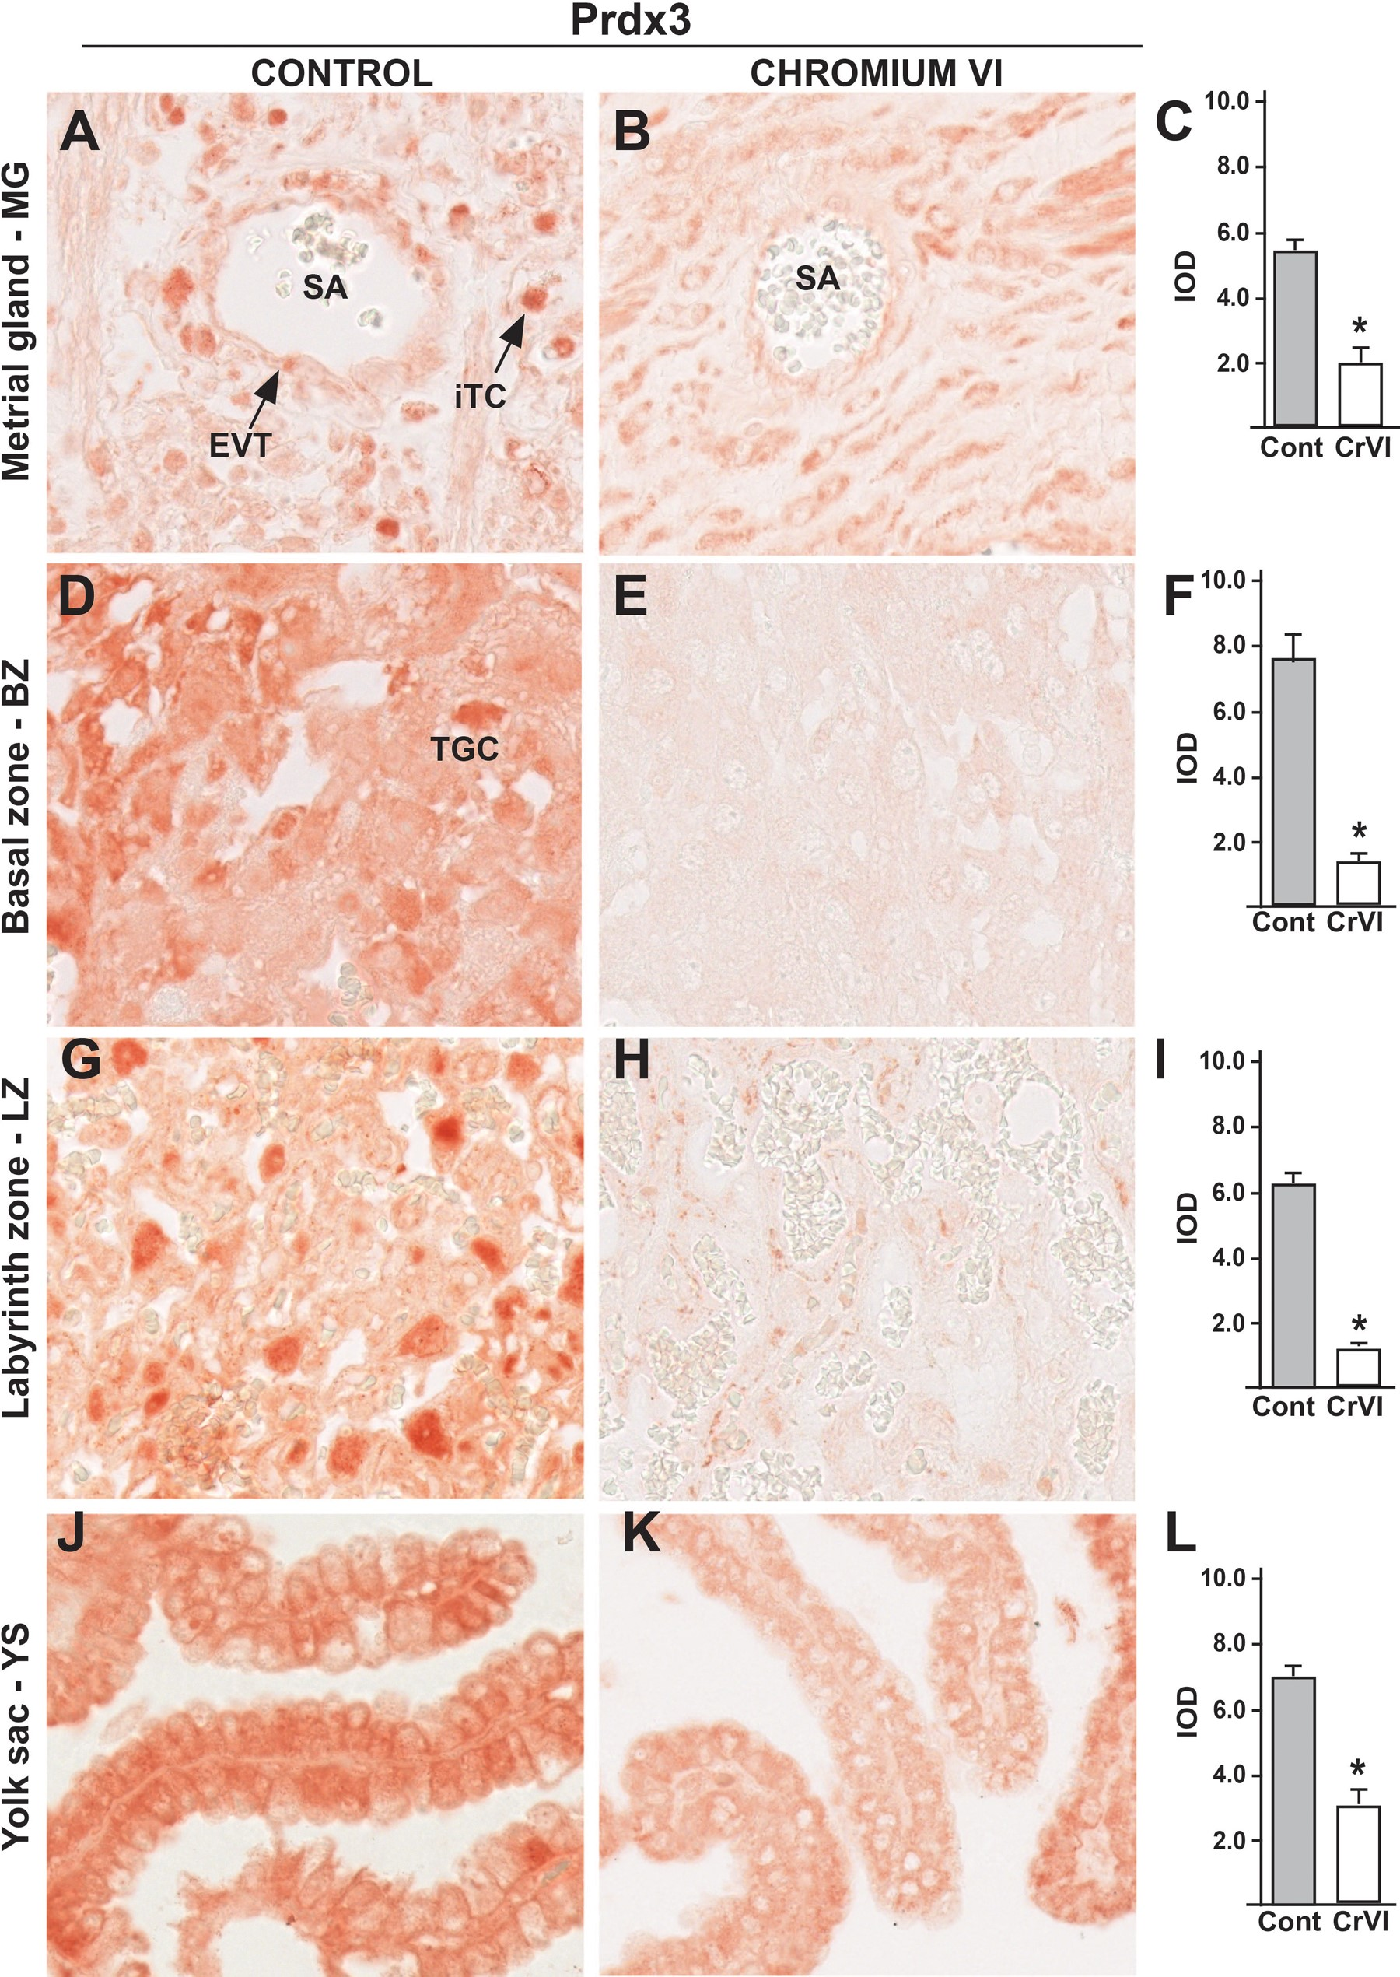
FIG. 9 Effect of CrVI on the expression of Prdx3 on 18.5 dpc in the placenta. Pregnant mothers (n = 5) received ...
Notes:
FIG. 9 Effect of CrVI on the expression of Prdx3 on 18.5 dpc in the placenta. Pregnant mothers (n = 5) received drinking water with or without CrVI (50 ppm) from 9.5 to 14.5 dpc. Placentas were separated on 18.5 dpc and processed for IHC. Representative images are shown for the expression of Prdx3 in MG (A, Control; B, CrVI; and C, histogram) and BZ (D, Control; E, CrVI; and F, histogram); LZ (G, Control; H, CrVI; and I, histogram) and YS (J, Control; K, CrVI; and L, histogram). EVT, endovascular trophoblast; iTC, interstitial trophoblast; SA, spiral artery; TGC, Trophoblastic giant cells. Each value represents mean ± SEM of 5 placentas. *Control versus CrVI, P <.05. Width of field for each image is 220 µm.
Unless provided in the caption above, the following copyright applies to the content of this slide: © The Author 2016. Published by Oxford University Press on behalf of the Society of Toxicology. All rights reserved. For Permissions, please e-mail: journals.permissions@oup.com

Slide 10
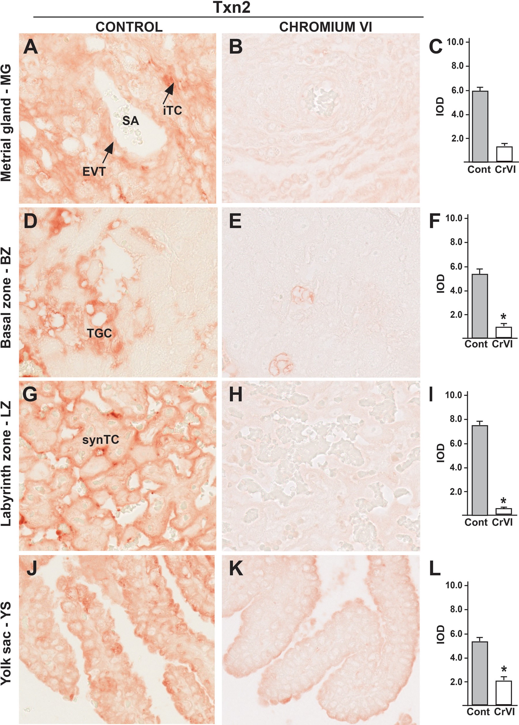
FIG. 10 Effect of CrVI on the expression of Txn2 on 18.5 dpc in the placenta. Pregnant mothers (n = 5) received ...
Notes:
FIG. 10 Effect of CrVI on the expression of Txn2 on 18.5 dpc in the placenta. Pregnant mothers (n = 5) received drinking water with or without CrVI (50 ppm) from 9.5 to 14.5 dpc. Placentas were separated on 18.5 dpc and processed for IHC. Representative images are shown for the expression of Txn2 in MG (A, Control; B, CrVI; and C, histogram) and BZ (D, Control; E, CrVI; and F, histogram); LZ (G, Control; H, CrVI; and I, histogram) and YS (J, Control; K, CrVI; and L, histogram). EVT, endovascular trophoblast; iTC, interstitial trophoblast; synTC, syncytial trophoblasts. Each value represents mean ± SEM of 5 placentas. *Control versus CrVI, P < .05. Width of field for each image is 220 µm.
Unless provided in the caption above, the following copyright applies to the content of this slide: © The Author 2016. Published by Oxford University Press on behalf of the Society of Toxicology. All rights reserved. For Permissions, please e-mail: journals.permissions@oup.com

