Slide 1
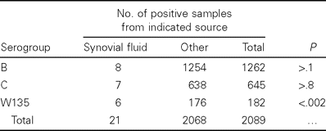
Table 2 Serogroup distribution of Neisseria meningitidis isolates from individuals with bacteriologically confirmed ...
Notes:
Table 2 Serogroup distribution of Neisseria meningitidis isolates from individuals with bacteriologically confirmed cases of meningococcal septic arthritis.
Unless provided in the caption above, the following copyright applies to the content of this slide: © 2003 by the Infectious Diseases Society of America

Slide 2
Table 1 Neisseria meningitidis strains of various serogroups isolated from individuals with invasive infections in ...
Notes:
Table 1 Neisseria meningitidis strains of various serogroups isolated from individuals with invasive infections in France, 1999–2002.
Unless provided in the caption above, the following copyright applies to the content of this slide: © 2003 by the Infectious Diseases Society of America

