Slide 1
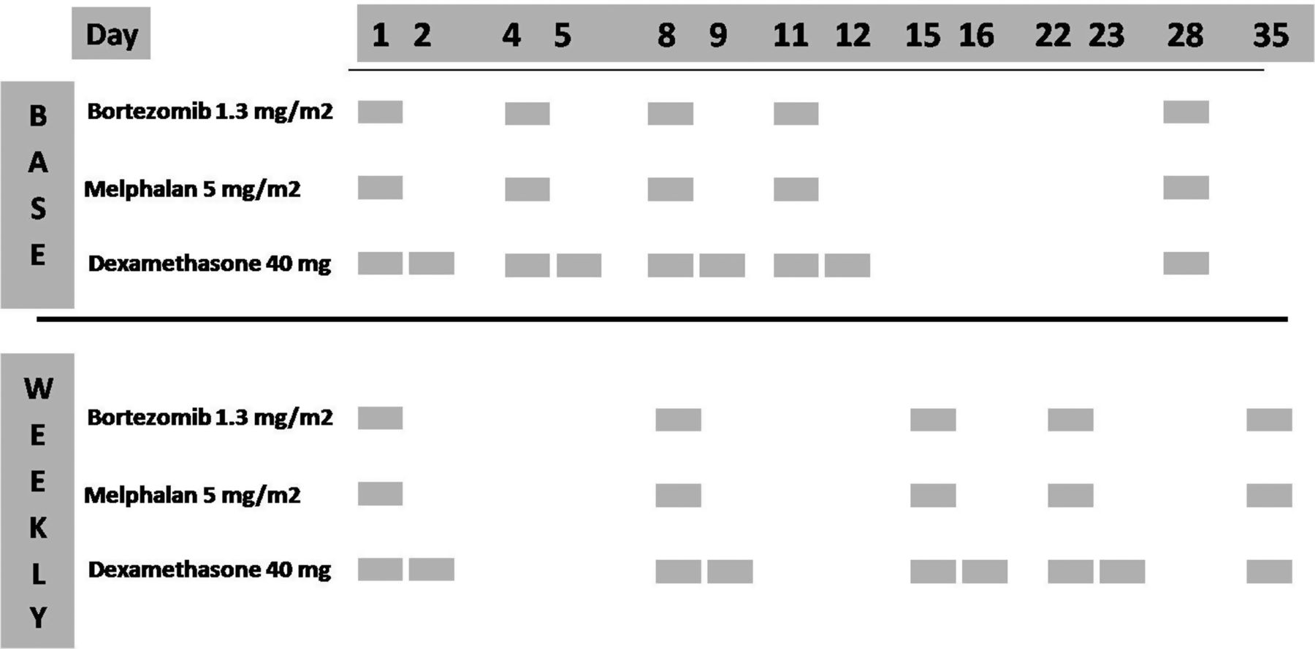
Figure 1. Dosage and administration route of drugs used in the BMD study. Each cycle was proposed every 28 days (‘base’ ...
Notes:
Figure 1. Dosage and administration route of drugs used in the BMD study. Each cycle was proposed every 28 days (‘base’ schedule) or 35 days (‘weekly’ schedule) for six planned courses.
Unless provided in the caption above, the following copyright applies to the content of this slide: © The Author 2012. Published by Oxford University Press on behalf of the European Society for Medical Oncology. All rights reserved. For permissions, please email: journals.permissions@oup.com.

Slide 2
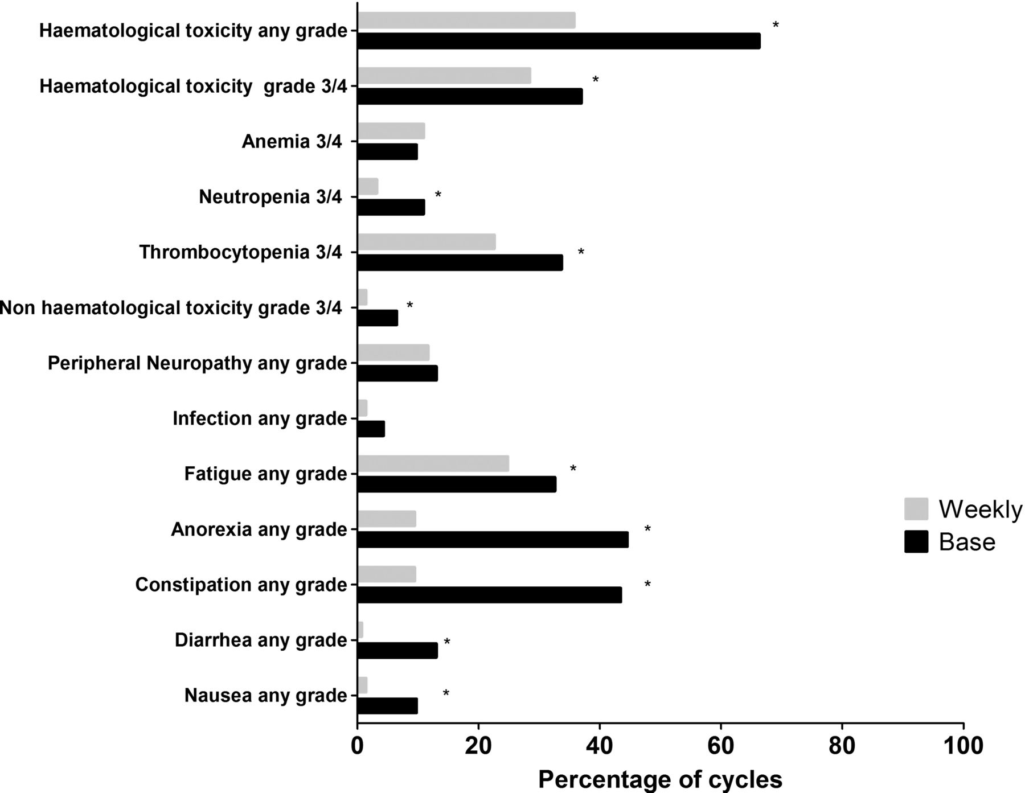
Figure 2. Frequency of adverse events of BMD. The toxicity associated to ‘weekly’ (grey) and ‘base’ (black) schedule ...
Notes:
Figure 2. Frequency of adverse events of BMD. The toxicity associated to ‘weekly’ (grey) and ‘base’ (black) schedule are reported separately. RBC, red blood cells; PLT, platelets; 3/4, toxicity grade 3 or 4 accordingly to NCI-CTC criteria. Stars indicate significant difference, P < 0.005 using chi-square test.
Unless provided in the caption above, the following copyright applies to the content of this slide: © The Author 2012. Published by Oxford University Press on behalf of the European Society for Medical Oncology. All rights reserved. For permissions, please email: journals.permissions@oup.com.

Slide 3
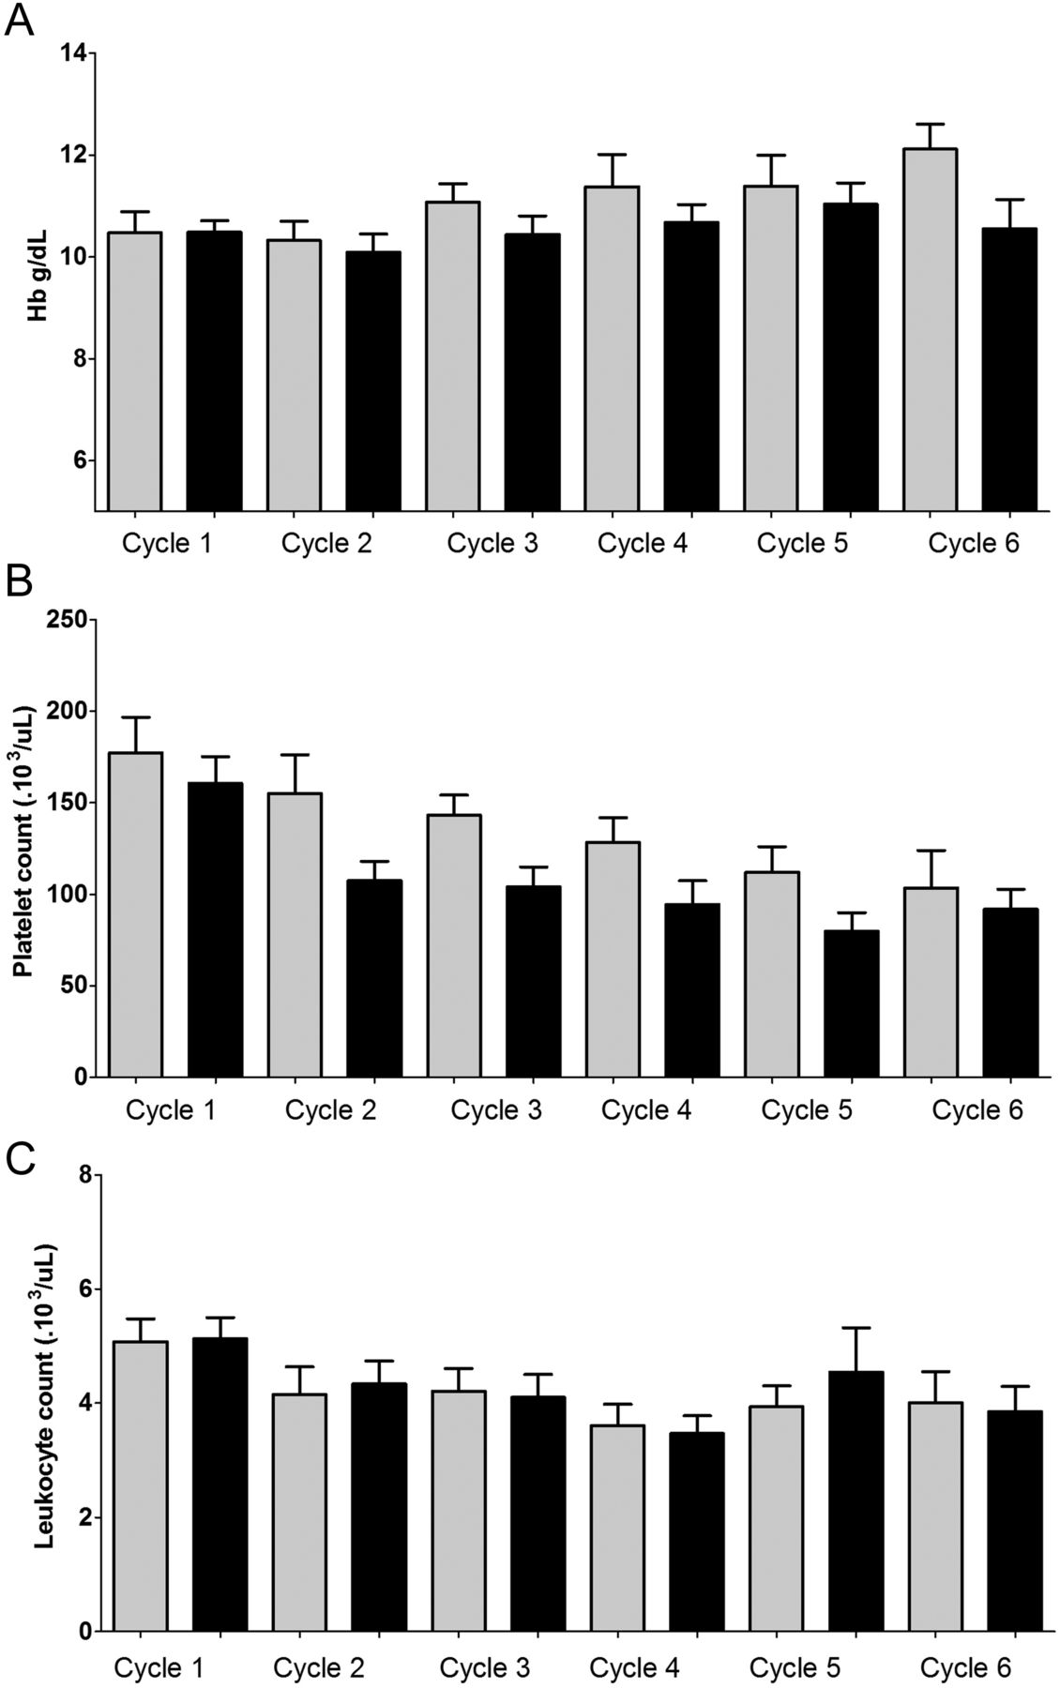
Figure 3. Haematological toxicity of BMD. Mean ± SEM of haemoglobin level (A), platelet count (B) and leukocyte count ...
Notes:
Figure 3. Haematological toxicity of BMD. Mean ± SEM of haemoglobin level (A), platelet count (B) and leukocyte count (C) for each cycle in the ‘weekly’ (grey) and ‘base’ cohort (black).
Unless provided in the caption above, the following copyright applies to the content of this slide: © The Author 2012. Published by Oxford University Press on behalf of the European Society for Medical Oncology. All rights reserved. For permissions, please email: journals.permissions@oup.com.

Slide 4
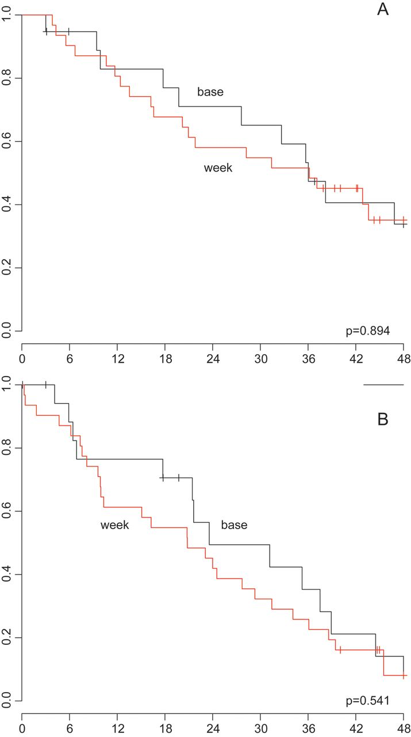
Figure 4. OS and PFS analysis of BMD. Kaplan–Meier plots of (A) OS and (B) PFS by schedule (‘weekly’ in red, ‘base’ in ...
Notes:
Figure 4. OS and PFS analysis of BMD. Kaplan–Meier plots of (A) OS and (B) PFS by schedule (‘weekly’ in red, ‘base’ in black) are reported.
Unless provided in the caption above, the following copyright applies to the content of this slide: © The Author 2012. Published by Oxford University Press on behalf of the European Society for Medical Oncology. All rights reserved. For permissions, please email: journals.permissions@oup.com.

