Slide 1
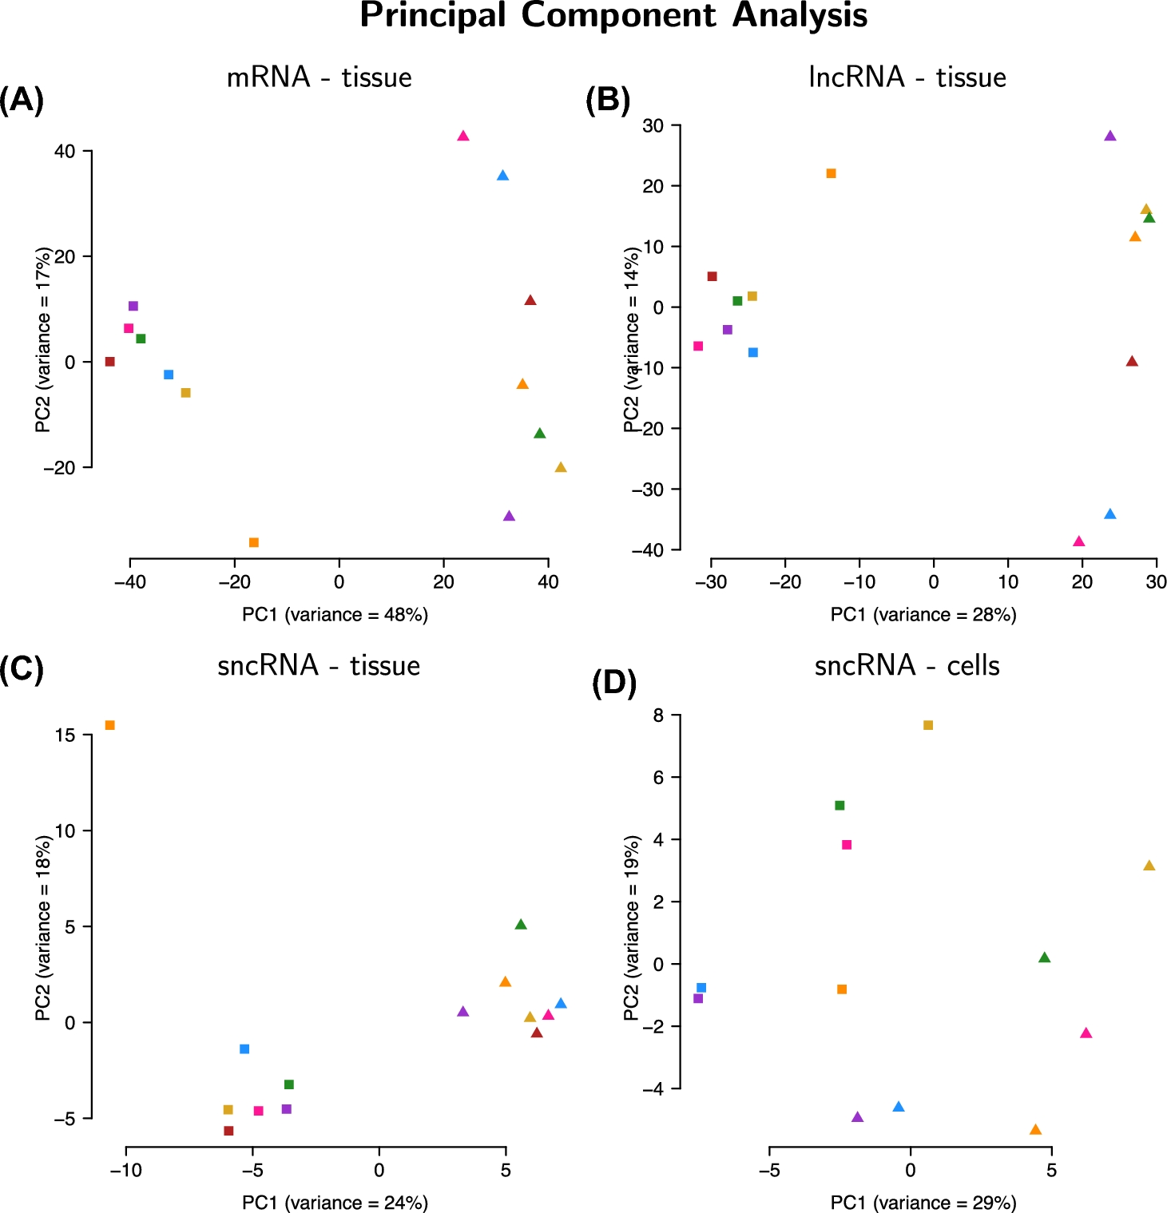
Figure 1. First two principal components of expression values for mRNA in tissue (A), lncRNA in tissue (B), sncRNA in ...
Notes:
Figure 1. First two principal components of expression values for mRNA in tissue (A), lncRNA in tissue (B), sncRNA in tissue (C), and sncRNA in cells (D). In the tissue (A–C), there is a clear separation of expression according to the two different time points of the menstrual cycle. Of note in the tissue is that one sample in the proliferative phase that deviates in expression from the other samples in the proliferative phase (orange square). For the cells (D), there is a separation of expression between before and after decidualization but the difference is not as clear as with the tissue. For the tissue, squares denote proliferative phase and triangles denote WOI. For the cells, squares denote before decidualization and triangles denote after decidualization.
Unless provided in the caption above, the following copyright applies to the content of this slide: © The Authors 2016. Published by Oxford University Press on behalf of Society for the Study of Reproduction. All rights reserved. For permissions, please journals.permissions@oup.com

Slide 2
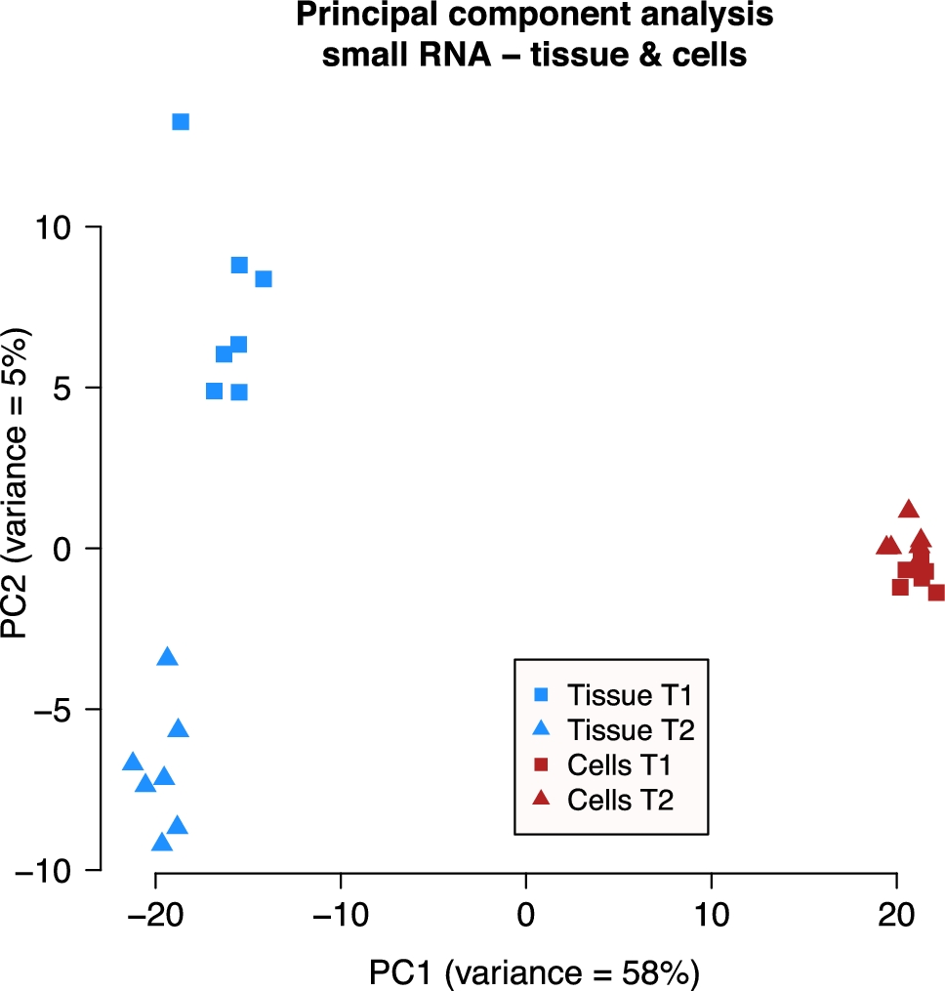
Figure 2. First two principal components of expression values for sncRNA for tissue and cells. Here, the expression ...
Notes:
Figure 2. First two principal components of expression values for sncRNA for tissue and cells. Here, the expression clusters according to source material. The separation of tissue into the two time points is still visible.
Unless provided in the caption above, the following copyright applies to the content of this slide: © The Authors 2016. Published by Oxford University Press on behalf of Society for the Study of Reproduction. All rights reserved. For permissions, please journals.permissions@oup.com

Slide 3
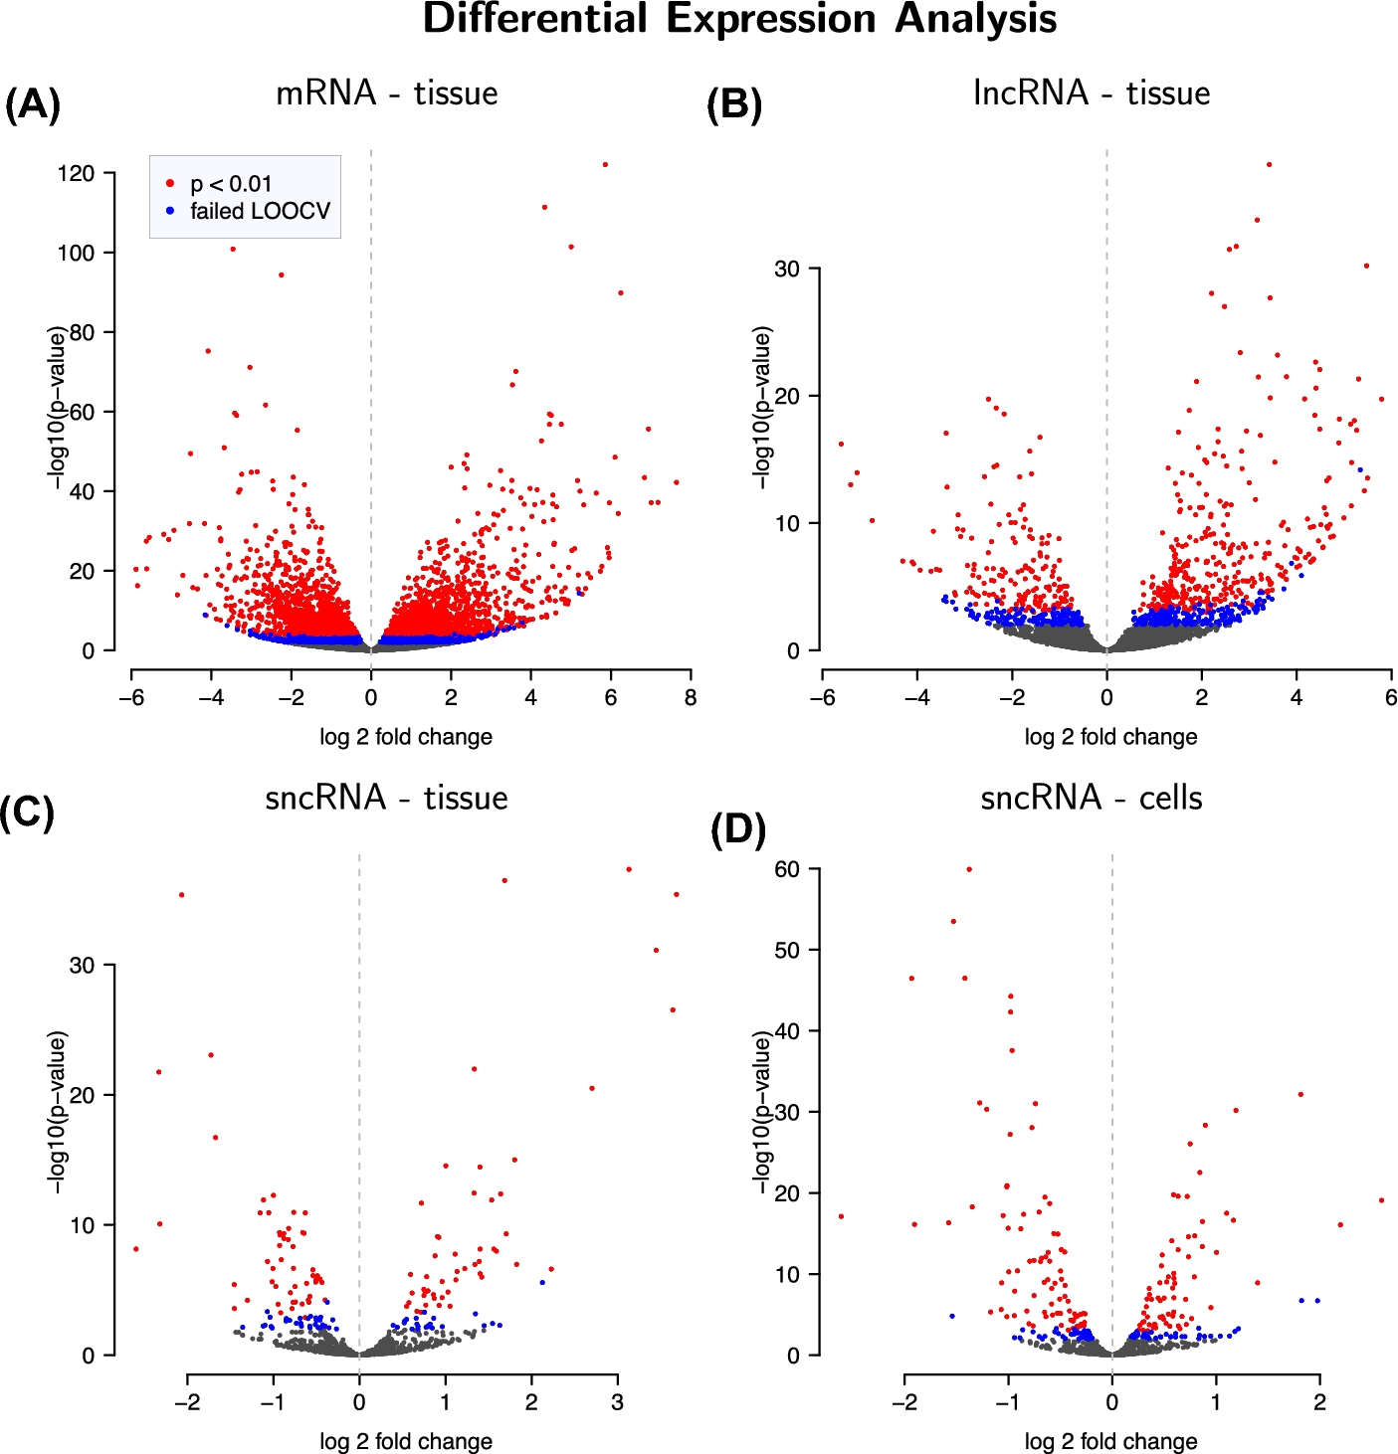
Figure 3. Volcano plots from DE analysis for mRNA in tissue (A), lncRNA in tissue (B), sncRNA in tissue (C), and sncRNA ...
Notes:
Figure 3. Volcano plots from DE analysis for mRNA in tissue (A), lncRNA in tissue (B), sncRNA in tissue (C), and sncRNA in cells (D).
Unless provided in the caption above, the following copyright applies to the content of this slide: © The Authors 2016. Published by Oxford University Press on behalf of Society for the Study of Reproduction. All rights reserved. For permissions, please journals.permissions@oup.com

Slide 4
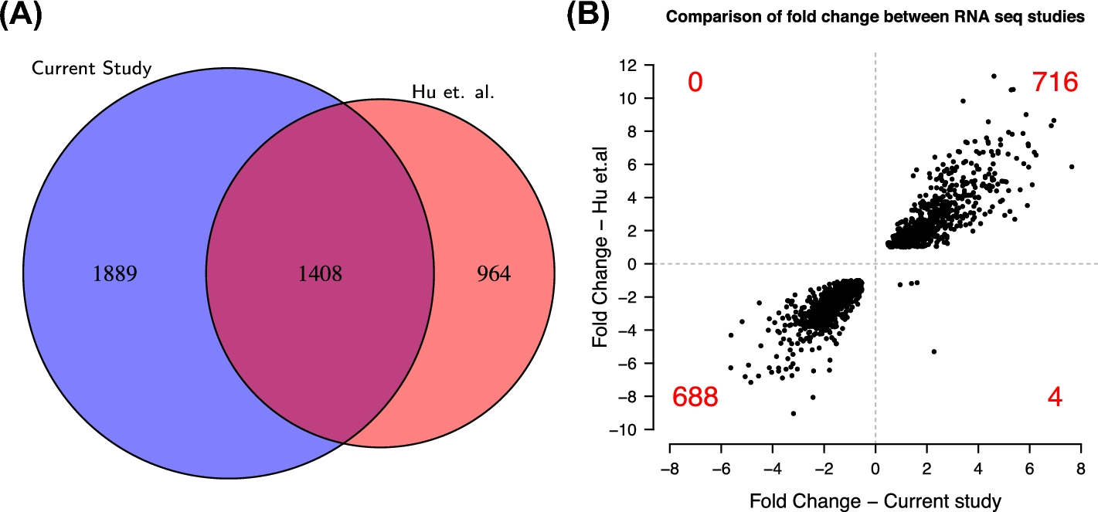
Figure 4. Comparison of SDE genes between RNA sequencing studies of the endometrium. (A) The overlap of SDE between the ...
Notes:
Figure 4. Comparison of SDE genes between RNA sequencing studies of the endometrium. (A) The overlap of SDE between the current study and Hu et al. [7]. In total, 1408 genes were identified as SDE in both studies, 1889 genes were uniquely identified in the current study, and 964 genes were uniquely identified in Hu et al. [7]. (B) Of the genes identifies as SDE in both studies, there is a good agreement with regards to the direction of expression. Of the 1408 genes found to be SDE in both studies, 1404 are expressed in the same direction. That is, 716 of these 1408 genes have a higher expression at WOI in both studies, and 688 genes have a lower expression at WOI in both studies.
Unless provided in the caption above, the following copyright applies to the content of this slide: © The Authors 2016. Published by Oxford University Press on behalf of Society for the Study of Reproduction. All rights reserved. For permissions, please journals.permissions@oup.com

