Slide 1
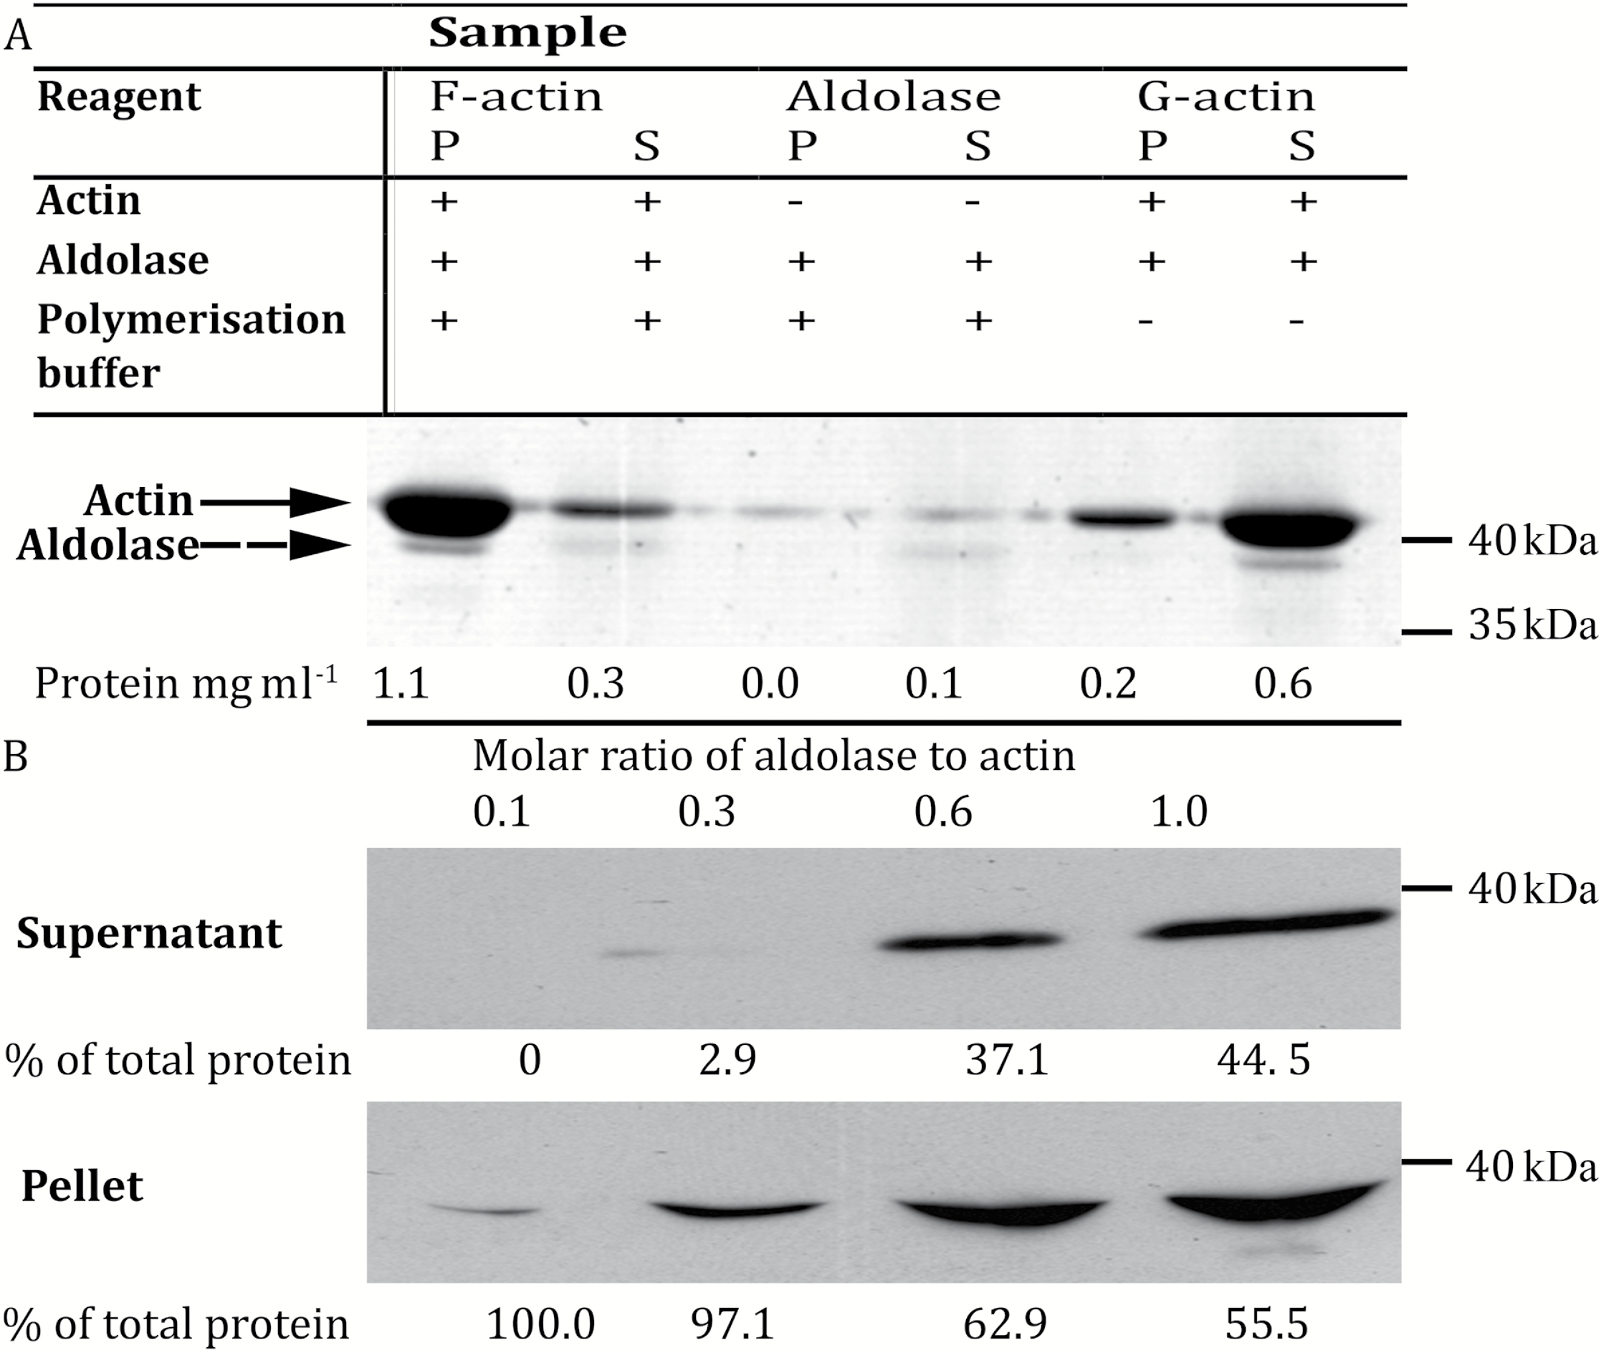
Fig. 1. Association of aldolase with actin in vitro. (A) An actin co-sedimentation assay using recombinant ...
Notes:
Fig. 1. Association of aldolase with actin in vitro. (A) An actin co-sedimentation assay using recombinant Arabidopsis aldolase (0.05 mg ml−1, monomer molar ratio to actin of ~0.1). Reagents added to each sample are shown in the table above the gel image. Actin samples (0.5 mg ml−1) were allowed to polymerize in a final volume of 1 ml, centrifuged to precipitate F-actin, and the resulting pellet (P) and supernatant (S) fractions analysed by SDS-PAGE followed by Coomassie staining. Actin bands, indicated by solid arrow, are present in all lanes due to carry-over during sample loading. Aldolase bands are indicated by a dashed arrow. The protein concentration of each fraction prior to loading is shown below the corresponding lane. (B) Supernatant and pellet fractions of a co-sedimentation assay similar to that shown in (A). A fixed amount of actin (0.5 mg ml−1) was polymerized in the presence of increasing molar ratios of aldolase (shown above each lane, 0.05–0.5 mg ml−1) and samples of 0.5 ml final volume were centrifuged. Resulting fractions were analysed by SDS-PAGE and western blotting with an anti-aldolase primary antibody; comparable amounts of each fraction were loaded per lane. Aldolase–actin molar ratios are shown above the fractions from each sample. Approximate molecular mass is shown on the right of each gel or blot. Supernatant and pellet fractions derived from the same sample are vertically aligned. Values below each lane are relative quantities (estimated by densitometry) as a percentage of total protein detected in both corresponding pellet and supernatant fractions.
Unless provided in the caption above, the following copyright applies to the content of this slide: © The Author 2017. Published by Oxford University Press on behalf of the Society for Experimental Biology. All rights reserved. For permissions, please email: journals.permissions@oup.com

Slide 2
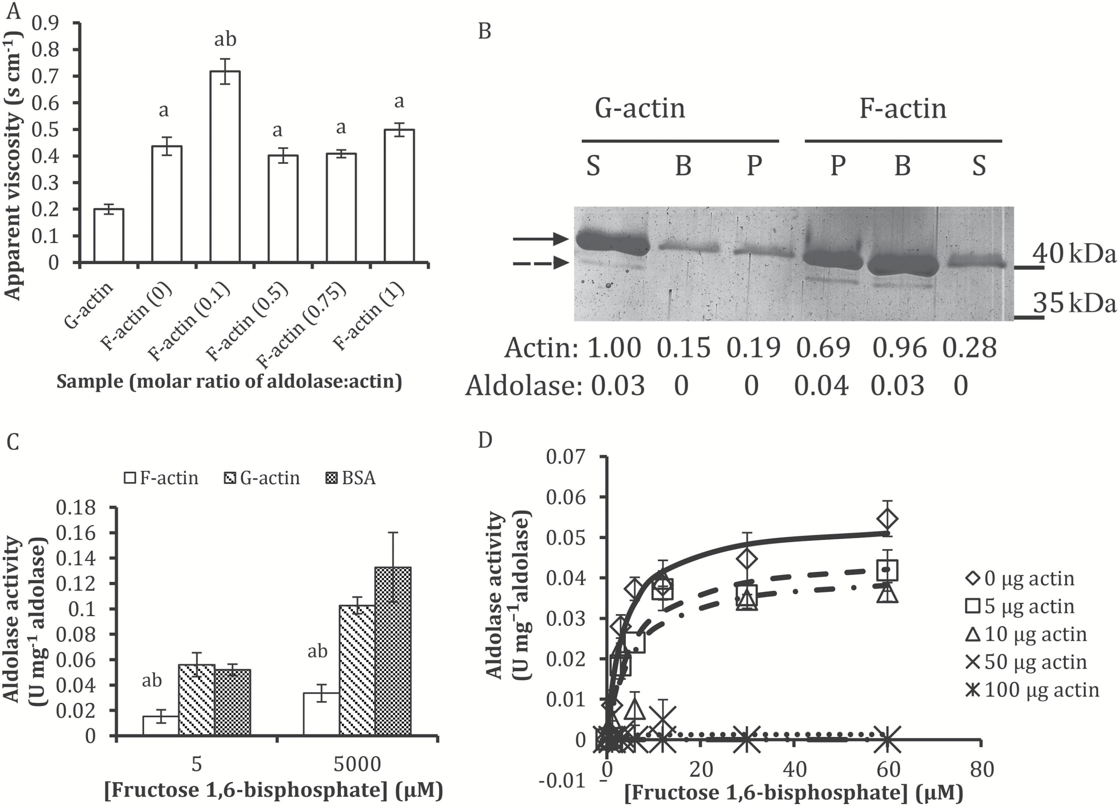
Fig. 2. Aldolase actin binding has reciprocal functional effects in vitro. (A) Falling-ball viscosity measurements of ...
Notes:
Fig. 2. Aldolase actin binding has reciprocal functional effects in vitro. (A) Falling-ball viscosity measurements of G- and F-actin samples in the presence of increasing molar ratios of aldolase. Numbers in parentheses indicate the molar ratio of aldolase to actin monomers in each sample. (a) denotes a significant difference compared with G-actin and (b) compared with F-actin (0) samples at P<0.01 using Student’s, two-tailed, homoscedastic t-test. (B) Serial co-sedimentation assays set up as in Fig. 1B. After polymerization samples were centrifuged at low speed; the supernatant from this step was then centrifuged at high speed and the resulting fractions analysed by SDS-PAGE and Coomassie staining. Equal volumes were run in each lane. G-actin, un-polymerized actin control with aldolase; F-actin, polymerized actin with aldolase; B, low-speed ‘bundled actin’ pellet fraction; P, high-speed pellet fraction; S, supernatant after high-speed centrifugation. Actin (solid arrow) and aldolase (dashed arrow) and approximate molecular masses are indicated. Values below each lane are the relative amounts of actin and aldolase estimated from the image, normalized to G-actin supernatant band intensity. (C) Aldolase specific activity in the presence of F-actin, G-actin, and BSA, at molar ratios of ~0.1 aldolase to other proteins and at two different concentrations of fructose 1,6-bisphosphate. (a) denotes a significant difference compared with corresponding G-actin sample and (b) to corresponding BSA sample at P<0.01 using Student’s, two-tailed, homoscedastic t-test. (D) Michaelis–Menten curves of aldolase activity in the presence of increasing amounts of polymerized actin. All values are the average of at least three technical replicates. Error bars are SEM. Experiments were repeated at least twice with reproducible results.
Unless provided in the caption above, the following copyright applies to the content of this slide: © The Author 2017. Published by Oxford University Press on behalf of the Society for Experimental Biology. All rights reserved. For permissions, please email: journals.permissions@oup.com

Slide 3
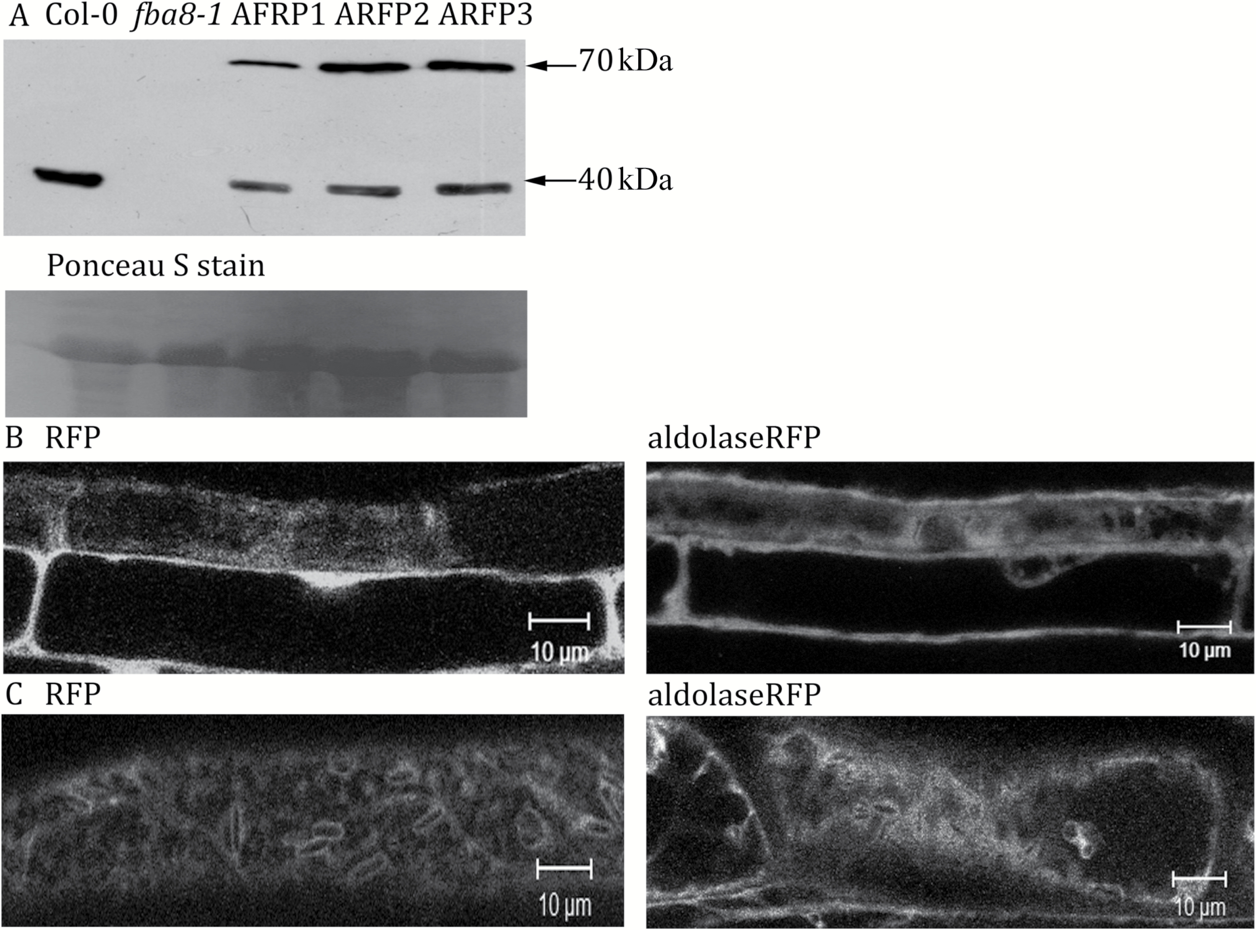
Fig. 3. Distribution of aldolase:RFP and free RFP expressed in an Arabidopsis aldolase knockout genetic background in ...
Notes:
Fig. 3. Distribution of aldolase:RFP and free RFP expressed in an Arabidopsis aldolase knockout genetic background in seedling root epidermal and hypocotyl cells imaged by CLSM. (A) Western blot on crude protein extracts from wild type (Col-0), aldolase knockout (fba8-1), and three independent aldolase:RFP expressing plants (ARFP1, 2, and 3) from leaves of 5-week-old plants using an anti-aldolase primary antibody. Approximate molecular masses of 70 and 40 kDa (arrows) as estimated by comparison to a molecular mass marker are indicated. The Ponceau S stained membrane before probing with the anti-aldolase antibody is shown as a loading control. Approximately 40 μg protein was loaded per lane. (B) Free RFP and aldolase:RFP in root epidermal cells. (C) Free RFP and aldolase:RFP in hypocotyl cells. Seedlings used for imaging were 10–14 d old.
Unless provided in the caption above, the following copyright applies to the content of this slide: © The Author 2017. Published by Oxford University Press on behalf of the Society for Experimental Biology. All rights reserved. For permissions, please email: journals.permissions@oup.com

Slide 4
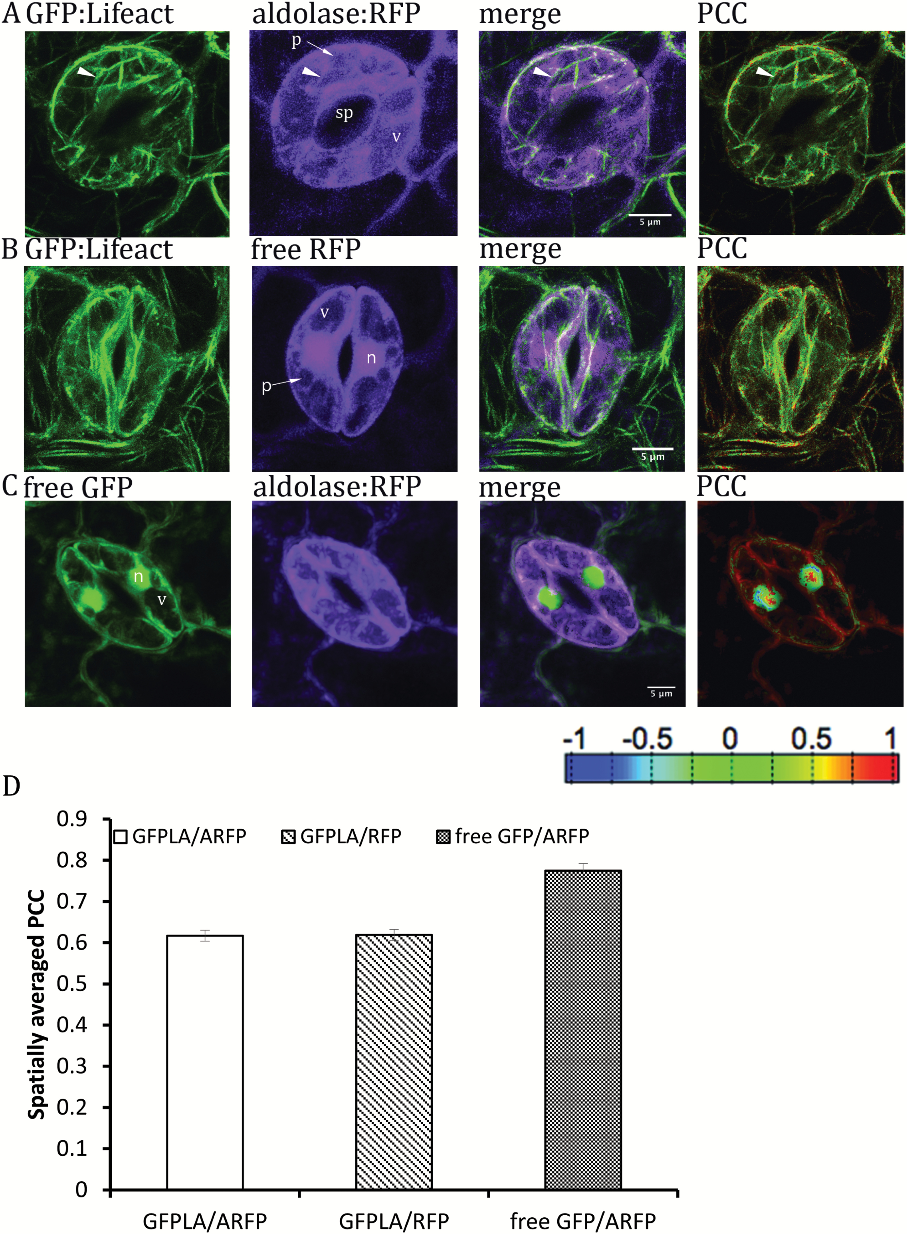
Fig. 4. Investigating the correlation of aldolase:RFP and free RFP with GFP:Lifeact, and aldolase:RFP with free GFP ...
Notes:
Fig. 4. Investigating the correlation of aldolase:RFP and free RFP with GFP:Lifeact, and aldolase:RFP with free GFP in Arabidopsis fba8-1 guard cells using CLSM. (A–C) Maximal intensity z-series projections of guard cells co-expressing GFP:Lifeact with aldolase:RFP (A), GFP:Lifeact with free RFP (B), and free, cytosolic GFP with aldolase:RFP (C). GFP fluorescence (GFP:Lifeact and free GFP) is pseudocoloured green, RFP fluorescence (aldolase:RFP and free RFP) is pseudocoloured magenta, co-localizing voxels in the merged images are shown in white. The PCC panel is a pseudocoloured image showing the Pearson’s correlation coefficient of the co-expressed fluorophores in each pixel, with blue indicating low correlation and red indicating maximum correlation of the two fluorophores (see reference bar below images). p, plastid; sp, stomatal pore; n, nucleus; v, vacuole. (D) Spatially averaged PCC of GFP:Lifeact with aldolase:RFP (GFPLA/ARFP) or with free RFP (GFPLA/RFP), and free GFP with aldolase:RFP (freeGFP/ARFP). Values are the spatially averaged coefficient±SEM calculated from a minimum of seven independent CLSM, z-stack image series (n=7) for each of the co-expressing lines.
Unless provided in the caption above, the following copyright applies to the content of this slide: © The Author 2017. Published by Oxford University Press on behalf of the Society for Experimental Biology. All rights reserved. For permissions, please email: journals.permissions@oup.com

Slide 5
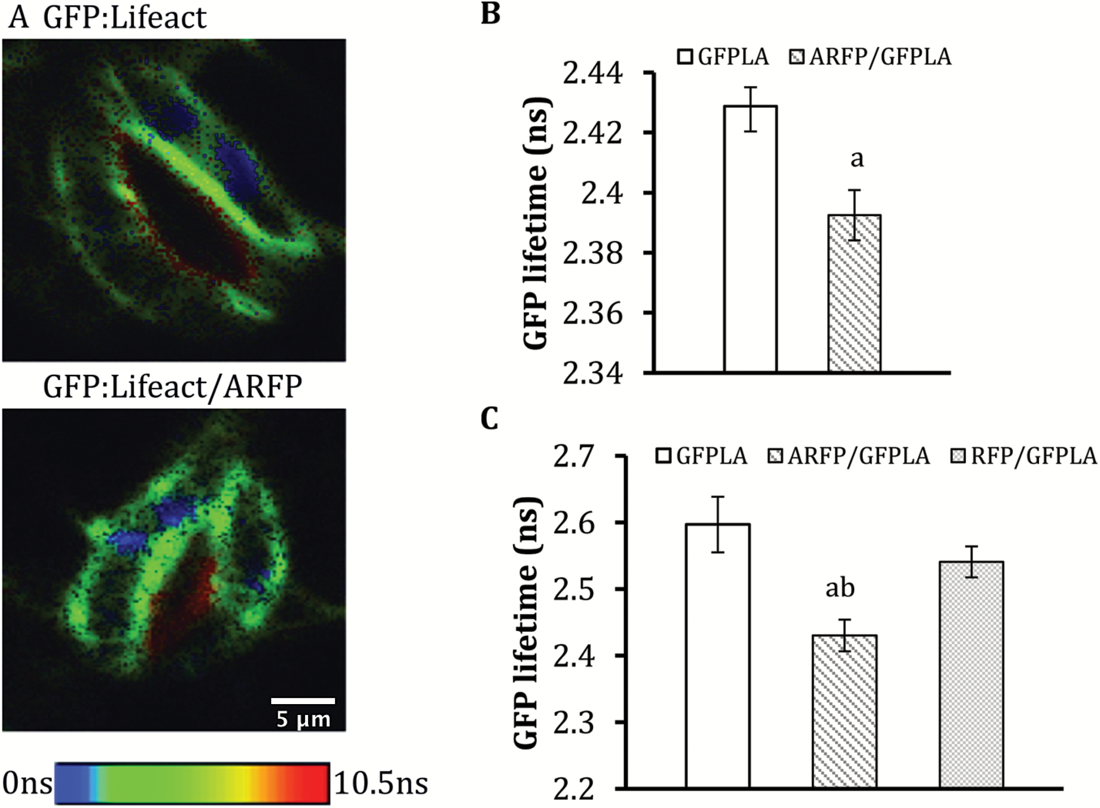
Fig. 5. FRET-FLIM measurements of GFP:Lifeact expressed in Arabidopsis guard cells and in tobacco leaf epidermal ...
Notes:
Fig. 5. FRET-FLIM measurements of GFP:Lifeact expressed in Arabidopsis guard cells and in tobacco leaf epidermal cells. (A) GFP:Lifeact expressed alone (GFP:Lifeact) and co-expressed with aldolase:RFP (GFP:Lifeact/ARFP) in Arabidopsis fba8-1 guard cells. Images are colour-coded according to the lifetime (in ns) of GFP in each pixel; a reference bar with the range of lifetimes is shown below the images. (B) Average lifetime of GFP:Lifeact when expressed alone (GFPLA), or co-expressed with aldolase:RFP (ARFP/GFPLA) in Arabidopsis fba8-1 guard cells. (C) Average lifetime of GFP:Lifeact expressed alone (GFPLA), co-expressed with aldolase:RFP (ARFP/GFPLA), or with free RFP (RFP/GFPLA) in tobacco leaf epidermal cells. Values are the average lifetime of nine independent images per line for both Arabidopsis and tobacco experiments; error bars are SEM. Three different images were taken from each of three leaves originating from different plants (n=9). Average lifetimes for each image were calculated from regions of interest that excluded lifetime values from the stomatal pore region (arrowheads in A), where strong auto-fluorescence would result in spuriously high lifetime values. (a) denotes significant difference from corresponding GFPLA and (b) denotes significant difference from the RFP/GFPLA at P<0.01 using Student’s, two-tailed, homoscedastic t-test.
Unless provided in the caption above, the following copyright applies to the content of this slide: © The Author 2017. Published by Oxford University Press on behalf of the Society for Experimental Biology. All rights reserved. For permissions, please email: journals.permissions@oup.com

Slide 6
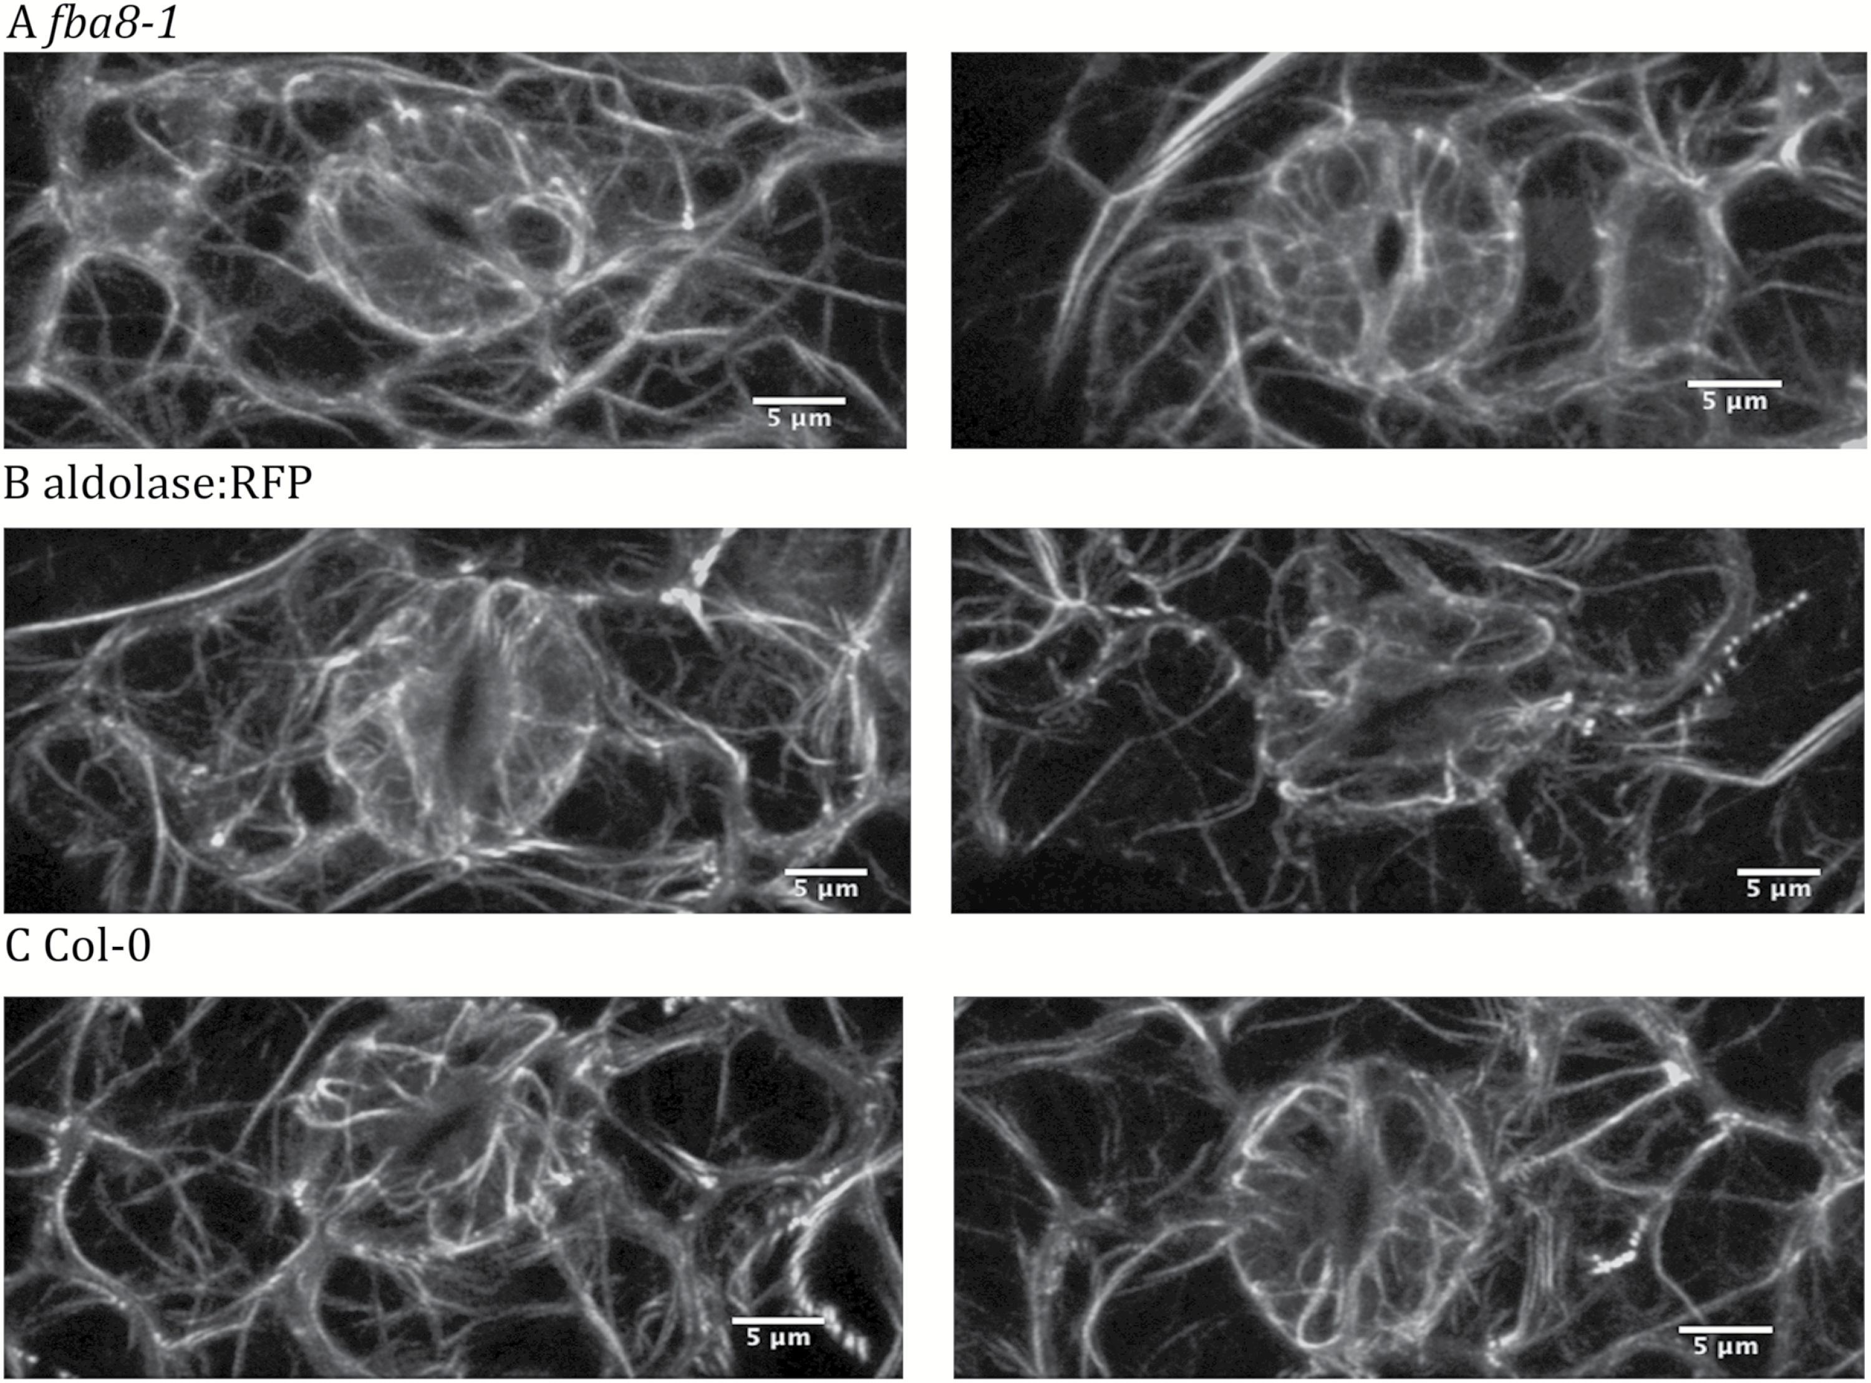
Fig. 6. Distribution of actin in guard cells of fba8-1, aldolase:RFP complemented and wild type plants. GFP:Lifeact ...
Notes:
Fig. 6. Distribution of actin in guard cells of fba8-1, aldolase:RFP complemented and wild type plants. GFP:Lifeact expressed in fba8-1 (A), aldolase:RFP complemented (B), and wild type (C) Col-0 Arabidopsis guard cells. Images are maximal intensity projections of z-stack confocal series. Comparable images were acquired from at least three different leaves per line, originating from different plants.
Unless provided in the caption above, the following copyright applies to the content of this slide: © The Author 2017. Published by Oxford University Press on behalf of the Society for Experimental Biology. All rights reserved. For permissions, please email: journals.permissions@oup.com

Slide 7
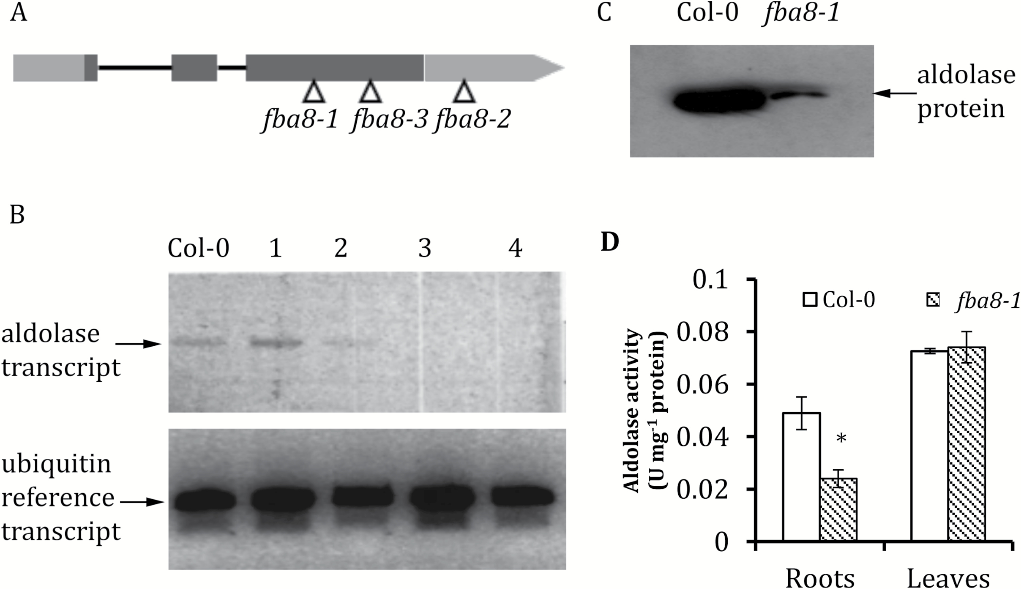
Fig. 7. Schematic gene model of Arabidopsis aldolase FBA8 (At3g52930) and isolation of an FBA8 knockout line. (A) ...
Notes:
Fig. 7. Schematic gene model of Arabidopsis aldolase FBA8 (At3g52930) and isolation of an FBA8 knockout line. (A) Schematic diagram of the FBA8 gene. 5′- (box) and 3′- (box arrow) untranslated regions are shown in light grey. Exons are shown as dark grey boxes; introns are shown as lines. The approximate insertion sites of the T-DNA insertions in lines fba8-1 (used in this work), fba8-2, and fba8-3 are indicated with white arrowheads. (B) Results of an RT-PCR targeting the full-length mature transcript of the aldolase gene and of an RT-PCR on the same cDNA, but targeting a fragment of a ubiquitin transcript as a reference, in individual fba8-1 plants, progeny of a segregating plant population. Numbers 1, 2, 3, and 4 denote individual heterozygous (1 and 2) and homozygous (3 and 4) plants. (C) Western blot with an anti-cytosolic aldolase antibody on crude protein extracts from wild type Col-0 and homozygous fba8-1 leaves. Molecular mass or aldolase band (arrow) is between 35 and 40 kDa (D) Crude protein extracts from roots and leaves of wild type and fba8-1 homozygous seedlings were assayed for total aldolase enzyme activity. Values are the average of two technical replicates from at least two biological samples (>20 seedlings per replicate) for each genotype. Error bars are SEM. *Significantly different from the corresponding Col-0 sample at P<0.01 using Student’s, two tailed, homoscedastic t-test. The experiment was repeated twice with similar results.
Unless provided in the caption above, the following copyright applies to the content of this slide: © The Author 2017. Published by Oxford University Press on behalf of the Society for Experimental Biology. All rights reserved. For permissions, please email: journals.permissions@oup.com

Slide 8
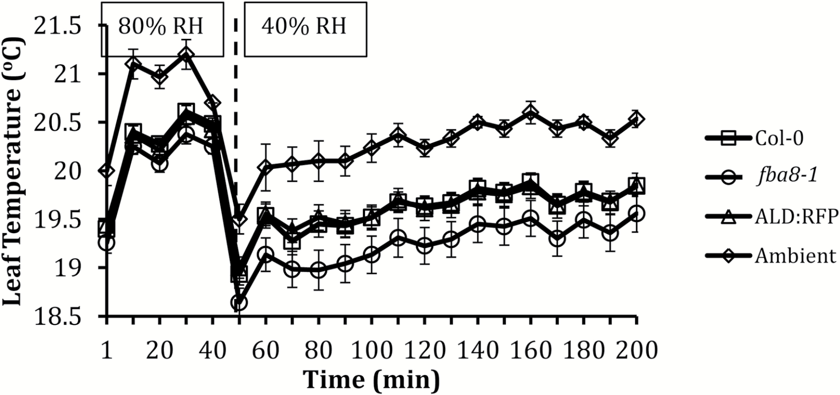
Fig. 8. Leaf temperature of fba8-1 during a humidity drop treatment. (A) Leaf temperature was measured by infrared ...
Notes:
Fig. 8. Leaf temperature of fba8-1 during a humidity drop treatment. (A) Leaf temperature was measured by infrared imaging. Plants were imaged at 80% relative humidity (RH) for 50 min. Humidity was decreased to 40% RH and plants were imaged for over 2 h. The dashed line indicates the time point where humidity began to decrease. Leaf temperature was compared with Col-0 and aldolase:RFP expressing fba8-1 plants. Ambient temperature was measured in parallel. Values are the average temperature of three different leaves from three different plants (n=9) per line; error bars are SEM. Fba8-1 leaf temperature was found to be significantly different from Col-0 and aldolase:RFP after the drop in RH, using one-way ANOVA.
Unless provided in the caption above, the following copyright applies to the content of this slide: © The Author 2017. Published by Oxford University Press on behalf of the Society for Experimental Biology. All rights reserved. For permissions, please email: journals.permissions@oup.com

