Slide 1
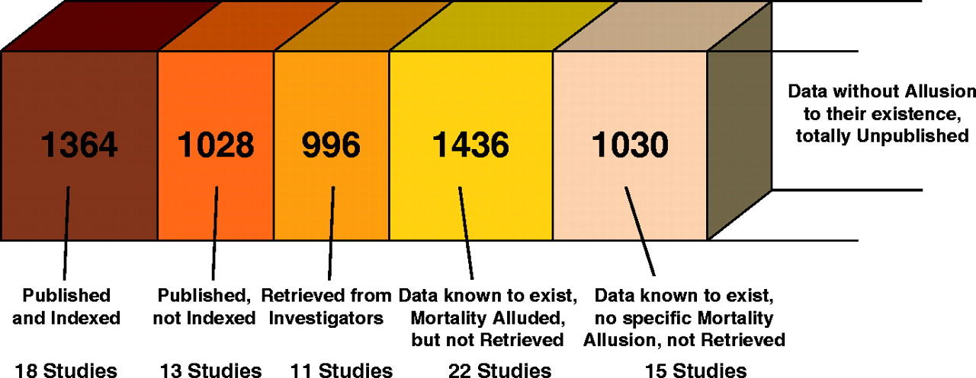
Fig. 1. Number of patients for each type of data considered in the meta-analysis of TP53 status and the risk of death ...
Notes:
Fig. 1. Number of patients for each type of data considered in the meta-analysis of TP53 status and the risk of death in patients with head and neck squamous cell cancer.
Unless provided in the caption above, the following copyright applies to the content of this slide: © The Author 2005. Published by Oxford University Press. All rights reserved. For Permissions, please e-mail: journals.permissions@oupjournals.org.

Slide 2
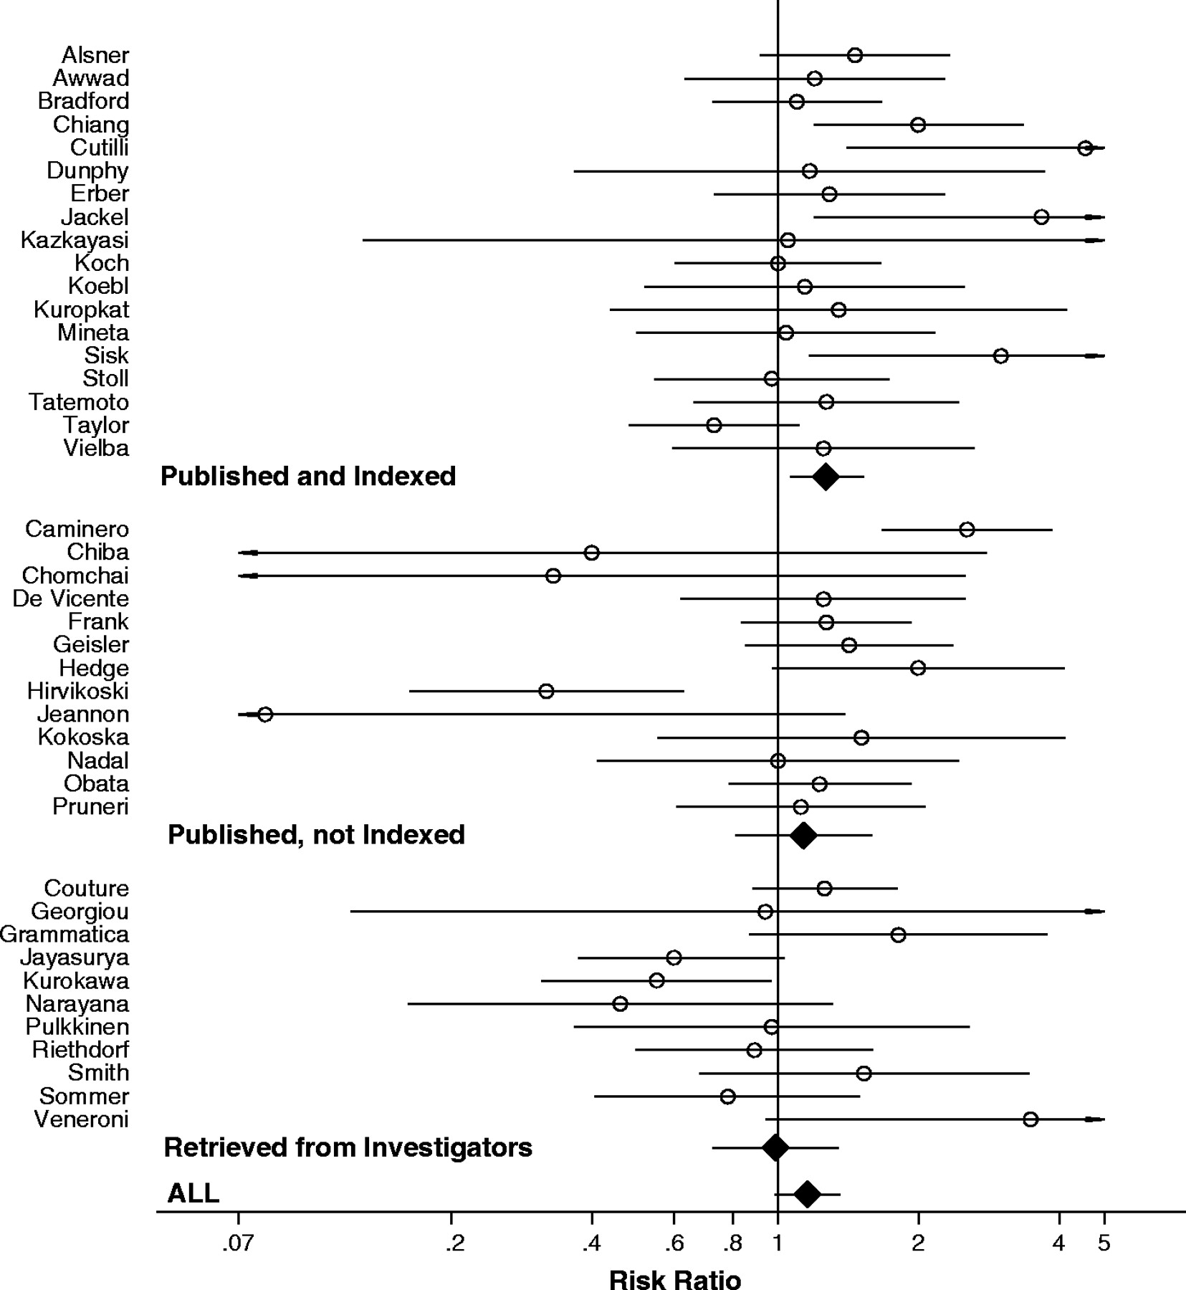
Fig. 2. Meta-analysis of the association between TP53 status and the risk of death at 2 years. Each study is shown ...
Notes:
Fig. 2. Meta-analysis of the association between TP53 status and the risk of death at 2 years. Each study is shown by the name of the first author and the risk ratio with 95% confidence intervals. RR is shown with open circle and 95% CI with continuous line . Summary risk ratio and 95% confidence intervals (according to random effects calculations) are also shown: RR is shown with solid diamonds and 95% CI with continuous line . Data are separated into published and indexed; published but not indexed; and retrieved. For CIs that extend beyond the visible range, arrows have been placed.
Unless provided in the caption above, the following copyright applies to the content of this slide: © The Author 2005. Published by Oxford University Press. All rights reserved. For Permissions, please e-mail: journals.permissions@oupjournals.org.

Slide 3
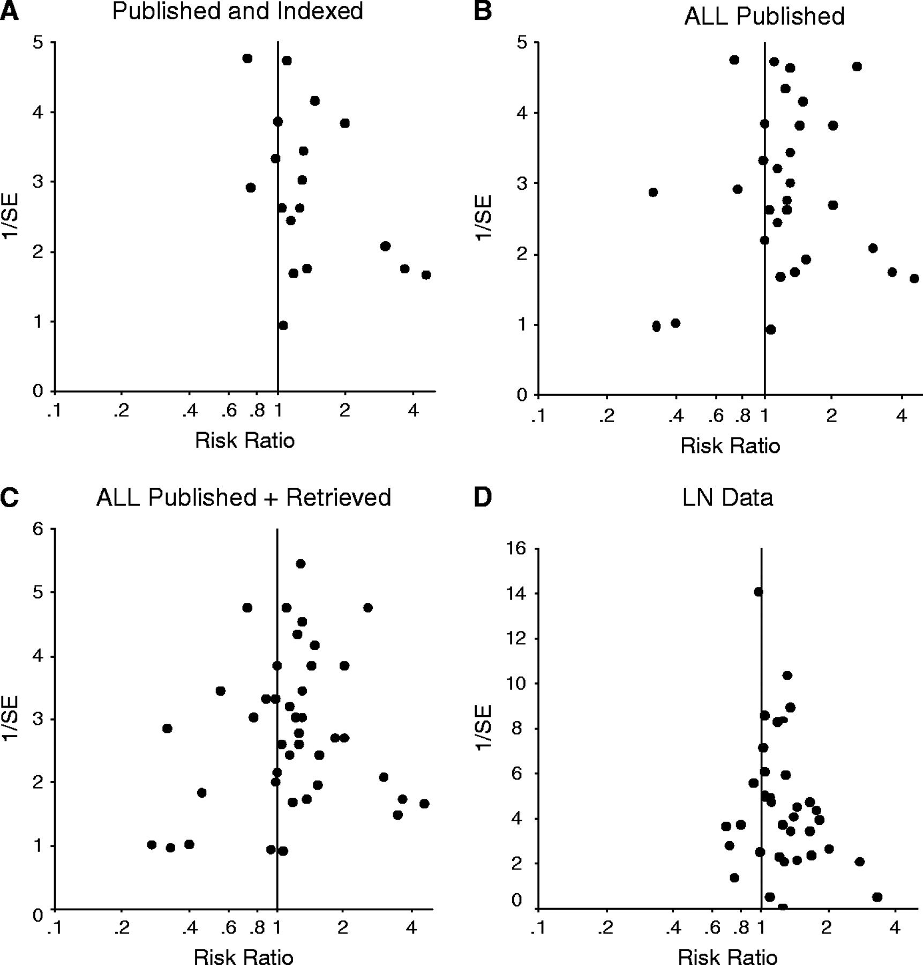
Fig. 3. Inverted funnel plots of the relation between risk ratios for survival and 1/standard error (1/SE). Inverted ...
Notes:
Fig. 3. Inverted funnel plots of the relation between risk ratios for survival and 1/standard error (1/SE). Inverted funnel plots show a measure of the effect size on the horizontal axis and a measure of the precision of the estimate on the vertical axis. Asymmetry may signal publication bias, other biases, or other sources of heterogeneity. ( A ) Published and indexed studies. ( B ) All published studies. ( C ) All studies with published or retrieved data. ( D ) Published studies with data for lymph node metastasis at the time of diagnosis.
Unless provided in the caption above, the following copyright applies to the content of this slide: © The Author 2005. Published by Oxford University Press. All rights reserved. For Permissions, please e-mail: journals.permissions@oupjournals.org.

