Slide 1
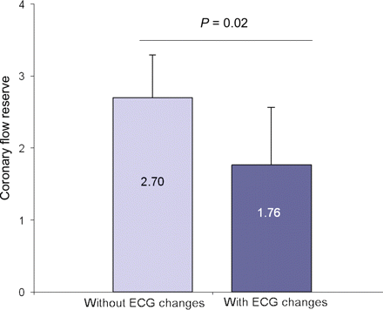
Figure 3 Coronary flow reserve in patients with and without ischaemic electrocardiographic (ECG) changes during ...
Notes:
Figure 3 Coronary flow reserve in patients with and without ischaemic electrocardiographic (ECG) changes during adenosine stress. Dark blue bar represents patients with ischaemic ECG changes. Light blue bar represents patients without ischaemic ECG changes. Error bars indicate standard deviation.
Unless provided in the caption above, the following copyright applies to the content of this slide: Published on behalf of the European Society of Cardiology. All rights reserved. © The Author 2009. For permissions please email: journals.permissions@oxfordjournals.org

Slide 2
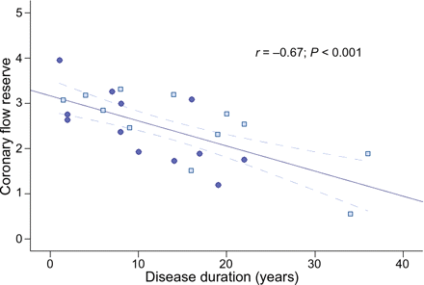
Figure 4 Relation between coronary flow reserve and disease duration. Scatter plot showing linear regression between ...
Notes:
Figure 4 Relation between coronary flow reserve and disease duration. Scatter plot showing linear regression between coronary flow reserve and disease duration (years) in patients. Dark blue circles represent SLE patients. Light blue squares represent RA patients. The solid lines represents the point estimated and the upper and lower lines the 95% confidence intervals. Coronary flow reserve = 3.16 − 0.06 × years of disease.
Unless provided in the caption above, the following copyright applies to the content of this slide: Published on behalf of the European Society of Cardiology. All rights reserved. © The Author 2009. For permissions please email: journals.permissions@oxfordjournals.org

Slide 3
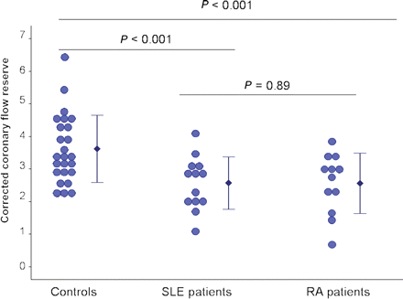
Figure 2 Coronary flow reserve corrected by rate–pressure product in rheumatoid arthritis and systemic lupus ...
Notes:
Figure 2 Coronary flow reserve corrected by rate–pressure product in rheumatoid arthritis and systemic lupus erythematosus patients and controls. Error bars represent mean ± standard deviation.
Unless provided in the caption above, the following copyright applies to the content of this slide: Published on behalf of the European Society of Cardiology. All rights reserved. © The Author 2009. For permissions please email: journals.permissions@oxfordjournals.org

Slide 4
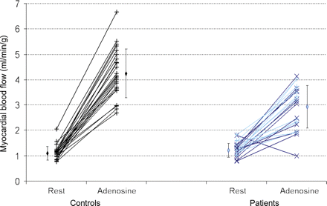
Figure 1 Myocardial blood flow in patients and controls. Individual values [systemic lupus erythematosus (SLE) and ...
Notes:
Figure 1 Myocardial blood flow in patients and controls. Individual values [systemic lupus erythematosus (SLE) and rheumatoid arthritis (RA) patients and controls) of myocardial blood flow at rest and during hyperaemia induced by adenosine. Light blue lines represent SLE patients. Dark blue lines represent RA patients. Error bars represent mean ± standard deviation.
Unless provided in the caption above, the following copyright applies to the content of this slide: Published on behalf of the European Society of Cardiology. All rights reserved. © The Author 2009. For permissions please email: journals.permissions@oxfordjournals.org

