Slide 1
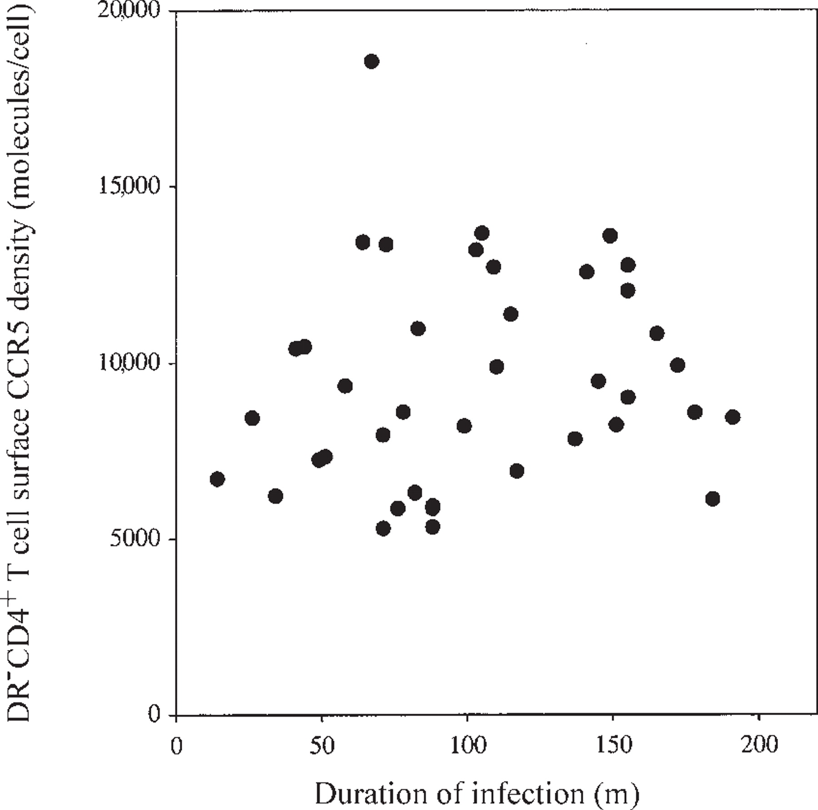
Figure 1. Absence of correlation in vertically infected children between duration of human immunodeficiency virus type ...
Notes:
Figure 1. Absence of correlation in vertically infected children between duration of human immunodeficiency virus type 1 infection and DR-CD4+ T cell surface CC chemokine receptor 5 (CCR5) density. m, months.
Unless provided in the caption above, the following copyright applies to the content of this slide: © 2002 by the Infectious Diseases Society of America

Slide 2
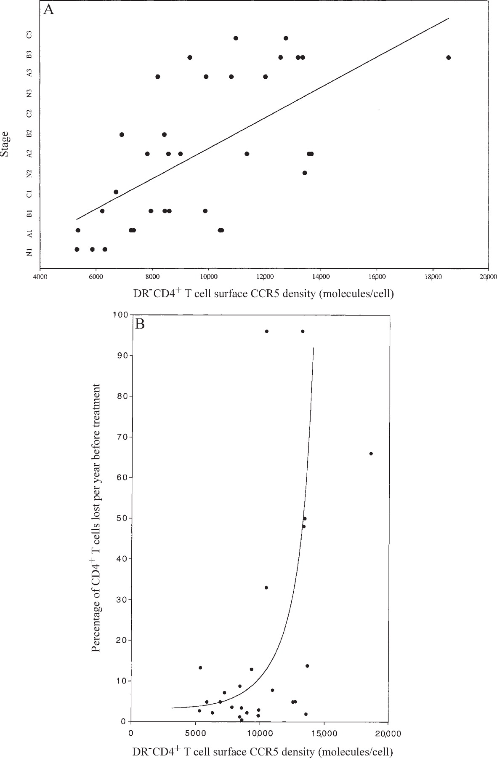
Figure 2. Correlation of DR⁻CD4⁺ T cell surface CC chemokine receptor 5 (CCR5) density with ...
Notes:
Figure 2. Correlation of DR-CD4+ T cell surface CC chemokine receptor 5 (CCR5) density with bioclinical stage (A) and with CD4+ T cell slope (B) in nontreated human immunodeficiency virus type 1-infected children.
Unless provided in the caption above, the following copyright applies to the content of this slide: © 2002 by the Infectious Diseases Society of America

Slide 3
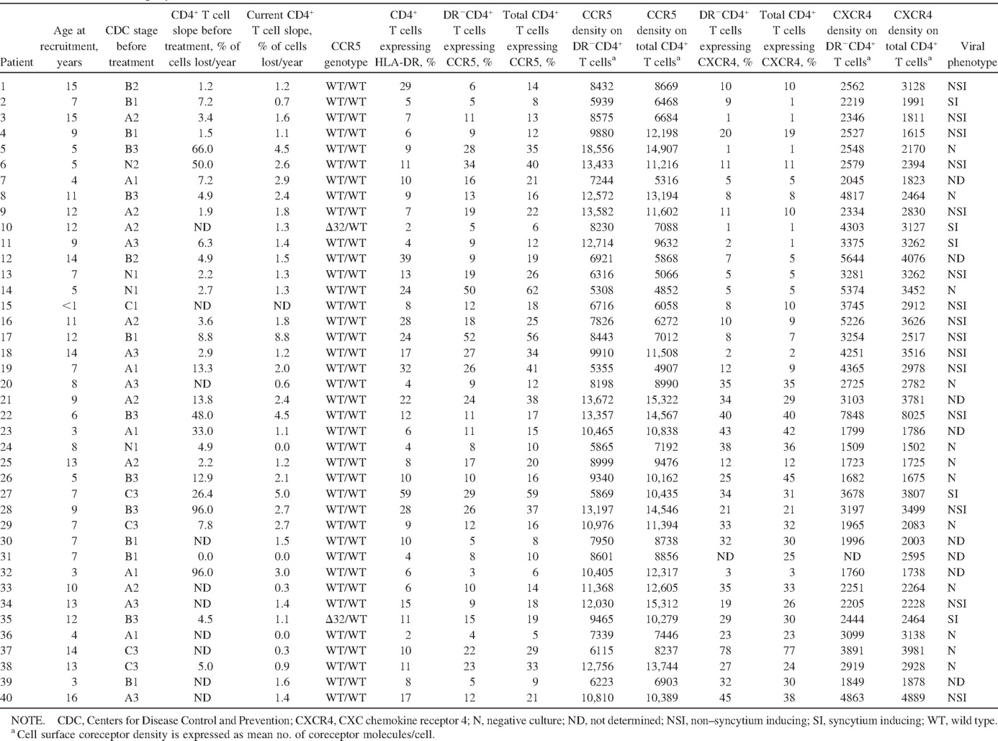
Table 1. Bioclinical characteristics of children vertically infected with human immunodeficiency virus type 1 (HIV-1) ...
Notes:
Table 1. Bioclinical characteristics of children vertically infected with human immunodeficiency virus type 1 (HIV-1) in study of CC chemokine receptor 5 (CCR5) density on CD4+ T cell surface and disease progression.
Unless provided in the caption above, the following copyright applies to the content of this slide: © 2002 by the Infectious Diseases Society of America

Slide 4
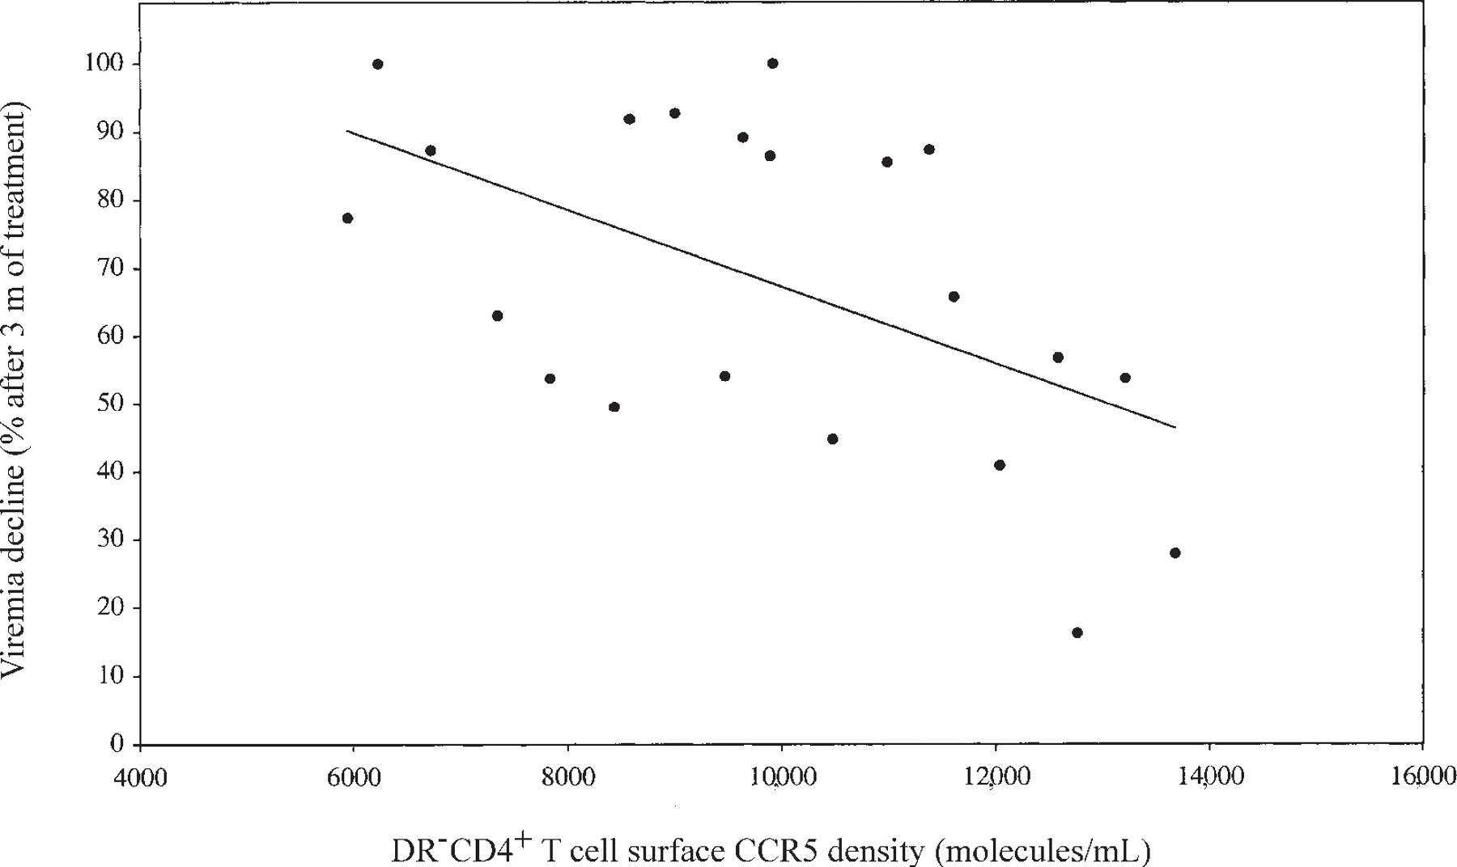
Figure 3. Correlation between DR⁻CD4⁺ T cell surface CC chemokine receptor 5 (CCR5) density and ...
Notes:
Figure 3. Correlation between DR-CD4+ T cell surface CC chemokine receptor 5 (CCR5) density and response to treatment (decline in viremia) among human immunodeficiency virus type 1-infected children. m, months.
Unless provided in the caption above, the following copyright applies to the content of this slide: © 2002 by the Infectious Diseases Society of America

Slide 5
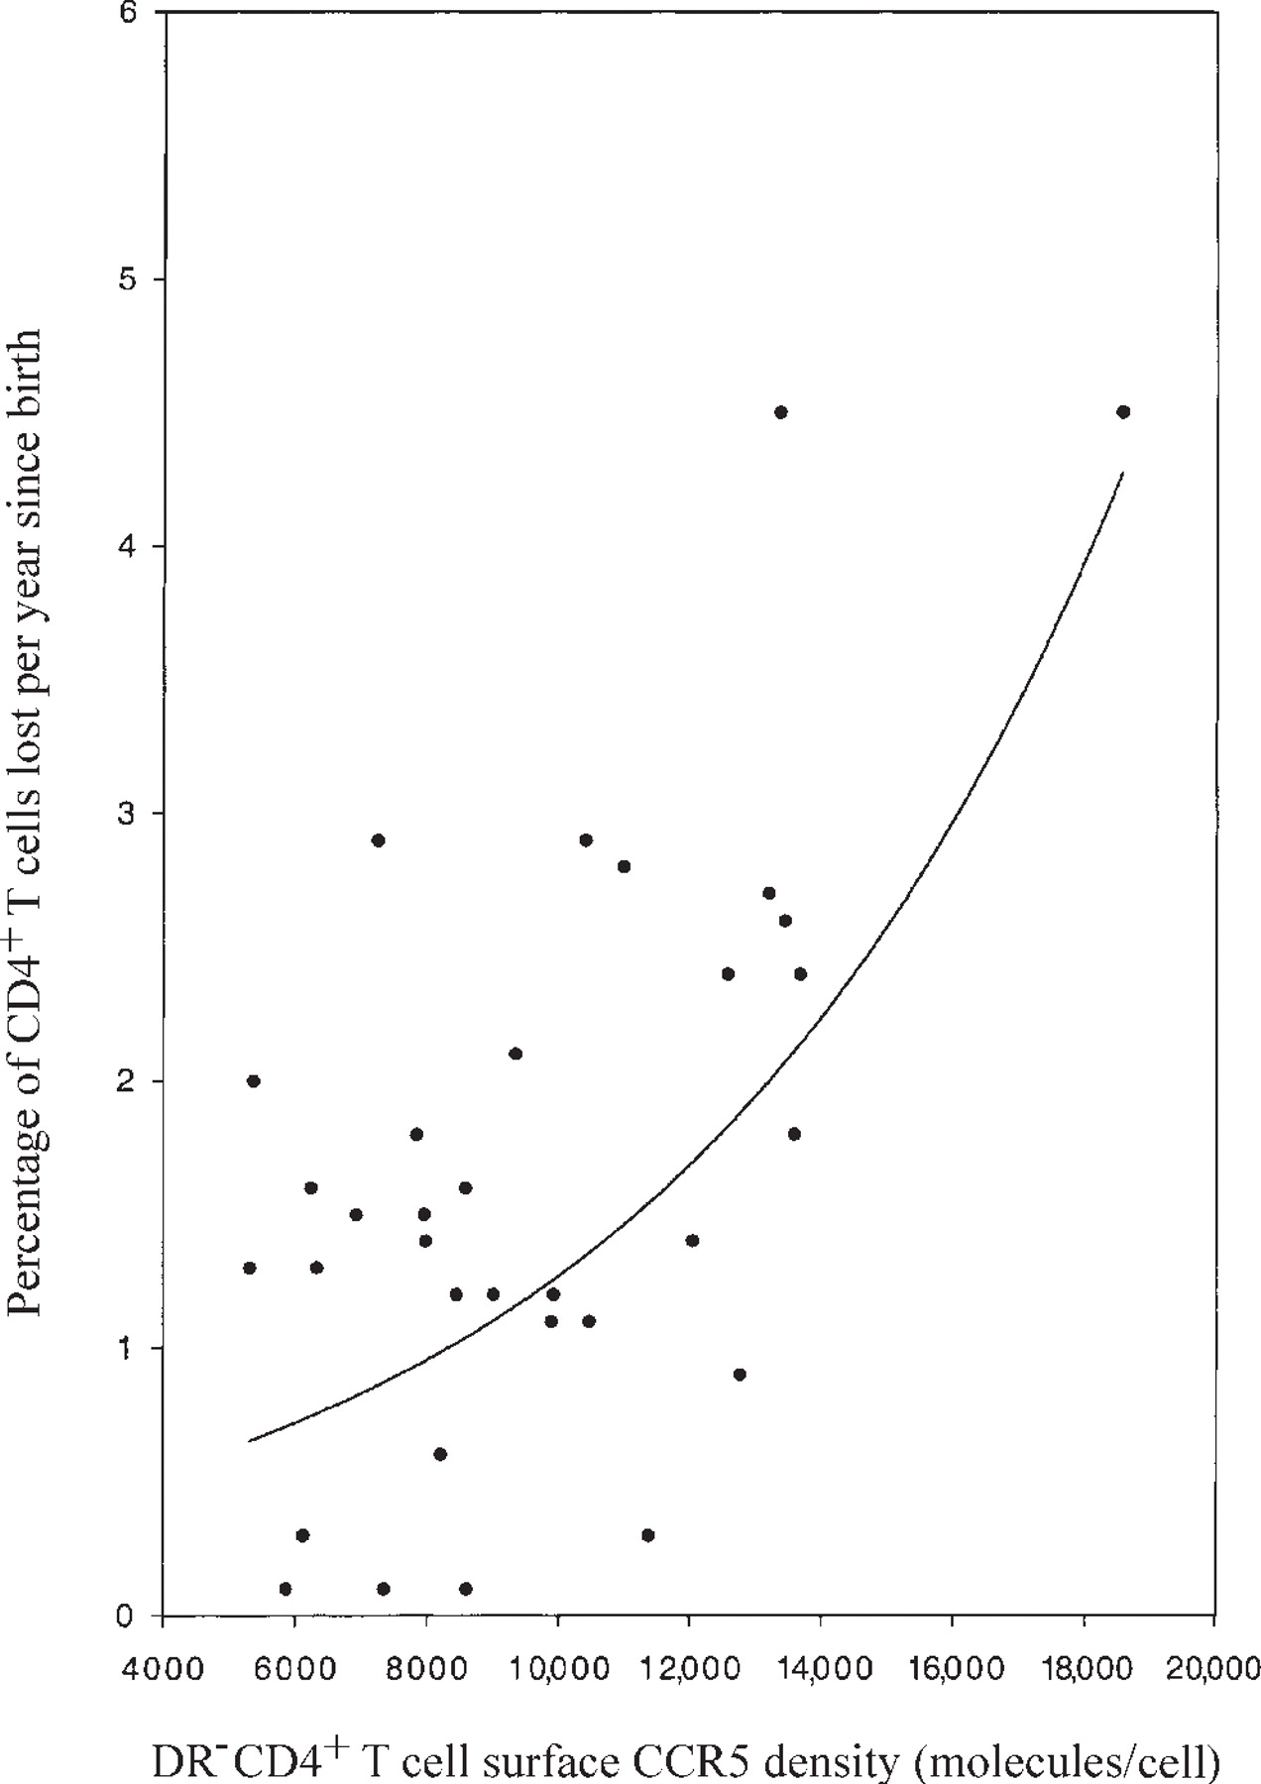
Figure 4. Correlation between DR⁻CD4⁺ T cell surface CC chemokine receptor 5 (CCR5) density and ...
Notes:
Figure 4. Correlation between DR-CD4+ T cell surface CC chemokine receptor 5 (CCR5) density and CD4+ T cell slope since birth among human immunodeficiency virus type 1-infected children.
Unless provided in the caption above, the following copyright applies to the content of this slide: © 2002 by the Infectious Diseases Society of America

