Slide 1
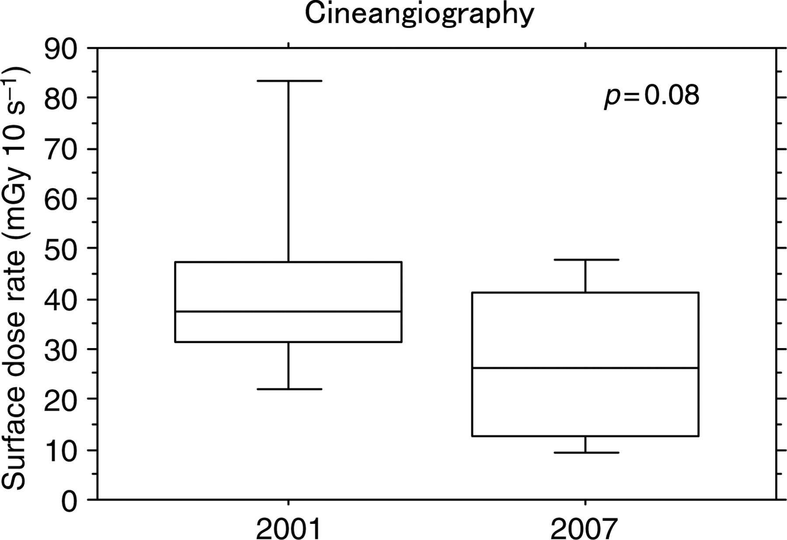
Figure 1. Box and whisker diagram of the entrance surface dose rate for cineangiography with a 20 cm thick acrylic ...
Notes:
Figure 1. Box and whisker diagram of the entrance surface dose rate for cineangiography with a 20 cm thick acrylic plate.
Unless provided in the caption above, the following copyright applies to the content of this slide: © The Author 2010. Published by Oxford University Press. All rights reserved. For Permissions, please email: journals.permissions@oup.com

Slide 2
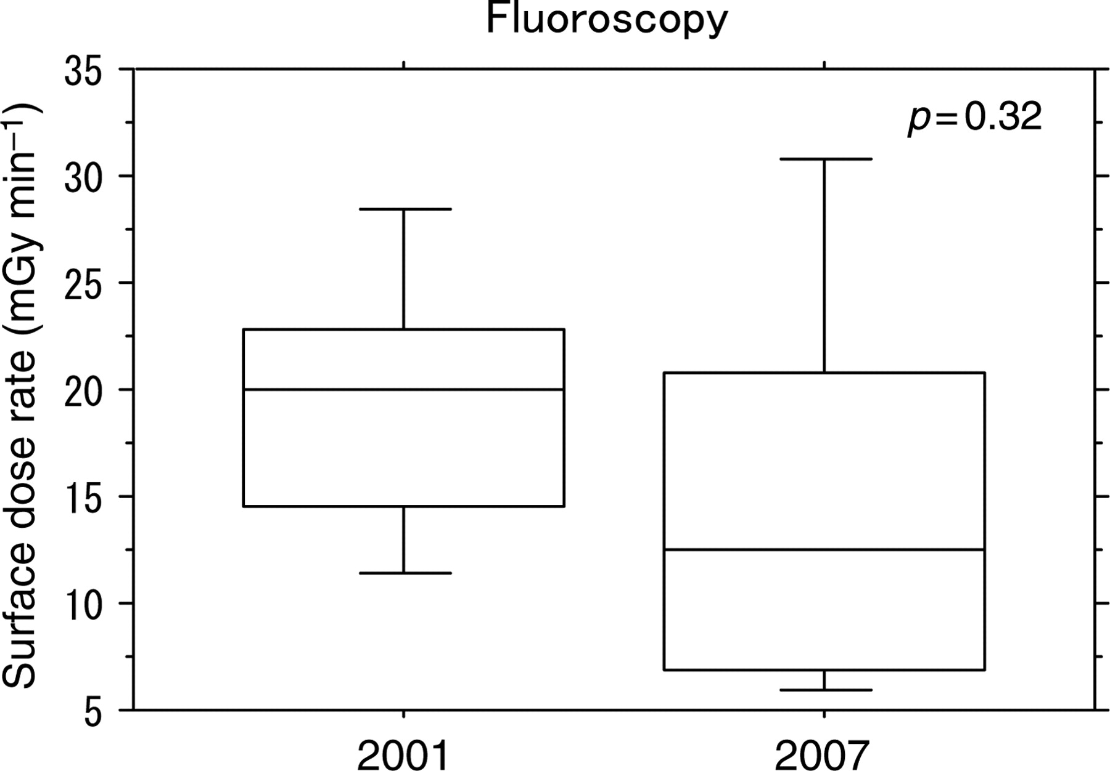
Figure 2. Box and whisker diagram of the entrance surface dose rate for fluoroscopy with a 20 cm thick acrylic plate.
Notes:
Figure 2. Box and whisker diagram of the entrance surface dose rate for fluoroscopy with a 20 cm thick acrylic plate.
Unless provided in the caption above, the following copyright applies to the content of this slide: © The Author 2010. Published by Oxford University Press. All rights reserved. For Permissions, please email: journals.permissions@oup.com

Slide 3
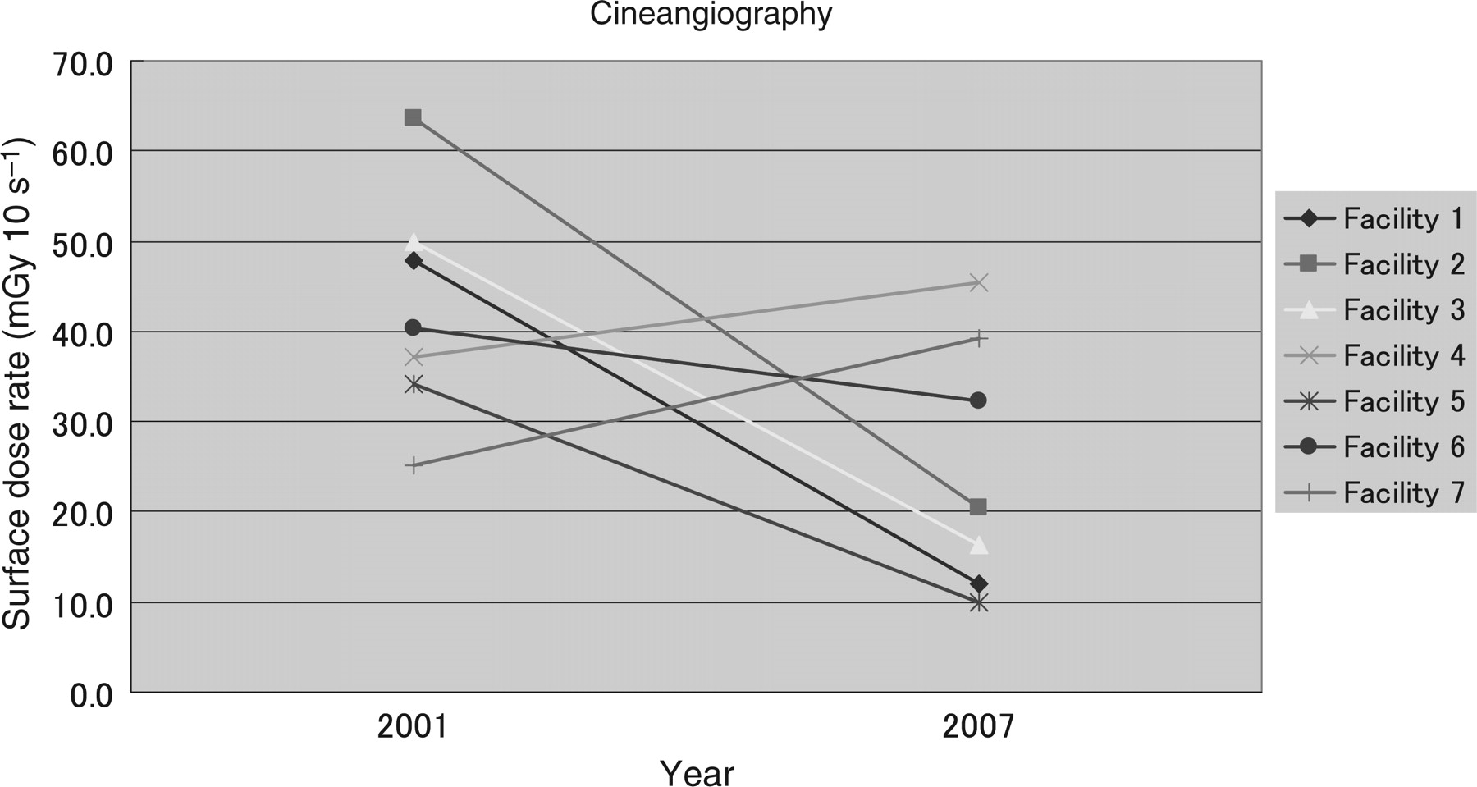
Figure 3. Average entrance surface dose rate for cineangiography with the 20 cm thick acrylic plate at seven facilities ...
Notes:
Figure 3. Average entrance surface dose rate for cineangiography with the 20 cm thick acrylic plate at seven facilities in 2001 and 2007.
Unless provided in the caption above, the following copyright applies to the content of this slide: © The Author 2010. Published by Oxford University Press. All rights reserved. For Permissions, please email: journals.permissions@oup.com

Slide 4
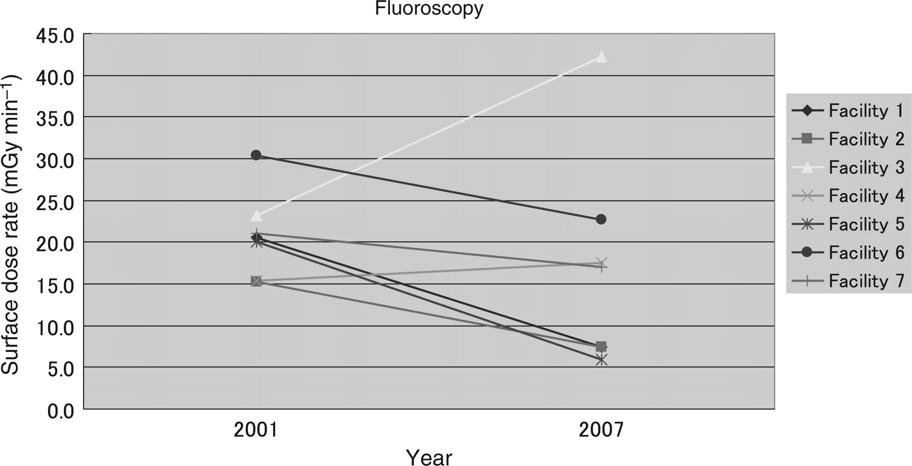
Figure 4. Average entrance surface dose rate for fluoroscopy with the 20 cm thick acrylic plate at the seven facilities ...
Notes:
Figure 4. Average entrance surface dose rate for fluoroscopy with the 20 cm thick acrylic plate at the seven facilities in 2001 and 2007.
Unless provided in the caption above, the following copyright applies to the content of this slide: © The Author 2010. Published by Oxford University Press. All rights reserved. For Permissions, please email: journals.permissions@oup.com

