Slide 1
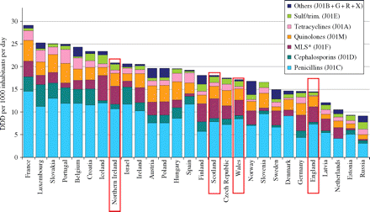
Figure 1 Comparison of annual use of antibiotics in the four administrations of the UK with 24 other European ...
Notes:
Figure 1 Comparison of annual use of antibiotics in the four administrations of the UK with 24 other European countries in 2005. *MLS, Macrolides, Lincosamides and Streptogramins.
Unless provided in the caption above, the following copyright applies to the content of this slide: © The Author 2008. Published by Oxford University Press on behalf of the British Society for Antimicrobial Chemotherapy. All rights reserved. For Permissions, please e-mail: journals.permissions@oxfordjournals.org

Slide 2
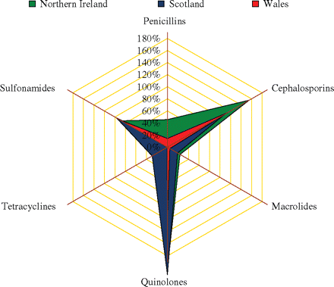
Figure 2 Radar plot of use above the UK mean for major antibiotic classes in Northern Ireland, Scotland and Wales in ...
Notes:
Figure 2 Radar plot of use above the UK mean for major antibiotic classes in Northern Ireland, Scotland and Wales in 2005. Percentages are expressed in relation to the UK mean, for example, cephalosporin use in Northern Ireland was 160% greater than the UK mean.
Unless provided in the caption above, the following copyright applies to the content of this slide: © The Author 2008. Published by Oxford University Press on behalf of the British Society for Antimicrobial Chemotherapy. All rights reserved. For Permissions, please e-mail: journals.permissions@oxfordjournals.org

Slide 3
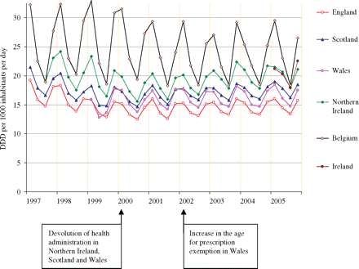
Figure 3 Longitudinal trends and seasonal variation of total outpatient antibiotic use in four UK administrations and ...
Notes:
Figure 3 Longitudinal trends and seasonal variation of total outpatient antibiotic use in four UK administrations and Belgium measured in DID.
Unless provided in the caption above, the following copyright applies to the content of this slide: © The Author 2008. Published by Oxford University Press on behalf of the British Society for Antimicrobial Chemotherapy. All rights reserved. For Permissions, please e-mail: journals.permissions@oxfordjournals.org

Slide 4
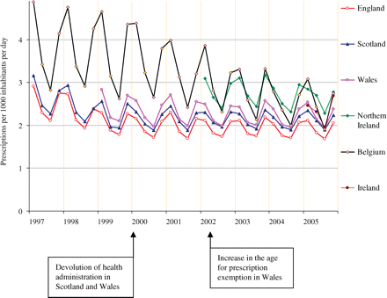
Figure 4 Longitudinal trends and seasonal variation of total outpatient antibiotic use in four UK administrations and ...
Notes:
Figure 4 Longitudinal trends and seasonal variation of total outpatient antibiotic use in four UK administrations and Belgium measured in PID.
Unless provided in the caption above, the following copyright applies to the content of this slide: © The Author 2008. Published by Oxford University Press on behalf of the British Society for Antimicrobial Chemotherapy. All rights reserved. For Permissions, please e-mail: journals.permissions@oxfordjournals.org

