Slide 1
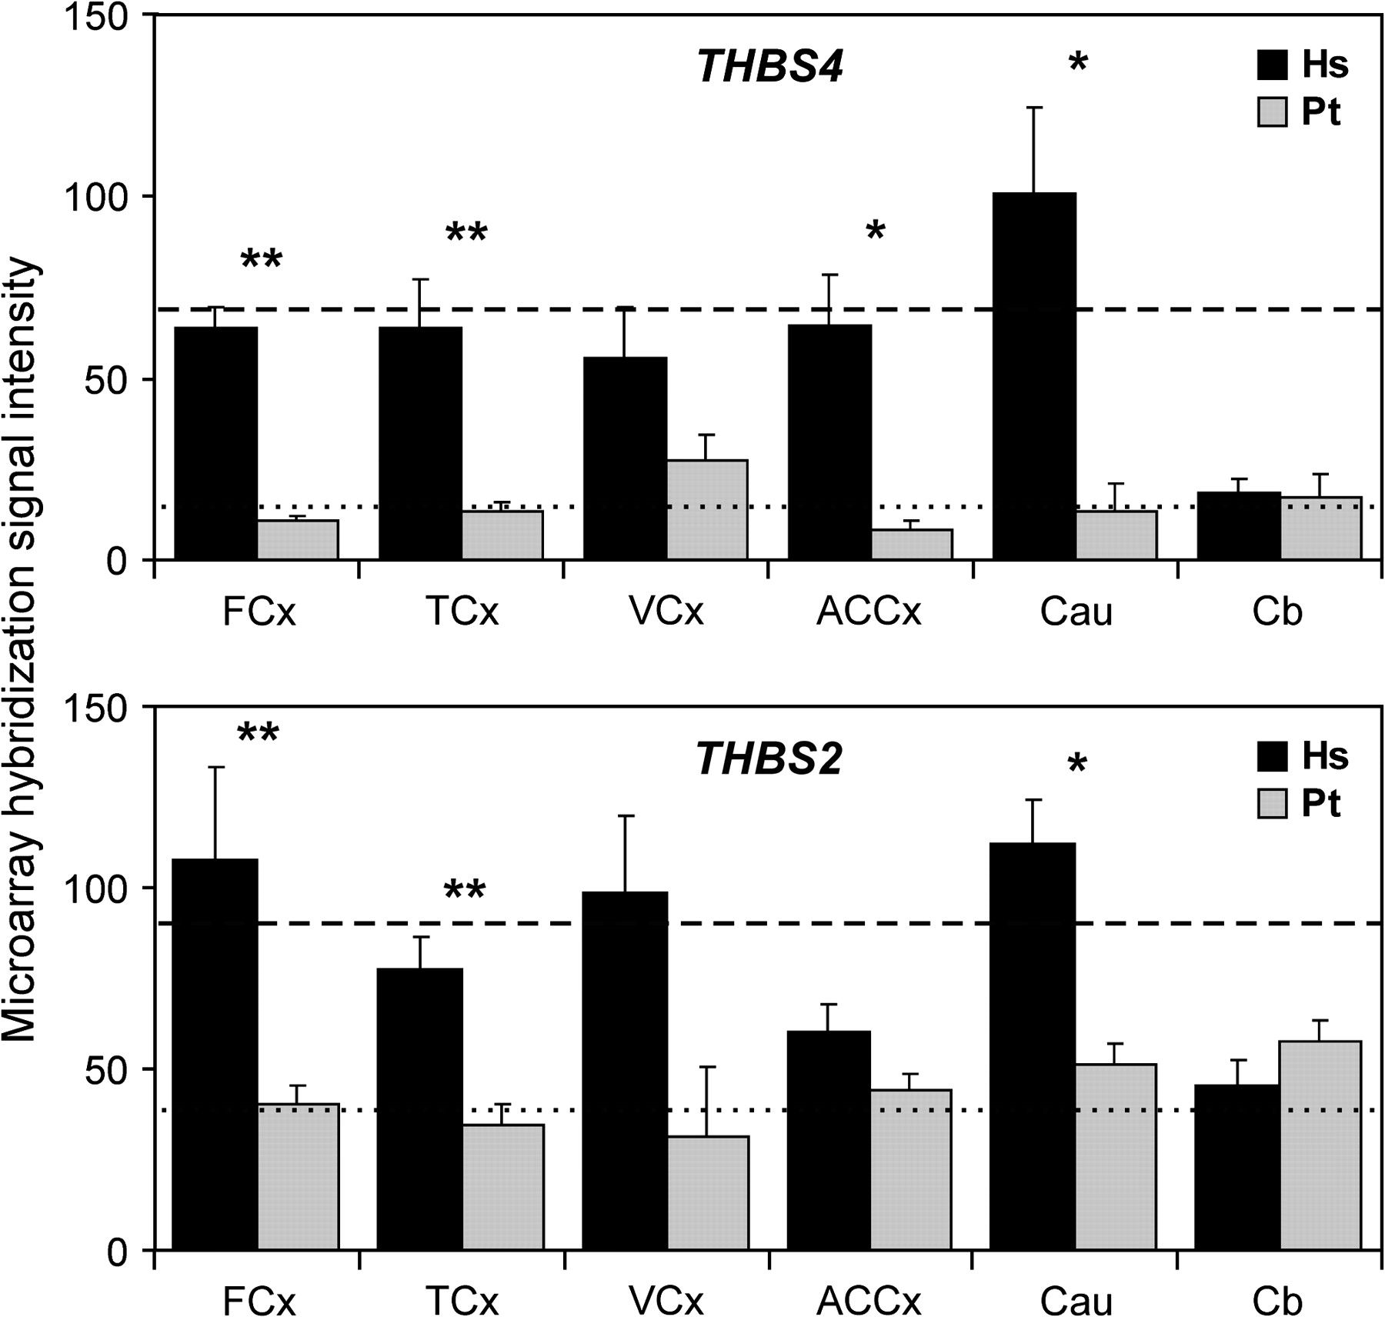
Figure 1. THBS4 and THBS2 expression levels in human (Hs) and chimpanzee brain (Pt) from oligonucleotide microarrays. ...
Notes:
Figure 1. THBS4 and THBS2 expression levels in human (Hs) and chimpanzee brain (Pt) from oligonucleotide microarrays. Graphs show the average hybridization signal intensity and standard error in different brain regions of each species. The brain regions are FCx, frontal cortex (FP, middle frontal gyrus, and Brodmann area 9); TCx, temporal cortex (Broca's area, TP, aIT cortex, and superior temporal gyrus); VCx, primary visual cortex; ACCx, anterior cingulate cortex; Cau, caudate nucleus; Cb, cerebellar vermis. The number of individuals analyzed was 9 humans and 5 chimpanzees for FCx, 6 humans and 6 chimpanzees for TCx, and 3 humans and 3 chimpanzees for the other brain regions. The average hybridization signal resulting from combining together all the forebrain regions (FCx, TCx, VCx, ACCx, and Cau) is represented by dashed and dotted lines in humans and chimpanzees, respectively. Asterisks indicate the results of the Mann–Whitney test for the comparison of THBS4 and THBS2 levels for each region between humans and chimpanzees. *P < 0.05; **P < 0.01.
Unless provided in the caption above, the following copyright applies to the content of this slide: © The Author 2006. Published by Oxford University Press. All rights reserved. For permissions, please e-mail: journals.permissions@oxfordjournals.org

Slide 2
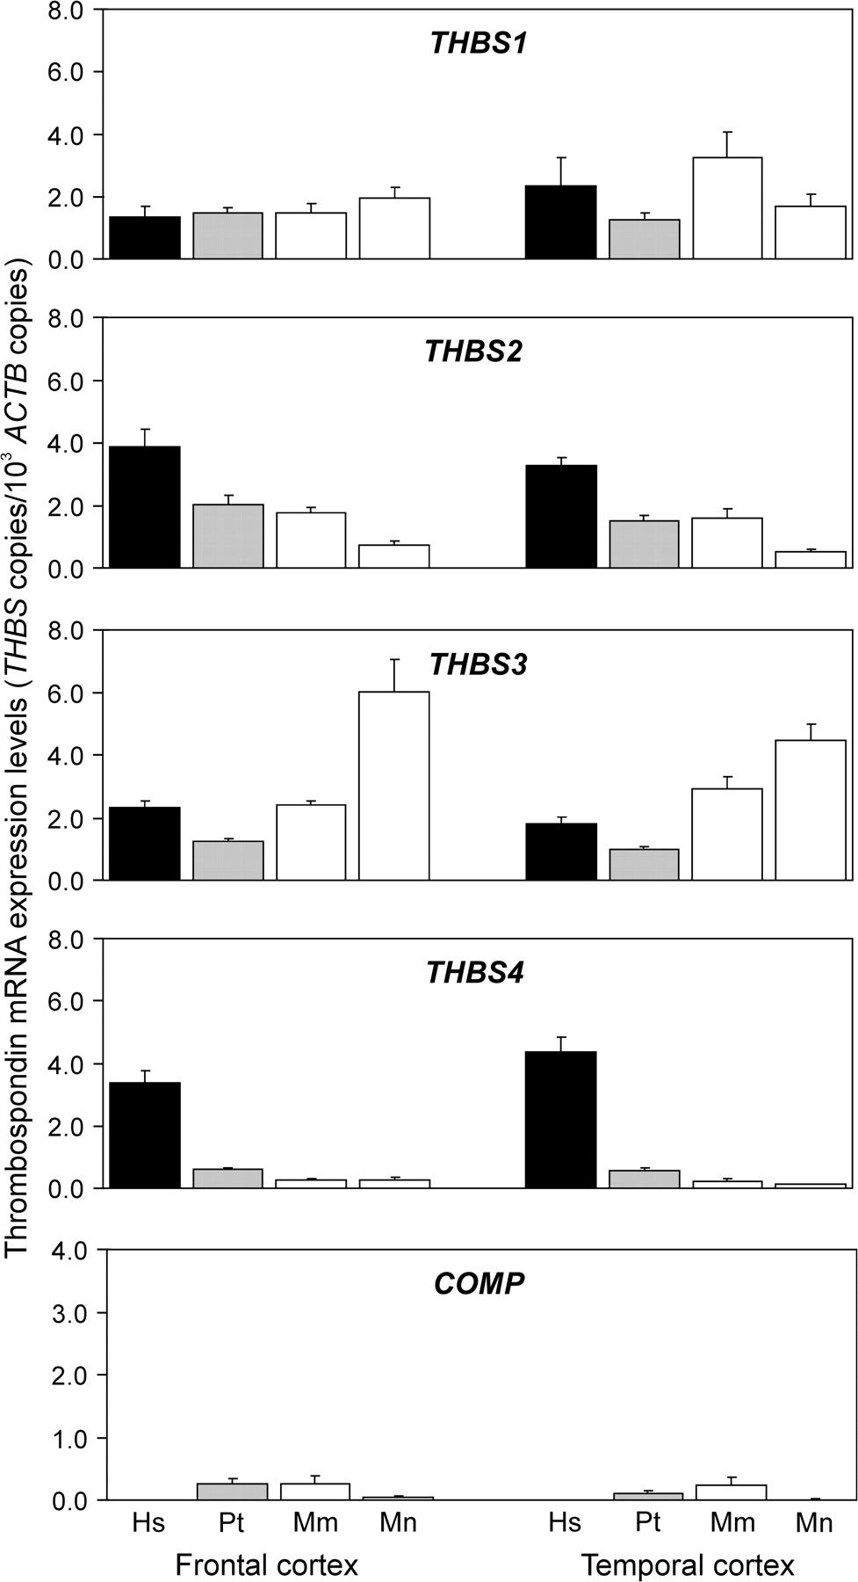
Figure 2. Quantification of mRNA expression levels of the 5 thrombospondin genes in frontal and temporal cortex of ...
Notes:
Figure 2. Quantification of mRNA expression levels of the 5 thrombospondin genes in frontal and temporal cortex of different primate species by real-time RT-PCR. Graphs represent the average number of copies of each thrombospondin (THBS) mRNA for 103 β-actin (ACTB) mRNA copies in the y axis, with the standard error indicated by error bars. Species included were humans (Hs), chimpanzees (Pt), rhesus macaques (Mm), and pigtail macaques (Mn).Expression levels in each individual sample are provided in Supplementary Figure 2.
Unless provided in the caption above, the following copyright applies to the content of this slide: © The Author 2006. Published by Oxford University Press. All rights reserved. For permissions, please e-mail: journals.permissions@oxfordjournals.org

Slide 3
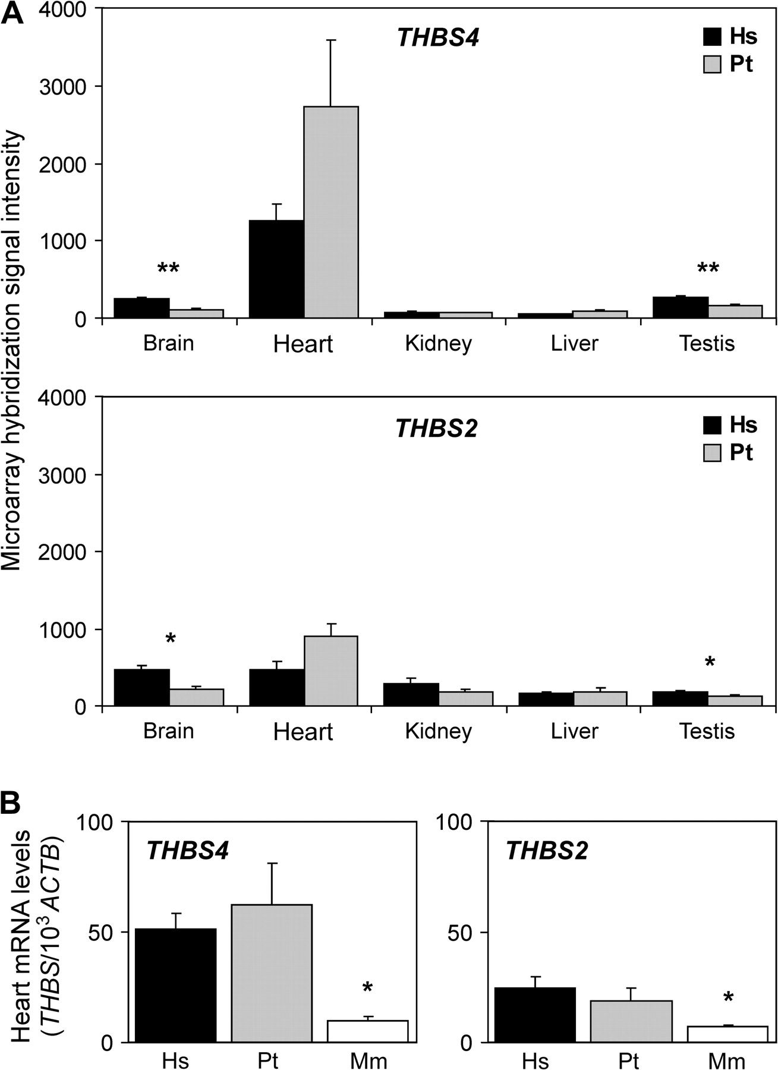
Figure 3. THBS4 and THBS2 expression levels in nonbrain tissues from humans and nonhuman primates. (A) Oligonucleotide ...
Notes:
Figure 3. THBS4 and THBS2 expression levels in nonbrain tissues from humans and nonhuman primates. (A) Oligonucleotide microarray results for THBS4 and THBS2 in nonbrain tissues of humans and chimpanzees. Graphs show the average hybridization signal in different tissues of 6 humans (Hs) and 5 chimpanzees (Pt), including brain frontal cortex for comparison. (B) Real-time RT-PCR quantification of THBS4 and THBS2 expression levels in heart from different primate species. The average number of copies of thrombospondin (THBS) mRNA for 1000 β-actin (ACTB) mRNA copies in humans, chimpanzees, and rhesus macaques is represented on the y axis. Error bars represent standard errors. The results of the Mann–Whitney test comparing THBS4 and THBS2 expression levels between humans and nonhuman primates are represented by asterisks. *P < 0.05; **P < 0.01.
Unless provided in the caption above, the following copyright applies to the content of this slide: © The Author 2006. Published by Oxford University Press. All rights reserved. For permissions, please e-mail: journals.permissions@oxfordjournals.org

Slide 4
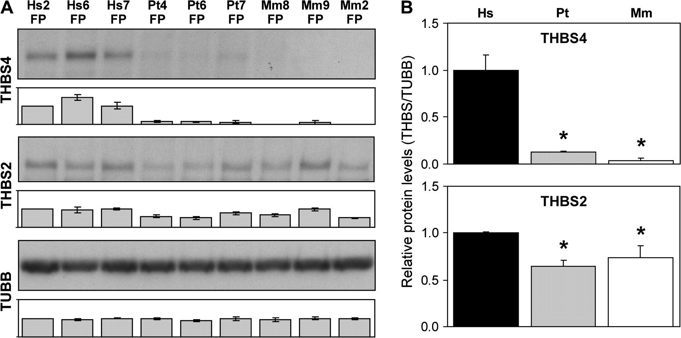
Figure 4. Quantification of THBS4 and THBS2 protein levels in primate frontal cortex by Western blot analysis. (A) ...
Notes:
Figure 4. Quantification of THBS4 and THBS2 protein levels in primate frontal cortex by Western blot analysis. (A) Western blot results for THBS4 (103.5 kDa), THBS2 (129.0 kDa), and β-tubulin (TUBB) (49.8 kDa) using FP samples of 3 humans (Hs), 3 chimpanzees (Pt), and 3 rhesus macaques (Mm). For each protein, one representative blot is shown on top and the average band intensity from the 3 different blots quantified is shown below. In each blot, band intensities were normalized to those of one human case (Hs2). (B) Average THBS4 and THBS2 protein levels in the FP of humans, chimpanzees, and rhesus macaques. The y axis corresponds to the average band intensities of the 3 individuals of each species relative to the human value, after normalization by TUBB levels to control for protein loading differences. Error bars represent standard errors. Asterisks indicate the results of the Mann–Whitney test for the comparison of thrombospondin levels between humans and nonhuman primates. *P < 0.05.
Unless provided in the caption above, the following copyright applies to the content of this slide: © The Author 2006. Published by Oxford University Press. All rights reserved. For permissions, please e-mail: journals.permissions@oxfordjournals.org

Slide 5
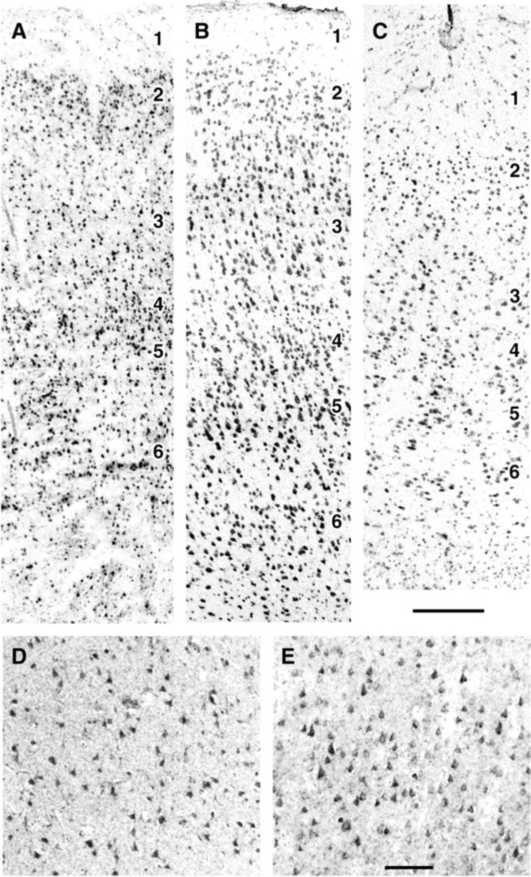
Figure 5. Histological localization of THBS4 mRNA in primate frontal cortex by in situ hybridization. (A–C) ...
Notes:
Figure 5. Histological localization of THBS4 mRNA in primate frontal cortex by in situ hybridization. (A–C) Low-magnification photomicrographs of the frontal polar cortex of a human (A), a chimpanzee (B), and a rhesus macaque (C), showing the hybridization of the THBS4 antisense probe in unfixed, snap-frozen sections. (D–E) High-magnification photomicrographs of fixed tissue sections showing numerous pyramidal cells labeled for THBS4 mRNA in cortical layer 3 of a human (D) and a chimpanzee (E). Scale bars: (A–C) 250 μm; (D–E) 50 μm.
Unless provided in the caption above, the following copyright applies to the content of this slide: © The Author 2006. Published by Oxford University Press. All rights reserved. For permissions, please e-mail: journals.permissions@oxfordjournals.org

Slide 6
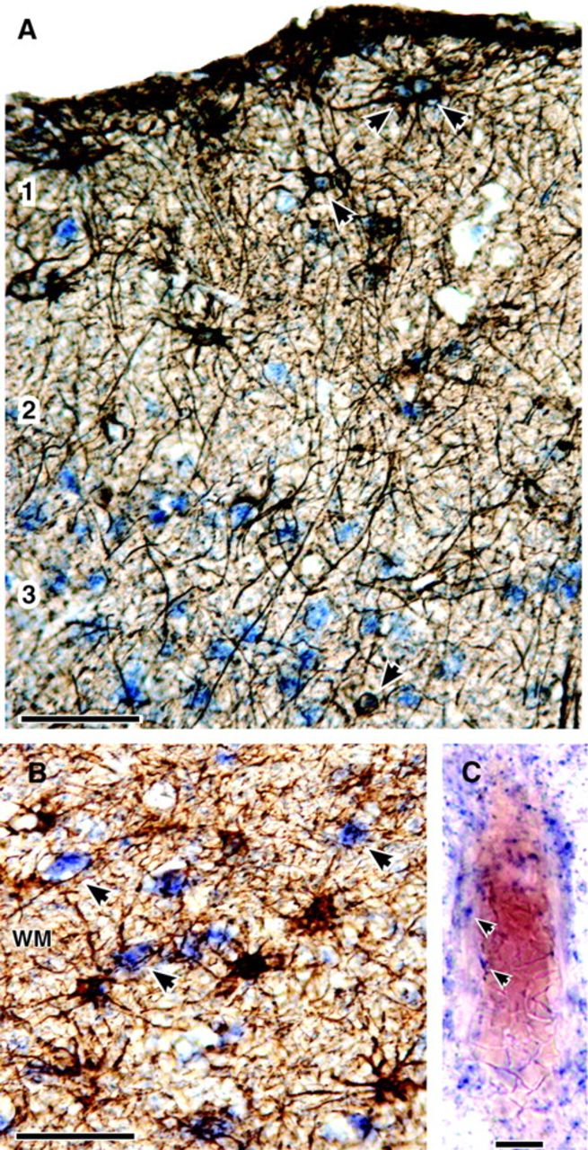
Figure 6. THBS4 mRNA expression in various cell types of human frontal cortex. (A–B) Gray and white matter sections ...
Notes:
Figure 6. THBS4 mRNA expression in various cell types of human frontal cortex. (A–B) Gray and white matter sections double labeled by in situ hybridization for THBS4 mRNA (blue staining) and by immunocytochemistry for the astrocyte-specific marker GFAP (brown staining). (A) In gray matter, arrowheads denote THBS4-expressing astrocytes in layer 1 and in deeper layers of the cortex. Not all GFAP-immunoreactive cells were clearly labeled with the THBS4 antisense probe, however. The cells in layers 2 and 3 exhibiting blue label only were probably neurons. (B) In the white matter (WM), a large population of small cells labeled strongly for THBS4 mRNA but did not stain for GFAP (arrowheads). Based on their number and size, these were probably oligodendrocytes. (C) Endothelial cells in the wall of a cerebral blood vessel labeled by in situ hybridization for THBS4 mRNA are indicated by arrowheads. The red coloration of the vessel is from blood. Scale bars: (A–B) 50 μm; (C) 10 μm.
Unless provided in the caption above, the following copyright applies to the content of this slide: © The Author 2006. Published by Oxford University Press. All rights reserved. For permissions, please e-mail: journals.permissions@oxfordjournals.org

Slide 7
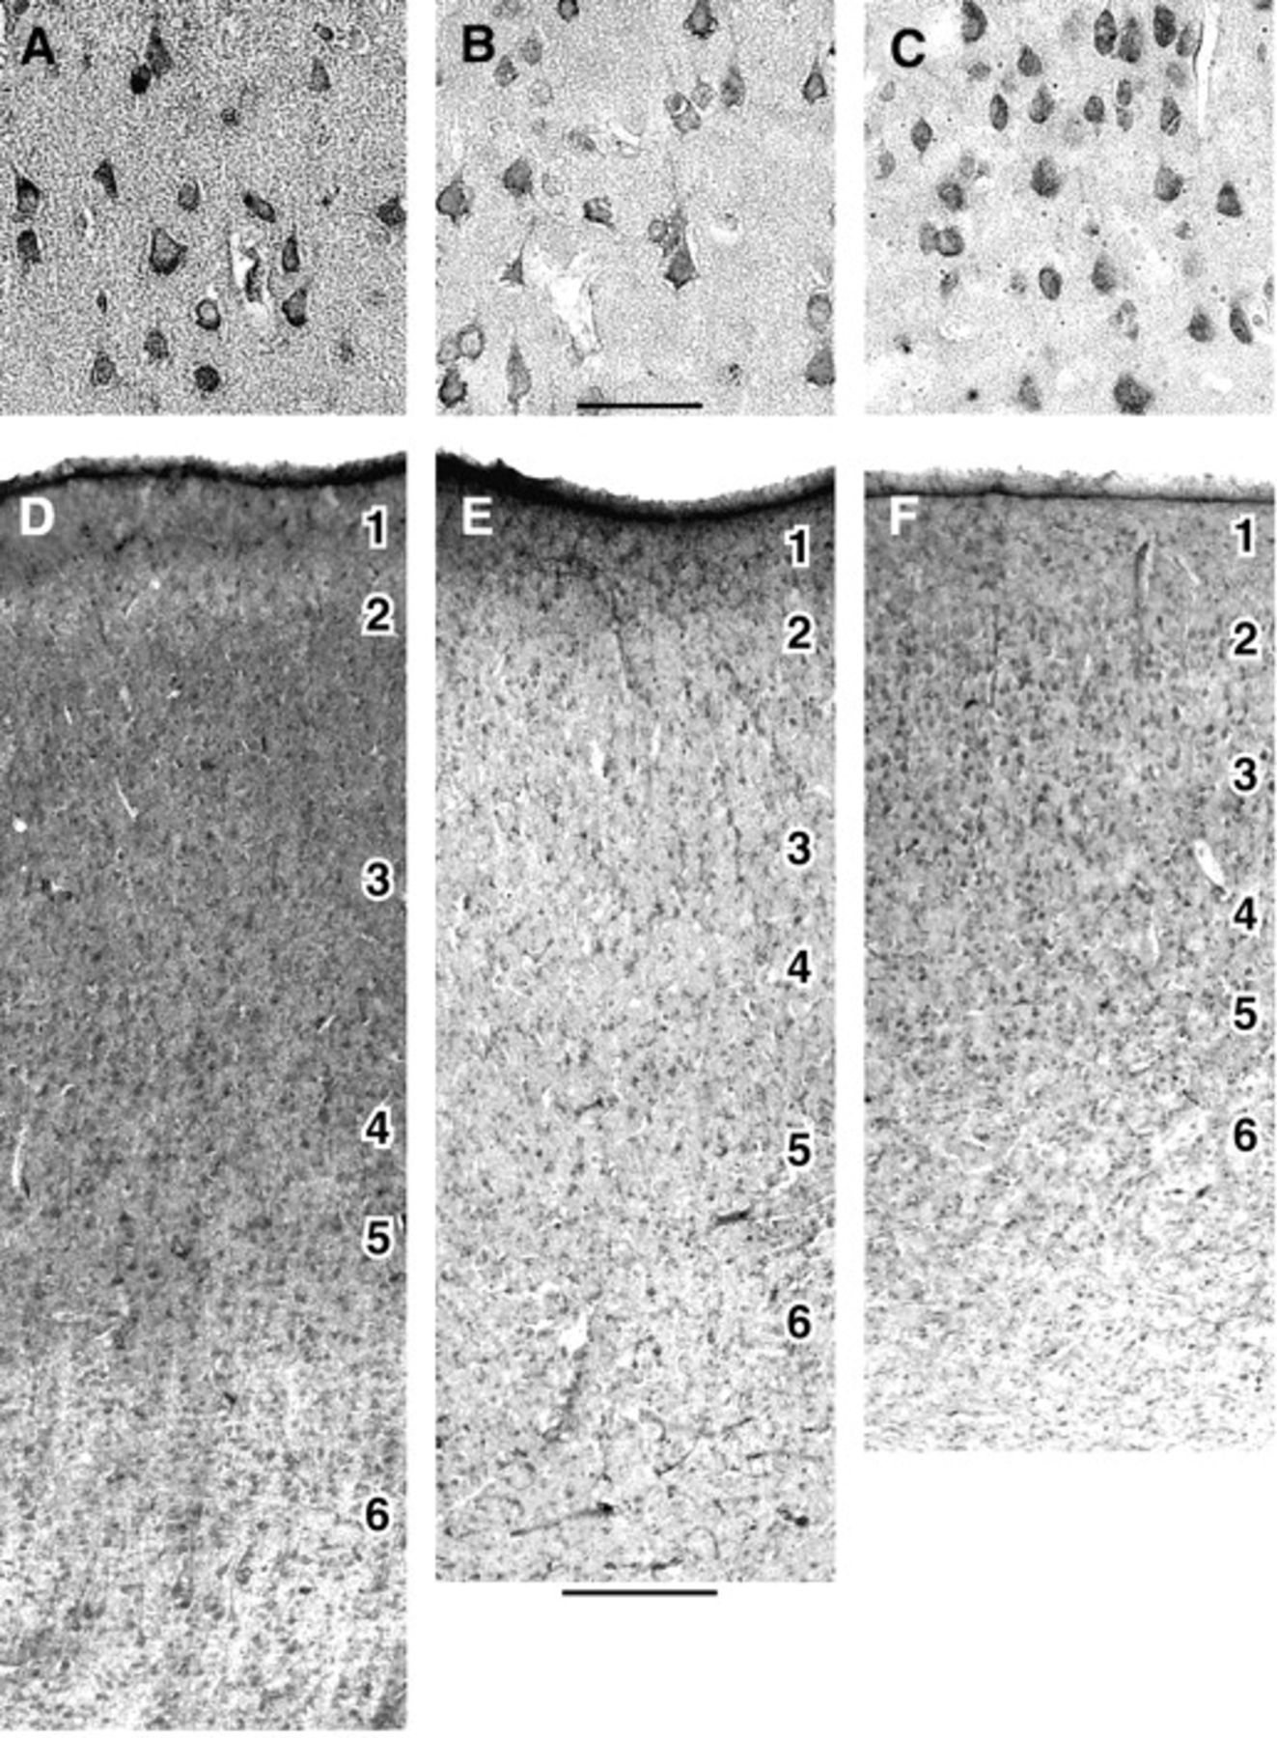
Figure 7. Localization of THBS4 protein by immunohistochemistry in the frontal polar cortex of humans, chimpanzees, and ...
Notes:
Figure 7. Localization of THBS4 protein by immunohistochemistry in the frontal polar cortex of humans, chimpanzees, and macaques. (A–C) High-magnification photomicrographs with differential-interference contrast optics of 5-μm-thick, paraffin-embedded sections through the upper part of cortical layer 3 of a human (A), a chimpanzee (B), and a rhesus macaque (C). (D–F) Representative low-magnification photomicrographs from 50-μm-thick fixed sections through cortical layers 1–6 of a human (D), a chimpanzee (E), and a rhesus macaque (F). In all species, THBS4 antibodies labeled numerous cell bodies, including many pyramidal cells in layers 2–6. Humans, however, were distinguished by dense labeling of the neuropil surrounding cell bodies. Scale bars: (A–C) 50 μm; (D–F) 250 μm.
Unless provided in the caption above, the following copyright applies to the content of this slide: © The Author 2006. Published by Oxford University Press. All rights reserved. For permissions, please e-mail: journals.permissions@oxfordjournals.org

Slide 8
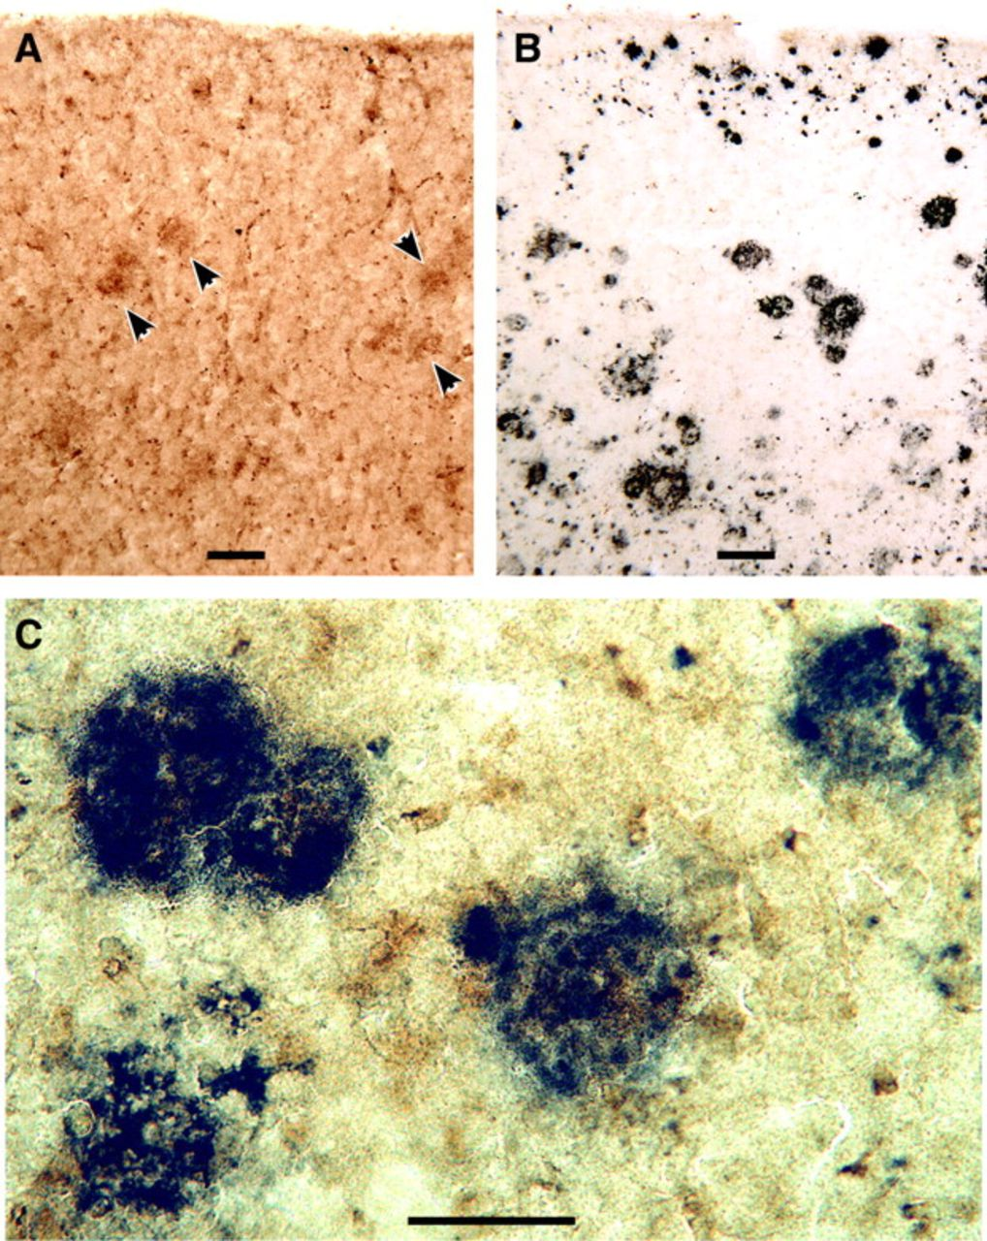
Figure 8. THBS4 immunostaining of Aβ-containing plaques in gray matter from human cortex. (A) Section of frontal cortex ...
Notes:
Figure 8. THBS4 immunostaining of Aβ-containing plaques in gray matter from human cortex. (A) Section of frontal cortex from an Alzheimer's case labeled with anti-THBS4 antibody and DAB (red-brown staining), revealing numerous plaque-like accumulations in the upper cortical layers, several of which are denoted by arrowheads. (B) A neighboring section stained for Aβ peptide with 4G8 antibody and Vector Nickel (dark staining), revealing numerous well-defined Aβ-containing plaques. (C) Higher-magnification photomicrograph of a section from the same case double-labeled for THBS4 with DAB (red-brown staining) and for Aβ protein with Vector Nickel (dark staining). The sequential double-staining protocol yielded a mosaic of small red-brown and dark purple territories within the plaques. Scale bars: (A–B) 100 μm; (C) 50 μm.
Unless provided in the caption above, the following copyright applies to the content of this slide: © The Author 2006. Published by Oxford University Press. All rights reserved. For permissions, please e-mail: journals.permissions@oxfordjournals.org

