Slide 1
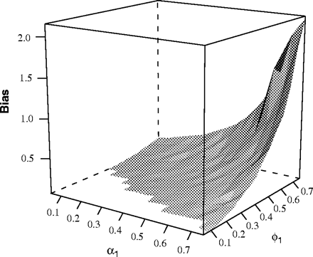
Fig. 1 Bias in the long-run effect, across α and ϕ for the LDV model.
Notes:
Fig. 1 Bias in the long-run effect, across α and ϕ for the LDV model.
Unless provided in the caption above, the following copyright applies to the content of this slide: © The Author 2005. Published by Oxford University Press on behalf of the Society for Political Methodology. All rights reserved. For Permissions, please email: journals.permissions@oxfordjournals.org

Slide 2
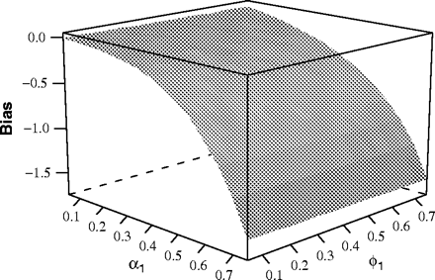
Fig. 2 Bias in the total effect, across α and ϕ for the ARMA model.
Notes:
Fig. 2 Bias in the total effect, across α and ϕ for the ARMA model.
Unless provided in the caption above, the following copyright applies to the content of this slide: © The Author 2005. Published by Oxford University Press on behalf of the Society for Political Methodology. All rights reserved. For Permissions, please email: journals.permissions@oxfordjournals.org

Slide 3
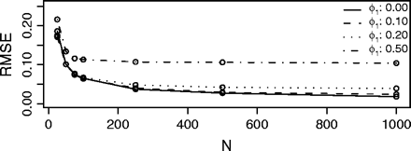
Fig. 3 Comparison of RMSE across values of ϕ.
Notes:
Fig. 3 Comparison of RMSE across values of ϕ.
Unless provided in the caption above, the following copyright applies to the content of this slide: © The Author 2005. Published by Oxford University Press on behalf of the Society for Political Methodology. All rights reserved. For Permissions, please email: journals.permissions@oxfordjournals.org

