Slide 1
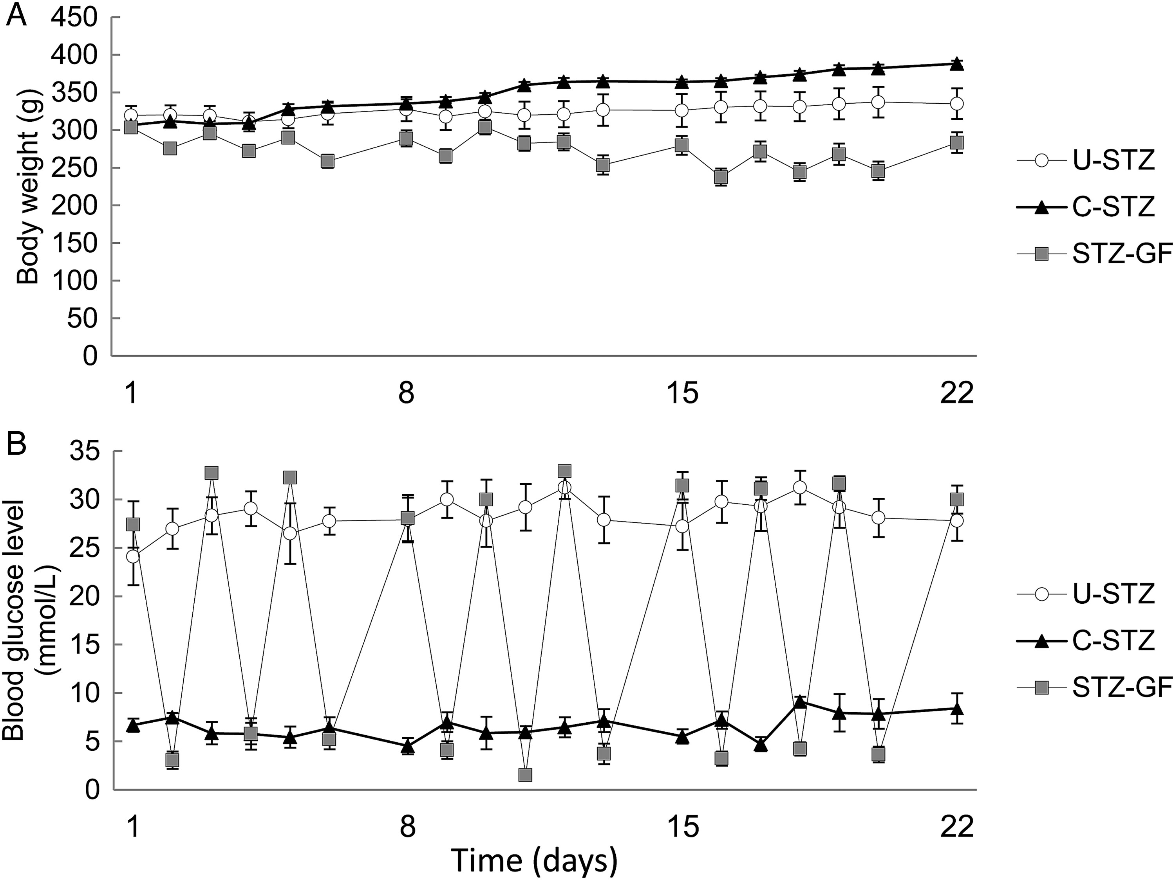
Figure 1 Blood glucose levels and body weight. (A) Body weight gain was significantly lower in U-STZ rats than in ...
Notes:
Figure 1 Blood glucose levels and body weight. (A) Body weight gain was significantly lower in U-STZ rats than in C-STZ rats, and this difference was more pronounced in STZ-GF rats. Body weights in STZ-GF rats fluctuated because of repetitive starvation. (B) Blood glucose levels in U-STZ rats were always >22.2 mmol/L. In contrast, glucose levels in C-STZ rats were maintained ∼5.5 mmol/L. After starvation and additional insulin injections, glucose levels were decreased <5.5 mmol/L in STZ-GF rats. Data are presented as mean ± SEM (n = 6 per group).
Unless provided in the caption above, the following copyright applies to the content of this slide: Published on behalf of the European Society of Cardiology. All rights reserved. © The Author 2014. For permissions please email: journals.permissions@oup.com.

Slide 2
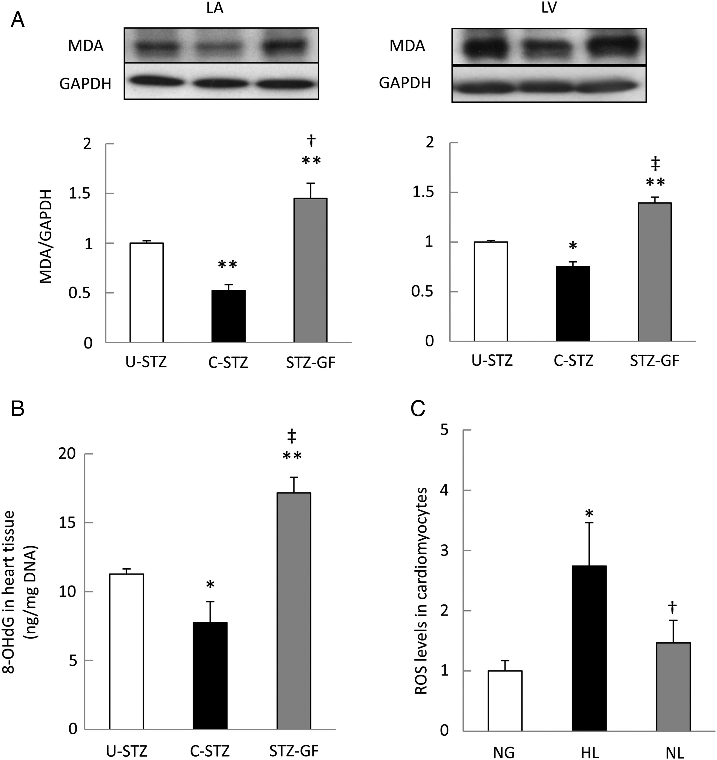
Figure 2 Levels of ROS. (A and B) MDA expression and levels of 8-OHdG were significantly larger in U-STZ rats than in ...
Notes:
Figure 2 Levels of ROS. (A and B) MDA expression and levels of 8-OHdG were significantly larger in U-STZ rats than in C-STZ rats, and this difference was more pronounced in STZ-GF rats. Data are presented as mean ± SEM (n = 6 or 7 per group). *P < 0.05 vs. U-STZ, **P < 0.01 vs. U-STZ, †P < 0.05 vs. C-STZ, and ‡P < 0.01 vs. C-STZ. (C) Quantitative results obtained by confocal microscopy in cultured neonatal cardiomyocytes stained with CM-H2DCFDA. Levels of ROS were significantly higher in HL than in HG and NL. Data are presented as mean ± SEM (n = 6 per group). CM-H2DCFDA; 5-(and-6)-chloromethyl-1-2′,7′-dichlorodihydrofluorescein diacetate, acetyl ester. *P < 0.05 vs. NG and †P < 0.01 vs. HL.
Unless provided in the caption above, the following copyright applies to the content of this slide: Published on behalf of the European Society of Cardiology. All rights reserved. © The Author 2014. For permissions please email: journals.permissions@oup.com.

Slide 3
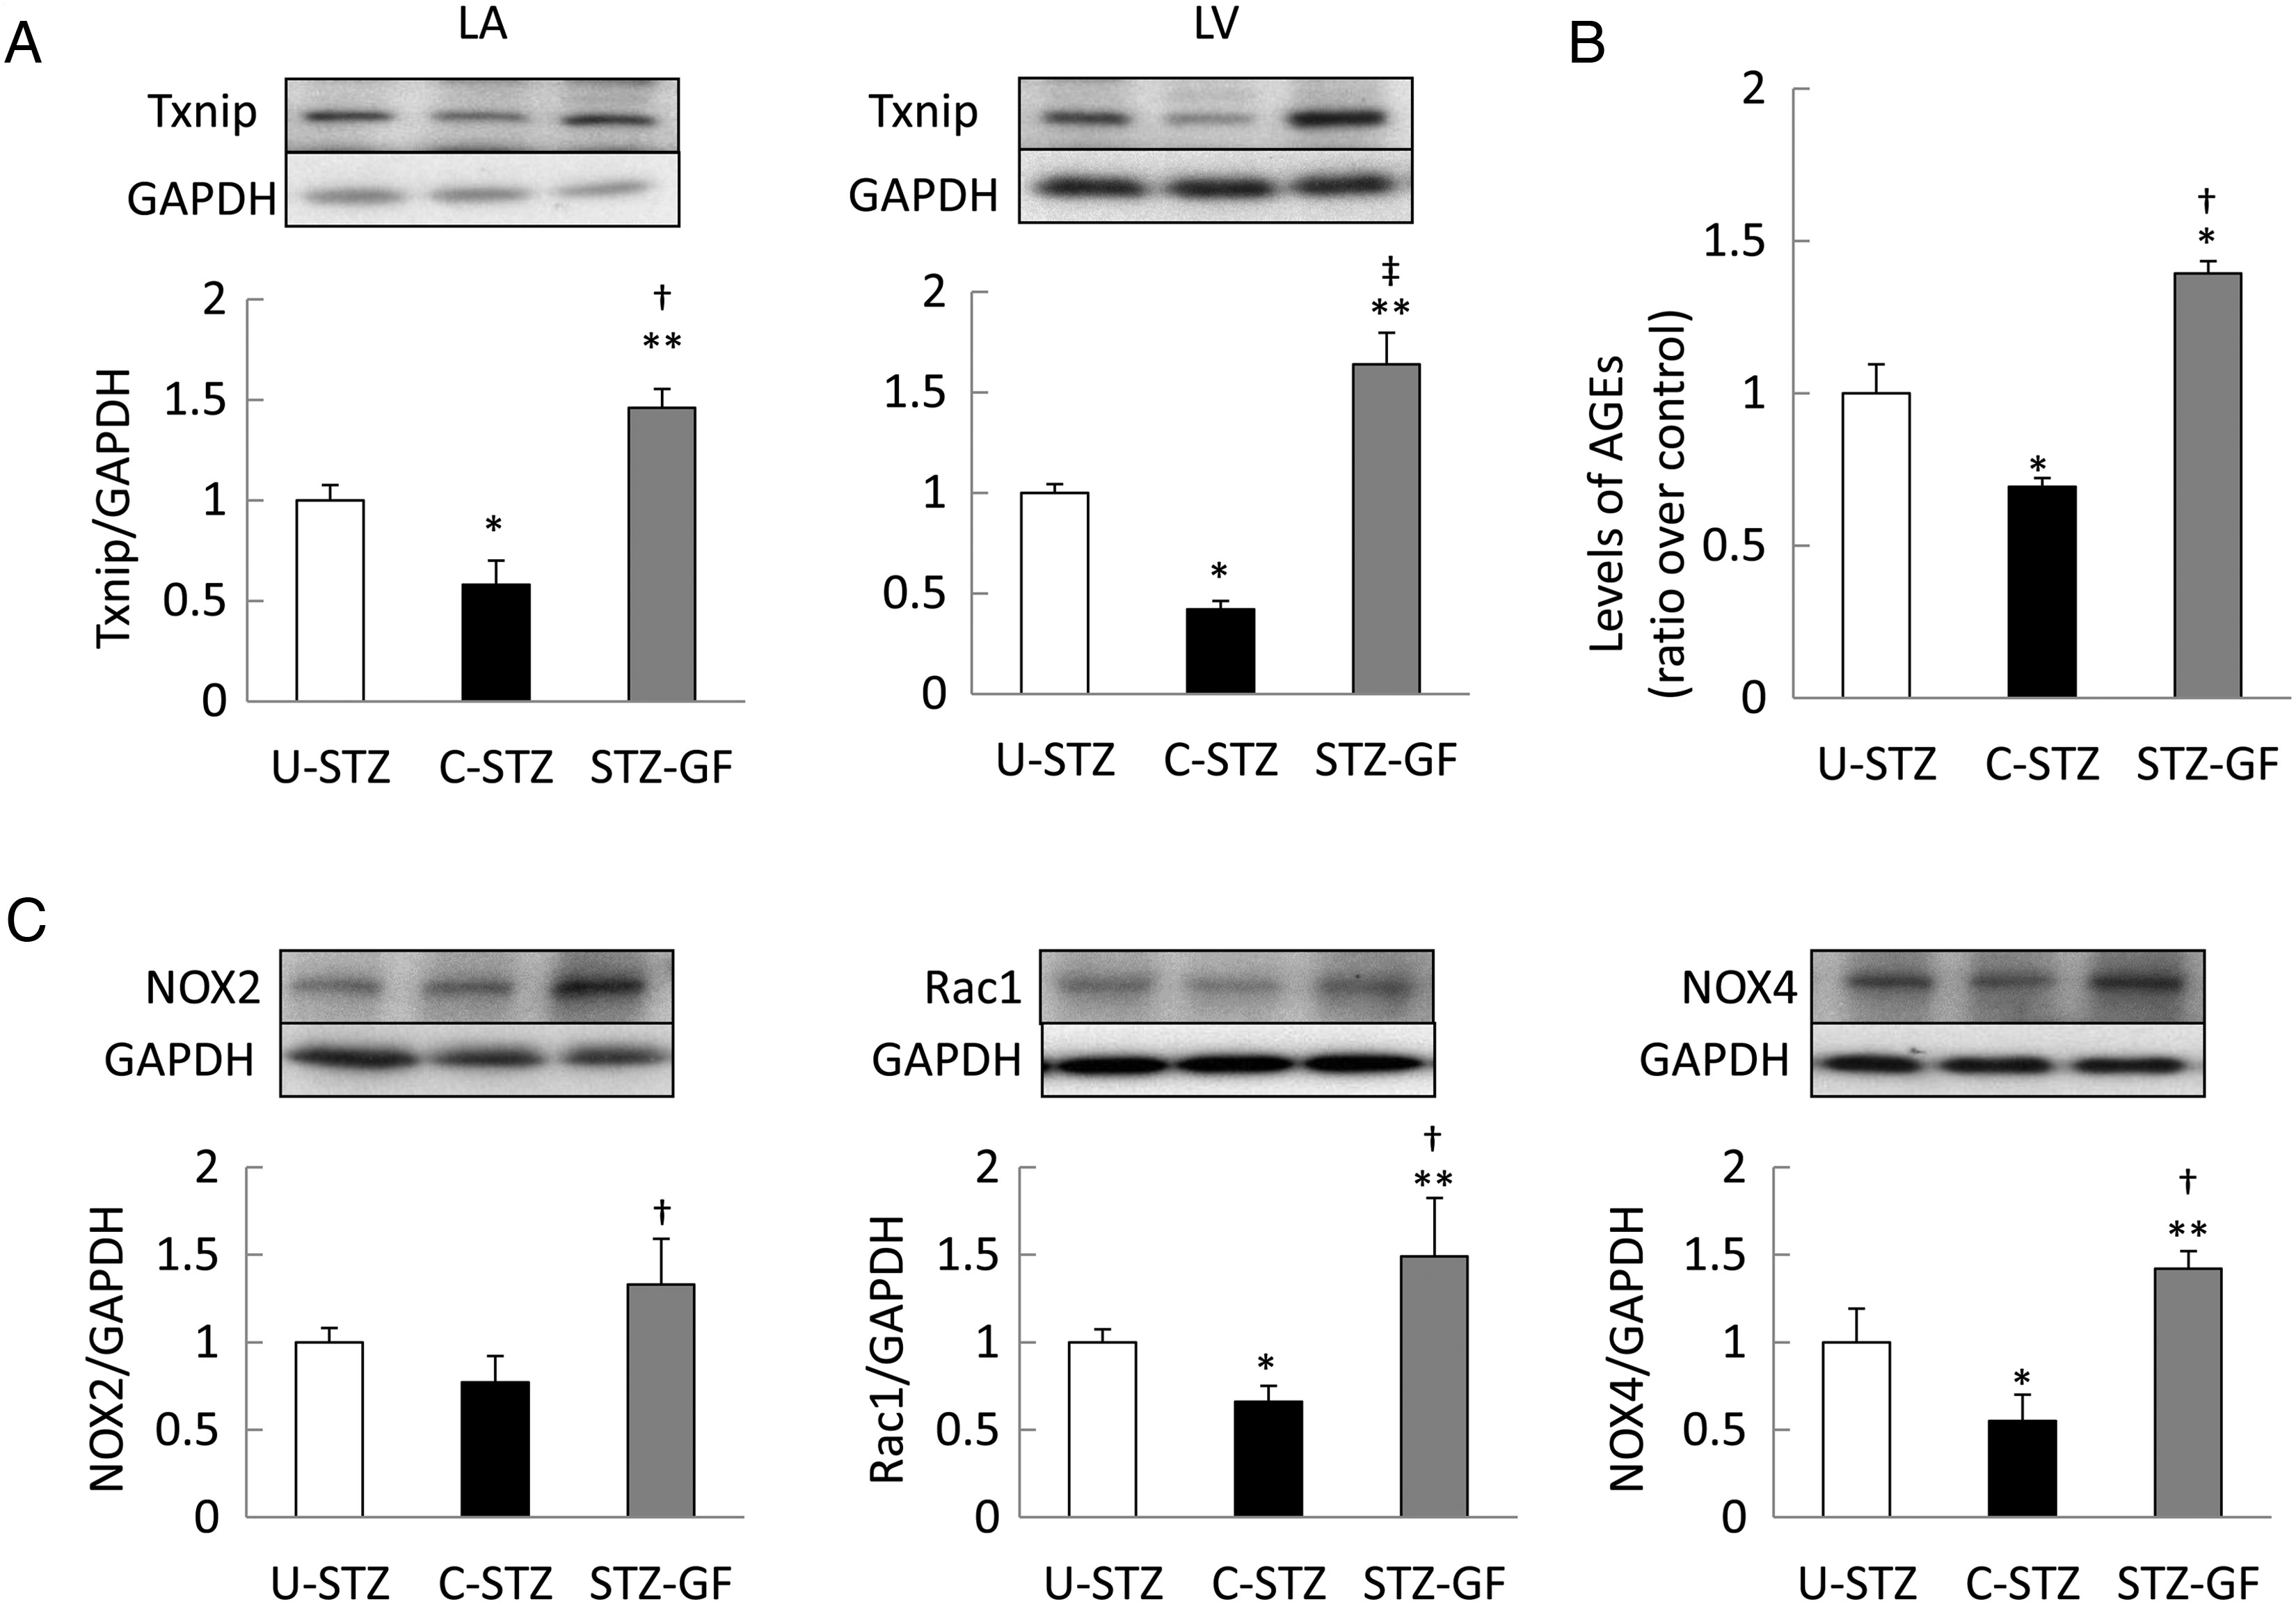
Figure 3 Mechanisms of ROS increase. (A) Txnip expression was upregulated in U-STZ compared with C-STZ rats, with ...
Notes:
Figure 3 Mechanisms of ROS increase. (A) Txnip expression was upregulated in U-STZ compared with C-STZ rats, with highest expression seen in STZ-GF rats. (B) Levels of AGEs in LA were significantly higher in U-STZ rats than in C-STZ rats, which were more increased in STZ-GF rats. (C) Protein expressions of NOX2, Rac1, and NOX4 were significantly upregulated in STZ-GF rats compared with C-STZ rats. Data are presented as mean ± SEM (n = 6 or 7 per group). *P < 0.05 vs. U-STZ, **P < 0.01 vs. U-STZ, †P < 0.05 vs. C-STZ, and ‡P < 0.01 vs. C-STZ.
Unless provided in the caption above, the following copyright applies to the content of this slide: Published on behalf of the European Society of Cardiology. All rights reserved. © The Author 2014. For permissions please email: journals.permissions@oup.com.

Slide 4
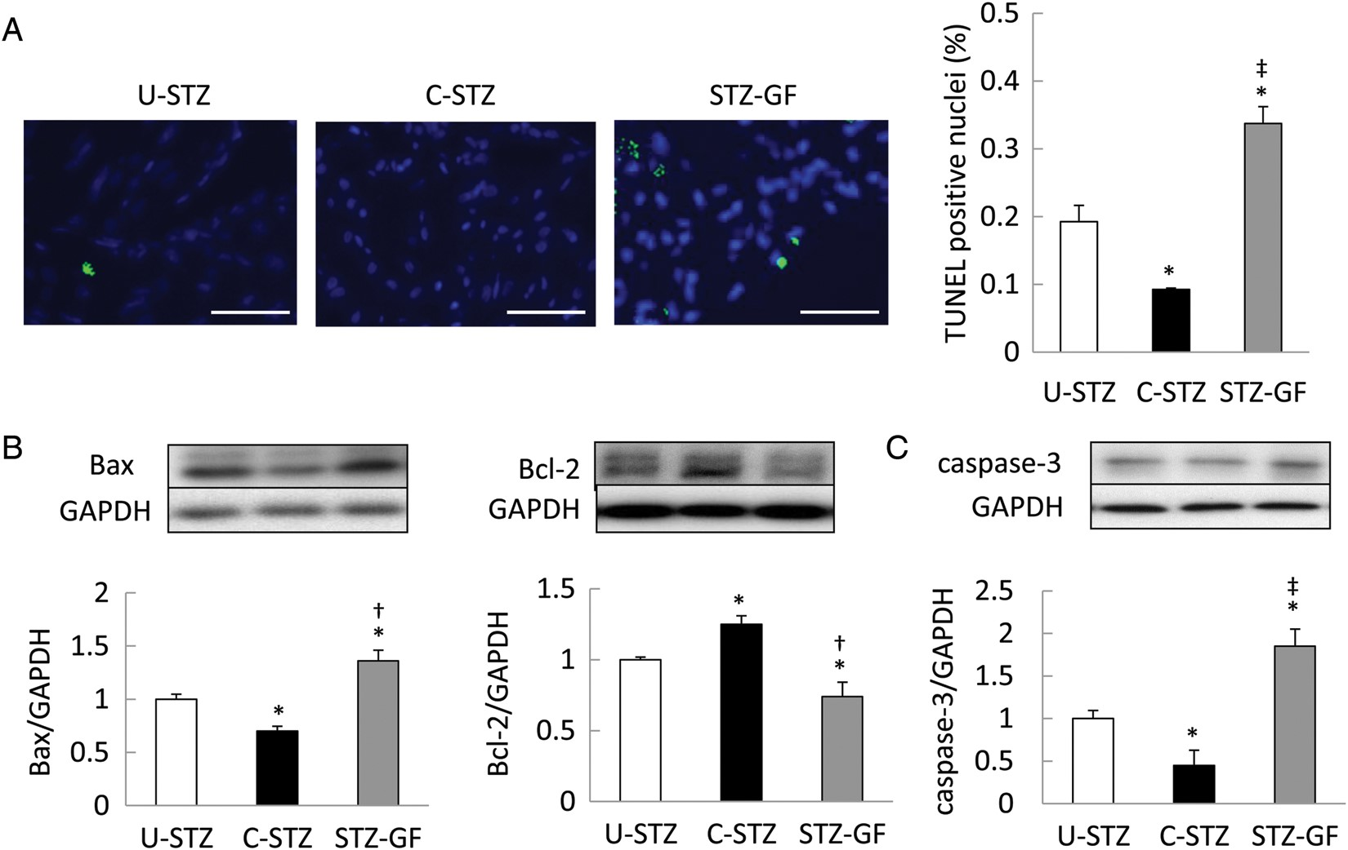
Figure 4 Apoptosis in LA. (A) Representative images and quantitative results of TUNEL staining of LA. The number of ...
Notes:
Figure 4 Apoptosis in LA. (A) Representative images and quantitative results of TUNEL staining of LA. The number of TUNEL-positive cardiomyocytes was significantly lower in C-STZ than in U-STZ rats, with the most TUNEL-positive cardiomyocytes observed in STZ-GF rats. (B) Bax expression was significantly increased and Bcl-2 was significantly decreased in LA of U-STZ rats compared with C-STZ rats. These changes were more pronounced in STZ-GF rats. (C) Levels of caspase-3 expression was significantly increased in LA of U-STZ rats compared with C-STZ rats, with the most pronounced effects in STZ-GF rats. Data are presented as mean ± SEM (n = 6 per group). Scale bar = 20 µm. *P < 0.05 vs. U-STZ, †P < 0.05 vs. C-STZ, and ‡P < 0.01 vs. C-STZ.
Unless provided in the caption above, the following copyright applies to the content of this slide: Published on behalf of the European Society of Cardiology. All rights reserved. © The Author 2014. For permissions please email: journals.permissions@oup.com.

Slide 5
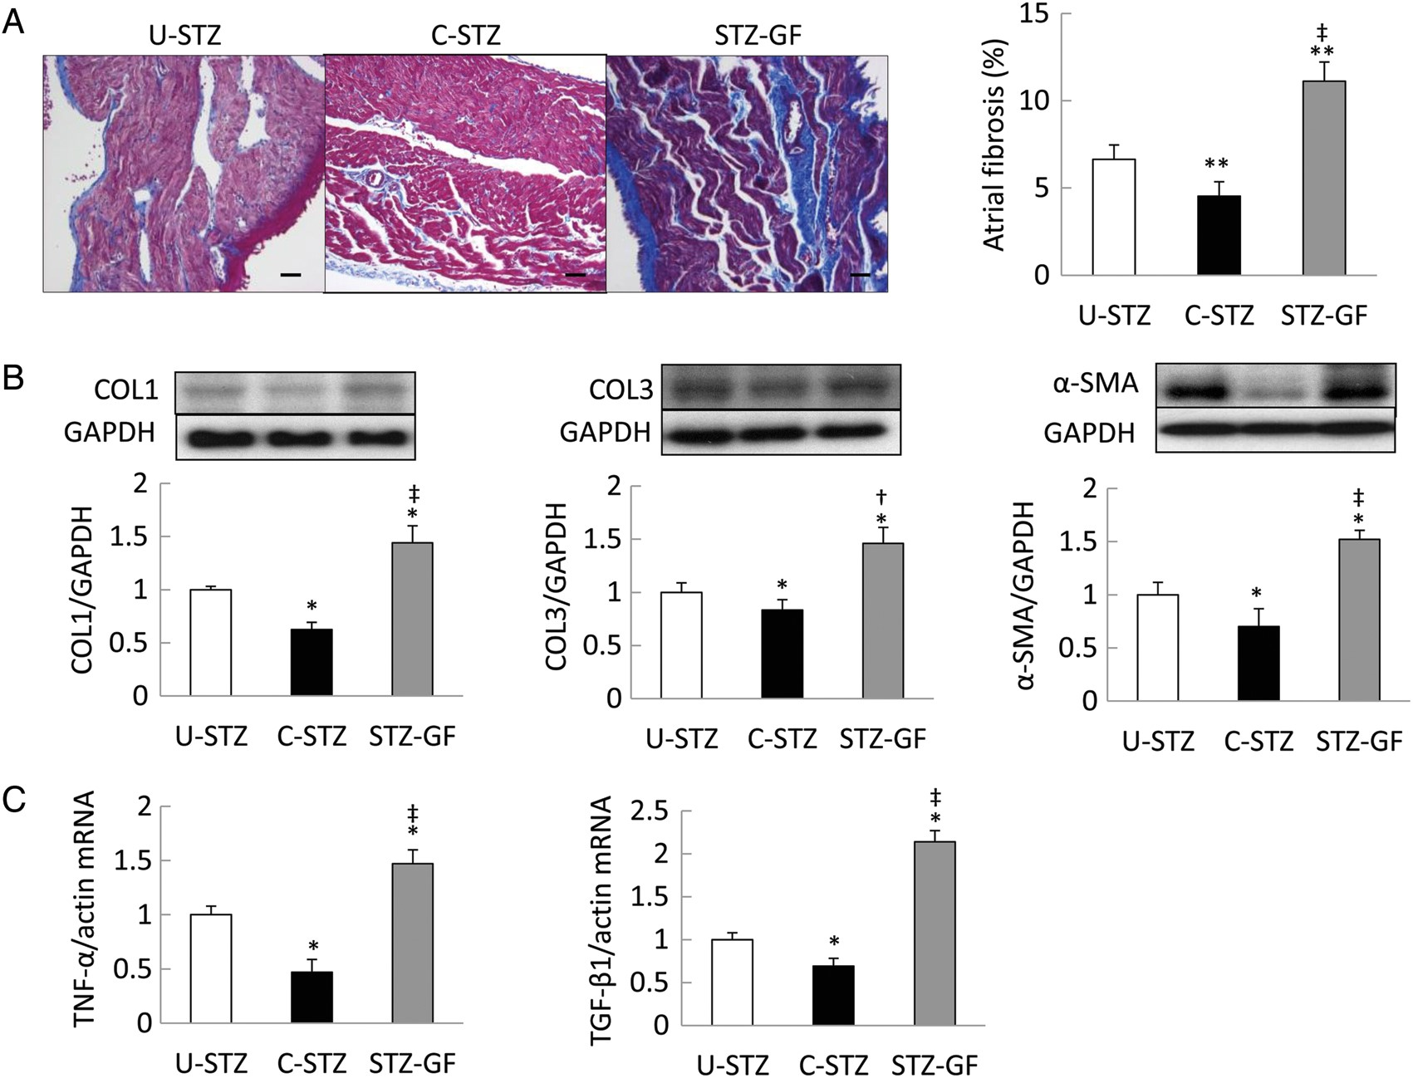
Figure 5 Fibrosis in LA. (A) Representative images and quantitative ratio of the area of fibrosis in LA. LA fibrosis ...
Notes:
Figure 5 Fibrosis in LA. (A) Representative images and quantitative ratio of the area of fibrosis in LA. LA fibrosis was increased in U-STZ rats than in C-STZ rats, which was more pronounced in STZ-GF rats. (B) The protein expressions of COL1, COL3, and α-SMA were significantly upregulated in LA of U-STZ rats than C-STZ rats; this effect was most pronounced in STZ-GF rats. (C) Expressions of TNF-α and TGF-β1 mRNA were significantly upregulated in LA of U-STZ rats than C-STZ rats; this effect was most pronounced in STZ-GF rats. Data are presented as mean ± SEM (n = 6 or 7 per group). COL1, collagen type 1; COL3, collagen type 3. Scale bar = 100 µm. *P < 0.05 vs. U-STZ, **P < 0.01 vs. U-STZ, †P < 0.05 vs. C-STZ, and ‡P < 0.01 vs. C-STZ.
Unless provided in the caption above, the following copyright applies to the content of this slide: Published on behalf of the European Society of Cardiology. All rights reserved. © The Author 2014. For permissions please email: journals.permissions@oup.com.

Slide 6
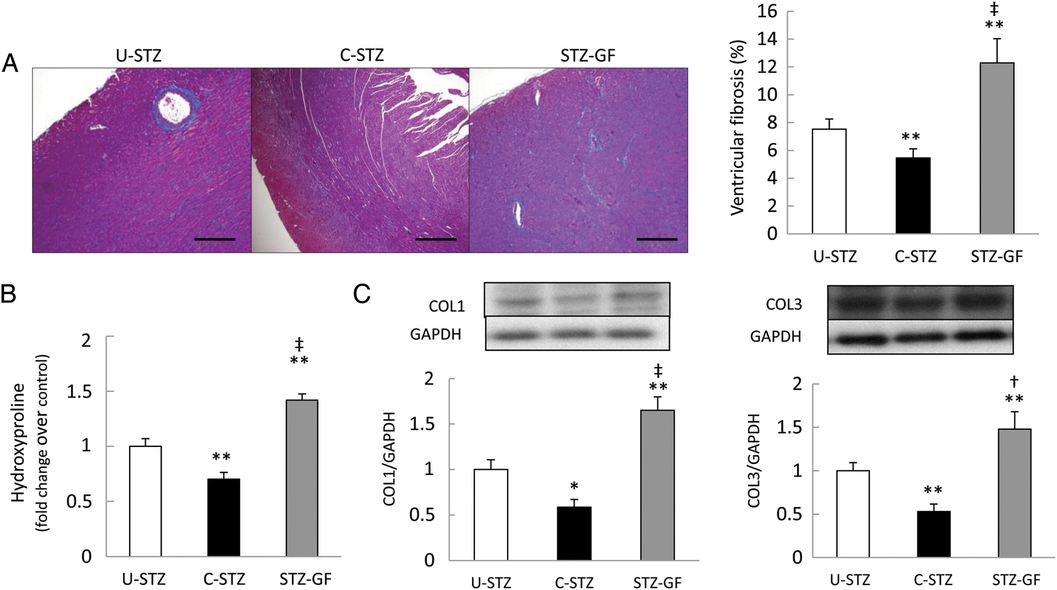
Figure 6 Fibrosis and diastolic dysfunction in LV. (A) Representative images and quantitative results of Masson ...
Notes:
Figure 6 Fibrosis and diastolic dysfunction in LV. (A) Representative images and quantitative results of Masson trichrome staining of LV. LV fibrosis was increased in U-STZ rats compared with C-STZ rats, and the difference was more pronounced between STZ-GF and C-STZ rats. (B) Quantification of hydroxyproline in LV as a marker of collagen content. (C) The expression of COL1 and COL3 was significantly upregulated in LV of U-STZ rats than C-STZ rats, and was highest in STZ-GF rats. Data are presented as mean ± SEM (n = 6 or 7 per group). COL1, collagen type 1; COL3, collagen type 3. Scale bar = 500 µm. *P < 0.05 vs. U-STZ, **P < 0.01 vs. U-STZ, †P < 0.05 vs. C-STZ, and ‡P < 0.01 vs. C-STZ.
Unless provided in the caption above, the following copyright applies to the content of this slide: Published on behalf of the European Society of Cardiology. All rights reserved. © The Author 2014. For permissions please email: journals.permissions@oup.com.

Slide 7
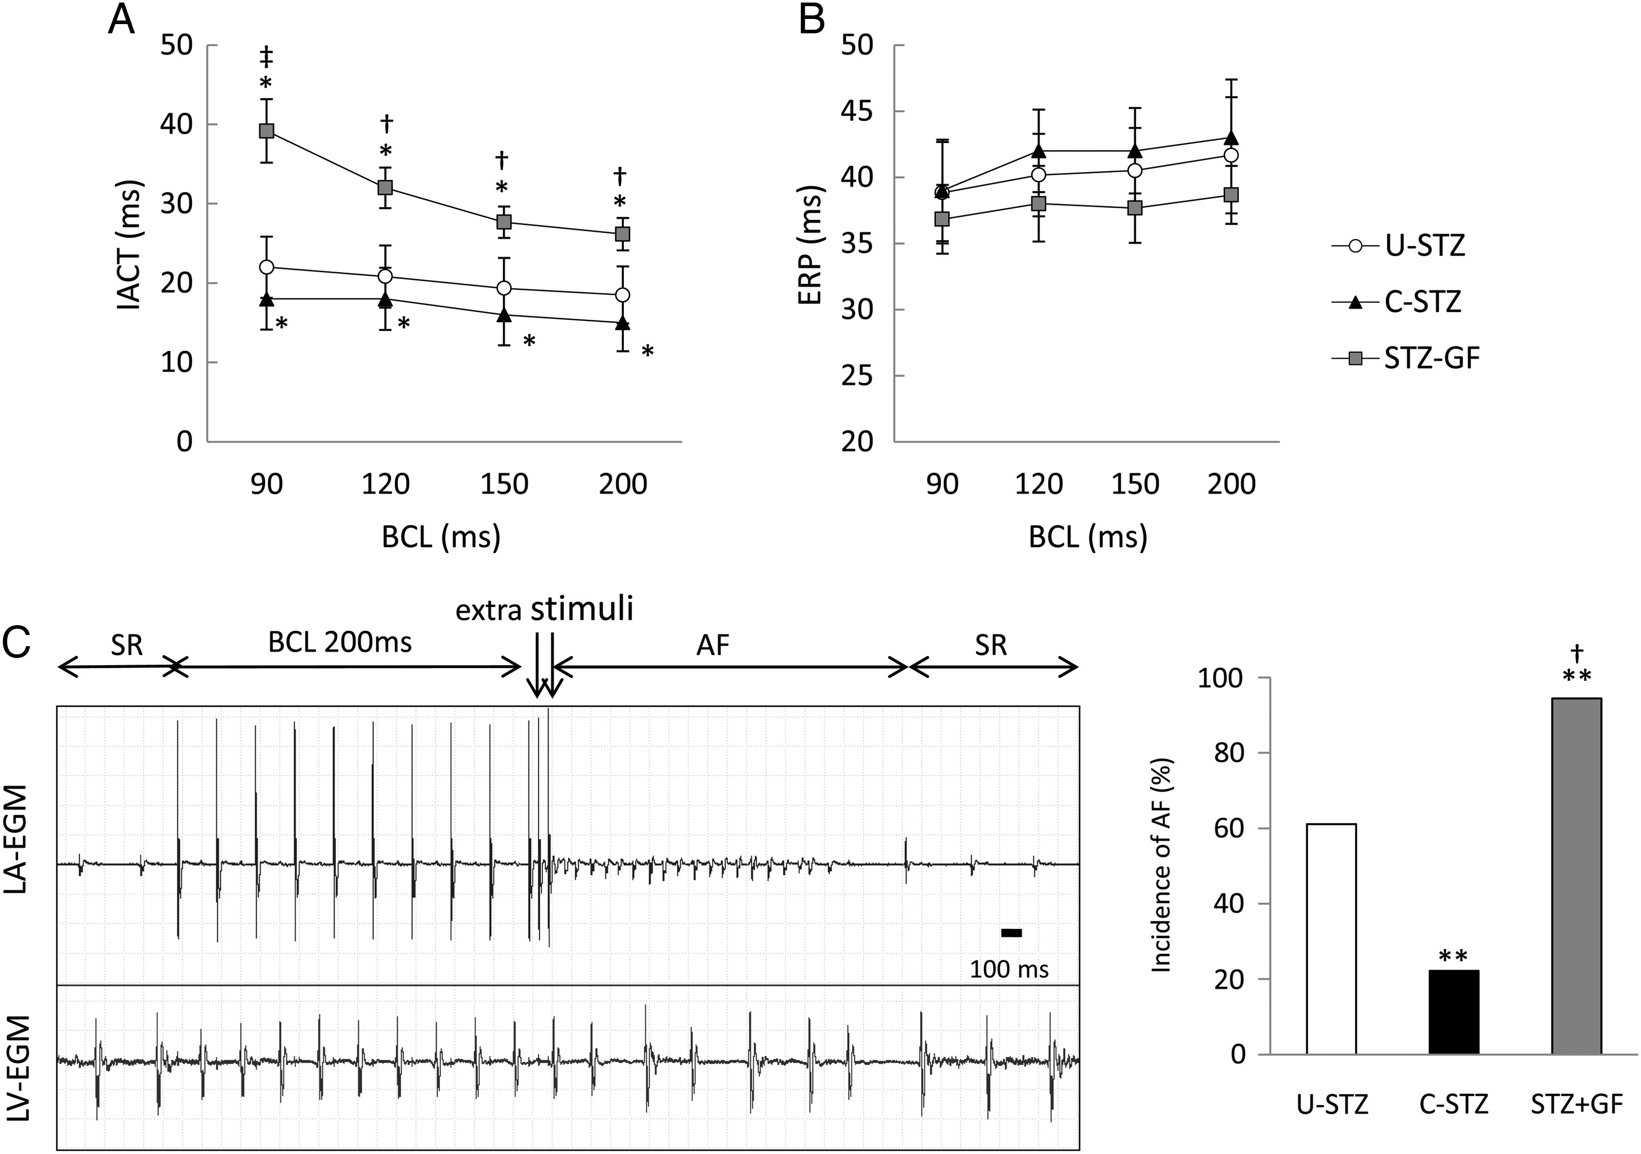
Figure 7 Electrophysiological studies and AF induction. (A and B) Interatrial conduction time (IACT) and effective ...
Notes:
Figure 7 Electrophysiological studies and AF induction. (A and B) Interatrial conduction time (IACT) and effective refractory period (ERP) of LA. IACT in U-STZ rats was significantly prolonged compared with that in C-STZ rats at all basic cycle lengths tested; IACT was further prolonged in STZ-GF rats. There were no significant differences in ERP of LA among the three groups. (C) Representative ECG recordings of AF triggered by S3 extrastimulus pacing. The incidence of AF was significantly higher in U-STZ rats compared with in C-STZ, and was highest in STZ-GF rats. Data are presented as mean ± SEM (n = 18 per group). *P < 0.05 vs. U-STZ, **P < 0.01 vs. U-STZ, †P < 0.05 vs. C-STZ, and ‡P < 0.01 vs. C-STZ.
Unless provided in the caption above, the following copyright applies to the content of this slide: Published on behalf of the European Society of Cardiology. All rights reserved. © The Author 2014. For permissions please email: journals.permissions@oup.com.

Slide 8
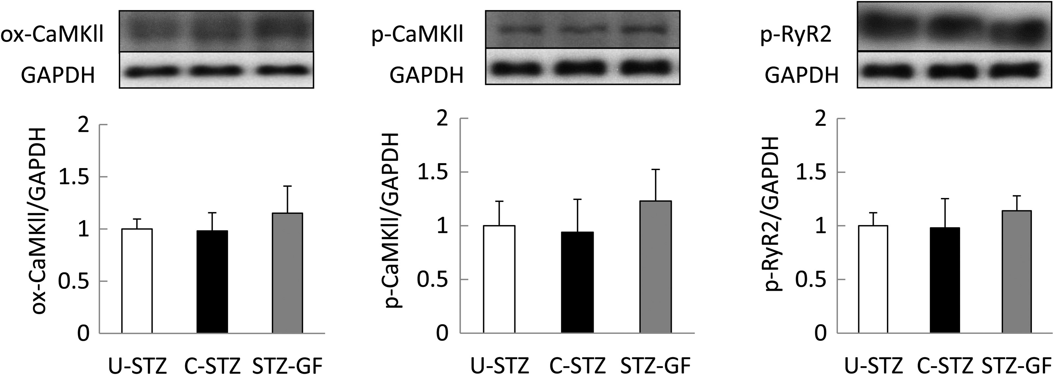
Figure 8 Activation of CaMKII and RyR2. Protein expressions of ox-CaMKll, p-CaMKII, and p-RyR2 in LA were not ...
Notes:
Figure 8 Activation of CaMKII and RyR2. Protein expressions of ox-CaMKll, p-CaMKII, and p-RyR2 in LA were not significantly different among U-STZ, C-STZ, and STZ-GF. Data are presented as mean ± SEM (n = 6 per group). ox-CaMKII, oxidized CaMKII; p-CaMKII, phosphorylated CaMKII; p-RyR2, phosphorylated ryanodine receptor 2 (Ser2808).
Unless provided in the caption above, the following copyright applies to the content of this slide: Published on behalf of the European Society of Cardiology. All rights reserved. © The Author 2014. For permissions please email: journals.permissions@oup.com.

