Slide 1
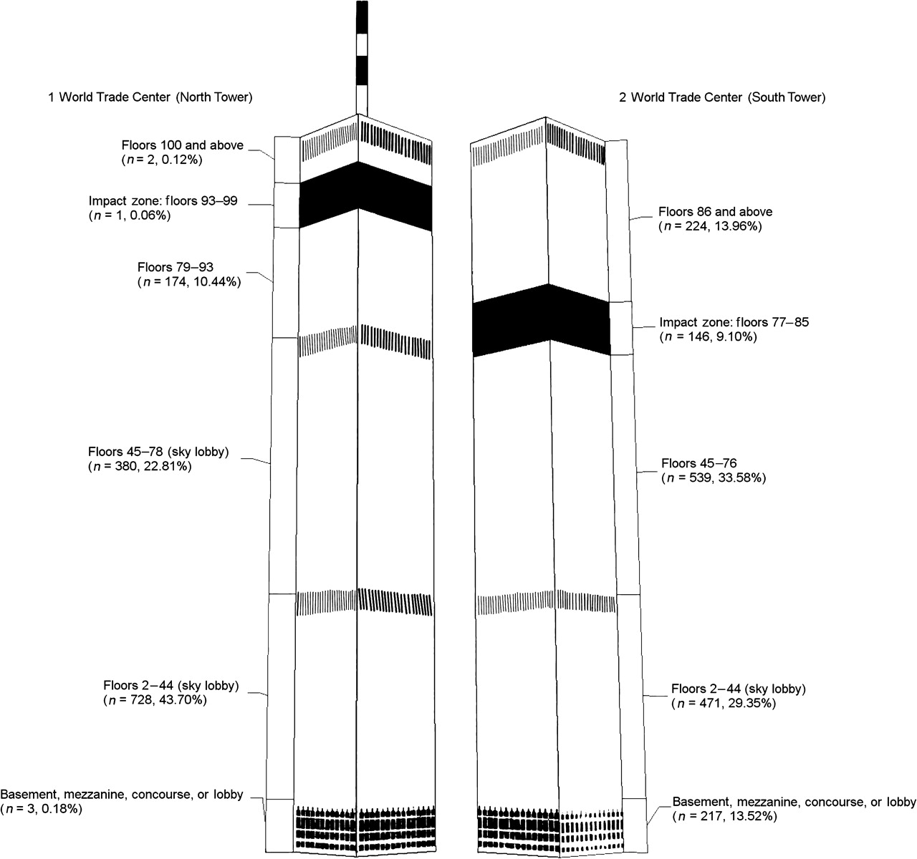
Figure 1. Location on September 11, 2001, reported by adult civilian survivors of the attacks on the World Trade ...
Notes:
Figure 1. Location on September 11, 2001, reported by adult civilian survivors of the attacks on the World Trade Center. Total n = 3,271; missing n = 11.
Unless provided in the caption above, the following copyright applies to the content of this slide: American Journal of Epidemiology © The Author 2010. Published by Oxford University Press on behalf of the Johns Hopkins Bloomberg School of Public Health. All rights reserved. For permissions, please e-mail: journals.permissions@oup.com.

Slide 2
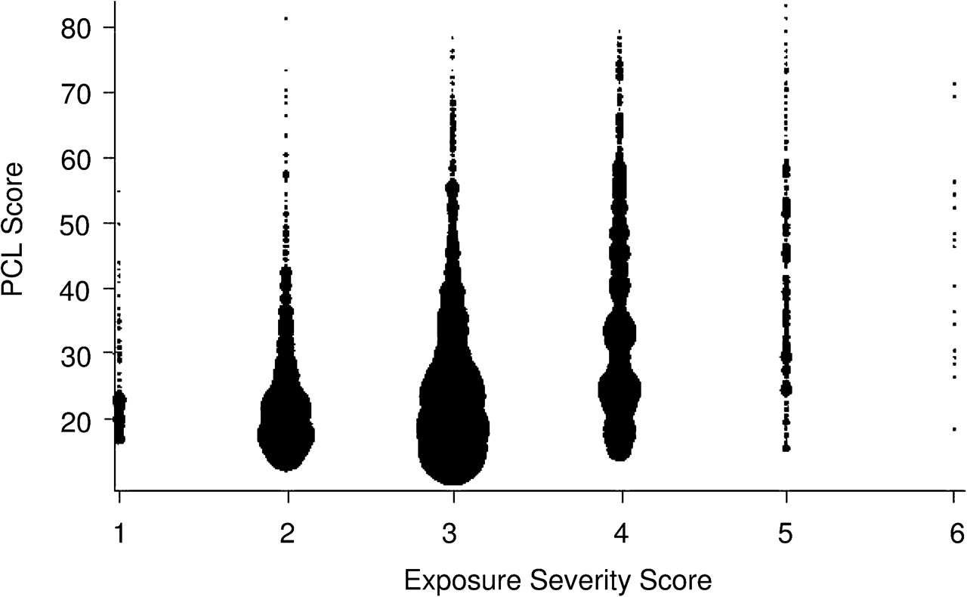
Figure 2. Relation of direct exposure and posttraumatic stress symptoms among adult civilian survivors of the attacks ...
Notes:
Figure 2. Relation of direct exposure and posttraumatic stress symptoms among adult civilian survivors of the attacks on the World Trade Center. Total n = 3,271; n = 102 and mean PTSD Checklist, Stressor-Specific Version (PCL-S) score = 25 at exposure severity score 0; n = 691 and mean PCL-S score = 28 at exposure severity score 1; n = 1272 and mean PCL-S score = 28 at exposure severity score 2; n = 901 and mean PCL-s score 32 at exposure severity score 3; n = 248 and mean PCL-S score = 44 at exposure severity score 4; and n = 17 and mean PCL score = 42 at exposure severity score 5.
Unless provided in the caption above, the following copyright applies to the content of this slide: American Journal of Epidemiology © The Author 2010. Published by Oxford University Press on behalf of the Johns Hopkins Bloomberg School of Public Health. All rights reserved. For permissions, please e-mail: journals.permissions@oup.com.

