Slide 1
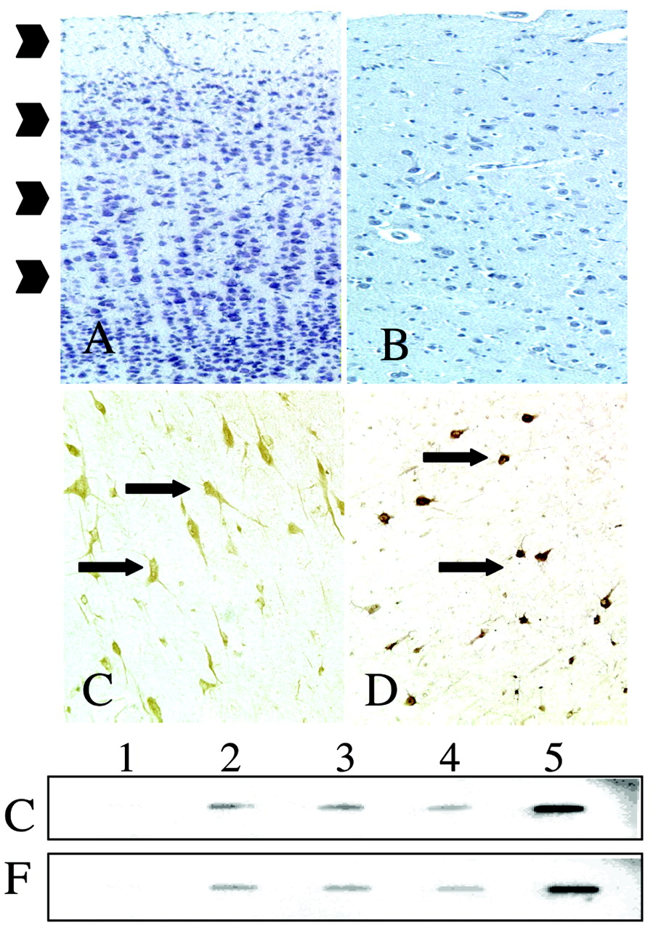
Figure 1. Cytoarchitectural distinctions between control cortex and FCD. (A) Control temporal neocortex (cresyl violet ...
Notes:
Figure 1. Cytoarchitectural distinctions between control cortex and FCD. (A) Control temporal neocortex (cresyl violet stain; arrowheads denote cortical layers). (B) FCD specimen (cresyl violet stain). Note disorganized lamination. (C) MAP2 immunolabeled DNs in FCD (arrows). Note loss of radial orientation (the pial surface is toward the top of the figure) and dysmorphic cell bodies. (D) MAP2 immunolabeled HNs (arrows) in the subcortical white matter. Bottom, equivalent hybridization of radiolabeled aRNA from control (C) and FCD (F) sections to cDNAs. Lane 1, pBlueScript plasmid control vector; lane 2, XAR; lane 3, αINX; lane 4, GFAP; lane 5, NFL.
Unless provided in the caption above, the following copyright applies to the content of this slide: © Oxford University Press

Slide 2
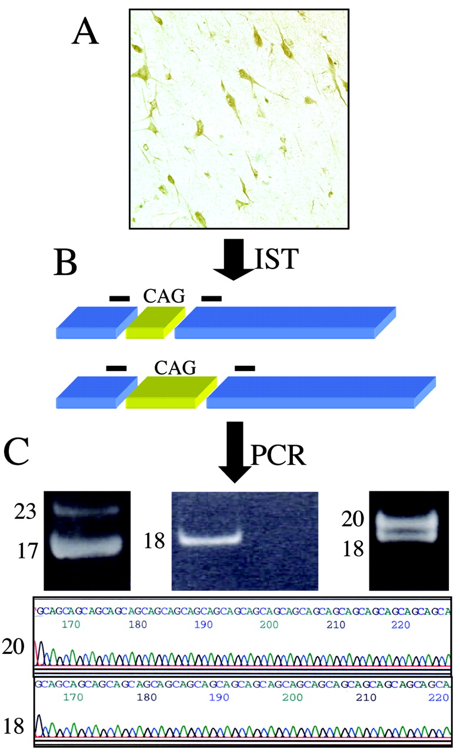
Figure 2. XAR CAG PCR assay. (A) In situ transcription (IST) on immunolabeled tissue sections to generate cDNA from ...
Notes:
Figure 2. XAR CAG PCR assay. (A) In situ transcription (IST) on immunolabeled tissue sections to generate cDNA from tissue poly(A) mRNA. (B) Schematic of two representative XAR cDNAs depicting location and differential size of CAG repeats (yellow) in the XAR mRNAs and the position of flanking primers (black lines). (C) Left, XAR CAG repeats amplified by PCR from section of female control cortex (CAG 17 and CAG 23). Middle, single XAR CAG repeat size in male (CAG 18). Adjacent lane demonstrates that PCR products were not detected in reaction without template cDNA. Right, two XAR CAG repeat sizes (CAG 18 and CAG 20) in female FCD specimen. Bottom, Sequence of CAG 18 and CAG 20 repeats identified in female FCD specimen.
Unless provided in the caption above, the following copyright applies to the content of this slide: © Oxford University Press

Slide 3
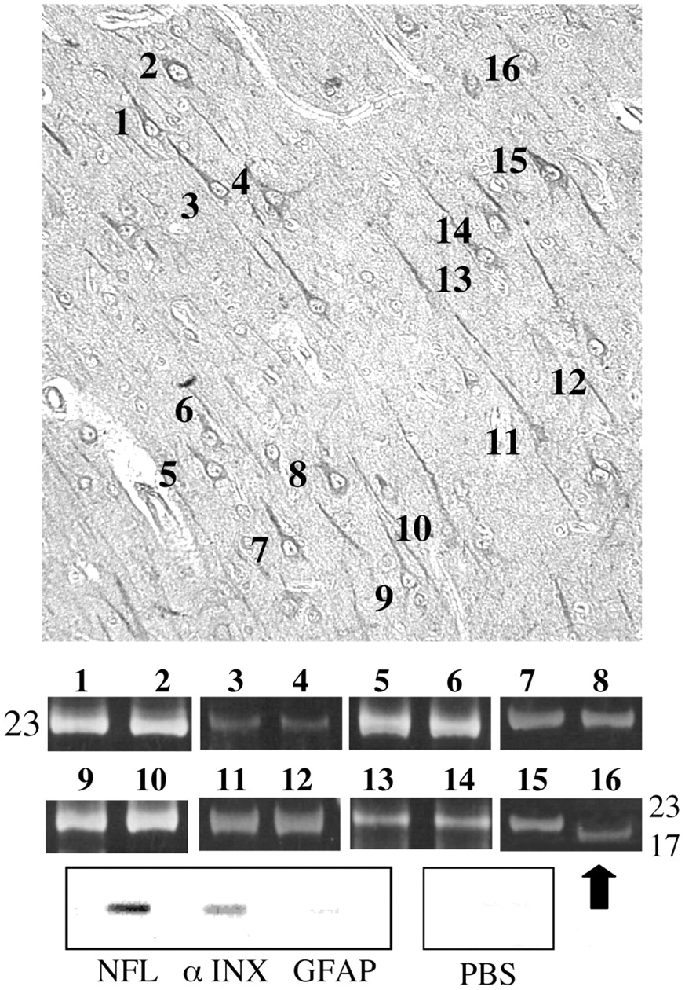
Figure 3. XAR CAG repeat sizes in single microdissected control neurons. Top, Single MAP2 immunolabeled pyramidal ...
Notes:
Figure 3. XAR CAG repeat sizes in single microdissected control neurons. Top, Single MAP2 immunolabeled pyramidal neurons in layer III selected for microdissection. Numbers depict 16 representative cells (eight cell pairs) selected for PCR amplification of XAR CAG repeat. Middle, PCR amplicons from each cell pair. Note similar CAG 23 repeat size in seven cell pairs (1–14). Despite close anatomic proximity, XAR CAG repeats of disparate size were identified in neurons 15 and 16 (arrow). Bottom, expression of neural mRNAs αINX and NFL but not GFAP mRNA, in dissected neurons. PBS, pBlueScript control plasmid.
Unless provided in the caption above, the following copyright applies to the content of this slide: © Oxford University Press

Slide 4
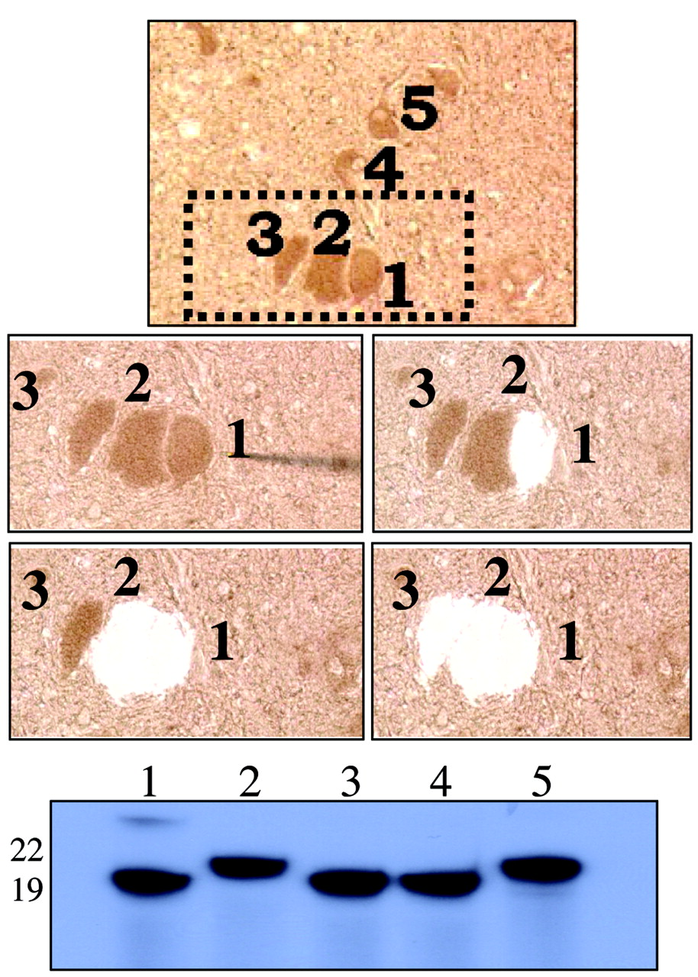
Figure 4. Single cell microdissection and PCR amplification in FCD. Top, Cluster of DNs in FCD (labeled 1–5). Middle, ...
Notes:
Figure 4. Single cell microdissection and PCR amplification in FCD. Top, Cluster of DNs in FCD (labeled 1–5). Middle, Representative microdissection of DNs 1–3 (box). Bottom, PCR products (incorporating 32PdCTP) in lanes 1–5 (6% polyacrylamide denaturing gel) demonstrate disparate CAG repeat sizes in DNs 1–5 depicted in panel A (lanes/cells 1, 3, 4 express CAG 19, lanes/cells 2 and 5 express CAG 22).
Unless provided in the caption above, the following copyright applies to the content of this slide: © Oxford University Press

Slide 5
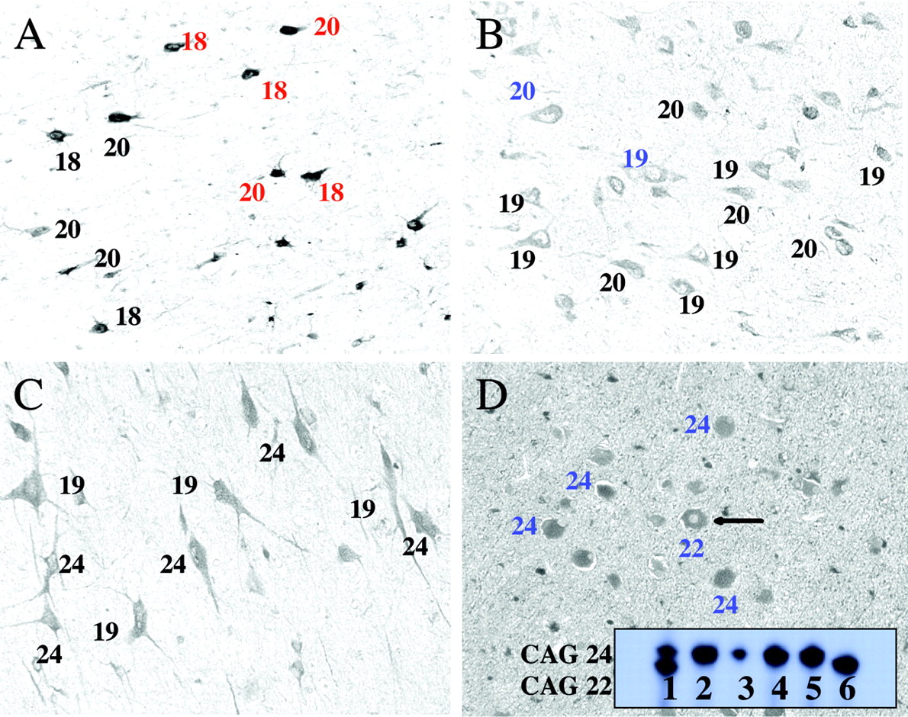
Figure 5. Distribution of XAR CAG repeats in four FCD cases. Numbers depict XAR CAG repeat size in single cell. (A) HNs ...
Notes:
Figure 5. Distribution of XAR CAG repeats in four FCD cases. Numbers depict XAR CAG repeat size in single cell. (A) HNs are red, DNs are black. Note equal expression of both XAR CAG repeats sizes among DNs and HNs. (B) Differential expression of XAR CAG repeats in DNs (black) and two cells morphologically defined as BNs (blue). (C) Among nine DNs, equal representation of both XAR CAG repeats identified in this specimen (CAG 19 and CAG 24). (D) Five BNs of similar morphology in which one of five XAR CAG repeat sizes are disparate. Inset, lane 1 shows size of XAR CAG repeats in tissue section. Similar XAR CAG repeat lengths (lanes 2–5) while lane 6 demonstrates disparate XAR CAG repeat size (6% polyacrylamide denaturing gel).
Unless provided in the caption above, the following copyright applies to the content of this slide: © Oxford University Press

