Slide 1
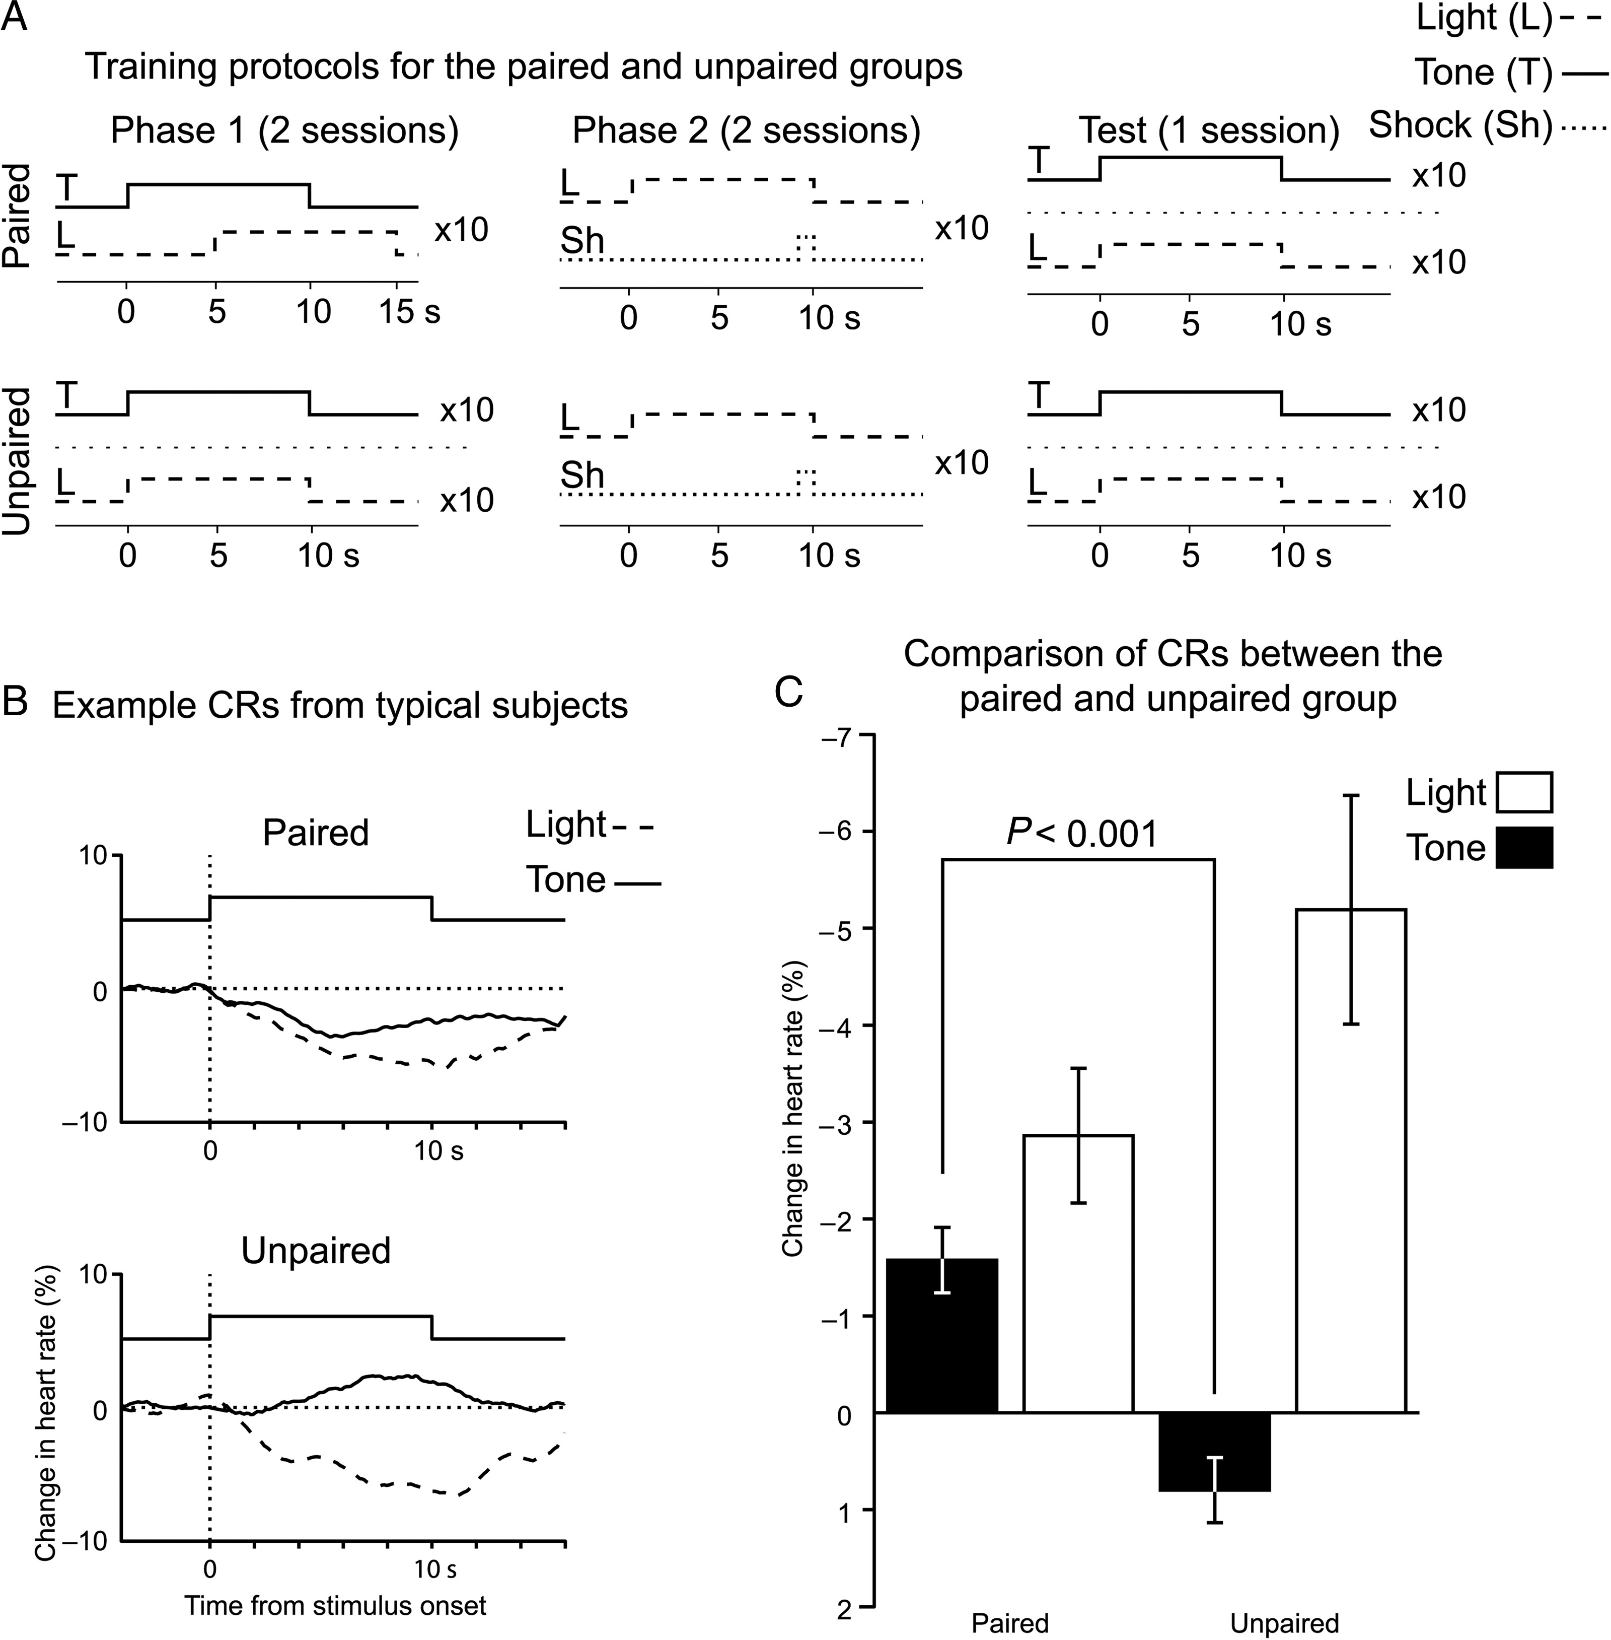
Figure 1. Subjects undergoing sensory preconditioning acquired a tone→light association. (A) A diagram illustrating the ...
Notes:
Figure 1. Subjects undergoing sensory preconditioning acquired a tone→light association. (A) A diagram illustrating the 2 training phases and test phase for the sensory preconditioning and nonassociative control groups. (B) Typical stimulus driven changes in heart rate during the test phase. CRs manifested as a slowing in heart rate, with both groups expressing fear responses to the light. Only sensory preconditioning subjects showed fear to the tone, despite it never being paired with a shock. (C) A group level comparison of the mean change in heart rate to the tone and light during the test phase.
Unless provided in the caption above, the following copyright applies to the content of this slide: © The Author 2013. Published by Oxford University Press. All rights reserved. For Permissions, please e-mail: journals.permissions@oup.com

Slide 2
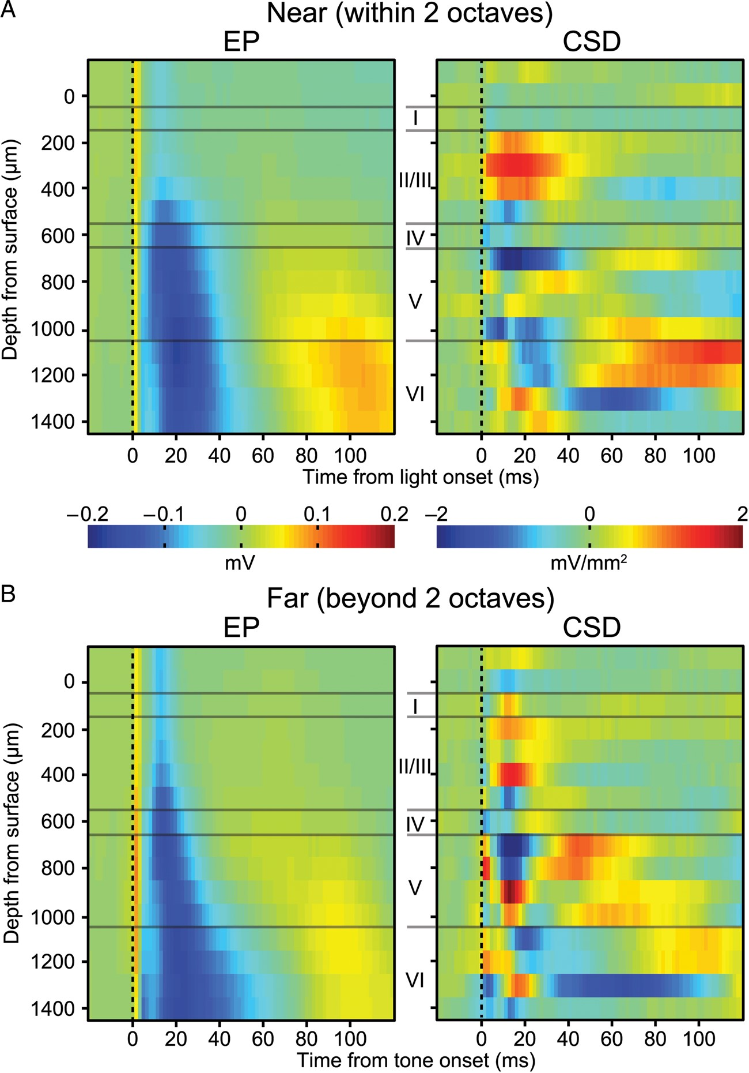
Figure 6. Responses in V1 to microstimulation of A1. (A) Laminar EP and CSD profile for responses evoked by stimulation ...
Notes:
Figure 6. Responses in V1 to microstimulation of A1. (A) Laminar EP and CSD profile for responses evoked by stimulation of sites in A1 with a best frequency within 2 octaves of the training tone frequency. (B) Same as (A), except for sites tuned >2 octaves away. On average both EP profiles show an infragranular pattern of activation that is similar to that seen for tone presentation during the test session.
Unless provided in the caption above, the following copyright applies to the content of this slide: © The Author 2013. Published by Oxford University Press. All rights reserved. For Permissions, please e-mail: journals.permissions@oup.com

Slide 3
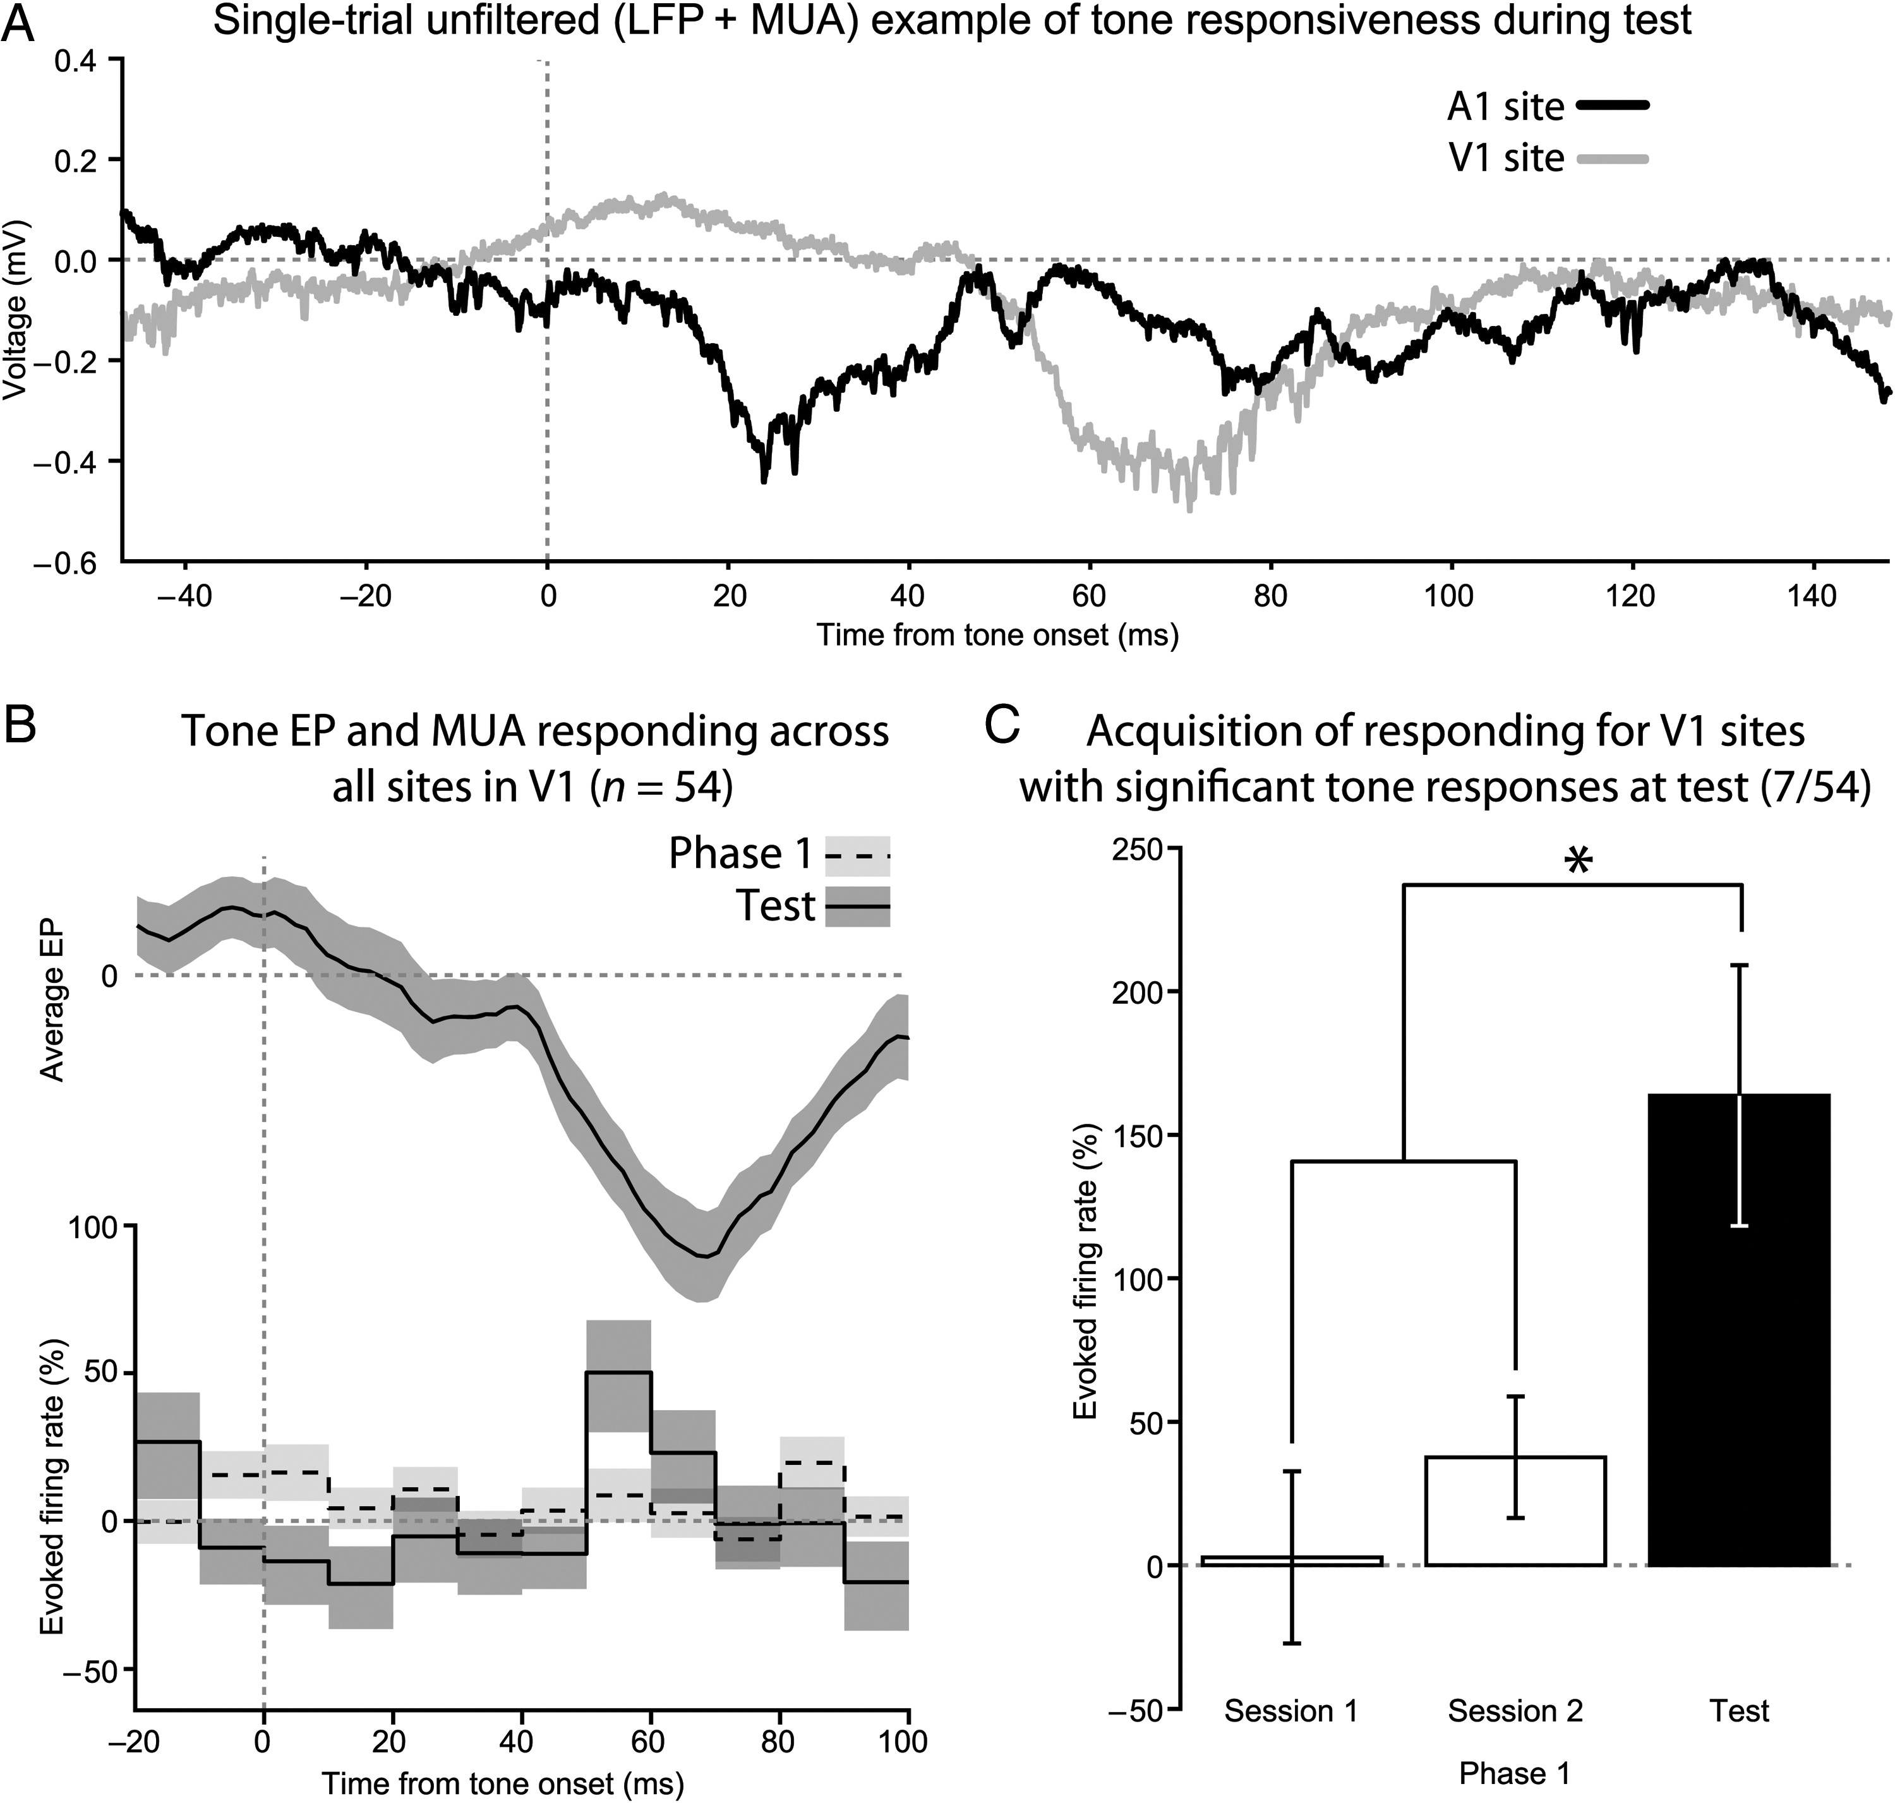
Figure 5. Only limited changes in MUA occurred in V1. (A) Example wideband local field potential recordings from A1 and ...
Notes:
Figure 5. Only limited changes in MUA occurred in V1. (A) Example wideband local field potential recordings from A1 and V1 during the same trial in response to the tone stimulus. Unit activity co-occurs with EP deflections. (B) On average, MUA from sites in V1 exhibited a small, but significant, increase in firing rate during the tone EP. Like the EP, this was not present during Phase 1, only becoming evident during the test phase. Top, the mean tone EP recorded from V1 during the test phase. Bottom, a firing rate histogram comparing the percent change in firing rate between Phase 1 and the test phase. (C) Only those sites in V1 that had significant changes in firing rate to the tone during the test were analyzed. These sites lacked responding during Phase 1, which supports the hypothesis that sensory preconditioning enhanced their tone-evoked MUA.
Unless provided in the caption above, the following copyright applies to the content of this slide: © The Author 2013. Published by Oxford University Press. All rights reserved. For Permissions, please e-mail: journals.permissions@oup.com

Slide 4
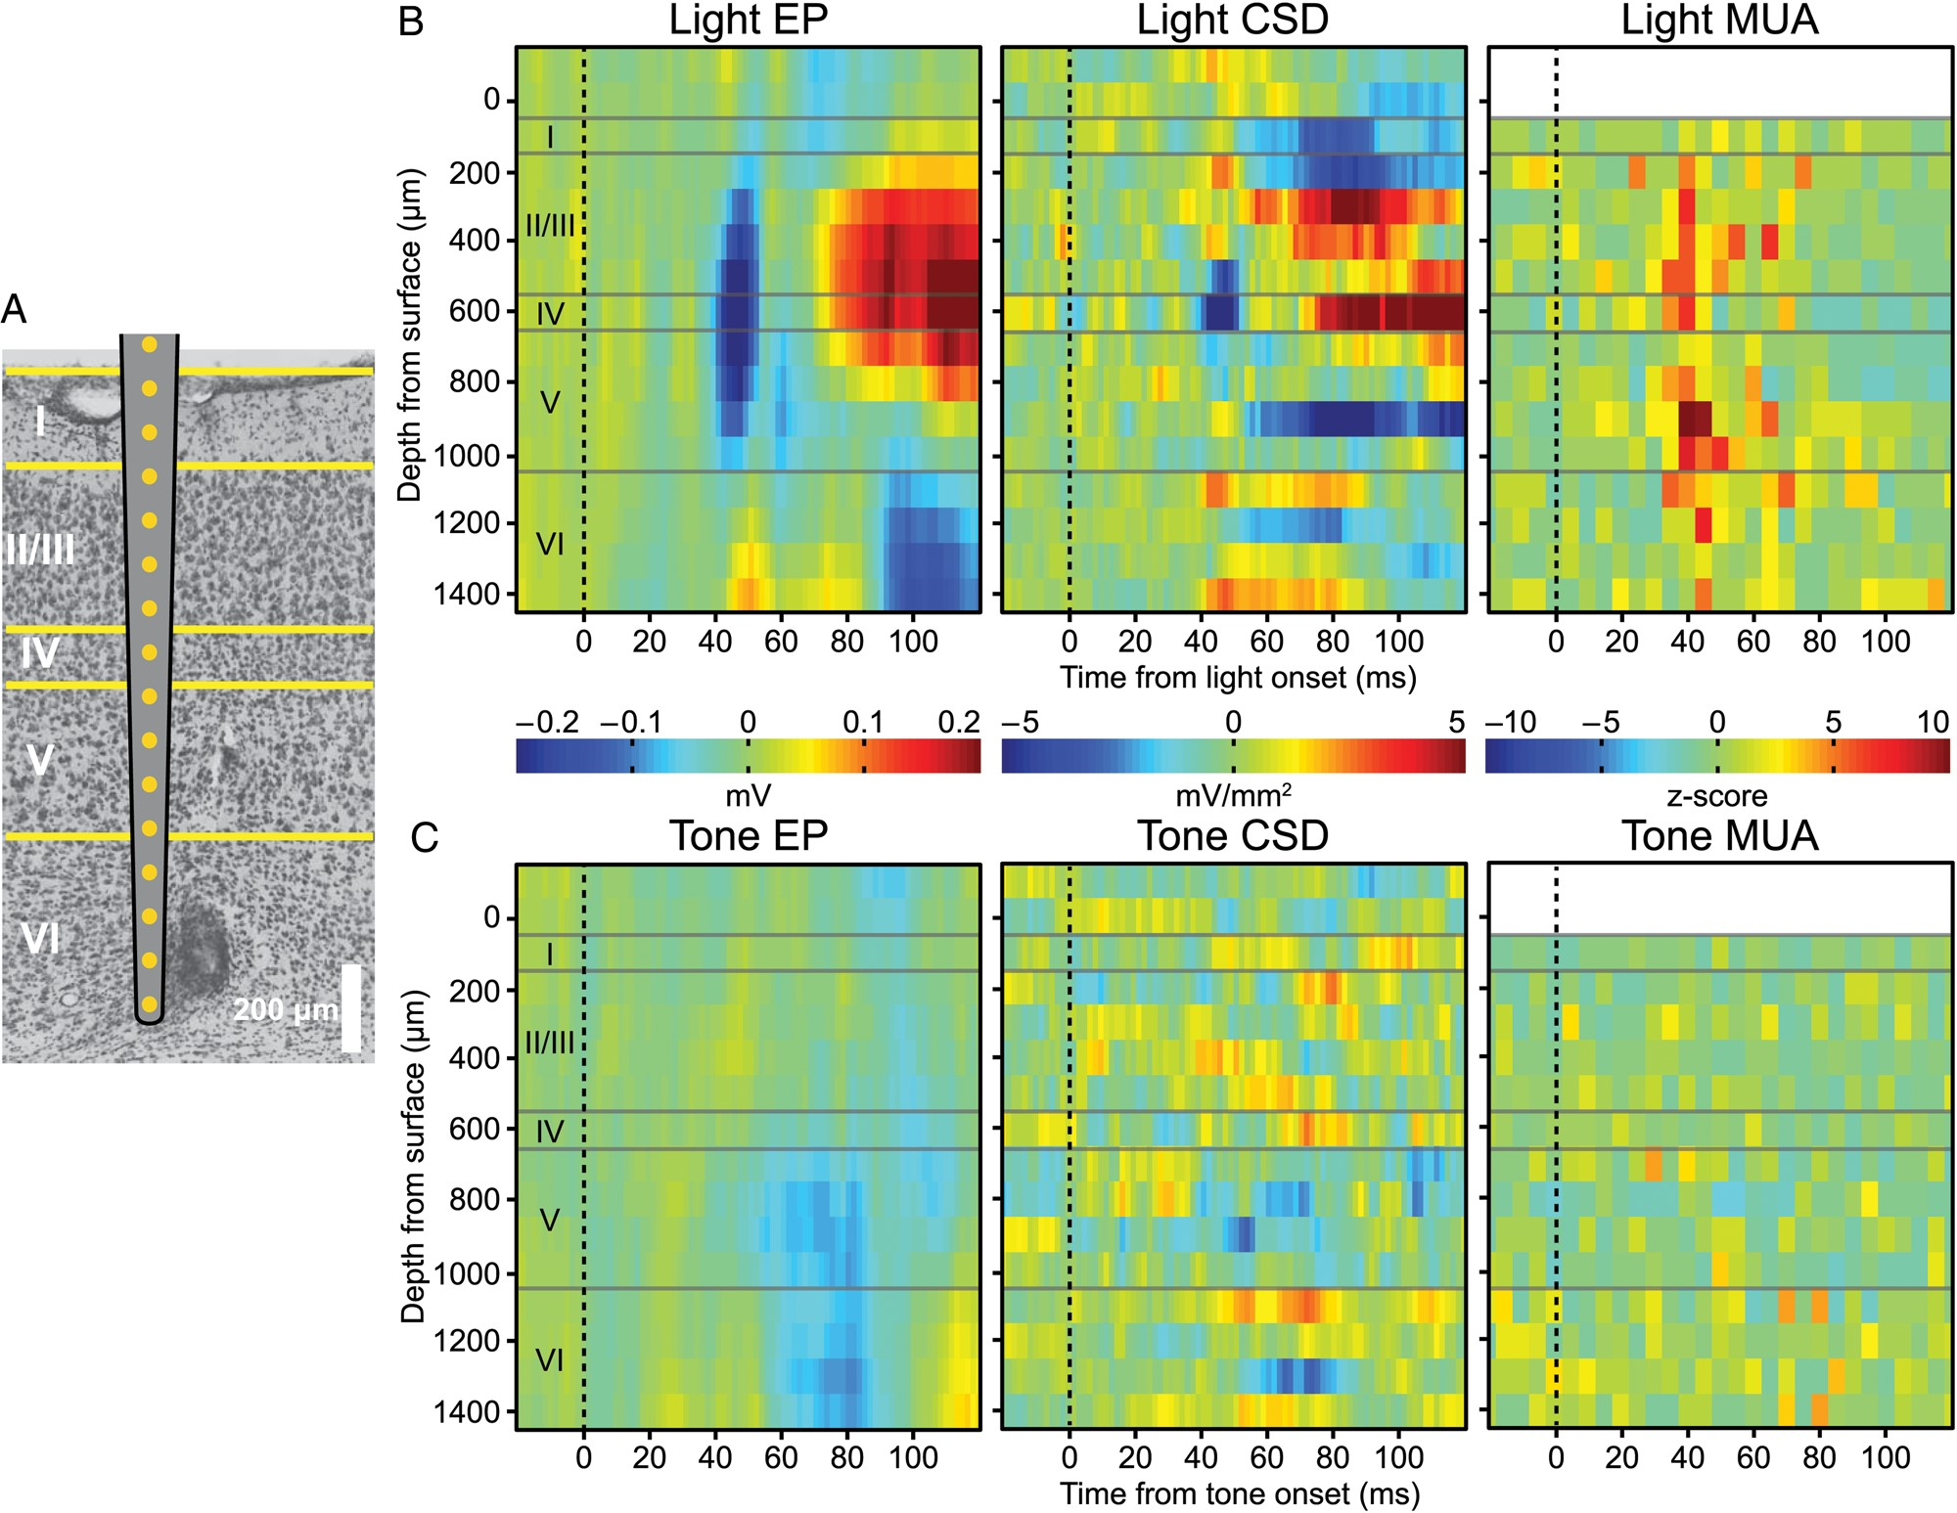
Figure 4. Tone-evoked EPs in V1 were strongest in infragranular layers. (A) Laminar silicon electrode arrays that ...
Notes:
Figure 4. Tone-evoked EPs in V1 were strongest in infragranular layers. (A) Laminar silicon electrode arrays that encompassed all cortical layers were implanted in V1. Histological validation of electrode placements were performed on Nissl stained sections. A marking lesion was placed on the second to last electrode. (B) Presenting the light produced an EP centered on Layer 4 with an ∼45 ms latency. CSD revealed that the generator of the EP was localized to Layer 4, while the distribution of MUA spanned all layers except Layer 1, which is cell sparse. (C) Tones produced an EP limited to infragranular layers, with current sinks localized to infragranular layers. No substantial changes in MUA occurred to the tone in any of the layers.
Unless provided in the caption above, the following copyright applies to the content of this slide: © The Author 2013. Published by Oxford University Press. All rights reserved. For Permissions, please e-mail: journals.permissions@oup.com

Slide 5
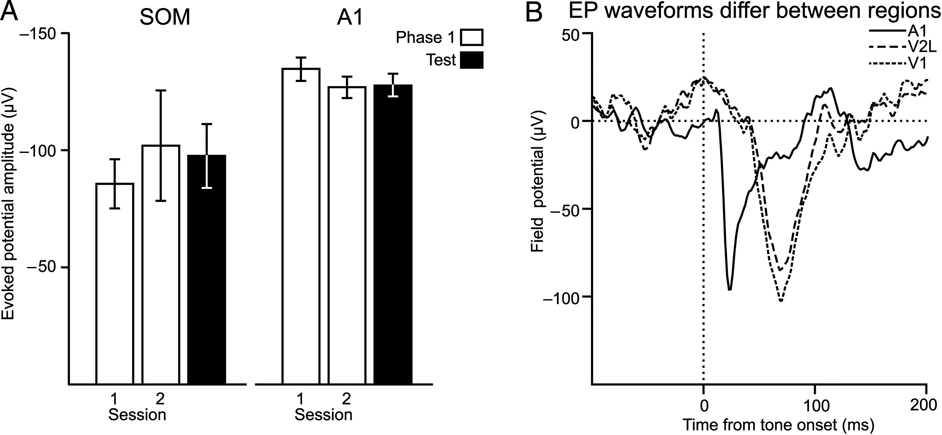
Figure 3. Enhanced tone EPs were specific for to the visual cortex. (A) Neither somatosensory cortex (SOM), nor A1, ...
Notes:
Figure 3. Enhanced tone EPs were specific for to the visual cortex. (A) Neither somatosensory cortex (SOM), nor A1, increased their tone-evoked EP strength in the paired group, despite both exhibiting comparable EP strength to that recorded in visual regions. (B) The tone EP in visual cortex does not reflect passive spread from auditory cortex. A1 exhibits a shorter, more punctuate, EP to the tone than V2L and V1. Each trace is the mean EP recorded from sites in A1 V2L, and V1.
Unless provided in the caption above, the following copyright applies to the content of this slide: © The Author 2013. Published by Oxford University Press. All rights reserved. For Permissions, please e-mail: journals.permissions@oup.com

Slide 6
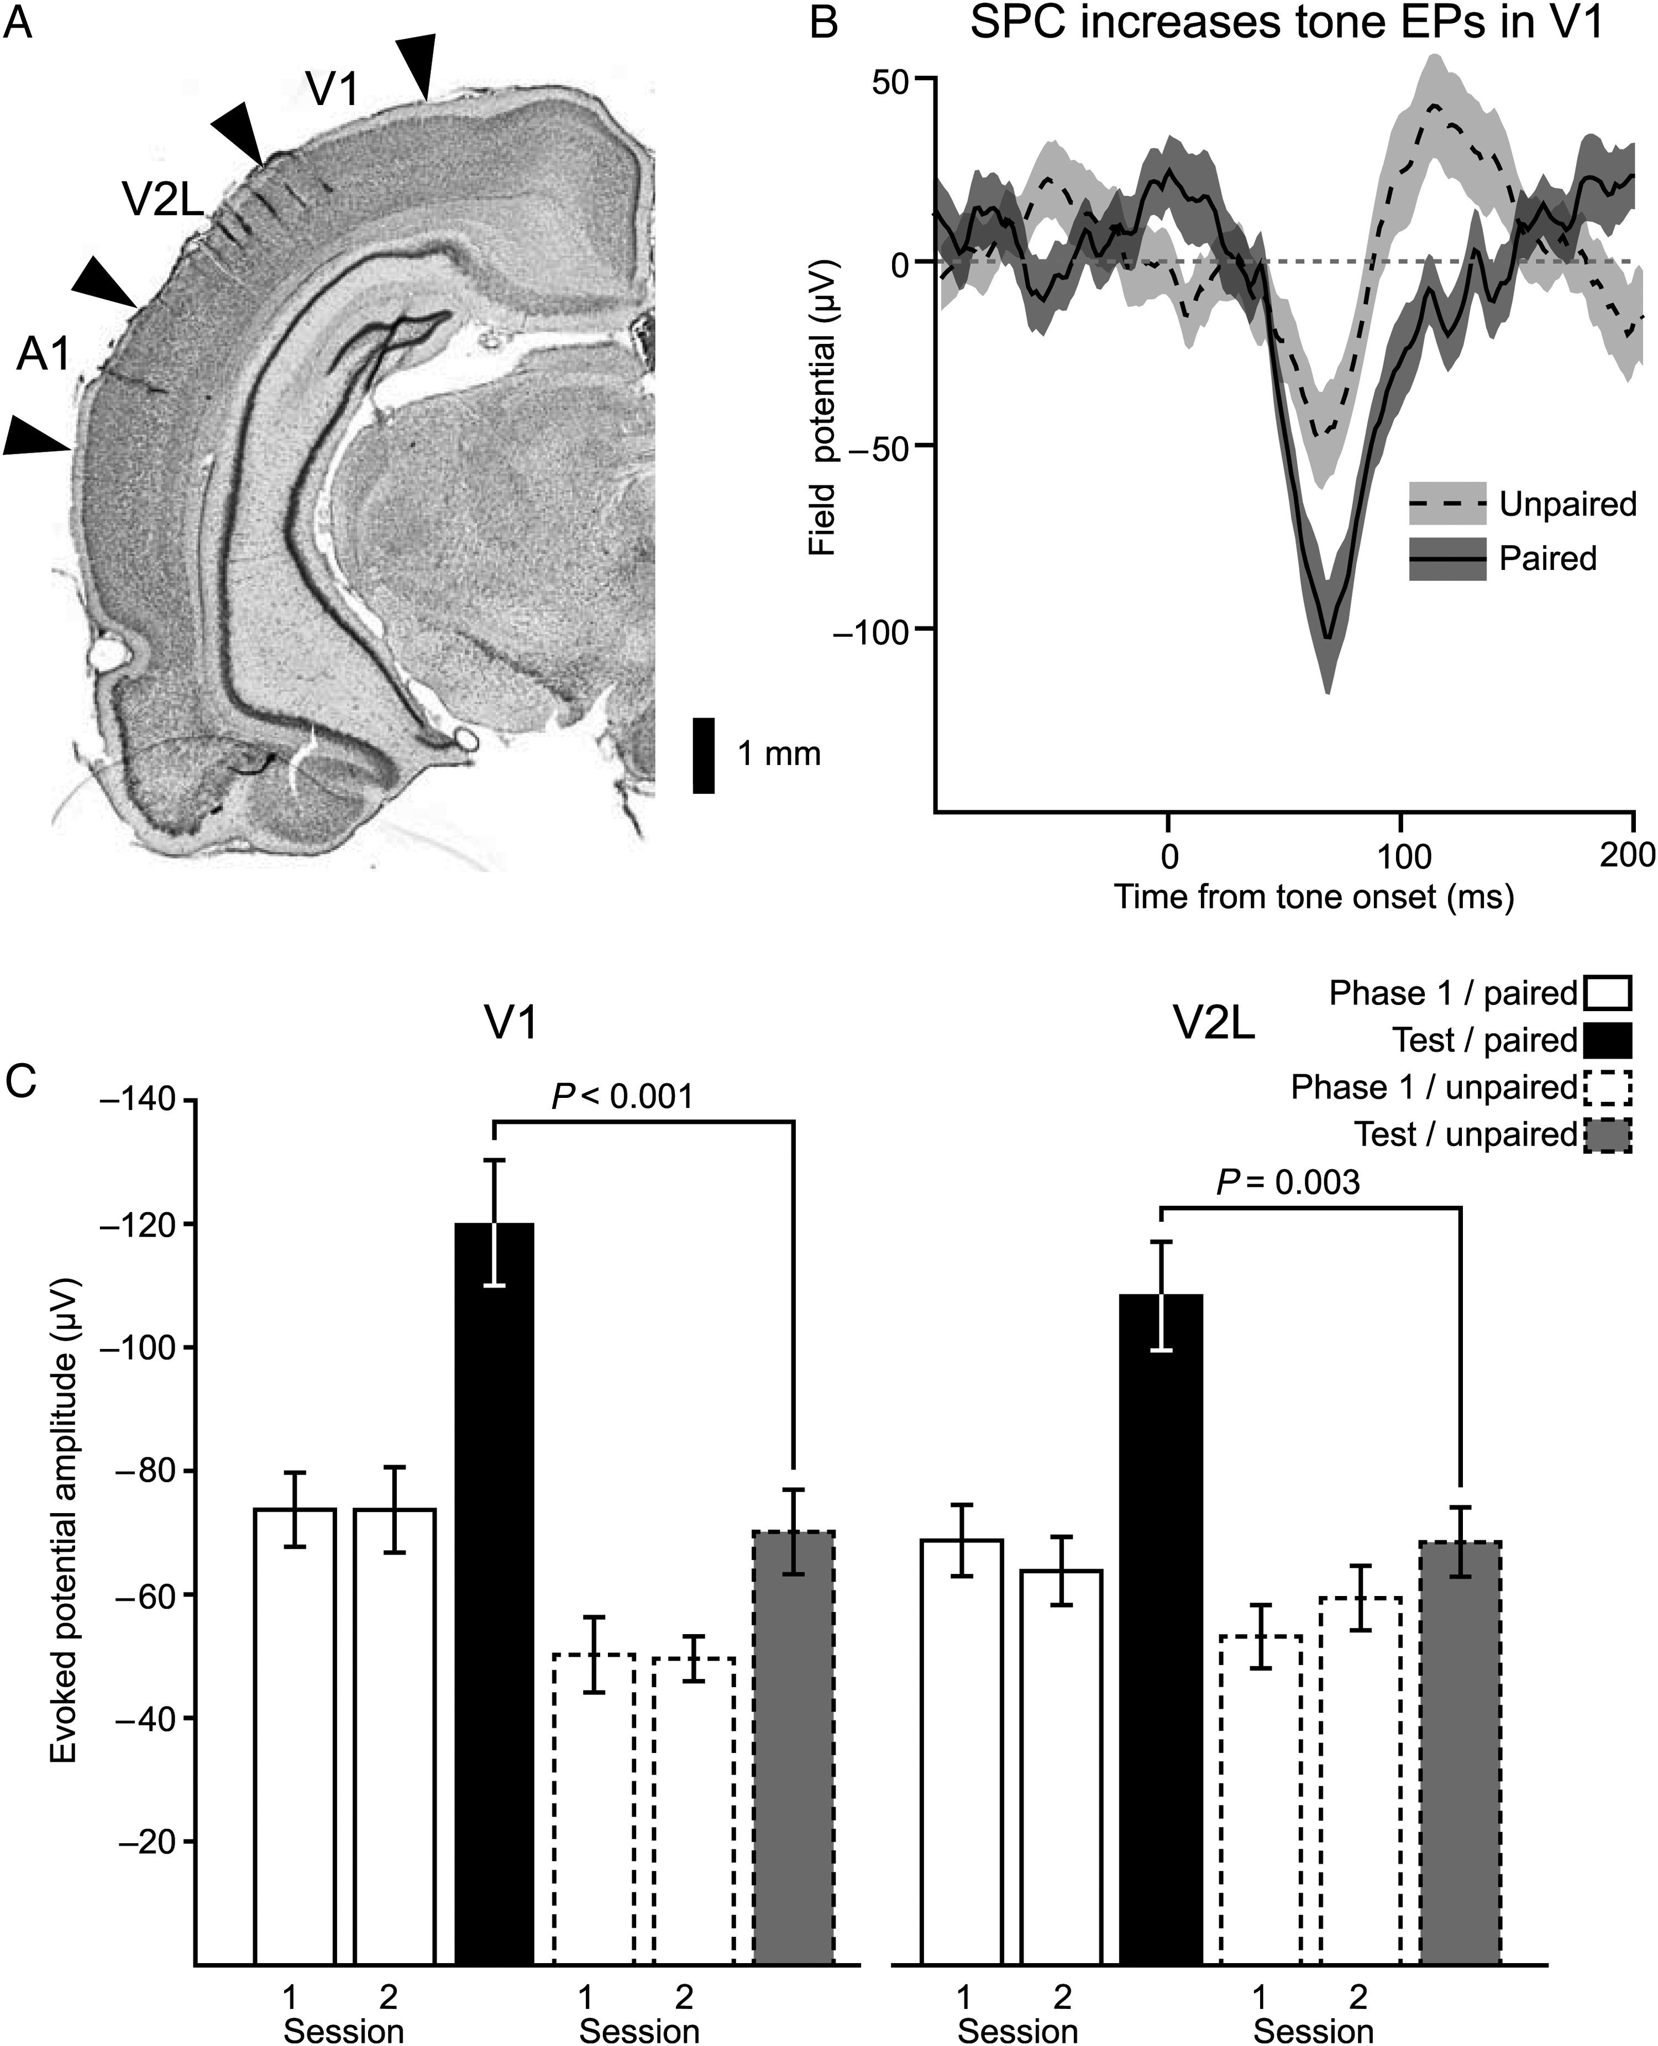
Figure 2. Sensory preconditioning strengthened tone EPs in visual cortex. (A) A coronal section illustrating the ...
Notes:
Figure 2. Sensory preconditioning strengthened tone EPs in visual cortex. (A) A coronal section illustrating the placement of microwire arrays. The array targeting auditory cortex was aligned along the rostro-caudal axis, while that targeting visual cortex spanned V2L and V1 along the medial-lateral axis. (B) The mean EP waveform to the tone during the test phase from subjects in the paired group is overlaid upon that of group that received unpaired presentations of the tone and light during Phase 1. The shaded region corresponds to the standard error of the mean. (C) EP amplitudes were compared between the paired and unpaired groups across Phase 1 and the test phase. Subjects that received paired presentations of the tone and light developed strengthened tone EPs in both V1 and V2L, while the unpaired subjects did not show significant changes in either visual region. Bar height is the mean EP strength, while error bars reflect standard error of the mean.
Unless provided in the caption above, the following copyright applies to the content of this slide: © The Author 2013. Published by Oxford University Press. All rights reserved. For Permissions, please e-mail: journals.permissions@oup.com

