Slide 1
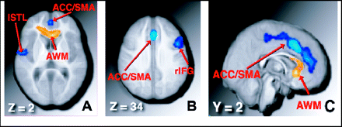
Figure 1. Regions showing a significant increase in volume for older adults who participated in an aerobic fitness ...
Notes:
Figure 1. Regions showing a significant increase in volume for older adults who participated in an aerobic fitness training program, compared to nonaerobic (stretching and toning) control older adults. A and B, Neurologically oriented axial slices through the brain, at +2 and +34 mm, respectively, in stereotaxic space. C, Sagittal slice 2 mm to the right of the midline of the brain. Blue regions: Gray matter volume was increased for aerobic exercisers, relative to nonaerobic controls. Yellow regions: White matter volume was increased for aerobic exercisers, relative to controls. (See also Table 2.)
Unless provided in the caption above, the following copyright applies to the content of this slide: The Gerontological Society of America

