Slide 1
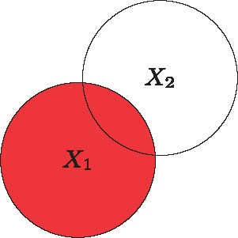
Figure 1 H(X1): Entropy of a random variable X₁:=E[ log⁡2(1P(X))]=−∑i=1mpi log⁡2(pi)
Notes:
Figure 1 H(X1): Entropy of a random variable X1:=E[ log⁡2(1P(X))]=−∑i=1mpi log⁡2(pi)
Unless provided in the caption above, the following copyright applies to the content of this slide: © The Author 2016. Published by Oxford University Press.This is an Open Access article distributed under the terms of the Creative Commons Attribution Non-Commercial License (http://creativecommons.org/licenses/by-nc/4.0/), which permits non-commercial re-use, distribution, and reproduction in any medium, provided the original work is properly cited. For commercial re-use, please contact journals.permissions@oup.com

Slide 2
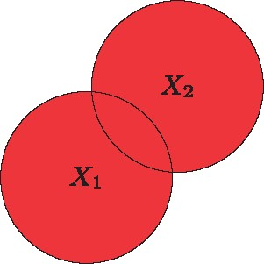
Figure 2 H(X1,X2): Joint entropy of the two random variables X₁ and ...
Notes:
Figure 2 H(X1,X2): Joint entropy of the two random variables X1 and X2:=E[ log⁡2(1P(X1,X2))]=−∑i=1m∑j=1m′pij log⁡2(pij)
Unless provided in the caption above, the following copyright applies to the content of this slide: © The Author 2016. Published by Oxford University Press.This is an Open Access article distributed under the terms of the Creative Commons Attribution Non-Commercial License (http://creativecommons.org/licenses/by-nc/4.0/), which permits non-commercial re-use, distribution, and reproduction in any medium, provided the original work is properly cited. For commercial re-use, please contact journals.permissions@oup.com

Slide 3
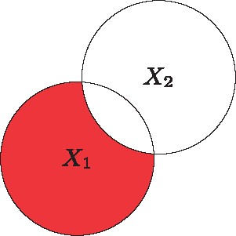
Figure 3 H(X1|X2): Conditional entropy of the variable X₁ given the variable ...
Notes:
Figure 3 H(X1|X2): Conditional entropy of the variable X1 given the variable X2:=E[ log⁡2(P(X2)P(X1,X2))]=−∑i=1m∑j=1m′pij log⁡2(pijp·j)=H(X1,X2)−H(X2)
Unless provided in the caption above, the following copyright applies to the content of this slide: © The Author 2016. Published by Oxford University Press.This is an Open Access article distributed under the terms of the Creative Commons Attribution Non-Commercial License (http://creativecommons.org/licenses/by-nc/4.0/), which permits non-commercial re-use, distribution, and reproduction in any medium, provided the original work is properly cited. For commercial re-use, please contact journals.permissions@oup.com

Slide 4
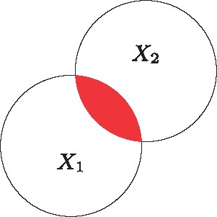
Figure 4 I(X1,X2): Mutual information of the variables X₁ and ...
Notes:
Figure 4 I(X1,X2): Mutual information of the variables X1 and X2:=E[ log⁡2(P(X1,X2)P(X1)P(X2))]=∑i=1m∑j=1m′pij log⁡2(pijpi·p·j)=H(X2)H(X2|X1)=H(X1)H(X1|X2)
Unless provided in the caption above, the following copyright applies to the content of this slide: © The Author 2016. Published by Oxford University Press.This is an Open Access article distributed under the terms of the Creative Commons Attribution Non-Commercial License (http://creativecommons.org/licenses/by-nc/4.0/), which permits non-commercial re-use, distribution, and reproduction in any medium, provided the original work is properly cited. For commercial re-use, please contact journals.permissions@oup.com

Slide 5
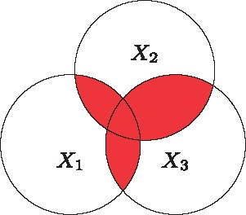
Figure 5 TCI(X1,X2,X3): Total correlation information of three random variables H(X1)+H(X2)+H(X3)−H(X1,X2,X3)
Notes:
Figure 5 TCI(X1,X2,X3): Total correlation information of three random variables H(X1)+H(X2)+H(X3)−H(X1,X2,X3)
Unless provided in the caption above, the following copyright applies to the content of this slide: © The Author 2016. Published by Oxford University Press.This is an Open Access article distributed under the terms of the Creative Commons Attribution Non-Commercial License (http://creativecommons.org/licenses/by-nc/4.0/), which permits non-commercial re-use, distribution, and reproduction in any medium, provided the original work is properly cited. For commercial re-use, please contact journals.permissions@oup.com

Slide 6
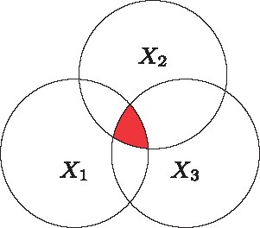
Figure 6 3WII(X1,X2,X3): Three-way interaction information of three random variables ...
Notes:
Figure 6 3WII(X1,X2,X3): Three-way interaction information of three random variables H(X1,X2)+H(X1,X3)+H(X2,X3)−H(X1)−H(X2)−H(X3)−H(X1,X2,X3)
Unless provided in the caption above, the following copyright applies to the content of this slide: © The Author 2016. Published by Oxford University Press.This is an Open Access article distributed under the terms of the Creative Commons Attribution Non-Commercial License (http://creativecommons.org/licenses/by-nc/4.0/), which permits non-commercial re-use, distribution, and reproduction in any medium, provided the original work is properly cited. For commercial re-use, please contact journals.permissions@oup.com

Slide 7
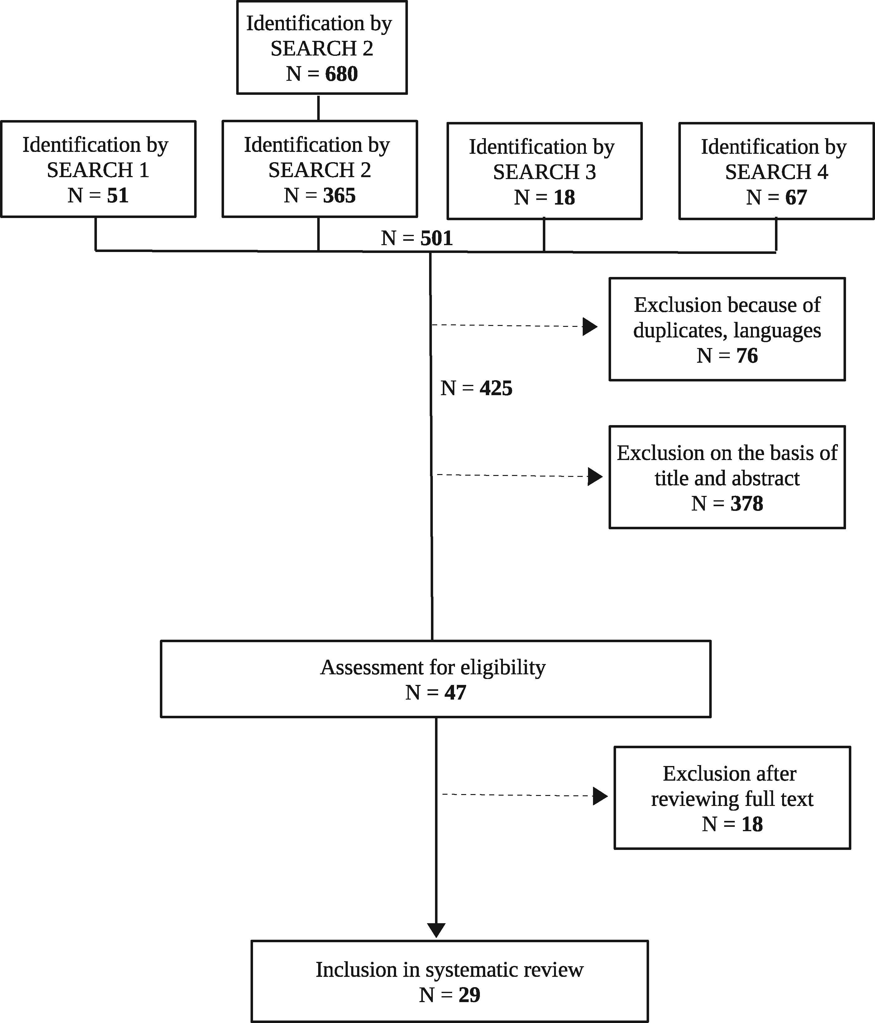
Figure 7 Flow diagram of the search process.
Notes:
Figure 7 Flow diagram of the search process.
Unless provided in the caption above, the following copyright applies to the content of this slide: © The Author 2016. Published by Oxford University Press.This is an Open Access article distributed under the terms of the Creative Commons Attribution Non-Commercial License (http://creativecommons.org/licenses/by-nc/4.0/), which permits non-commercial re-use, distribution, and reproduction in any medium, provided the original work is properly cited. For commercial re-use, please contact journals.permissions@oup.com

