Slide 1
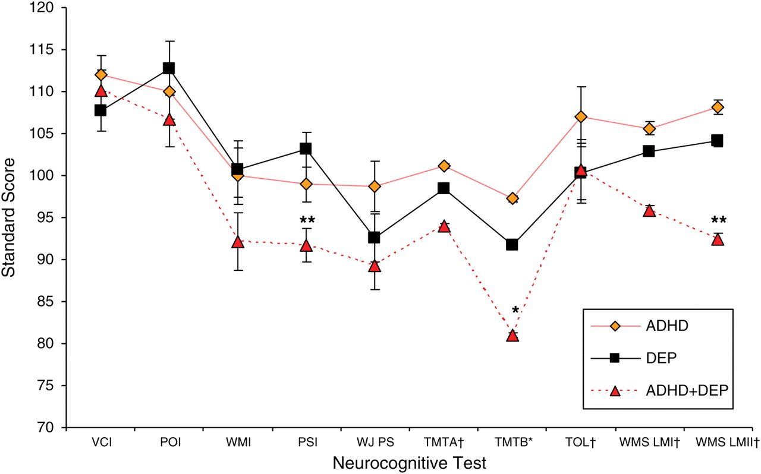
Fig. 1. Neurocognitive test performance by the diagnostic group. ADHD = attention deficit/hyperactivity disorder ...
Notes:
Fig. 1. Neurocognitive test performance by the diagnostic group. ADHD = attention deficit/hyperactivity disorder group; DEP = depressive symptom group; WAIS VCI = Wechsler Adult Intelligence Scale-third edition Verbal Comprehension Index; WAIS POI = Wechsler Adult Intelligence Scale-third edition Perceptual Organization Index; WAIS WMI = Wechsler Adult Intelligence Scale-third edition Perceptual Working Memory Index; WAIS PSI = Wechsler Adult Intelligence Scale-third edition Processing Speed Index; WJ PS = Woodcock–Johnson-third edition Processing Speed; WMS LMI = Wechsler Memory Scales-third edition Logical Memory Immediate; WMS LM II = Wechsler Memory Scales-third edition Logical Memory Delayed Recall. Dagger denotes scores converted from scaled scores (M = 10, SD = 3) to standard scores (M = 100, SD = 15). *ADHD + DEP < ADHD and **ADHD + DEP < ADHD and ADHD + DEP < DEP.
Unless provided in the caption above, the following copyright applies to the content of this slide: © The Author 2011. Published by Oxford University Press. All rights reserved. For permissions, please e-mail: journals.permissions@oup.com.

