Slide 1
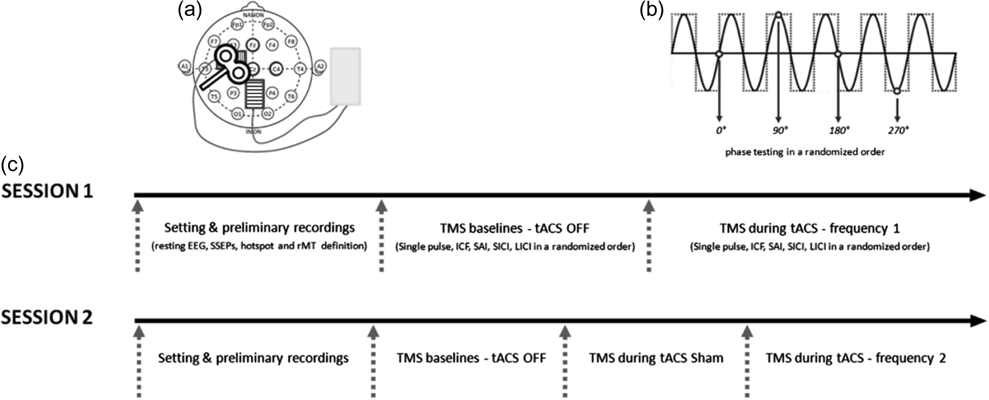
Figure 1. Experimental procedure. (a) tACS montage and stimulation. tACS was delivered through 5 × 7 cm electrodes, the ...
Notes:
Figure 1. Experimental procedure. (a) tACS montage and stimulation. tACS was delivered through 5 × 7 cm electrodes, the stimulation electrode was placed over the left M1 hotspot (dotted rectangle) and the reference electrode positioned over Pz (striped rectangle). The transcranial magnetic stimulation was targeted on the hotspot of the abductor pollicis brevis muscle of the right hand. EEG was recorded from Fz, C3, Cz, C4, and Pz (bold circles) before the stimulation and from Fz, Cz, and C4 during and after the stimulation. (b) TMS during tACS. The tACS signal was recorded and the instantaneous phase of the tACS signal was calculated in real time; 12 TMS stimuli were triggered at each of the 4 tested phases (0°, 90°, 180°, and 270°) of the tACS sinewave in random order. (c) Experimental design. Every participant underwent 2 sessions; each session started with the experimental setting and preliminary recordings (EEG and SSEP recordings, TMS hotspot identification and resting motor threshold definition), followed by the baseline recordings (TMS without tACS) and the during tACS recordings. In the second session sham tACS was tested as a further control condition immediately before real tACS stimulation. The order of tACS frequency was randomized as well as the presentation order of the 5 TMS protocols. SSEP, somatosensory evoked potential.
Unless provided in the caption above, the following copyright applies to the content of this slide: © The Author 2016. Published by Oxford University Press.This is an Open Access article distributed under the terms of the Creative Commons Attribution License (http://creativecommons.org/licenses/by/4.0/), which permits unrestricted reuse, distribution, and reproduction in any medium, provided the original work is properly cited.

Slide 2
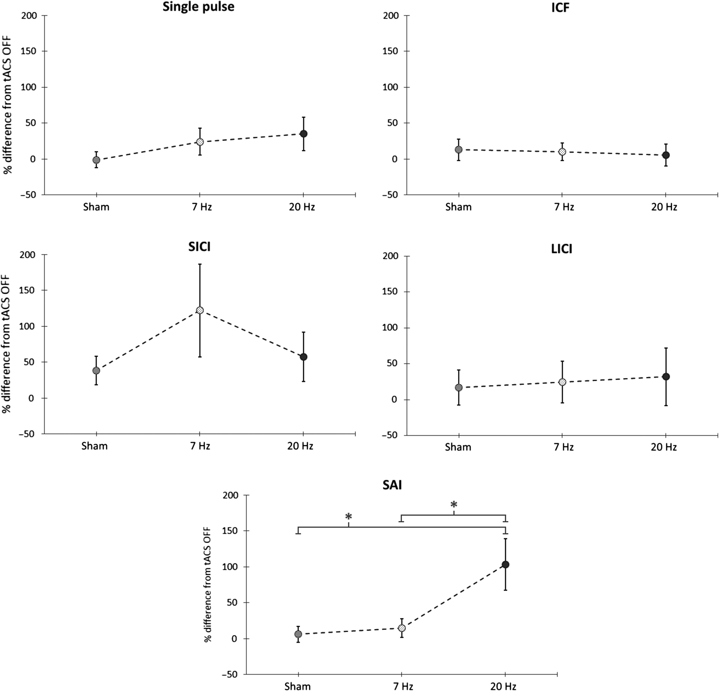
Figure 2. Protocol dependent tACS effects on cortical excitability. Percentage of increase or decrease of the MEP size ...
Notes:
Figure 2. Protocol dependent tACS effects on cortical excitability. Percentage of increase or decrease of the MEP size during sham, 7 Hz and 20 Hz tACS compared with the tACS OFF condition (baseline) for the 5 tested protocols. Only the effects of the short afferent inhibition (SAI—bottom panel) protocol were dependent on the tACS stimulation frequency (one-way ANOVA; P = 0.006). MEP size selectively increased during 20 Hz tACS stimulation. Asterisks denote significant difference (20 Hz vs sham P = 0.047; 20 Hz vs 7 Hz P = 0.046).
Unless provided in the caption above, the following copyright applies to the content of this slide: © The Author 2016. Published by Oxford University Press.This is an Open Access article distributed under the terms of the Creative Commons Attribution License (http://creativecommons.org/licenses/by/4.0/), which permits unrestricted reuse, distribution, and reproduction in any medium, provided the original work is properly cited.

Slide 3
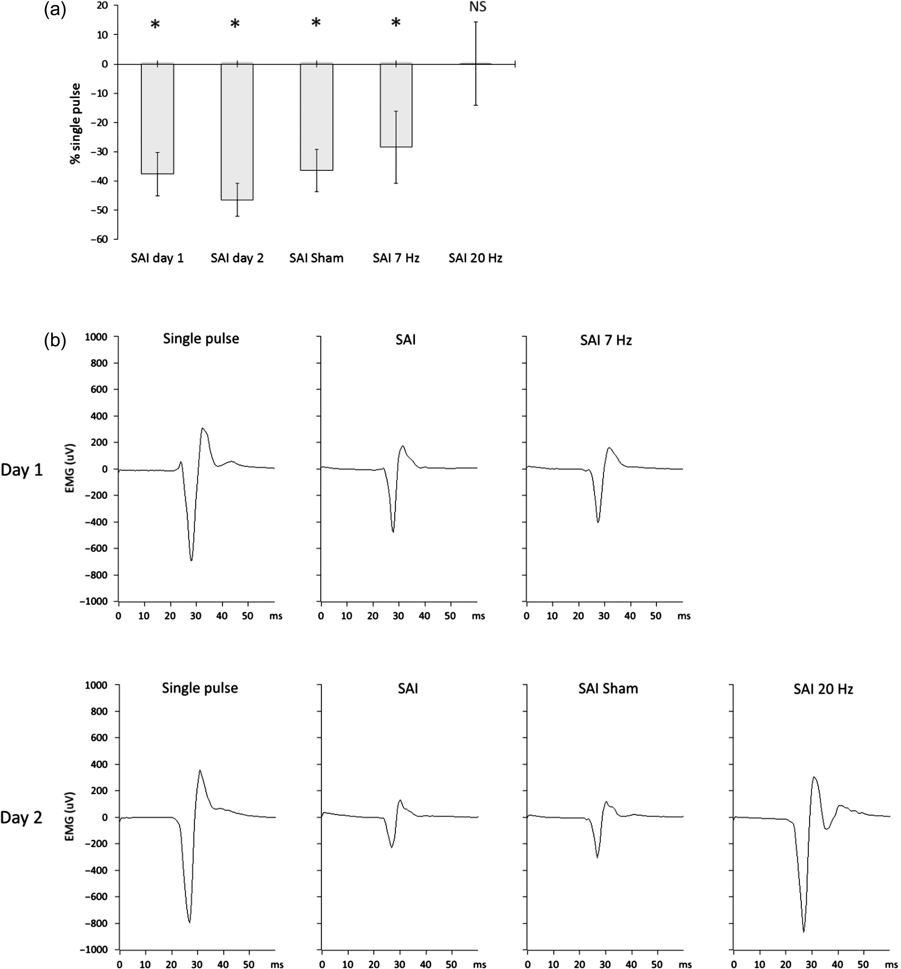
Figure 3. SAI effectiveness across conditions. (a) Percentage increase or decrease of MEP size during the SAI tested ...
Notes:
Figure 3. SAI effectiveness across conditions. (a) Percentage increase or decrease of MEP size during the SAI tested conditions (SAI baseline during session 1, SAI baseline during session 2, SAI during sham tACS, SAI during 7 Hz tACS, SAI during 20 Hz tACS) versus the single suprathreshold stimulus (single pulse protocol). Asterisks denote significant inhibition ( P < 0.05). During the 20 Hz tACS condition, the effect of the SAI protocol was canceled. P values are presented after Bonferroni correction for multiple comparisons. Group mean and standard errors of the mean are shown ( n = 15 healthy subjects). (b) MEP amplitude modulation during SAI (data from a representative subject). The characteristic inhibitory effect of the SAI (with respect to the single pulse) was preserved in all conditions except during 20 Hz tACS, where the MEP size was about the same as during single pulse.
Unless provided in the caption above, the following copyright applies to the content of this slide: © The Author 2016. Published by Oxford University Press.This is an Open Access article distributed under the terms of the Creative Commons Attribution License (http://creativecommons.org/licenses/by/4.0/), which permits unrestricted reuse, distribution, and reproduction in any medium, provided the original work is properly cited.

Slide 4
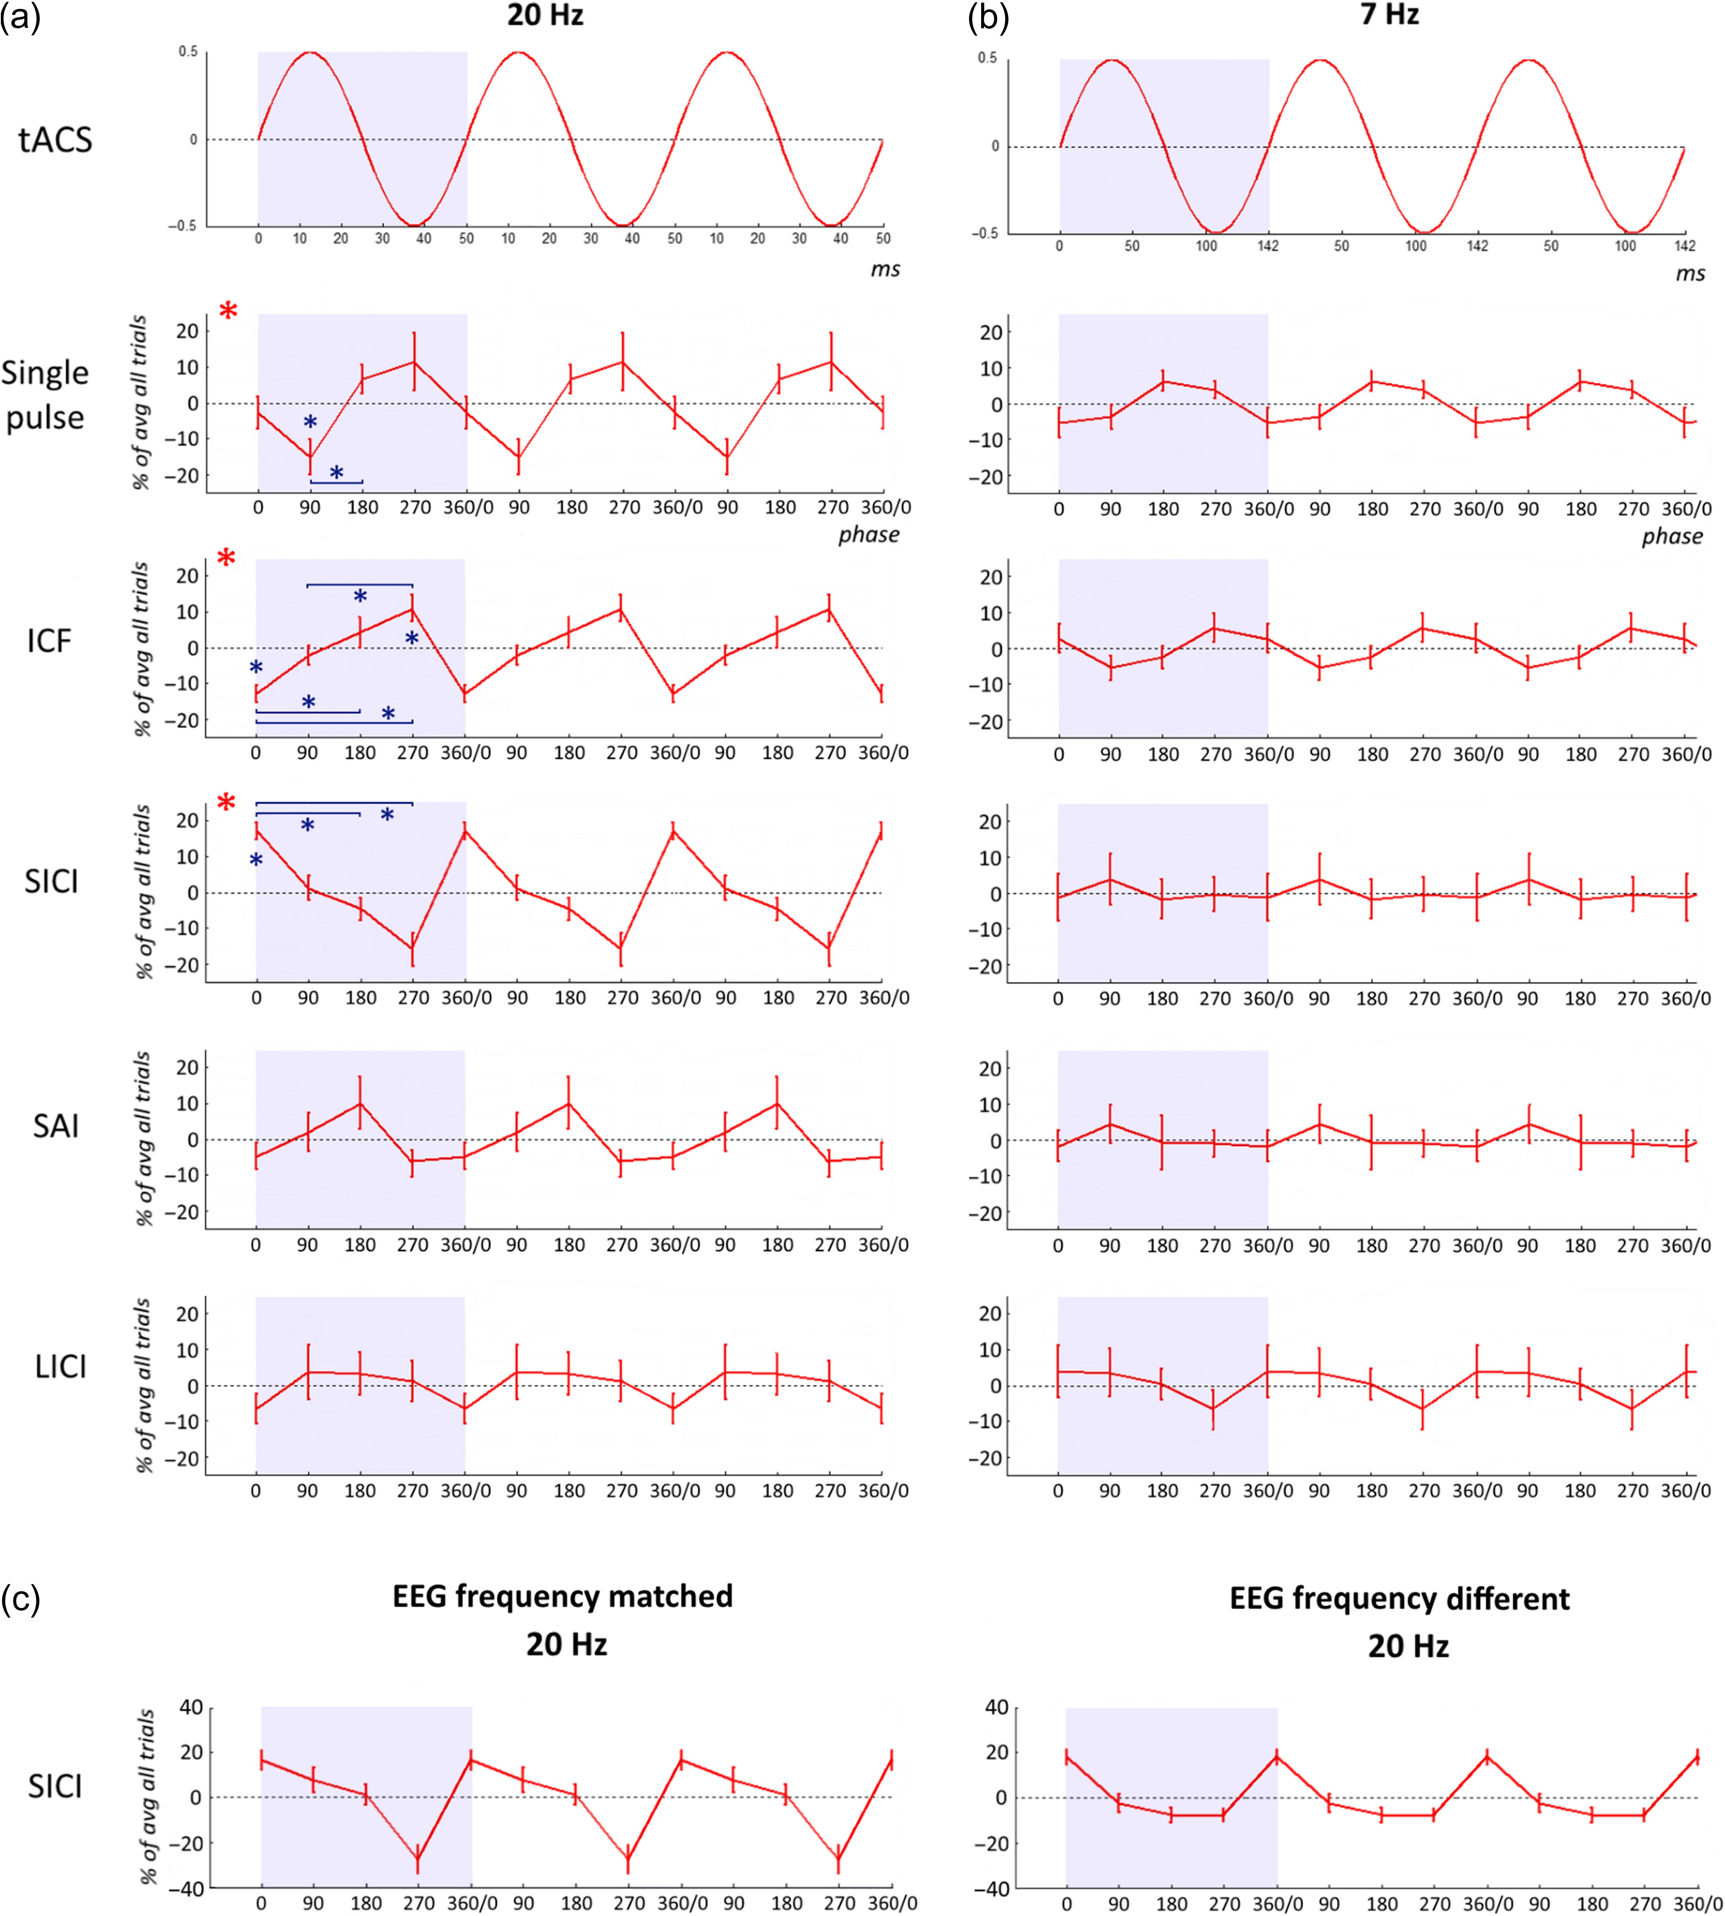
Figure 4. Phase dependency of tACS effects on cortical excitability. (a) Phase-dependent MEP size modulation during 20 ...
Notes:
Figure 4. Phase dependency of tACS effects on cortical excitability. (a) Phase-dependent MEP size modulation during 20 Hz (motor cortex resonance frequency) tACS. Percentage increase or decrease of MEP size according to the stimulation phase (0°, 90°, 180°, or 270°) versus the mean of the MEPs with TMS delivered at all 4 phases. For single pulse, ICF, and SICI protocols, the MEP size was modulated in a phase-dependent manner (two-way ANOVA with factors “protocol” (5 levels: single pulse, ICF, SAI, SICI, and LICI) and “phase” (4 levels: 0°, 90°, 180°, and 270°) identified a significant interaction between factors “protocols” × “phase” (F(5,69) = 3.021; P = 0.016). Red asterisks denote a significant effect of the factor “phase” (one-way ANOVA; single pulse: P = 0.024, ICF: P < 0.001, and SICI: P = 0.024). Blue asterisks denote significant post hoc t-tests P < 0.05. P values are presented after Bonferroni correction for multiple comparisons. (b) Phase-dependent MEP size modulation during 7 Hz (nonmotor cortex resonance frequency) tACS. Percentage increase or decrease of the MEP size according to the stimulation phase (0°, 90°, 180°, or 270°) versus the mean of the MEPs with TMS delivered at all 4 phases. Group mean and standard errors of the mean are shown (n = 15 healthy subjects). Three cycles of phase-dependent modulation are shown for each frequency for clarity. (c) Phase-dependent SICI modulation during 20 Hz (motor cortex resonance frequency) tACS according to whether or not tACS was matched to spontaneous beta frequency. Left and right panels show SICI modulation in “EEG frequency matched” ( n = 7) and “EEG frequency different” ( n = 7) groups, respectively. Note that the y-axis is double than in (a) and (b).
Unless provided in the caption above, the following copyright applies to the content of this slide: © The Author 2016. Published by Oxford University Press.This is an Open Access article distributed under the terms of the Creative Commons Attribution License (http://creativecommons.org/licenses/by/4.0/), which permits unrestricted reuse, distribution, and reproduction in any medium, provided the original work is properly cited.

Slide 5
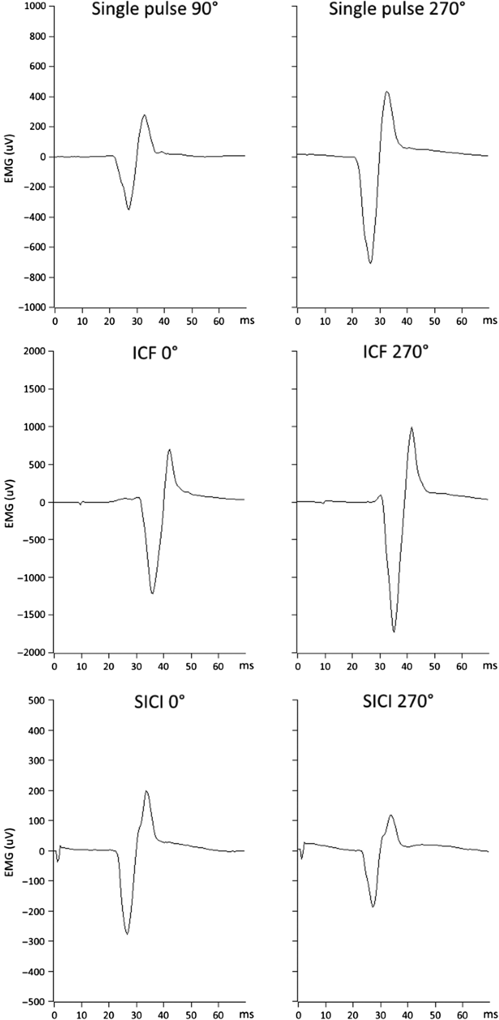
Figure 5. Phase-dependent MEP size modulation during 20 Hz tACS. Single pulse, intracortical facilitation (ICF), and ...
Notes:
Figure 5. Phase-dependent MEP size modulation during 20 Hz tACS. Single pulse, intracortical facilitation (ICF), and short-interval intracortical inhibition (SICI) MEP amplitude modulation. The least and the most effective tACS phases are shown for a representative participant. During the single pulse protocol, 90° was the worst phase (smallest MEP) and 270° was the best one (biggest MEP). During both ICF and SICI, 0° was the worst phase (less MEP facilitation during ICF and less MEP inhibition during SICI) and 270° was the best one (greater MEP facilitation during ICF and more MEP inhibition during SICI). Note the different y-axis scales for the 3 protocols.
Unless provided in the caption above, the following copyright applies to the content of this slide: © The Author 2016. Published by Oxford University Press.This is an Open Access article distributed under the terms of the Creative Commons Attribution License (http://creativecommons.org/licenses/by/4.0/), which permits unrestricted reuse, distribution, and reproduction in any medium, provided the original work is properly cited.

