Slide 1
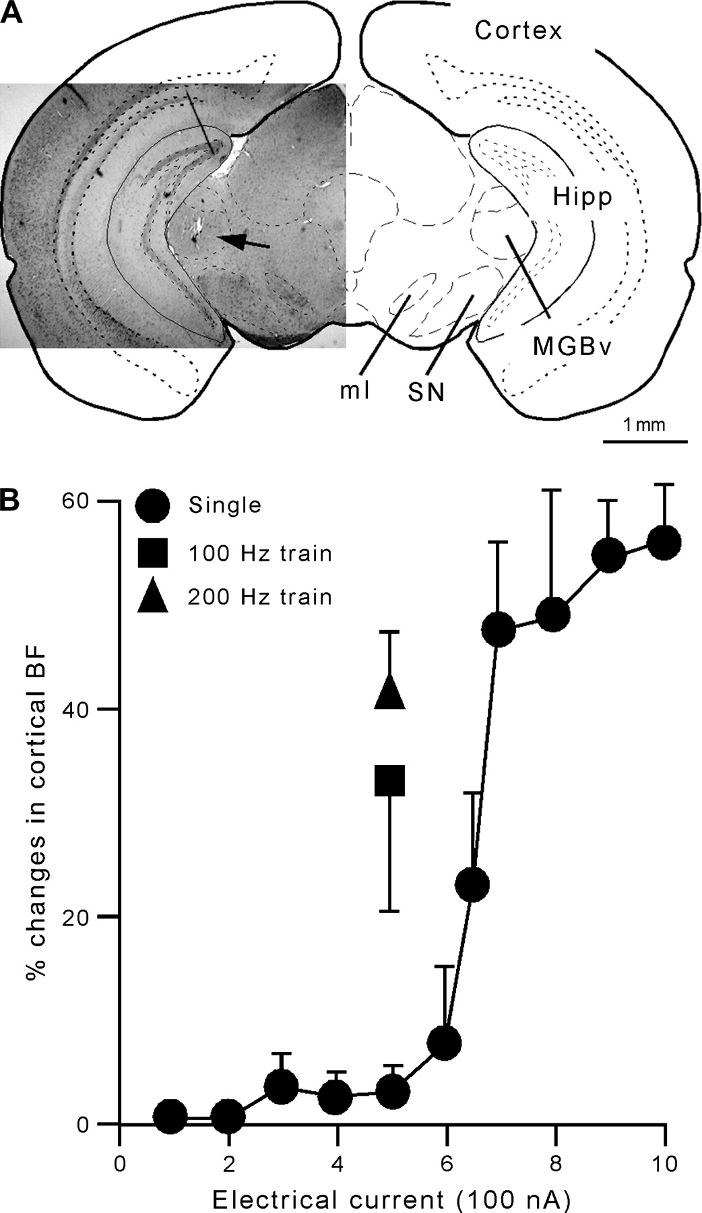
Figure 1 (A) Microscopic photograph of the coronal section of the left brain at 3.1 mm posterior to the bregma with a ...
Notes:
Figure 1 (A) Microscopic photograph of the coronal section of the left brain at 3.1 mm posterior to the bregma with a superimposed schematic drawing of the coronal section of the mouse brain at 3.16 mm posterior to the bregma. A lesion site can be seen at the MGBv as indicated by a black arrow. ml, medial lemniscus; Hipp, hippocampus; SN, substantia nigra. (B) The percentage of the shifts in cortical BFs evoked by the ESMGB as the function of the current level for the ESMGB. A remarkable shift in cortical BFs was observed when the current was 700 nA or larger.
Unless provided in the caption above, the following copyright applies to the content of this slide: © The Author 2006. Published by Oxford University Press. All rights reserved. For permissions, please e-mail: journals.permissions@oxfordjournals.org

Slide 2
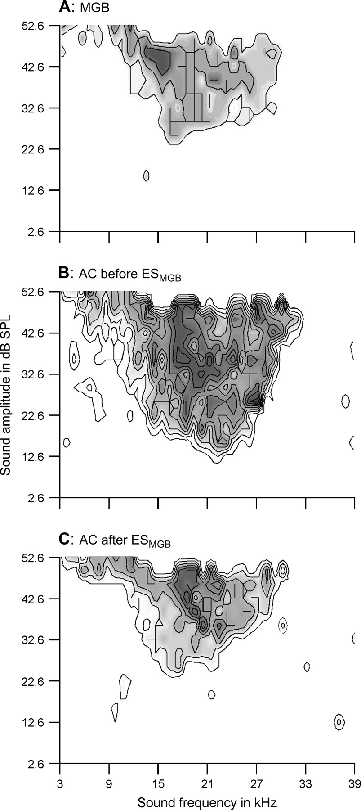
Figure 2 The multiunit RF of the stimulated thalamic neurons (A) and the single-unit RFs of the recorded cortical ...
Notes:
Figure 2 The multiunit RF of the stimulated thalamic neurons (A) and the single-unit RFs of the recorded cortical neuron before (B) and after (C) ESMGB. The thalamic RF shows a lower BF, higher MT, shorter bandwidth, smaller size, and lower response magnitude when compared with the pre-ESMGB cortical RF. The ESMGB changed the cortical RF toward the thalamic RF. The contour line represents 2-spike increments.
Unless provided in the caption above, the following copyright applies to the content of this slide: © The Author 2006. Published by Oxford University Press. All rights reserved. For permissions, please e-mail: journals.permissions@oxfordjournals.org

Slide 3
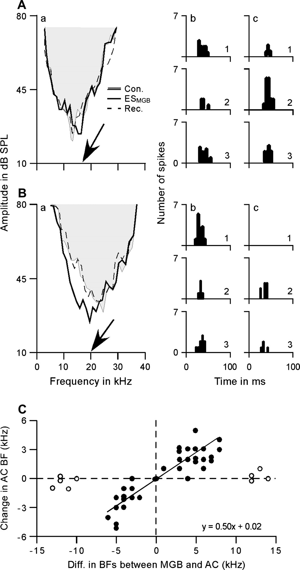
Figure 3 Effects of the ES_{MGB} on the BFs of cortical neurons. ES_{MGB} shifted the BFs of cortical ...
Notes:
Figure 3 Effects of the ESMGB on the BFs of cortical neurons. ESMGB shifted the BFs of cortical neurons upward (Aa) or downward (Ba) depending on the BFs of the stimulated thalamic neurons. Accordingly, the auditory responses were decreased at the control BFs (Ab and Bb) and increased at the shifted BFs (Ac and Bc) following the ESMGB. The shift in cortical BF was linearly correlated to the difference in BFs between thalamic and cortical neurons (filled circles in C). ESMGB rarely shifted the cortical BFs when the difference between cortical and thalamic BFs was >10 kHz (open circles in C). In Ab,c and Bb,c, “1” represents control, “2” represents post-ESMGB, and “3” represents recovery. The arrows in (Aa) and (Ba) indicate the BFs of the stimulated thalamic neurons.
Unless provided in the caption above, the following copyright applies to the content of this slide: © The Author 2006. Published by Oxford University Press. All rights reserved. For permissions, please e-mail: journals.permissions@oxfordjournals.org

Slide 4
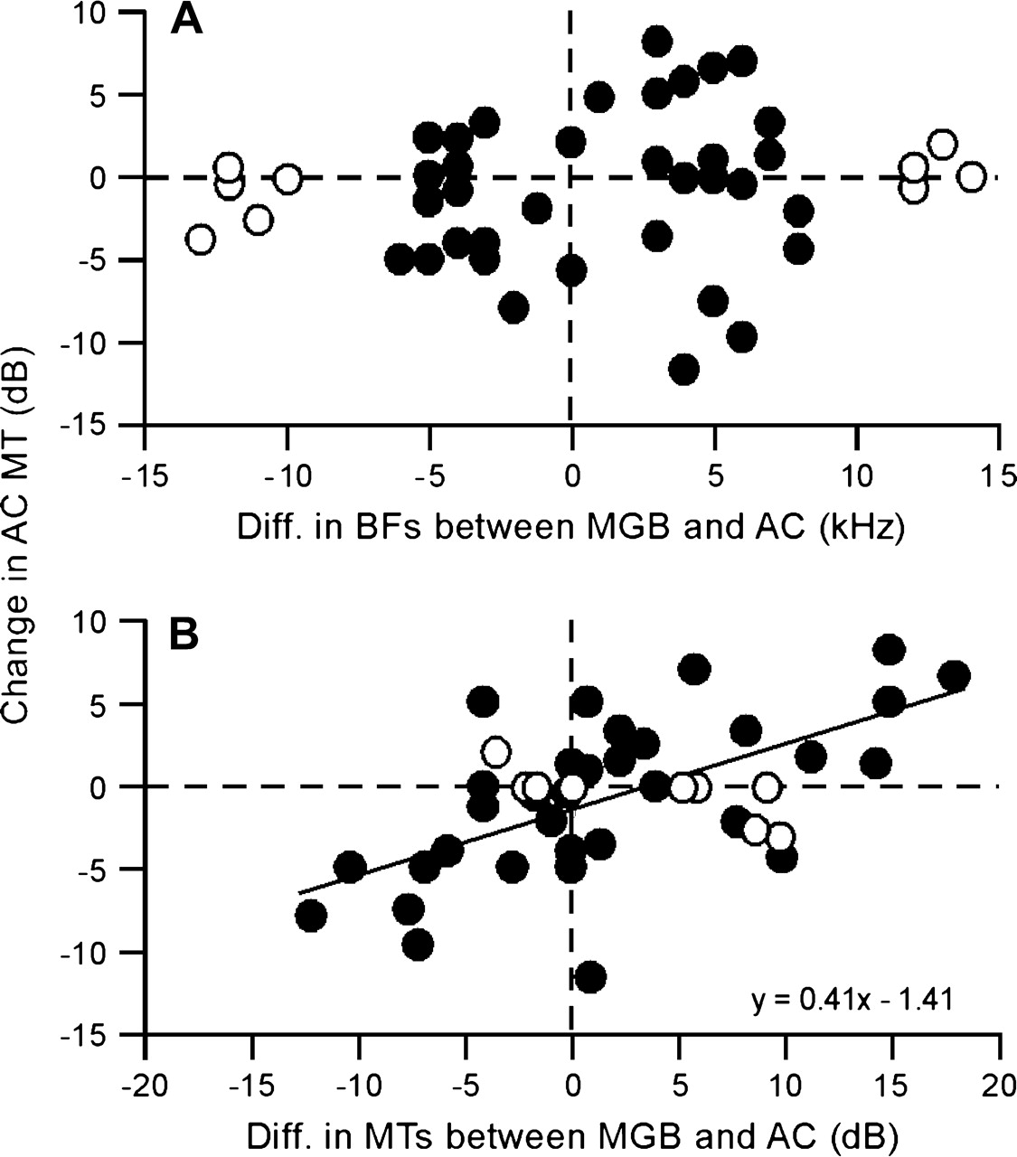
Figure 4 The changes in cortical MTs after the ES_{MGB} were plotted as the function of the difference in BFs ...
Notes:
Figure 4 The changes in cortical MTs after the ESMGB were plotted as the function of the difference in BFs (A) and MTs (B) between thalamic and cortical neurons. The changes in MTs were only correlated to the MT difference between thalamic and cortical neurons (filled circles). Such correlation did not apply to the changes in MTs of those cortical neurons that differed by >10-kHz BF from that of the thalamic neurons (open circles).
Unless provided in the caption above, the following copyright applies to the content of this slide: © The Author 2006. Published by Oxford University Press. All rights reserved. For permissions, please e-mail: journals.permissions@oxfordjournals.org

Slide 5
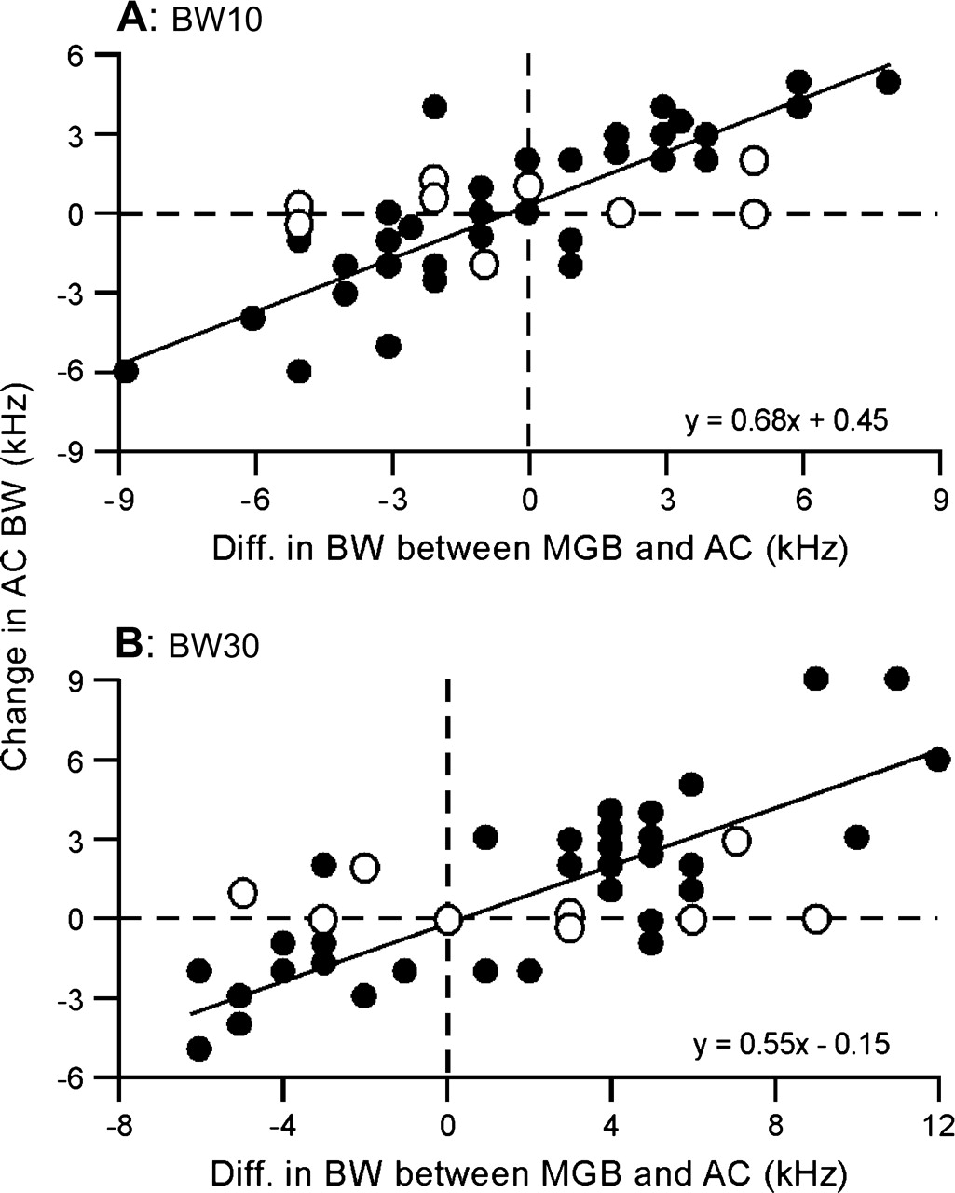
Figure 5 Changes of cortical bandwidth following the ES_{MGB}. The BW10s (A)/BW30s (B) were systematically ...
Notes:
Figure 5 Changes of cortical bandwidth following the ESMGB. The BW10s (A)/BW30s (B) were systematically correlated to the difference in BW10s/BW30s between thalamic and cortical neurons (filled circles). For the cortical neurons with >10-kHz difference from thalamic neurons (open circles), the ESMBG did not significantly change their bandwidths.
Unless provided in the caption above, the following copyright applies to the content of this slide: © The Author 2006. Published by Oxford University Press. All rights reserved. For permissions, please e-mail: journals.permissions@oxfordjournals.org

Slide 6
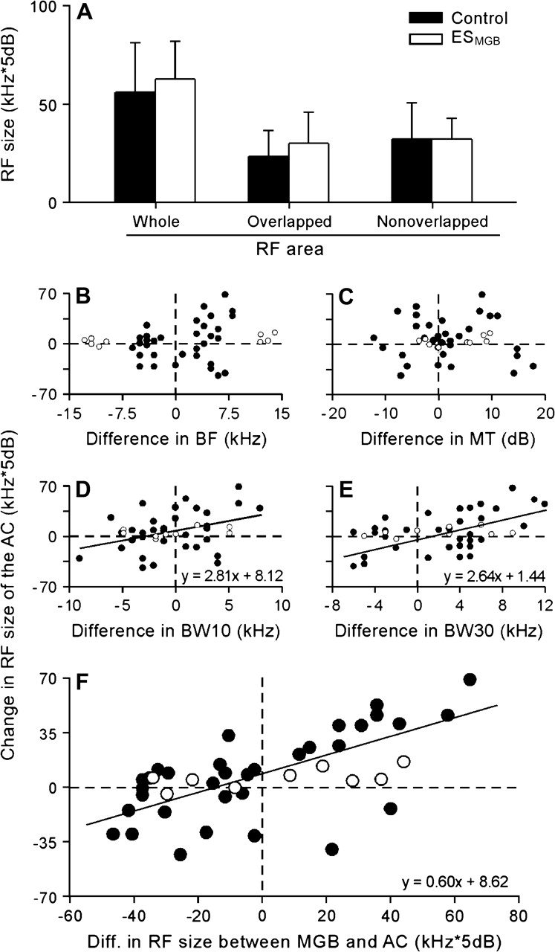
Figure 6 Effects of the ES_{MGB} on the size of cortical RFs. In general, the ES_{MGB} tended to ...
Notes:
Figure 6 Effects of the ESMGB on the size of cortical RFs. In general, the ESMGB tended to increase the size of the cortical RF, particularly the size of the overlapped cortical RF. These increases, however, were statistically insignificant (A). For each individual sample, the cortical RF either increased or decreased in size. Such changes did not correlate to the difference in BFs (B) and MTs (C) between thalamic and cortical neurons. The changes in cortical RF size, however, were observed to be significantly correlated to the difference in bandwidths (filled circles in D and E) and the RF sizes between thalamic and cortical neurons (filled circles in F). As with the other parameters, a correlation did not apply to those cortical neurons whose BFs differed by >10 kHz from those of the thalamic neurons (open circles).
Unless provided in the caption above, the following copyright applies to the content of this slide: © The Author 2006. Published by Oxford University Press. All rights reserved. For permissions, please e-mail: journals.permissions@oxfordjournals.org

Slide 7
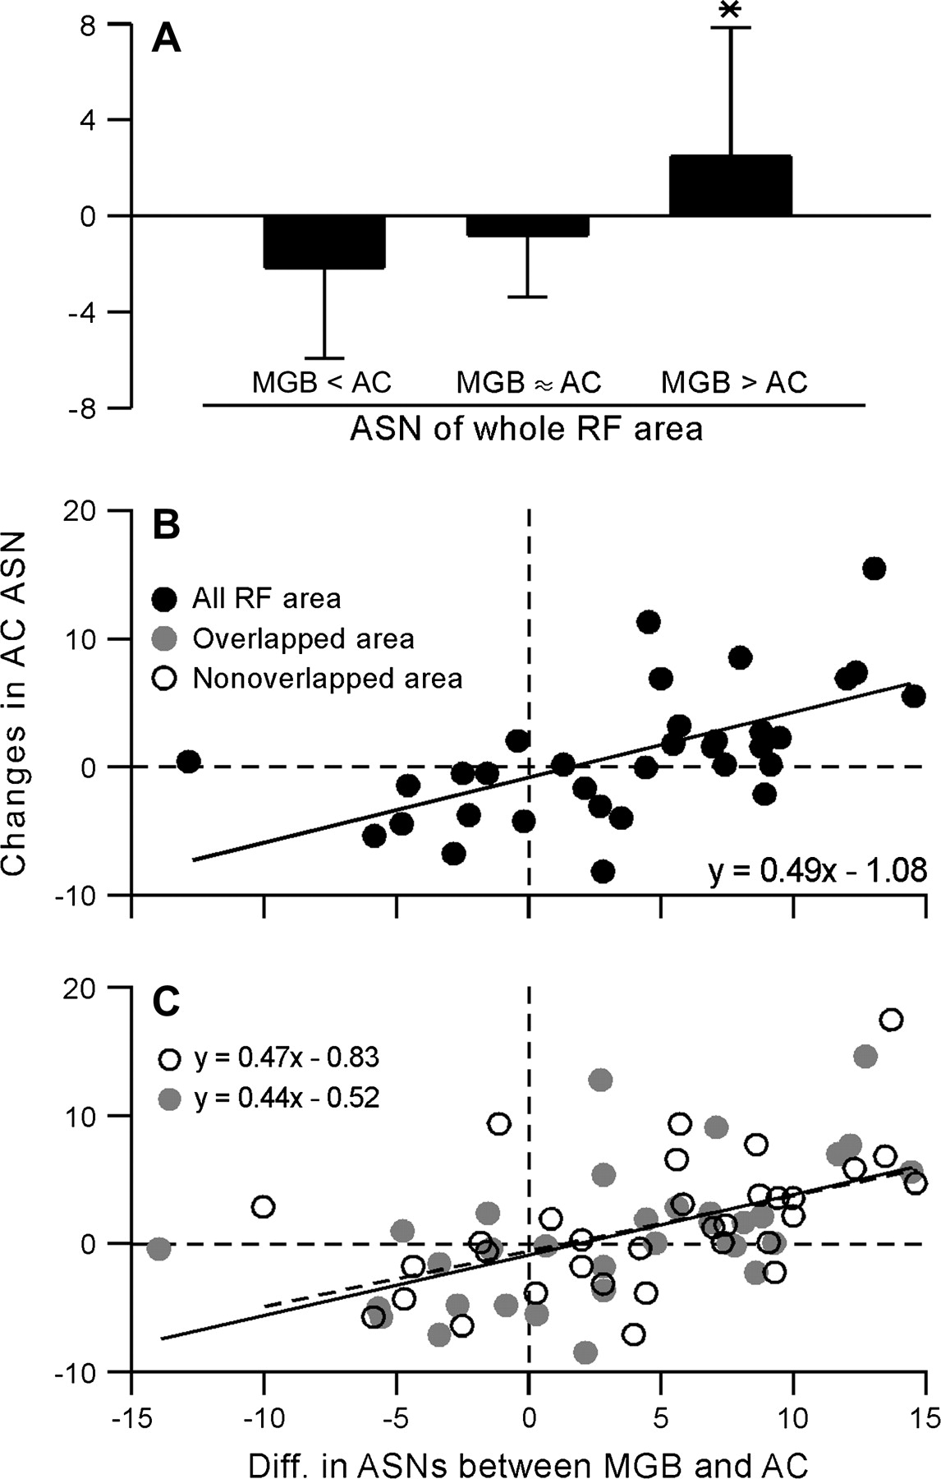
Figure 7 Effects of the ES_{MGB} on the ASN. The changes in the ASN were dependent on the difference in the ...
Notes:
Figure 7 Effects of the ESMGB on the ASN. The changes in the ASN were dependent on the difference in the ASN between thalamic and cortical neurons (A). In each of the assessed areas, the whole RF (B), the overlapped RF (filled circles in C), or the nonoverlapped RF (open circles in C), the changes in ASNs were systematically correlated to the difference in ASNs between thalamic and cortical neurons.
Unless provided in the caption above, the following copyright applies to the content of this slide: © The Author 2006. Published by Oxford University Press. All rights reserved. For permissions, please e-mail: journals.permissions@oxfordjournals.org

