Slide 1
Figure 3. Dipole locations. ECD for D2 (red) and D5 (blue) projected onto the individual's anatomical MRI for a ...
Notes:
Figure 3. Dipole locations. ECD for D2 (red) and D5 (blue) projected onto the individual's anatomical MRI for a representative subject through the experimental blocks of B0–B6.
Unless provided in the caption above, the following copyright applies to the content of this slide: © The Author 2006. Published by Oxford University Press. All rights reserved. For permissions, please e-mail: journals.permissions@oxfordjournals.org

Slide 2
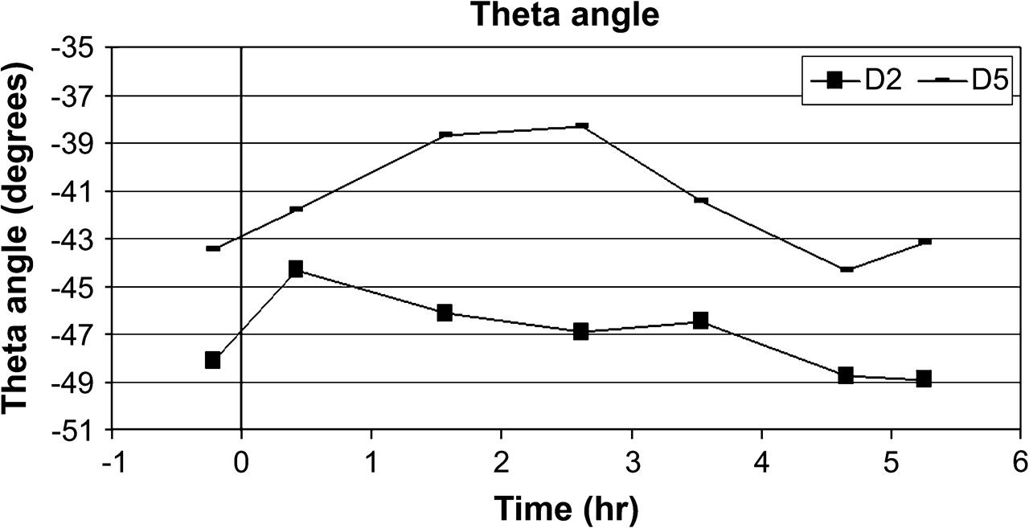
Figure 4. Theta angle interaction. In polar BESA coordinates, for D2 and D5 with time (P < 0.014), average theta ...
Notes:
Figure 4. Theta angle interaction. In polar BESA coordinates, for D2 and D5 with time (P < 0.014), average theta values. Note that during the maximum ED (block B3), the 2 sources moved in opposite directions.
Unless provided in the caption above, the following copyright applies to the content of this slide: © The Author 2006. Published by Oxford University Press. All rights reserved. For permissions, please e-mail: journals.permissions@oxfordjournals.org

Slide 3
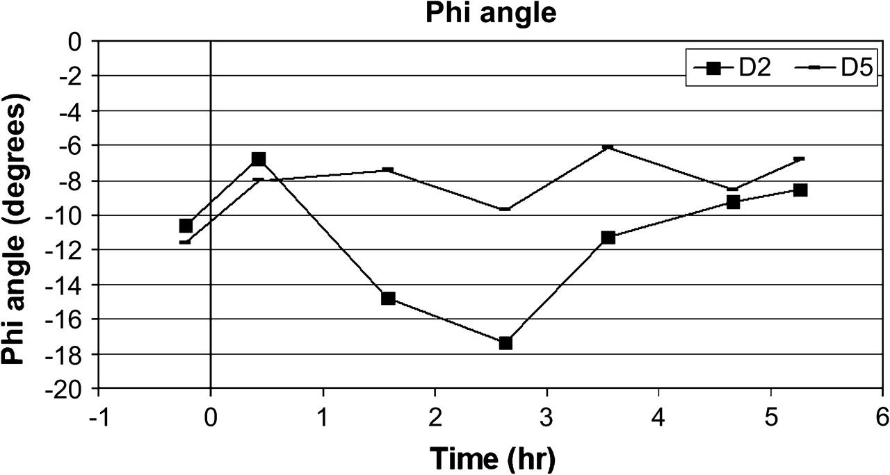
Figure 5. Phi angle interaction. In polar BESA coordinates, for D2 and D5 with time (P < 0.05), average phi values. ...
Notes:
Figure 5. Phi angle interaction. In polar BESA coordinates, for D2 and D5 with time (P < 0.05), average phi values. During maximum ED (block B3), the dipole representing D2 moved more anteriorly.
Unless provided in the caption above, the following copyright applies to the content of this slide: © The Author 2006. Published by Oxford University Press. All rights reserved. For permissions, please e-mail: journals.permissions@oxfordjournals.org

Slide 4
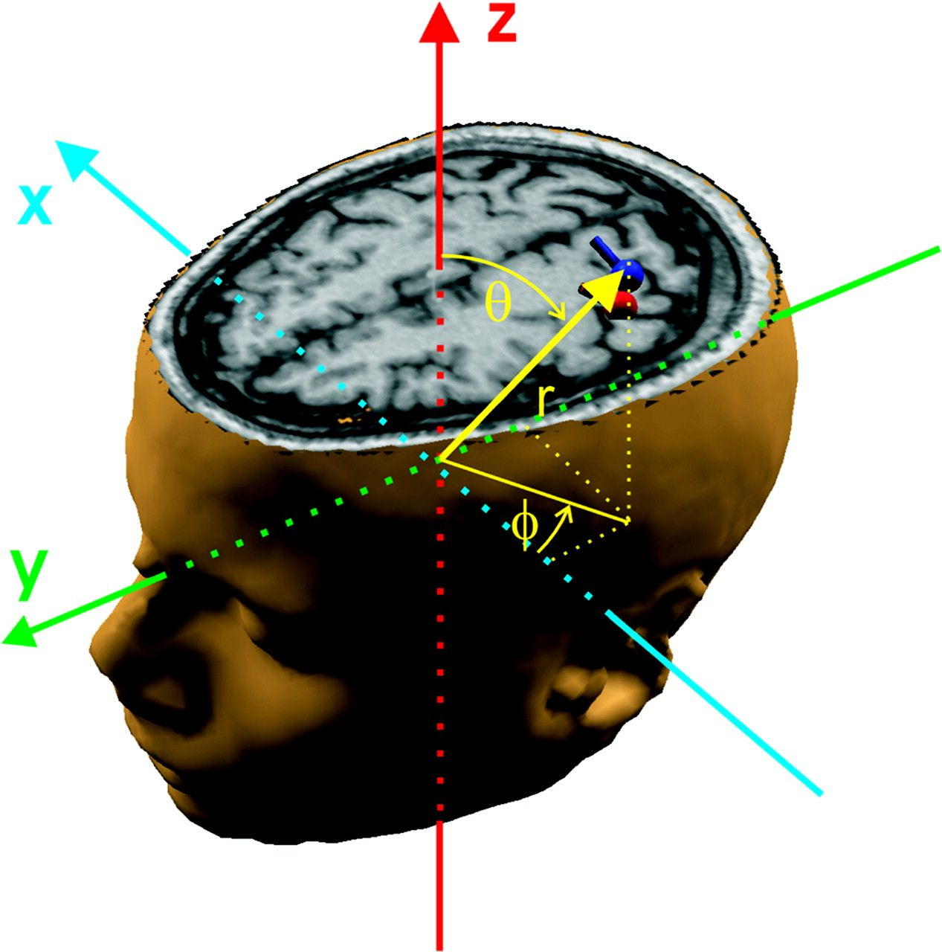
Figure 2. Description of polar BESA coordinates of an ECD (blue) on a representative subject's anatomical MRI. ...
Notes:
Figure 2. Description of polar BESA coordinates of an ECD (blue) on a representative subject's anatomical MRI. Cartesian axes are also shown.
Unless provided in the caption above, the following copyright applies to the content of this slide: © The Author 2006. Published by Oxford University Press. All rights reserved. For permissions, please e-mail: journals.permissions@oxfordjournals.org

Slide 5
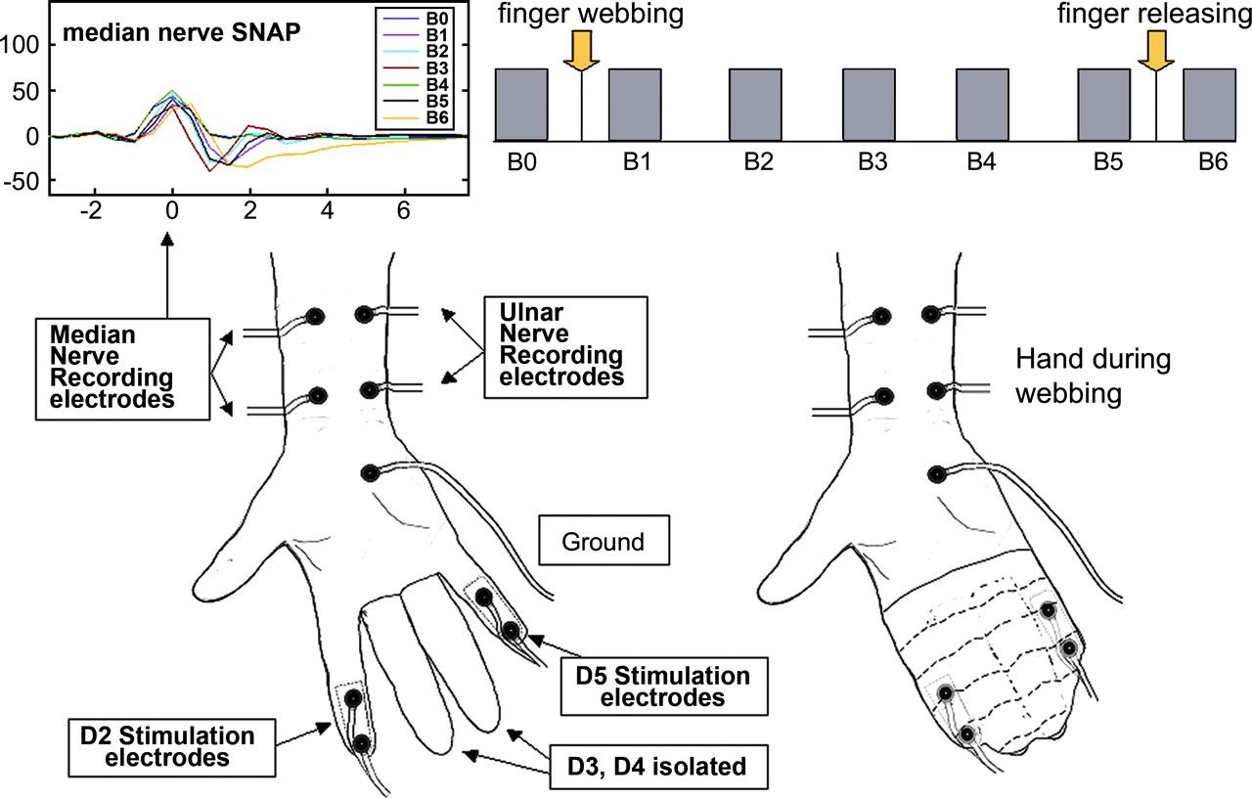
Figure 1. Experimental procedure. Flow chart of MEG recordings: bars represent MEG recordings (upper right). View of ...
Notes:
Figure 1. Experimental procedure. Flow chart of MEG recordings: bars represent MEG recordings (upper right). View of the palmar surface of a right hand without webbing with the positions of the stimulating and SNAP recording electrodes (left); the same view during webbing (right); a sample SNAP recording (upper left).
Unless provided in the caption above, the following copyright applies to the content of this slide: © The Author 2006. Published by Oxford University Press. All rights reserved. For permissions, please e-mail: journals.permissions@oxfordjournals.org

Slide 6
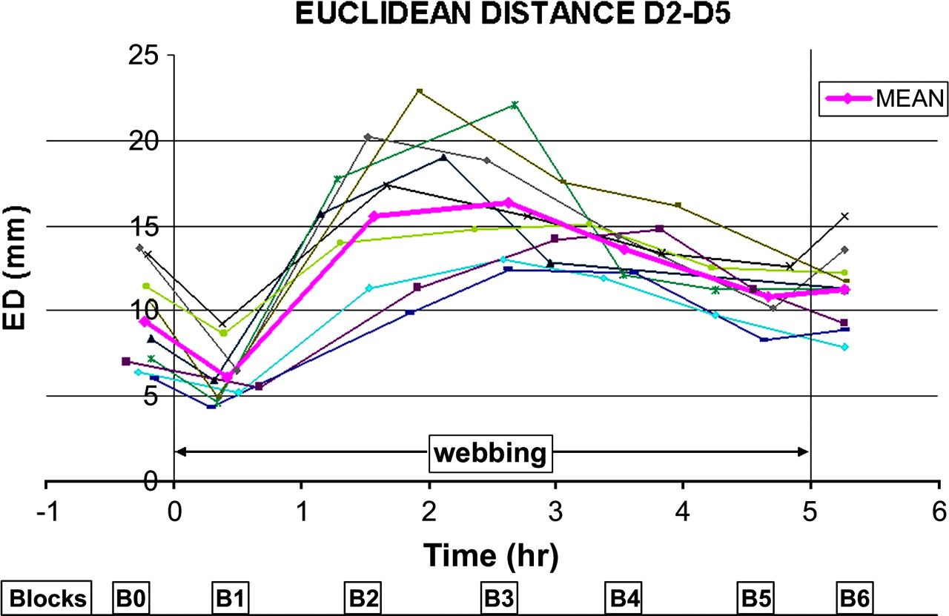
Figure 6. ED with time. The 3D distance between the sources activated during electric stimulation of D2 and D5 ...
Notes:
Figure 6. ED with time. The 3D distance between the sources activated during electric stimulation of D2 and D5 (experimental blocks) follows a trend similar for all subjects (thin lines). The mean ED is indicated with thick line. Lines at 0 h and 5 h indicate starting and ending of webbing condition, respectively.
Unless provided in the caption above, the following copyright applies to the content of this slide: © The Author 2006. Published by Oxford University Press. All rights reserved. For permissions, please e-mail: journals.permissions@oxfordjournals.org

Slide 7
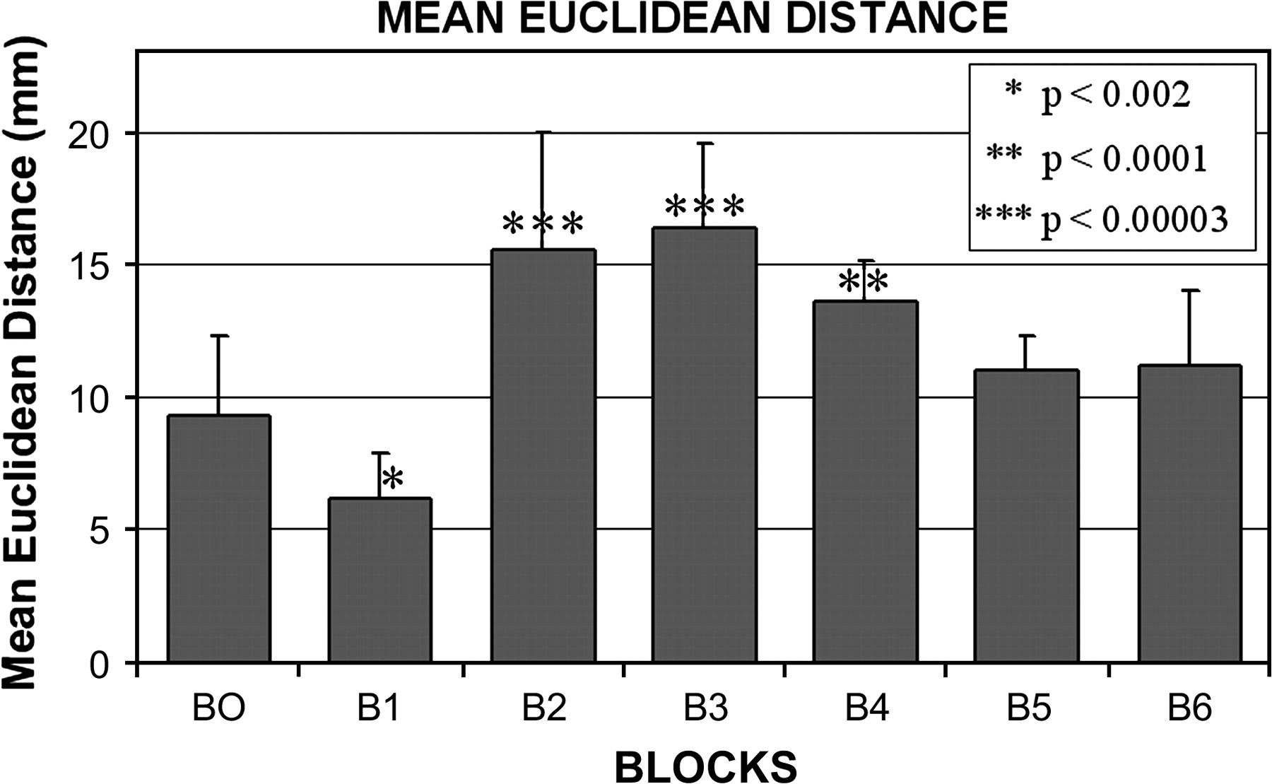
Figure 7. Mean ED values and standard deviation. Statistical significance with respect to B0 is indicated.
Notes:
Figure 7. Mean ED values and standard deviation. Statistical significance with respect to B0 is indicated.
Unless provided in the caption above, the following copyright applies to the content of this slide: © The Author 2006. Published by Oxford University Press. All rights reserved. For permissions, please e-mail: journals.permissions@oxfordjournals.org

Slide 8
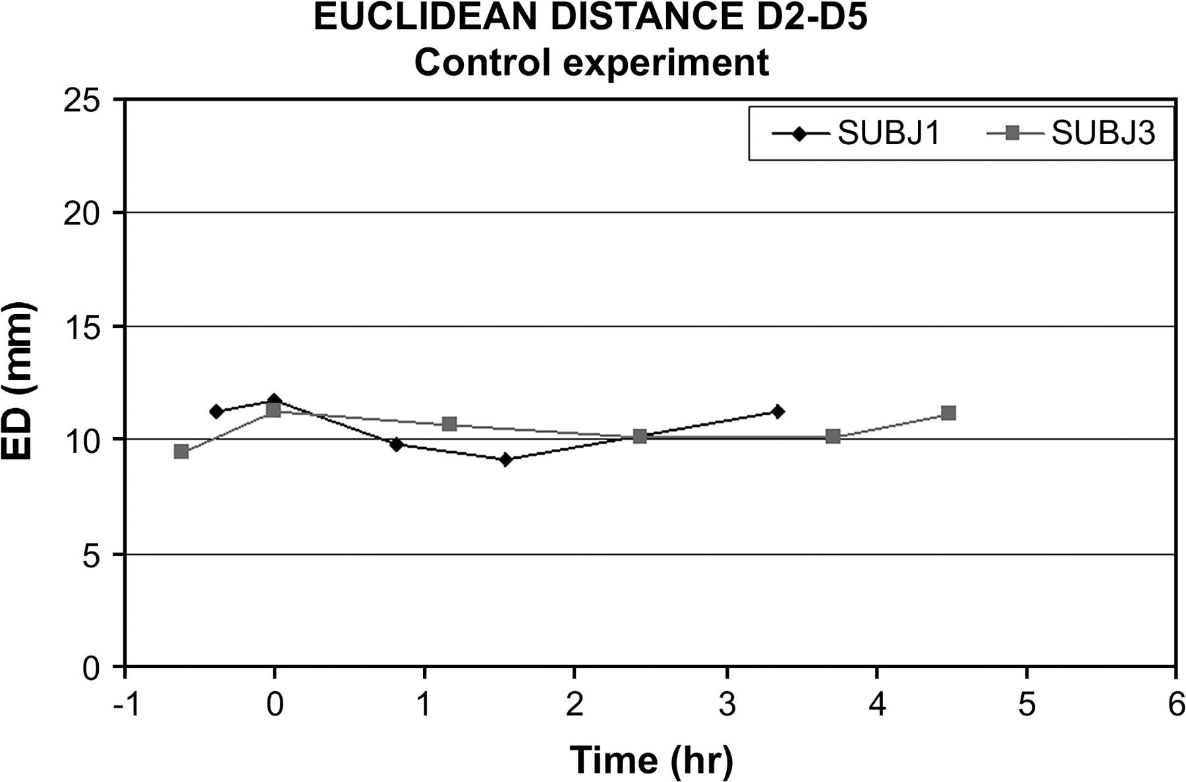
Figure 8. ED for the experiment performed on subject 1 and 3 with the same stimulation sequence without finger webbing. ...
Notes:
Figure 8. ED for the experiment performed on subject 1 and 3 with the same stimulation sequence without finger webbing. Without webbing, the ED between the sources activated during electric stimulation of D2 and D5 remains at the same levels.
Unless provided in the caption above, the following copyright applies to the content of this slide: © The Author 2006. Published by Oxford University Press. All rights reserved. For permissions, please e-mail: journals.permissions@oxfordjournals.org

