Slide 1
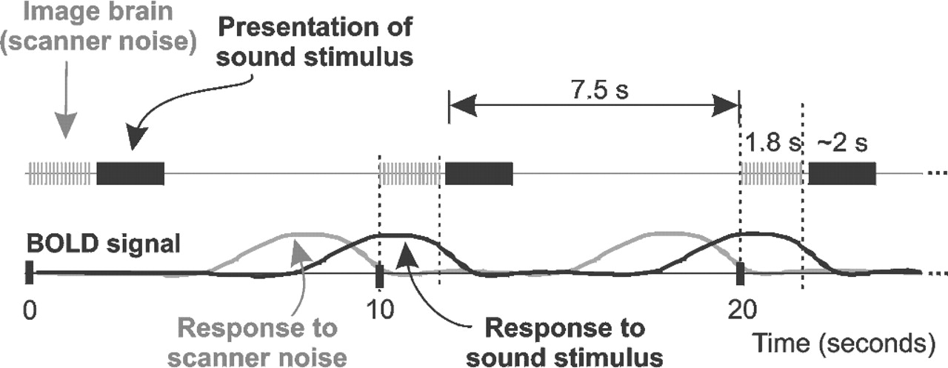
Figure 1. Schematic of the imaging paradigm. Upper panel shows cycles of stimulus presentation and MRI ...
Notes:
Figure 1. Schematic of the imaging paradigm. Upper panel shows cycles of stimulus presentation and MRI clustered-acquisitions. Lower panel shows the ideal BOLD response signals for a responsive voxel of brain.
Unless provided in the caption above, the following copyright applies to the content of this slide:

Slide 2
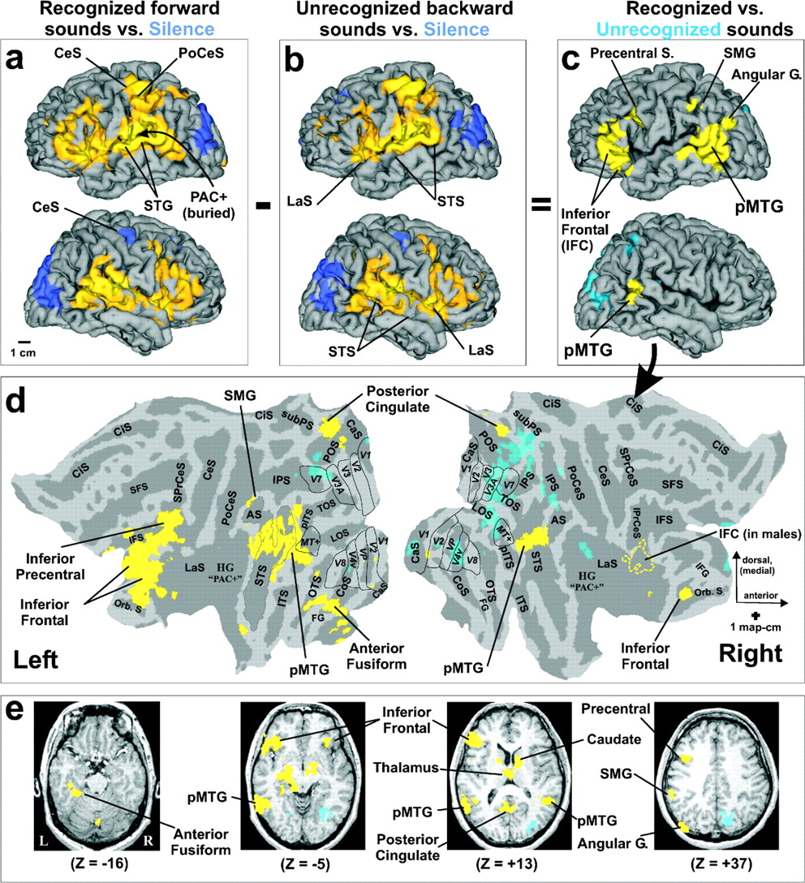
Figure 2. Brain regions involved in environmental sound recognition. Yellow hues show group-averaged (n = 24) ...
Notes:
Figure 2. Brain regions involved in environmental sound recognition. Yellow hues show group-averaged (n = 24) activated regions (relative increases in BOLD signal) and dark blue shows relative decreases in BOLD signal projected onto the Colin brain atlas, evoked by (a) recognizable, forward sounds relative to silence or (b) the corresponding unrecognizable, backward sounds relative to silence. (c) Data from panel b subtracted from a, revealing regions preferentially involved in recognizing sounds (yellow) versus not recognizing the corresponding backward-played sounds (light blue), both relative to silence. Brain surfaces in a–c depict an approximation of layer 2. (d) Flat maps showing data from panel c. Identified visual areas (V1, V2, V3, MT+, etc.,) are from the Colin atlas database and are indicated by black outline. The left STS is outlined in gray for clarity. See text for other details. (e) Axial sections of data from panel c displayed on the brain of one subject. All colored foci are statistically significant at a corrected α < 0.05. Data sets are available for visualizing or downloading at: http://brainmap.wustl.edu:8081/sums/directory.do?dir_id=707085 (human colin atlas). AS, angular sulcus; CaS, calcarine sulcus; CeS, central sulcus; CiS, cingulate sulcus; CoS, collateral sulcus; FG, fusiform gyrus; HG, Heschl’s gyrus; IFG, inferior frontal gyrus; IFS, inferior frontal sulcus; IPrCeS, inferior precentral sulcus; IPS, intraparietal sulcus; ITS, inferotemporal sulcus; LaS, lateral sulcus; LOS, lateral occipital sulcus; Orb. S, orbital sulcus; OTS, occipito-temporal sulcus; pITS, posterior inferotemporal sulcus; PoCeS, postcentral sulcus; POS, parieto-occipital sulcus; SMG, supramarginal gyrus; SPrCeS, superior precentral sulcus; STS, superior temporal sulcus; subPS, subparietal sulcus; TOS, transverse occipital sulcus.
Unless provided in the caption above, the following copyright applies to the content of this slide:

Slide 3
Figure 3. Analysis of ‘miss-trial’ data within regions of interest (ROIs) associated with sound recognition. ...
Notes:
Figure 3. Analysis of ‘miss-trial’ data within regions of interest (ROIs) associated with sound recognition. Column 1 (RF vs. UB) shows the group-averaged MR BOLD response differences (arbitrary MR intensity units) within seven ROIs derived from Figure 2c–e, comparing Recognized, Forward-played sounds (RF; 1344 trials across all subjects) versus the corresponding Unrecognized Backward-played sounds (UB; 1344 trials). Column 2 (RF versus UF) compares the Recognized versus Unrecognized Forward-played sounds (UF; 373 trials). Column 3 (UF versus UB) illustrates Forward versus Backward sounds that were all deemed Unrecognizable. Standard errors were derived from the average of mean unthresholded MR intensities across the 24 subjects. Values not statistically different from zero are indicated by asterisks (**P < 0.05).
Unless provided in the caption above, the following copyright applies to the content of this slide:

Slide 4
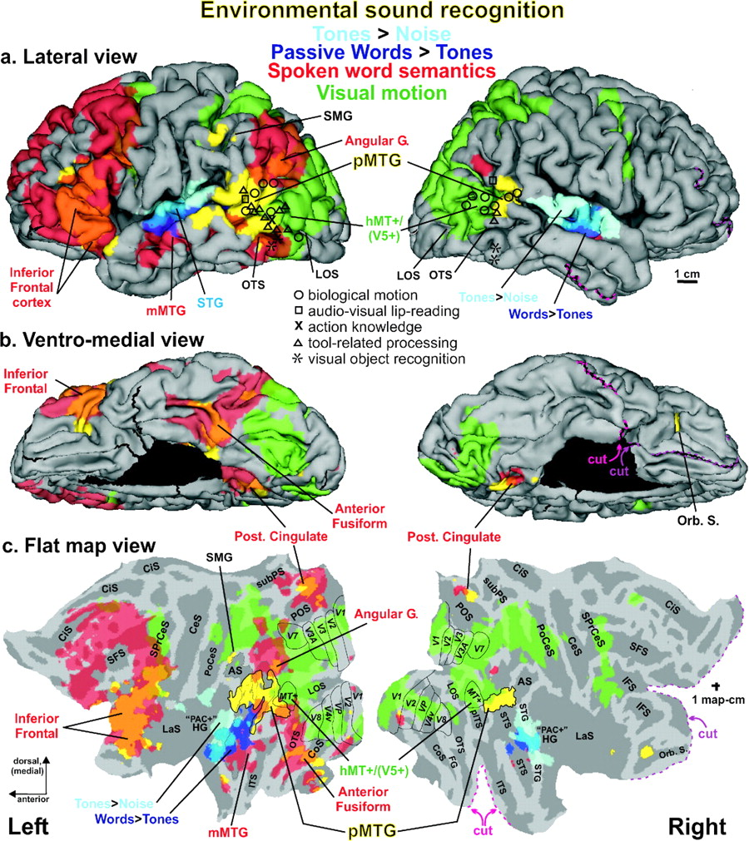
Figure 4. Direct comparison of environmental sound recognition (yellow) with other processing pathways and ...
Notes:
Figure 4. Direct comparison of environmental sound recognition (yellow) with other processing pathways and reported foci. (a) Lateral view as in Figure 2c. Blue hues = early acoustic processing; including passive listening to tones vs. white noise (light blue) and spoken words vs. tones (dark blue). Red = semantic processing of spoken words (animal names). Green = visual motion processing of coherent versus random dot displays. Regions of overlap are indicated by intermediate colors. Symbols indicate previously reported activation centroids in Talairach coordinates (projected to the outer cortical surface for visibility). Refer to text for other details. (b) The ventro-medial view shows a layer 4 surface representation, allowing visualization deep within sulci. On the flat map view (c) the pMTG foci are outlined in black for clarity. All data corrected to α < 0.05. The magenta and purple dashed lines indicate two of the cuts on the right hemisphere model, shown to help orient viewers to the flat maps. Other conventions as in Figure 2.
Unless provided in the caption above, the following copyright applies to the content of this slide:

