Slide 1
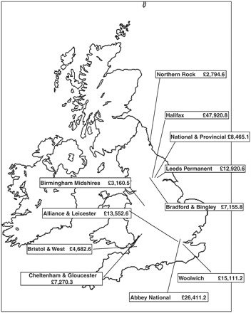
Figure 1. Map of Building Societies Converters and Assets from 1990 (£ million). Source: BSA Yearbook 1990 and 1989.
Notes:
Figure 1. Map of Building Societies Converters and Assets from 1990 (£ million). Source: BSA Yearbook 1990 and 1989.
Unless provided in the caption above, the following copyright applies to the content of this slide: © The Author (2011). Published by Oxford University Press. All rights reserved. For Permissions, please email: journals.permissions@oup.com

